Slide 1
Working together to integrate care White Paper: published February 2021
Building on the NHS Long Term Plan, the white paper focuses on integrated care systems (ICS), breaking down barriers to accessing health and social care separately, and building on lessons learnt in the pandemic
Statutory Integrated Care Systems (ICSs) in each area:
Incorporate the functions of current CCGs
Have two boards – an NHS ICS Board; and a Health and Care Partnership Board
Take effect from 1 April 2022 (subject to legislation being passed) with shadow operation likely to be from October 2021
NHS and Local Authority duty to collaborate (public health and social care)
The NHS will be free to make decisions on how it organises itself without the involvement of the Competition and Markets Authority (CMA)
Procurement processes should only go ahead if they add value, moving away from the notion of procuring services that deliver the biggest cost savings and rather focusing on improved patient outcomes.

Slide 2
Core purpose of an integrated care system

Slide 3
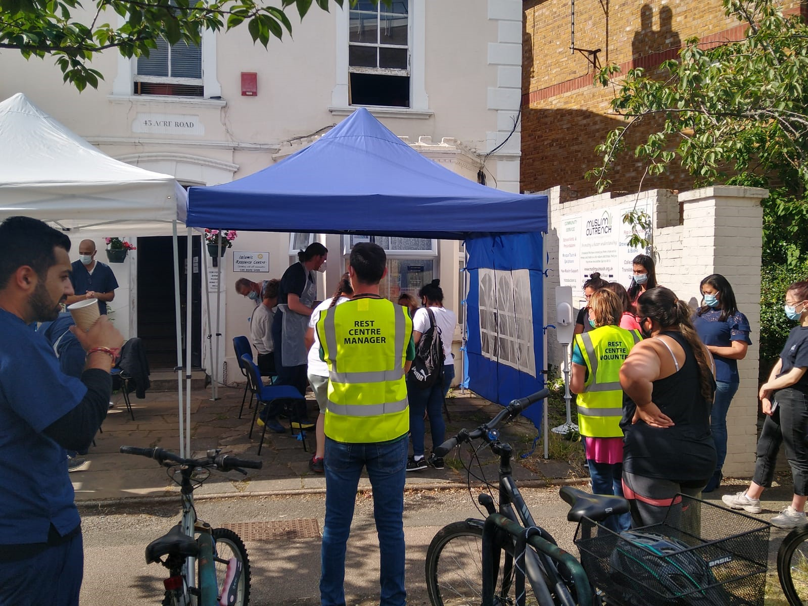
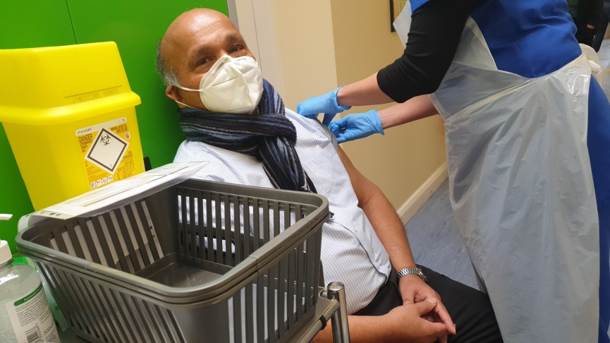
Setting the context locally
We are starting from a position of strong collaborative working across partners.
Partnership working has been at the heart of our response to the coronavirus pandemic and the NHS vaccination programme.
We have seen what the NHS, our Council, voluntary sector and communities can do when we work together in the most testing period in our recent history.
Good coherence between Kingston and Richmond where it makes sense e.g. vaccination programme and some of the transformation programmes
Nationally, the NHS hopes that the establishment of ICSs across the country will help to ensure closer working leading to greater integration of care beyond the pandemic.
Notes:
Response to Covid surge flow, GP inreach.
Here an update on transformation programmes from Martin.

Slide 4
Current areas of focus
The White Paper outlines that place will work with partners such as the local authority and voluntary sector in an inclusive transparent and collaborative way and will have four main roles:
to support and develop primary care networks (PCNs) which join up primary and community services across local neighbourhoods;
to simplify, modernise and join up health and care (including through technology and by joining up primary and secondary care where appropriate);
to understand and identify –using population health management techniques and other intelligence –people and families at risk of being left behind and to organise proactive support for them; and
to coordinate the local contribution to health, social and economic development to prevent future risks to ill-health within different population groups.
Ensuring that our Places are representative of the populations that we serve

Slide 5
Each place has an NHS Place leader, supported by a Transition Team
Place | NHS Transition Place based lead | NHS Primary Care Lead | NHS Acute Care Lead | NHS Community Lead | Local Authority Lead | NHS Mental Health Lead
Croydon | Mathew Kershaw | Agnelo Fernandez/ Bill Jasper | Mathew Kershaw | Mathew Kershaw | Annette McPartland | James Lowell
Kingston | Naz Jivani | Naz Jivani | Jo Farrar | Ed Montgomery | Sharon Houlden | Jen Allan / Richard Morton
Merton | Vanessa Ford | Sy Ganesaratnam | Suzanne Marcello | Alison Edgington | Hannah Doody | Vanessa Ford / Jen Goddard
Richmond | Jo Farrar | Patrick Gibson | Jo Farrar | Jo Farrar | Liz Bruce & Susan Anderson-Carr | Dr Billy Boland / Richard Morton
Sutton | Daniel Elkeles | Dino Pardhanani | Daniel Elkeles | Daniel Elkeles | Imran Choudhury | Amy Scammel / Dr Victoria Hill
Wandsworth | Nicola Jones | Nicola jones | Andrew Grimshaw | Alison Edgington | Liz Bruce & Susan Anderson-Carr | Vanessa Ford / Jen Goddard

Slide 6
Approach to communications and engagement at place
Aims are to:
Communicate transparently to build understanding of ‘place’ – what is it, and what does it mean for our stakeholders – and what work we are doing together.
Create common purpose for the partners at place level and our staff so that we understand what integrated working is and why it is important.
Develop a clear and shared approach for community and patient engagement at place so that our work is informed by citizens
SWL CCG comms and engagement leads for Kingston and Richmond are bringing together a comms and engagement way of working for ‘place’.
This work will be done with the local authority communications and community engagement team and informed by the borough communications and engagement group.
22

Slide 7
Any questions?

