Slide 1
Why do Funding applications Fail?
(And how they can succeed)
John Mikucki – Fundraising Officer
john.mikucki@kva.org.uk

Slide 2
Check the eligibility criteria
“If only they had read our eligibility criteria, they would clearly see we don't fund that"

Slide 3
Common restrictions
Many funders will ask you to take an eligibility quiz
Or they may state only registered charities and CIOs but not CICs.
Geographical area.
Income (Turnover) – if you have income of more than £2M – do not apply, if you have income of less than £50,000 do not apply etc.
Service must be in the top 20% most deprived areas
Only capital projects

Slide 4
Some will have a list of organisations they will not support, e.g. faith-based charities, hospices, animal welfare, national bodies or charities that enjoy widespread support.
Some will be by invitation only
Key tip - Read the funders last annual report – have they funded similar organisations to yours in the past.

Slide 5
Talk to the funder before applying
Funders usually welcome phone calls to discuss potential projects. If in doubt ring them and ask – they will appreciate your call, you will be saving your time and their time if you are ineligible to apply. If you are eligible the funder will probably remember you as the sensible person who checked this first before applying and may look with more favour on your application when they read it.

Slide 6
Don’t be fearful of rejection by doing this.
Also use the opportunity to get an idea of how much to apply for, so you don’t over or under apply for a project!
For example.
Q - we are looking for an IT hardware upgrade.
A – Yes, we usually support that with £7-10K

Slide 7
The Current Climate-
A Surge in Demand
Grant application numbers have surged, with some funders seeing their number double. This represents thousands of organisations desperately seeking support to continue their vital work.
Many funders operate with small teams to maximise funds for grants, so this places huge pressure on their ability to maintain the quality and equity of their grant-making processes.
Some have paused their programmes to new applications – City Bridge Foundation and the Tudor Trust for example. Just recently BBC children in need announced a pause of 4 months in their grant making from April.

Slide 8
Why are they doing this? These pauses will give them time to review their funding priorities but also to allow time to clear a huge backlog of applications.
Other funders – like Lankelly Chase have decided to spend out their endowment over the next 5 years and are identifying legacy partners.
Funding for UK charities and voluntary organisations has seen sharp declines across the board: central government funding decreased by 33% from 2022 to 2023, local authority funding dropped by 23% since 2009-2010, and individual donations have fallen by 14% in recent years.
In June 2024 there were more than 170,000 registered charities in England Wales and the number is growing – a further 668 charities have registered this year. There are also a further 100,000 unregistered charities and 76,000 social enterprises in the UK.

Slide 9
Ok so you’re eligible –
What are your chances!
The Fund could be heavily oversubscribed – They may have too many applications
If it seems like a long shot, then it probably is. Make a judgement call on what you think your chances of success are!
Many funders will state that they receive many more suitable applications than they can ever hope to fund – usually they may say that 1 in 3 or 1 in 5 of the applications they receive will be successful. Esmée Fairbairn Foundation state that they funded about 4% of applications received

Slide 10
Last Year the Leathersellers’ Foundation received 498 expressions of interest for their main grants programme.
50 organisations were invited to apply
17 grants allocated
Success rate = 3.4 % from EOI
Success rate from full application = 34% (1 in 3)

Slide 11
Someone must read your application – make their job easier and provide the right amount of information

Slide 12
Trustees do not see your application
It is rarely the decision maker who reads your application. It is usually an assessor who makes a decision on your eligibility and whether you meet their priorities. The assessor will complete a summary of your application (or a report) – usually 1 to 2 pages – so if you have written 20 pages you have wasted your time and probably bored the assessor to death. You will fail. Assessors work to deadlines and are often looking at 40 or 50 applications a week. Have pity on them!

Slide 13
For the Assessor, who is reading loads of applications, to suddenly be confronted with something that has no paragraphs, really long sentences and very dense text will find that off putting.
It is a good idea to ask someone not connected with your organisation to read your grant applications before they are sent to ensure they make sense.
Don’t include photos unless it adds something to the application, don’t include case studies unless asked for, don’t include feedback unless asked for.
If they are not an outcome funder they won’t be interested in your outcomes – don’t include them.
Don’t include additional reports – reference them by all means
Avoid jargon
Avoid buzz words
Avoid Acronyms

Slide 14
Keep your application simple
In simple terms it is likely that shorter applications do better. If they need more information they will contact you.
Funders have word counts- to limit the amount of information you can give them
Take your time - if there is a deadline there will usually be no advantage in being early

Slide 15
Using Artificial Intelligence
Use it if you feel confident doing so but only as a drafting tool.
Funders usually want charities to apply in their own words. Make sure those words are readable.
Don’t forget that most AI tools will have a USA centred approach.
You may be uploading confidential financial and other information which may not be protected (GDPR considerations)
AI may not answer questions such as how are your services embedded locally and how are service users involved in designing services

Slide 16
Clearly describe what your organisation does
You may know all about your charity, but don't expect the outside world to know what you do. Don’t make the assumption that the funder is familiar with your work or forget to provide a basic explanation.
Applicants often don't describe the very basic things about who the beneficiaries are, what the project does, how they do it and what impact they have.
Use bullet points for greater clarity.
The assessor may look at your website or your annual report or look on the charity commissioner’s website for further information

Slide 17
Clearly describe what the project will do
Describe your project clearly. What are you trying to achieve.
Be clear on what you are applying for:
Is it an existing service
Is it an expansion of an existing service
Is it a new service
Is it for core/unrestricted funding
Is it for capital – one off items of expenditure

Slide 18
Evidence the difference your service will make
Is your work tried and tested.
Your application should demonstrate that your organisation has experience delivering the work you are asking them to fund.
And you have the ability and capacity which makes it best placed to deliver the work.

Slide 19
Many applications provide only unsubstantiated or anecdotal information about their work, some provide no outcomes information, and others only case studies without any data to back up their claims about impact.

Slide 20
Have a Clear Project Budget
(don’t ask for too much money or not enough)
Some applicants ask for less money than they need in the mistaken belief that this will increase their chances of success. It's an assumption that's not correct - be clear about the amount you need.
Detail the funding already secured for the project
Detail other applications you have made but are not yet determined - who else you have applied to and for how much?
Do you have a contingency plan – what will you do if you do not get all the money you want, could you scale down, or indeed scale up the project if you get more than you need.

Slide 21
Full Cost Recovery
If you are applying for project funding and want to include core costs clearly identify:
Direct costs for the project.
Indirect costs – show how this is calculated. Is it a straight line % or based on number of staff or a direct calculation of additional costs, e.g. 3 hours of management supervision plus one hour of IT per week etc.

Slide 22
Present Clear Financial information
It is important that you provide the requested financial information and that the figures presented on the application form mirror those in the most recent published accounts.
Make sure your budget adds up correctly.
Check and double check that your figures add up – there is nothing more embarrassing than being told that you haven’t added up your budget correctly

Slide 23
Free reserves
Many funders ask you for your level of free reserves – this will be any unrestricted funding less tangible fixed assets and designated funds.
Designate funds carefully– funders may ask questions
Generally, not less than 3 months free reserves – shows you are not in financial peril.
And
Generally, not more than 6 months, you don’t need their funding, use up your free reserves first. (The exception though is for very small organisations - where up to 12 months may be considered appropriate)

Slide 24
Other common mistakes
The applicant misses the deadline.
The application form is incomplete.
The supporting documents are incomplete, inaccurate, out-of-date, contradict the application form or are simply not enclosed.
Retrospective funding is requested – the project has already started or has been completed
Missing contact details

Slide 25
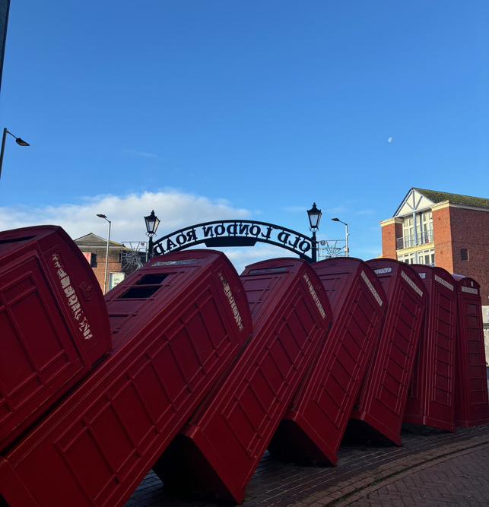
Get Feedback
Many funders say they won’t give feedback because they have small staff teams and don’t want to be inundated but if your application fails, ring and ask for feedback, they can only say no!

Slide 26
Two key thoughts to take away from today
Read the guidelines, Read the guidelines, Read the Guidelines
Keep it simple - simple applications are far more likely to succeed

Slide 27
Finally - Coming soon
Our Pilot Funding Applications Review Surgery
Not just on applications you want to make but also to review ones where you failed
Every other Wednesday, starting from 30 April 2025, from 11:00 to 15.45 for 3 months.
Book a 45 minute slot online and send your application at least a week in advance.
Kingston Eco-op
Text here
Superhighways
Text here
Funding
More text

Slide 28
Any questions?

