Slide 1
VCS Review, Seizing the Moment and Community Hubs
July 2021

Slide 2
Seizing the Moment
Build on the sense of mission and coming together that has existed during the pandemic. Initiate an inclusive, open and honest conversation about the future of the borough, with a particular focus on creating trusting relationships needed for closer collaboration between council, voluntary and community organisations, businesses, residents and other public sector bodies. Set in motion a change process that gives informal and formal community and voluntary groups more freedom, support and resources to address address local and brough wide challenges

Slide 3
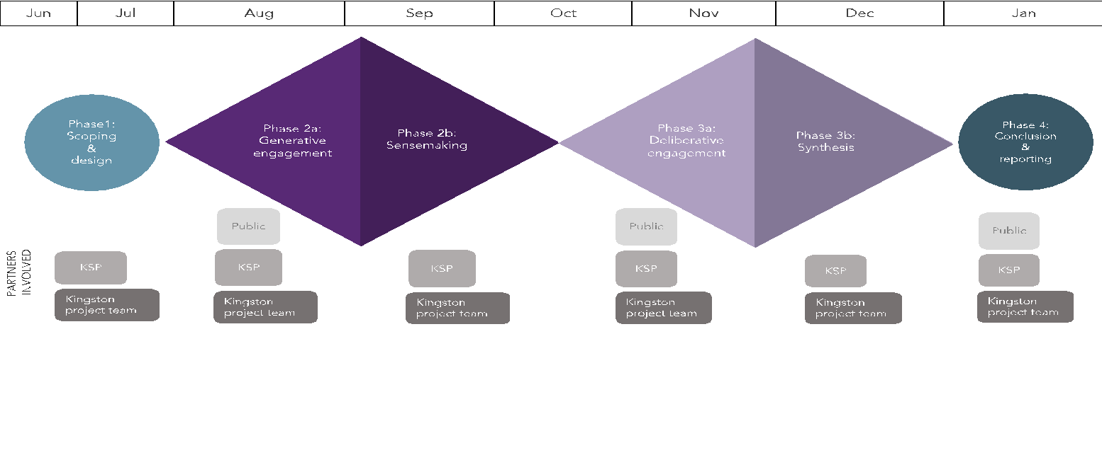
Our approach

Slide 4
Overall project lead and co-design - Not-for-profit social change agency. Work with local authorities, across the public sector, with the voluntary sector and with communities to create collaborative relationships, thinking and practice. Research lead - An organisational transformation agency. Work with local authorities, charities, social enterprises and other social purpose organisations to overcome organisational challenges through engagement, research and the practical application of evidence into practice. Community engagement lead - An award-winning social business that specialises in designing, delivering and facilitating cutting-edge projects.
We’re working with

Slide 5
VCS Review Update
The Council commenced a ‘review’ of relationships and commissioning models in 2019
This work was informed by feedback from the sector and engagement with partners to explore new ways of working
The proposals included creating a Kingston Together Fund to bring together commissioning activity with the sector
This work was paused due to Covid and existing arrangements were extended
In June the Deputy Leader wrote to commissioned partners in the sector to confirm the intention to extend agreements to March 2023
Committee approval has now been given to extend agreements to March 2023
The Council’s Commissioning Governance Board is now approving the individual commissioning arrangements
Each organisation should receive confirmation of their extension by 13 August
Extensions provide an opportunity to work with partners to trial new ways of working, explore new solutions and develop new models of delivery

Slide 6
Approach
Co-produce and reshape the ‘review’ working with the sector and service users
Take account of how we have all worked differently during the Covid response
Ensure sufficient time and opportunity to learn from Seizing the Moment report and other local research and engagement
Reflect on the challenges and opportunities of a post-Covid world
Be mindful of wider partnerships and joint commissioning considerations
Align with wider system changes, particularly around health and social care
Consider how best to ensure support for the existing and emerging voluntary and community groups
Support sector sustainability and innovation in the short, medium and long term

Slide 7
Context and interdependencies
Communities taskforce | Integrated Care Systems
Economic recovery taskforce | Commissioning framework
Ongoing covid response | Social value policy
Community hubs New VCS Strategy | Community empowerment Seizing the Moment

Slide 8
Proposed workstreams
Infrastructure and capacity building
Information, Advice and Guidance
Specialist commissioning
Occupational activities
Targeted interventions
Small grants and seed funding
Relationships between the Council and the VCS

Slide 9
Indicative timetable
July 2021 | Committee decision and extensions enacted, including agreements regarding opportunities to transform and reshape services
September 2021 - December 2021 | Develop new VCS Strategy, partnership model, and partnership priorities
December 2021 | Approval of new VCS Strategy
January - June 2022 | Co-design a new commissioning model. Develop new VCS commissioning infrastructure
July 2022 - December 2022 | Call-off services and award new contracts Agree tapered hardship / transition support packages
December 2022 - March 2023 | Mobilise new services
April 2023 | New services commence Hardship / transition support packages commence

Slide 10
What is a Community Hub?
What?
Connecting people through activities to interact and have fun.
How?
With?
Residents
Council
VCS & Faith and Non-faith partners
Local GP & Health Networks (PCN)
Other partners (e.g. KU, Police, KSP etc.)
Why?
There is a significant amount of evidence showing the real value of community hubs in building community resilience; as seen more recently in response to Covid-19.
Physical Hub
Digital
@Home
So...
...we can work together with communities to build resilience, reduce social isolation and improve health and wellbeing; towards our residents living happier, and more independent lives.
Notes:
Community hubs are a place based approach to engaging, empowering and enabling communities. There are three ways of engaging with a community hub: i) in a physical building; ii) in a digital way; iii) through an ‘at home’ offer.

Slide 11
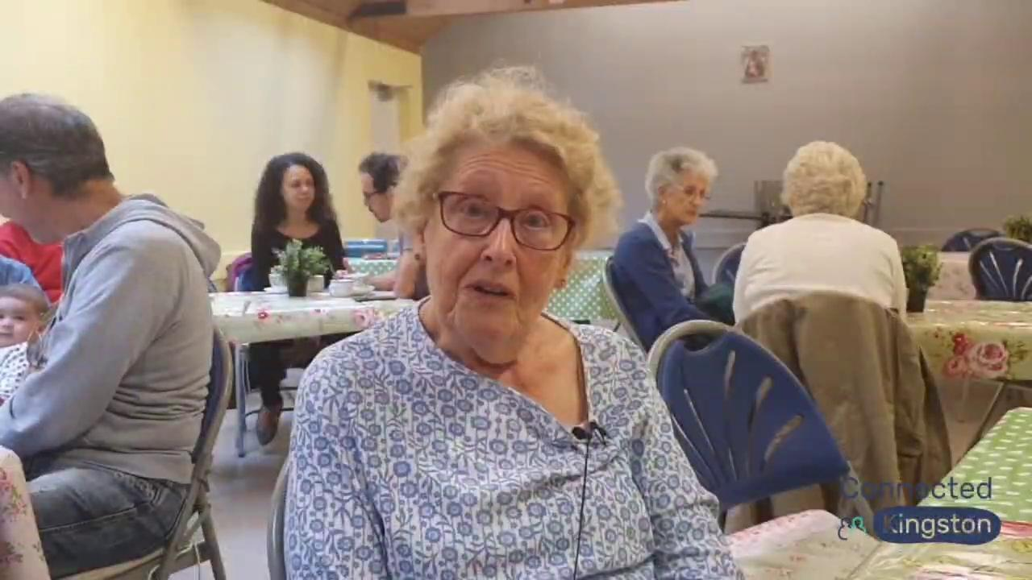
What are the outcomes to be achieved?
ENABLE & EMPOWER:
communities to rebuild and strengthen post Covid-19
people to experience improved health and wellbeing
a borough vision to be tailored for local communities
buildings and spaces to be flexible and maximised
Kingston resident at Tea & Treats
ENGAGE:
people so they feel more connected and less isolated
people through physical spaces, digitally or at home
a wide range of partners and communities

Slide 12
How do Community Hubs fit with the bigger picture in Kingston?
Corporate outcomes
A safe borough which celebrates our diverse and vibrant communities, with local priorities shaped through participatory democracy
Healthy, independent and resilient residents with effective support to those who need it most
What is the Council seeking to achieve
Seizing the Moment Renewal
OD Strategy & Future Workplace
Blueprint Design Principles
How the Council will achieve these outcomes
Human-Centred Design
Prevention & Early Intervention
Marmot Principles
Council Services
Property
Culture and Libraries
Adult Social Care
Public Health
AfC
Leisure
Asset Strategy
Libraries Review
Anticipatory Care
Community Dev.
Early Help & Resilience
Leisure Strategy
Community Hubs
VCS & Partners
PCNs
KST Hub
Connected Kingston
Website
Customer Review
Ongoing programmes
Council Access to Services

Slide 13
What are the timelines?
DO - next 12 months
Starting off with key RBK assets:
Hook Centre, New Malden Library, Kingston Library, build digital hub and @Home offer
EMPOWER - next 12+ months
Other RBK assets, community/VCS assets & commercial assets:
Empty shops, Kingston University Townhouse, Rose Theatre, Farm/Museum of Futures, Undercroft, Good Food Co-op
INFLUENCE - up to 5 years
Longer term, strategic developments and regeneration programmes:
Kingfisher Leisure Centre / Cultural Destination, Cambridge Road Estate, Cocks Crescent

Slide 14
Our aim is to make Community Hubs (initially Kingston Library, New Malden Library & Hook Centre) welcoming, social and inclusive community spaces. We want to work with communities to open up these spaces. To achieve this we are encouraging residents and colleagues in voluntary and community groups to get in touch.
Whether wanting to host a book group, a new chess club, a coffee morning, support sessions, craft sessions, skills sessions or another idea we want to hear it and where possible help to make it a reality*.
We would encourage those with ideas to contact giselle.monbiot@kingston.gov.uk
*We will accommodate groups wherever possible (pending availability of space). Timelines may be delayed whilst covid rates remain high, safety of residents & staff are our top priority.
The Offer

Slide 15
Questions and feedback
In particular we are keen to hear how partners want to engage with this work.

