Slide 1

Befriending service - Health & Wellbeing network
July 2020

Slide 2
Introduction
Aim
The RBK befriending service or ‘tier 3’ was set up in partnership with KVA to provide emotional support for residents who were either in a vulnerable ‘shielding’ group or self isolating due to Covid-19.
Service
A new programme was developed to provide support through assigning a volunteer "buddy" to ensure the resident is keeping well, having regular contact with another person and issues are recognised and escalated. The programme aimed to reduce social isolation and reduce the number of people from accessing other services.

Slide 3
Befriending Team
Staff Structure
Project lead - Emma Hill
Project Support - Helen May
Project stat support - Chris Wiffen, Jo Lambert
IT support - Pamela Deakin, Cheney Parsons
KVA lead - Gurpreet Keila
Volunteer supervision team - Kathryn Smith, Karen Penny (KVA)
Buddy Allocating team - Adelaide, David, Bill, Sree, Lakhwinder, Chris W (KVA) Leeni (KVA) Holly, Steph
Hours
Helen and Emma work full time on the project and cover the inbox over the weekend / bank holidays.
The rest of the team are part time and will do various hours throughout the week to ensure we always have a team of buddy allocators between 9-5 Monday to Friday.

Slide 4
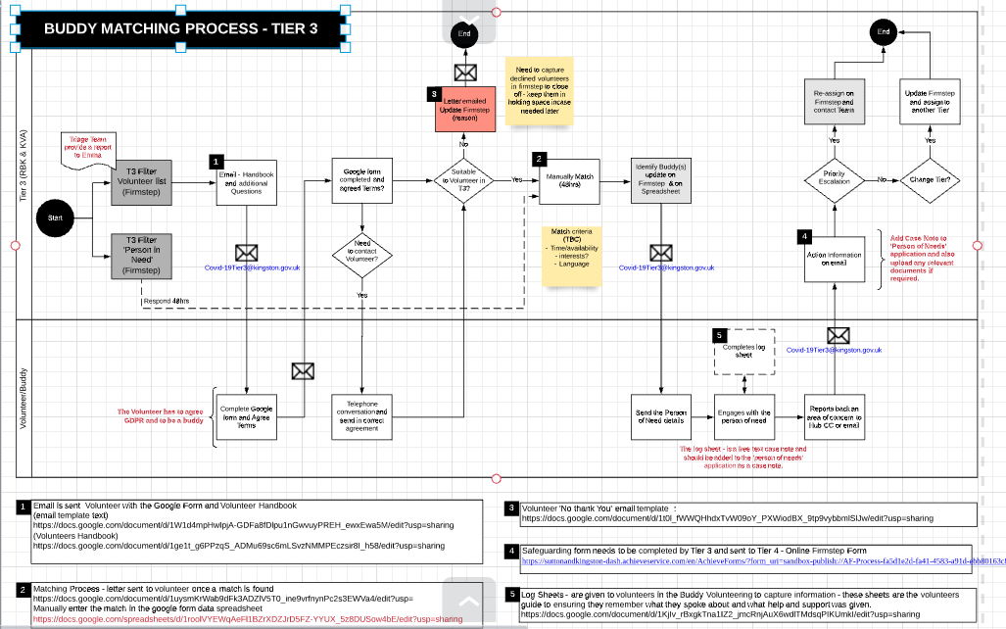
Service model
To view more clearly Full Buddy Process

Slide 5
Service platforms
Firmstep
Customer Platform
Volunteer
Master spreadsheet Form
Trello Board
KST platform that provides all the case information from the Person in need.
Volunteer information from the google form that indicates experience, availability and deployment of volunteer
Trello board used to case manage the tickets to show where in the process the case is;
Not spoken to
In progress
Matched
No longer requires support

Slide 6
Service users
Some of the findings from the analysis of Tier 3 People In Need:
  Currently supporting 140 people with a buddy
  Two-thirds of the People in Need live alone;
  Pressing need for support, 80% require support within 4 days (20% require immediate support);
  Nearly one in ten have a preference for a language over than English;
  Over eight in ten belong to a vulnerable group - split closely between over 70s and those aged under 70 with a pre-existing health condition;
  One in ten report having had COVID-19 symptoms within the last seven days of requesting help from the KST hub;
  A third report feeling unsafe;
  Nearly one in ten have been discharged from hospital
  Over half of those answering would like to be contacted at least a few times a week, with telephone being the preferred method
  20 people have been identified as ‘3.5’ and requiring further mental health support
Analysis of Tier 3 People In Need

Slide 7
Service users
3 cohorts of support
‘3.5’s’ - Mental Health Support
Basic befriending
Those requiring a bit more support and help(eg; financial, food, housing issues)

Slide 8
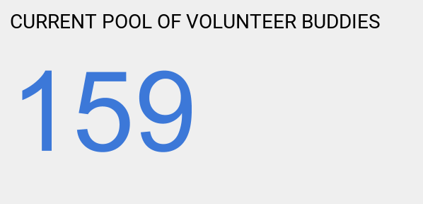
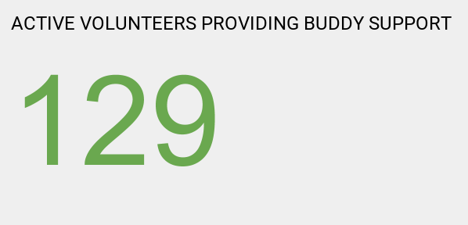
Buddy Volunteers
The buddy programme support is provided by local volunteers.
Latest position (click each to update)
More data and charts
A recent survey with volunteers showed that 80% of volunteers have enjoyed their experience as a buddy and 40% would like to continue for the long term

Slide 9
Supervisions
Supervision sessions have been provided for volunteers to ensure they touch base with staff and receive regular updates and advice on being a buddy.
Two sessions a week have been lead by KVA with various themes each week. Padlet and email after each session
Themes include;
  Mental Health - Kingston Mind, 5 Ways to Wellbeing
  Physical Fitness - Bobby Ellington, Get Active Team and Nima Ajith, Better Bones (RBK), presented some simple exercises for residents self-isolating
  Dementia awareness - Alzheimer’s Society
  Solving digital and IT issues - Superhighways
  Accessing online library services - RBK
  Advice on responding to buddies’ suicidal thoughts - RBK
  Social Prescribing - Community Connector
  An overview of Adult Social Care
A total number of 53 volunteers have attended.
More recently a reflection supervision has been developed with Icope and two clinical psychologists to offer volunteers who are having more difficult conversations with their buddy an opportunity to debrief and receive advice on best way to deal with these conversations.

Slide 10
Training
Volunteers and staff have been offered the following training:-
  Befriending training
  Mental Health awareness - RBK
  Psychological first Aid - PHE
  Safeguarding
  Digital training - Age UK
  Suicide prevention - Suicide prevention alliance

Slide 11
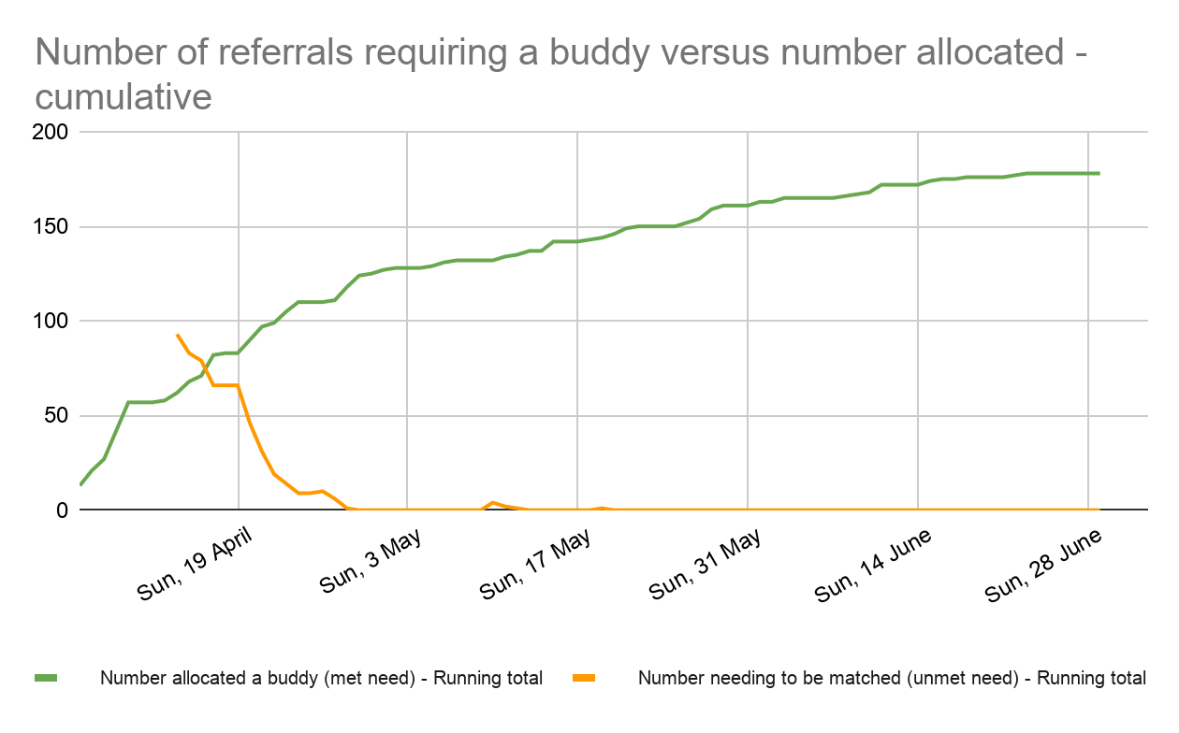
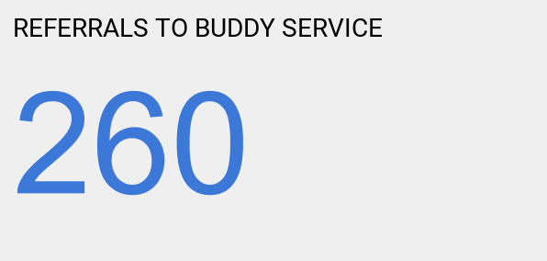
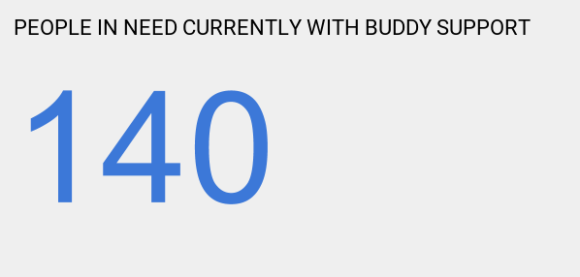
Demand for service
Current position (click to update):
More data and charts
  Since mid-April we have received an average of c. 10 referrals per week, slowing to less than 5 last week
  Some referrals will have resulted in a Person in Need being referred to another tier, and others having used the buddy service will have decided they no longer require one.

Slide 12
Case Studies
Client T suffers from anxiety and has been shielding. She has an allocated support worker from a mental health organisation. When T applied for a buddy she said: “I enjoy making things such as knitting and crafts. I have mental health difficulties too and it would be helpful if there was someone that had an understanding of this area.”
Over the last two months her volunteer buddy J has developed a great rapport with her. They have weekly 40 minute chats when they often talk about gardening and cooking. J has encouraged T to develop her creative talents by taking part in art projects including Mind’s online art therapy and she has sent her details of Grayson Perry’s Channel 4 Art in Lockdown programme. J also helped T to access weekly food parcels when she was running low. T is now allowed to go outdoors but is still feeling very anxious about the virus. Her buddy is encouraging her to make small outings to build up her confidence again.
“My buddy has landed a new job in the career change she has been aiming at for a long time.
She is absolutely delighted and also thanked her support worker a lot. She also fed back how exceptional she thought Kingston council were being in their response to Covid. I agreed you are doing a wonderful job of it.
I told her how well deserved it is because she has stayed so positive throughout and so caring about others having an
even harder time. I told her good things come to those who wait!”
“My buddy is doing better now, she does have complex needs. I find that face time is best for her and it helps me understand her wellbeing....She did say to me last week that she would have been in hospital if it was not for contact either by phone or FaceTime.”

Slide 13
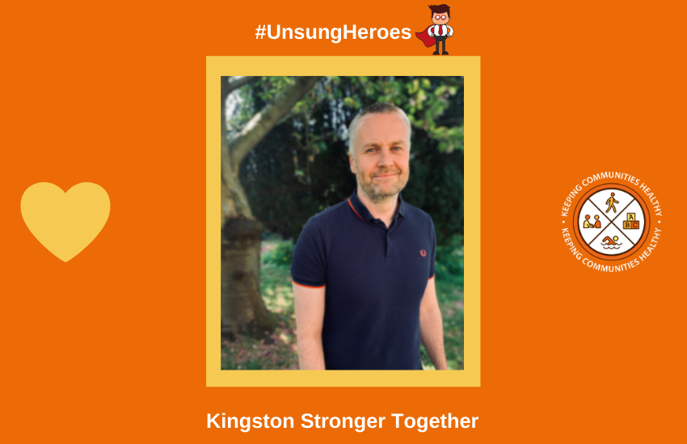
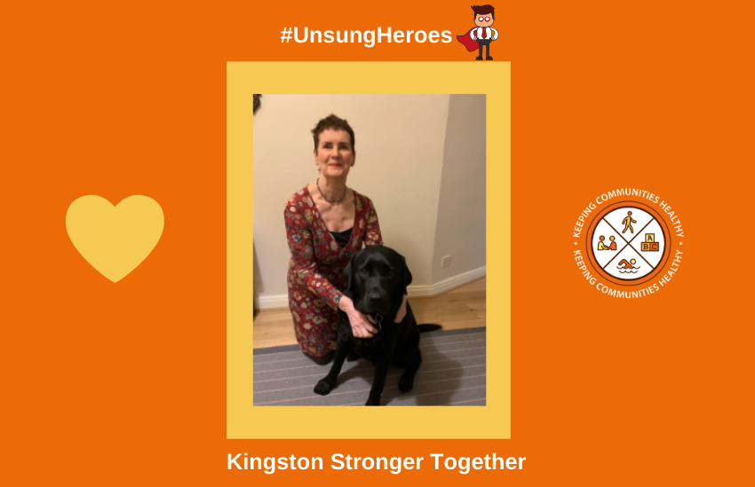
Feedback
My buddy has been really supportive by encouraging me to look after my wellbeing and this has included making sure that I am eating properly as well as encouraging me to take up walking which I now do 3 times a week.
My buddy has been an amazing independent support. He is a really kind person - I am partially sighted and he has encouraged me to use audio books and this has been a very positive experience for me. He has also helped me in choosing some new IT equipment. I wish this scheme had been around before the lockdown period.
K is really good, we have a lot in common. She helped me source a new bed from the Community Furniture Project which has been great as I was having problems with my old one which was over 20 years old. It was so bad I couldn't sleep and had insomnia, so getting a new one has helped improve my mental health. Having my buddy is like having my mum checking how I am doing and making sure that I am alright. I definitely have more good days than bad days now and speaking to her has helped me to improve my diet as she often asks me what I am having for my tea.
I think the way the volunteering has been organised is brilliant. It makes me proud to live in Kingston.

Slide 14
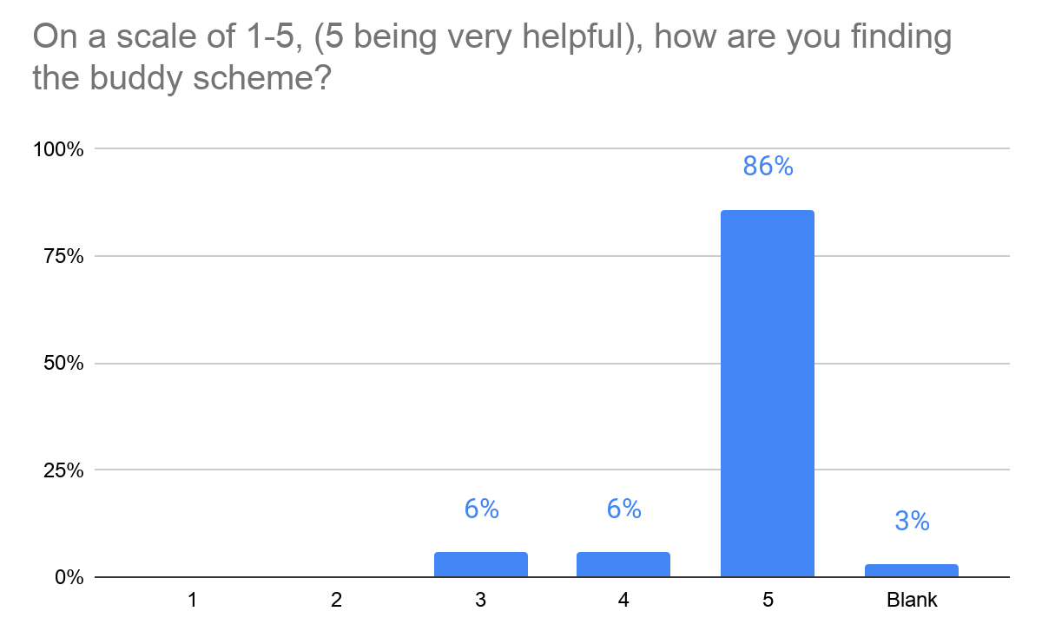
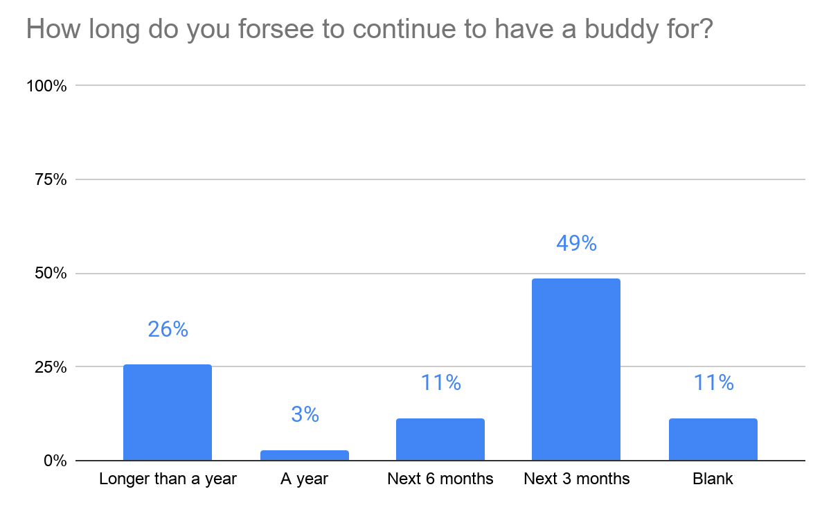
Feedback - service users
Survey of users of the service (People In Need) currently live. Selected results based on 35 respondents so far (click to update):

Slide 15
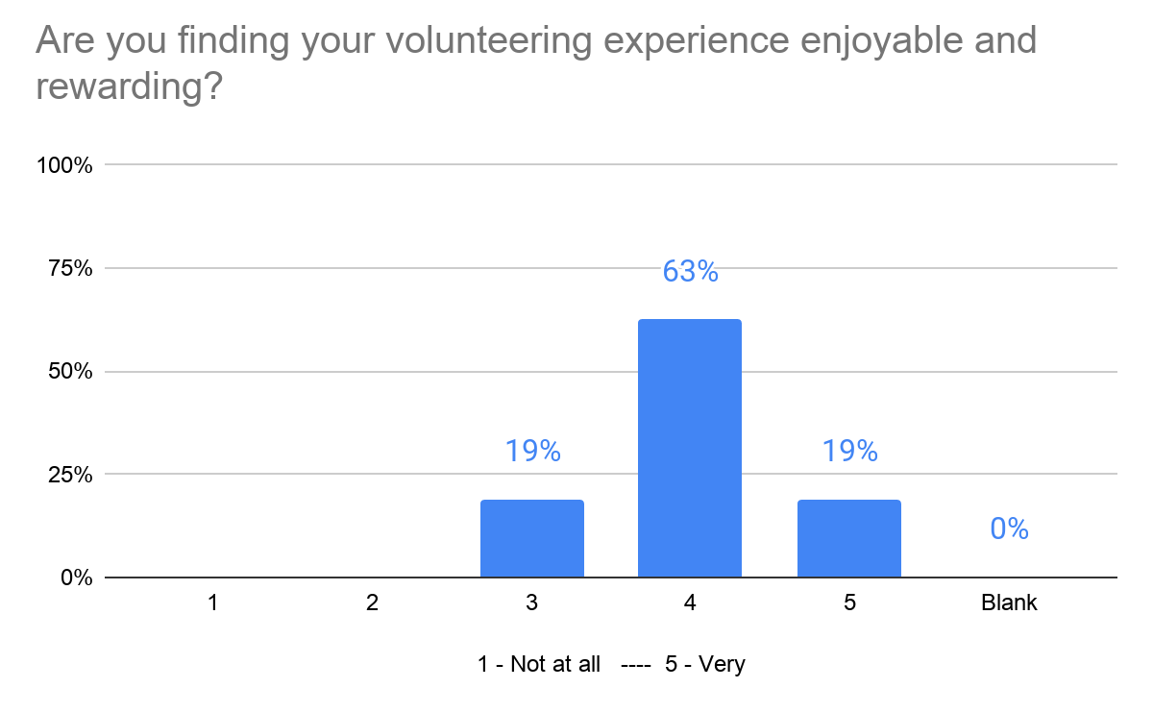
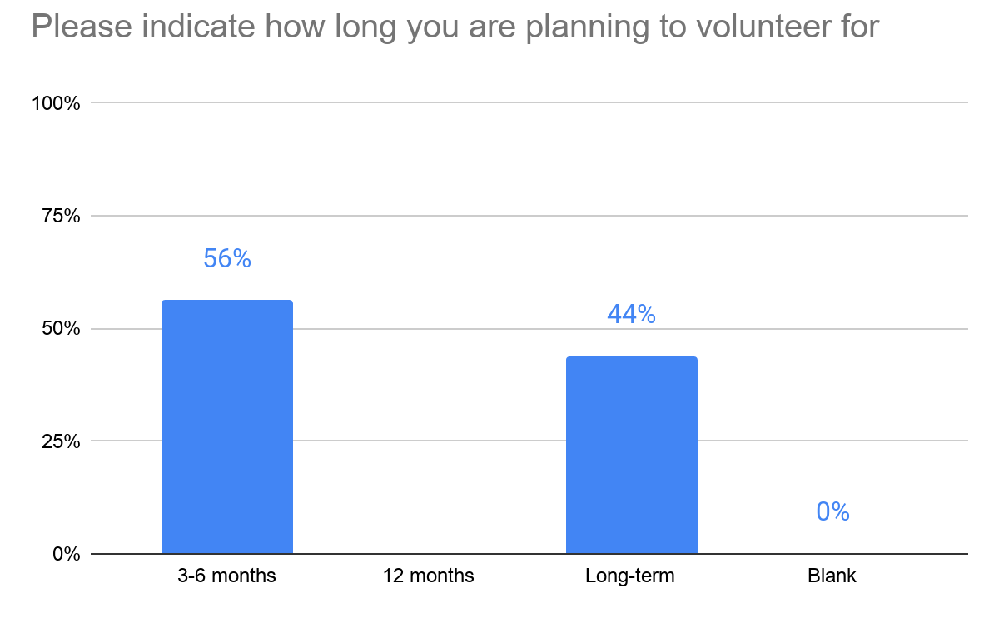
Feedback - volunteers
Survey of volunteers of the service (Buddies) currently live. Selected results based on 15 respondents so far (click to update):

Slide 16
Reflections so far
What has worked well
The scheme was set up very quickly over the space of 2-3 weeks and we have received positive feedback from clients and volunteers.
This programme has shown a great need for a support service for people who feel lonely and would like that extra support from someone other then friends and family.
Effective partnership work between RBK and KVA
Providing 140 vulnerable residents with telephone support
Great volunteer involvement
We have a good team of RBK staff - most of whom have not worked together before - who offer a variety of skills and perspectives
Linking up with colleagues in different Tiers of the KST Hub
Identifying people who may have fallen through the gaps to receive additional support outside of covid.

Slide 17

Learning
To find out as much as you can about the service users including involvement with other professional services,
Develop a good case management system
Spend time training the volunteers and providing them with resources and setting clear boundaries for them to follow
Engaging Supervision sessions run at various times
Ensure you have an emergency process in place for volunteers to get in touch.
Mental health referral pathways
Encourage the volunteers to report back and good stories / feedback - It makes it all worthwhile

Slide 18
Contact Details
Project Lead Emma Hill - emma.hill@kingston.gov.uk
Buddy Programme - covid-19tier3@kingston.gov.uk

