Slide 1
Social Isolation
Healthy at Home
Kingston Adult Education
Kingston Music Service
Early Intervention and Prevention
Community Development Team

Slide 2
Social Isolation
Healthy at Home
A service to support people be active and healthy
at home and beyond
People aged over 18
People who are shielding
Overweight or frail
Long term conditions
Mental Health concerns
Complex lives
Contact: 0208 547 6815, healthy.lifestyles@kingston.gov.uk

Slide 3
Services available now
Get Active Exercise Referral
1:1 sessions online
Groups of 6 sessions
Better Bones,
Information session on Bone health, Osteoarthritis and Physical activity
Group exercise classes for Osteoporosis, Osteoarthritis knee and general Strength and Balance
Weight management
Weight Watchers/Slimming World digital offer 16 week course online
Stop smoking service
KickiT smoking cessation (stop smoking service) over the telephone
E-Drink check (reduce alcohol consumption) and wellbeing service
Online E-Drink check and signposting

Slide 4
Social Isolation
Kingston Adult Education
KAE has transferred the vast majority of their classes online to all curriculum areas including ESOL. The following socially isolated groups are worth noting:
Weekly newsletter offering mental wellbeing workshops supporting learners who are suffering with mental health issues. Courses include Stress and anxiety management; Improving sleep, as well as online exercise classes including Standing Pilates. This online programme will continue into the autumn term to support those who are unable to return to class.

Slide 5
Social Isolation
Kingston Adult Education
LLDD Learners have had weekly phone calls from their tutors, checking in on them and giving them tasks to do, e.g. cooking, art projects as well as tutors sending regular pre-recorded classes such as singing and drama. The Learners have been very engaged in this and looked forward to their regular 'check-ins'. This is set to continue until safe to return to class.
16-19 year olds with EHCPs have been kept going with 100% attendance and they remain engaged with staff. They were loaned laptops to ensure they could continue learning. Five Supported Internship learners have continued contact and did not miss a single "day" of attendance since lockdown, probably completing more work than they were in physical attendance and one has also been offered work!

Slide 6
Social Isolation
Kingston Adult Education
Will continue to deliver online learning for the foreseeable future as well as classroom based learning (when it starts back) and are looking to put an ‘Expression of Interest’ through the DevicesDotNow Campaign to access tablet devices for those prospective Learners who don’t have digital access and are socially isolated. They are also looking to put a bid to the GLA to access funds which they could use to purchase chromebooks that could go out on loan to learners in a similar situation. In both of these areas, they will be looking to provide data where possible.

Slide 7
Social Isolation
Kingston Music Service
Delivering all music lessons online including keyboard groups and one to one tuition for adults.
Introduced a 5 week bundle of lessons for adults at a discounted rate to get back into playing and instrument or singing
Massed ensemble and singing projects online including our Midsummer Festival 30th June to 4th July including a Adult band and Gospel Choir

Slide 8
Social Isolation
ASC Early Intervention and Prevention
Commissioned services providing a digital offer to support socially isolated people during coronavirus such as:
Kingston Carers Network- online activities and events, digital updates and newsletters.
Community Catalysts- supporting people to meet and share ideas and activities online.
Supported Employment-Working age adults with social care needs

Slide 9
Social Isolation
ASC Early Intervention and Prevention
Services providing phone support for socially isolated people during coronavirus
Alzheimer’s Society- telephone information advice and support from dementia development team and advisor
Staywell befriending
Supported employment

Slide 10
Social Isolation
Community Development Team
The Community Development Team’s approach has been to tackle social isolation by providing integration opportunities for vulnerable and socially excluded members of our community in Kingston.
We have currently 10 funded projects (currently reaching over 500 people)
For more information please contact nighat.taimuri@kingston.gov.uk
Notes:
Ministry of Housing. Communities & Local Government.

Slide 11
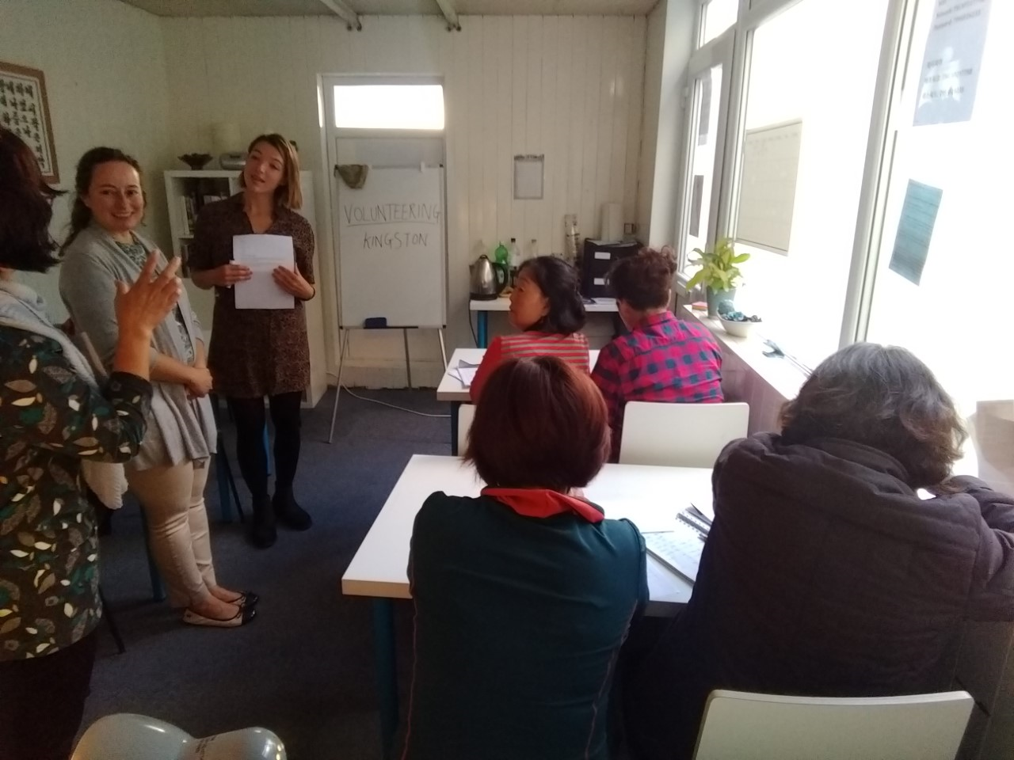
Community Development Team Social Inclusion (Integration) Projects
Recovery Initiative Social Enterprise RISE
Kingston RISE is a group for individuals in recovery from alcohol /drug addiction, the homeless, those with long term conditions and people with mental health needs.
RISE is supported through funding from RBK, Southwest London St Georges and the CCG to provide weekly sessions for vulnerable (mostly isolated men) to group together and meet.
Online sessions being organised
Benefitting 60 people
Videos:
Giles - Thinking works video (Warmer Homes)
Julie - Kick it video (Smoking cessation)
Thinking Works visits RISE Member video here
Connect North Korea
Integration Activities for vulnerable North Koreans
Benefits (completed recently)
25 benefit from ESOL classes
12 benefit from conversational classes
32 advocacy sessions
4 Dangers of Gambling awareness sessions reaching 60 people
3 people receiving intensive counselling sessions
Session with Volunteering Kingston

Slide 12
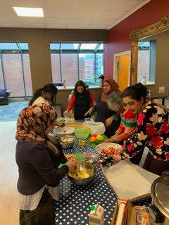
Community Development Team Social Inclusion (Integration) Projects
Independent Yemen Group (IYG)
Healthy Eating project (funded by MHCLG) for women to learn about healthy eating and parenting with social activities. These activities reduce isolation as it provides opportunities for vulnerable women to learn and socialise
Use creative methods as a hook encourages participation in projects. Video.
Project on hold during COVID-19
Benefitting 14 people todate
Learn English at Home New England Seafood Company
The Community Development Team made links with New England Seafood Company and Learn English at Home to develop a partnership project to benefit their migrant workforce who work very long shifts.
The project offers their 40 people ESOL classes around their shifts. This means that their workforce can meet others in informal settings and learn English to integrate successfully.
Sessions halted during COVID-19 - online classes are being organised. Benefitting 24 people to date

Slide 13
Community Development Team Social Inclusion (Integration) Projects
Summary of other projects
Homework club: Refugee Action Kingston
This project provides homework support for children and teaches parents how to support their children at school.
Parents also receive English classes.. The Homework club will continue when COVID-19 restrictions end.
Benefitting 30 children and 19 parents
Migrant Advocacy Services : IYG
Provides advocacy for vulnerable migrants. This is undertaken in community settings in the borough and at the Contact Centre in Guildhall 2. Currently delivered by phone.
The service talso akes cases that require bilingual support from council staff. This service is essential for those who feel they need additional support. Through this service they are signposted to other integration activities that reduce isolation. 200 benefited to date
Activities for Korean Senior Association: Korean Seniors Association
English and craft classes for vulnerable North and South Korean Elders. These sessions have been halted temporarily due to COVID-19.
There is a Whatsapp group for people to connect and ask for support. These sessions also provide service providers to engage with North and South Koreans. This project hopes to benefit 20 people
Arrivals Project: Refugee Action Kingston
The Arrivals project which finished recently, provided integration activities for newly arrived refugees.
A range of activities which included an introduction to the local area and services.
This project reduces isolation because many newly arrived refugees are isolated on arrival and do not know where to go for help or access services. Benefitting 28 refugees
Vulnerable Persons Resettlement Scheme: (RBK/Refugee Action Kingston)
The council has committed to take 50 Syrian refugees and resettle them into Kingston.
One of the aims is to ensure they are connecting with their communities and services, thereby reducing social isolation.
Positive news stories below featured in Surrey Comet for Calligraphy article and BBC News for Life under Lockdown
Home Office has suspended arrivals until further notice.Benefitting to date 44 individuals (resettled)
Activities for South Korean Women: Nanoom
Funding was secured to provide health and wellbeing activities for South Korean women through Nanoom.
These sessions have been temporarily halted due to COVID-19 but women are still able to meet online via Zoom.
These sessions are designed to reduce isolation and connect with public health lifestyle programmes and other services The Project hopes to benefit 15 individuals

Slide 14
Resident newsletter
https://www.kingston.gov.uk/info/200175/your_council_democracy_and_elections/1649/sign_up_to_our_new_borough_newsletter

