Slide 2
What do we do?!
Superhighways helps small charities and community groups gain essential digital and data skills, backed by the right tech, to achieve their goals.

Slide 3
Digital Foundations
Small charities and community groups will have the digital skills and tech infrastructure they need to run their organisation and amplify their impact

Slide 4
Data Essentials
Small charities and community groups better use data to shape services and influence change

Slide 5
Datawise London www.datawise.london

Slide 6
Digital Foundations

Slide 7
What devices, software and online tools we can use.
And how can they all fit together into a simple system?

Slide 8
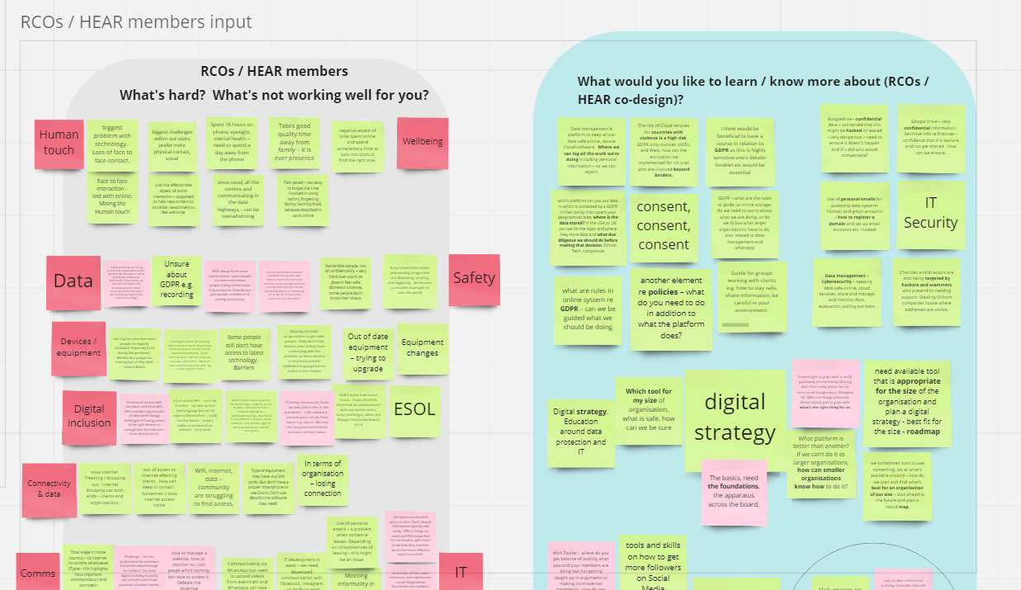
Co-designing the programme

Slide 9
What groups told us they needed
Planning and choosing appropriate tools
Basic technology systems to run a group
Data security and best practice
Visibility, reach and connecting to people
Supporting your communities
Resources including how to get funding
Adapting to change and sustainability

Slide 10
Our training programme
60
mins
Short bite size sessions:
Cyber security series 1 - 5
Passwords & Multi Factor Authentication
Phishing & other email scams…
Short practical tools based sessions e.g.
Intro to Teams
Intro to PowerPoint
Creating publicity materials with Canva
Trello for collaboration

Slide 11
Living our values
Capability minded
“It was at my level and built from the quite limited knowledge I have of Teams.
I was not made to feel in any way stupid for having limited knowledge and skills, as has sometimes happened elsewhere, and that made it possible to relax and so learn.”

Slide 12
Living our values
Committed to value
“The beauty of this session is that I have already actioned my action- I have set up a Rule to direct emails to Finance that I had to manually send every month.”

Slide 13
Next step actions for Kingston groups
I will create some posters for our community classes. Many thanks!
Trying out using chat with team members rather than always emailing.
Create a board for the Kingston Carnival to test out how it could work.

Slide 14
One to one support
A small charity is paying for multiple Dropbox accounts but some volunteers cannot access the folders they need.
We trained them how to move files and share across the team, working together to consolidate accounts.
Saving them money, controlling access & making the day to day more efficient.

Slide 15
Data Essentials

Slide 16
Excel for managing, analysing & visualising data
Intro to Excel:
Viewing & formatting your data
Sorting your data
Auto Formulae
Printing
Next Steps 1:
Adding & formatting tables
Filtering data
Conditional formatting
Adding visual filters
Total columns
Next Steps 2:
Data validation & picklists
Splitting columns
An introduction to pivot tables
Summary sheets

Slide 17
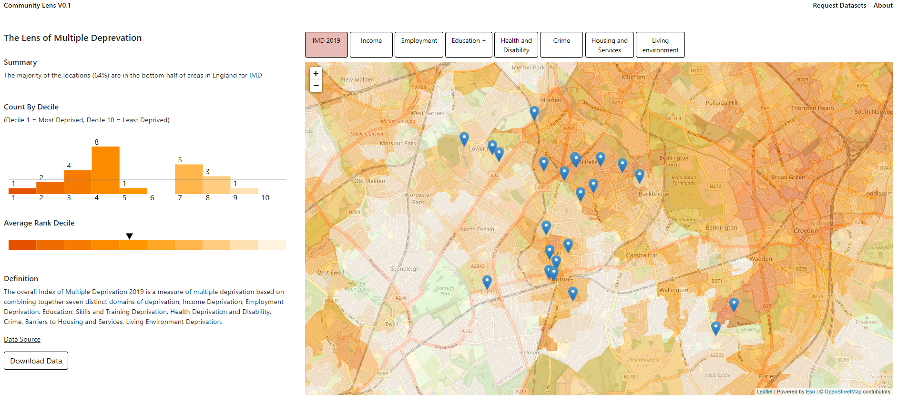
Create a map using Community Lens

Slide 18
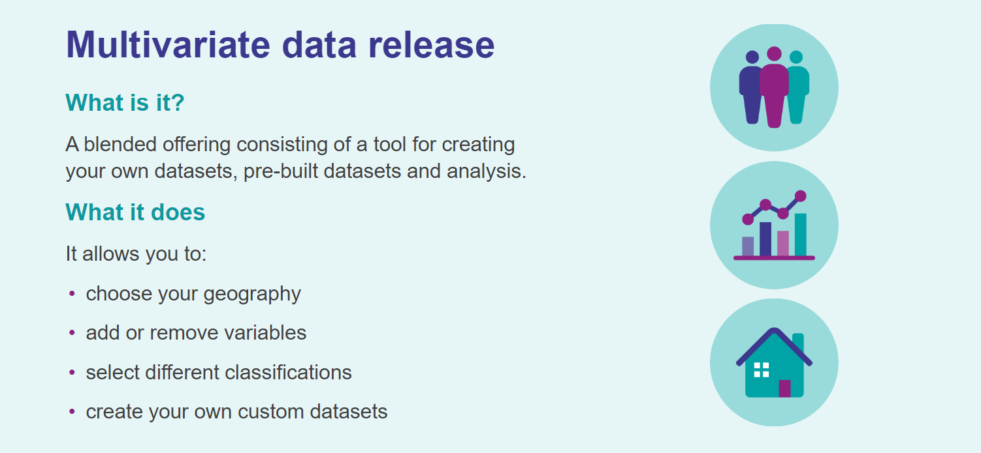
Build your own Census21 custom datasets

Slide 21
One-to-one advice
Book with one of our friendly team for 30 minutes to 1 hour.
info@superhighways.org.uk

Slide 22
Our Kingston focus

Slide 23
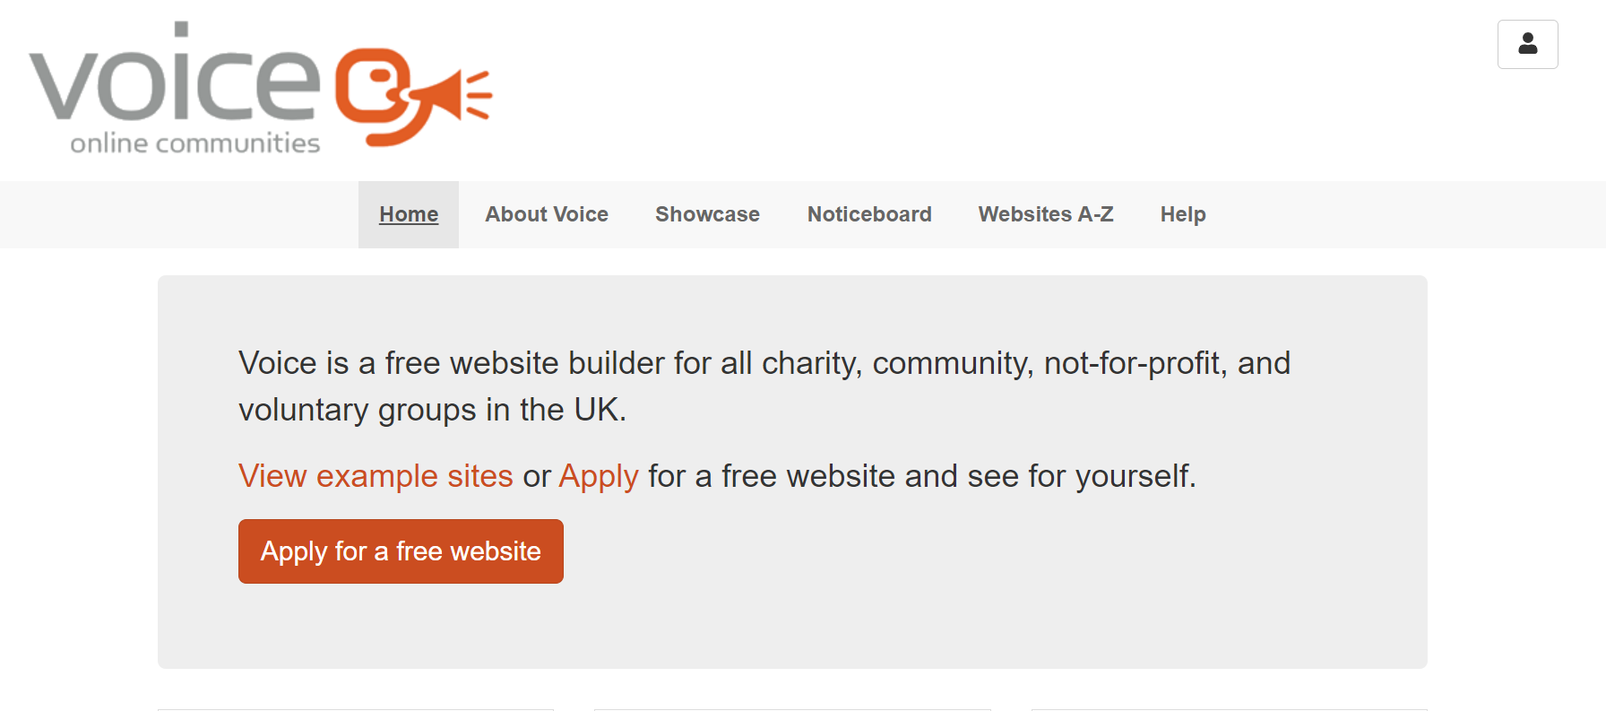
Do you need a website. Voice is a free website builder you can use. Apply today.

Slide 24
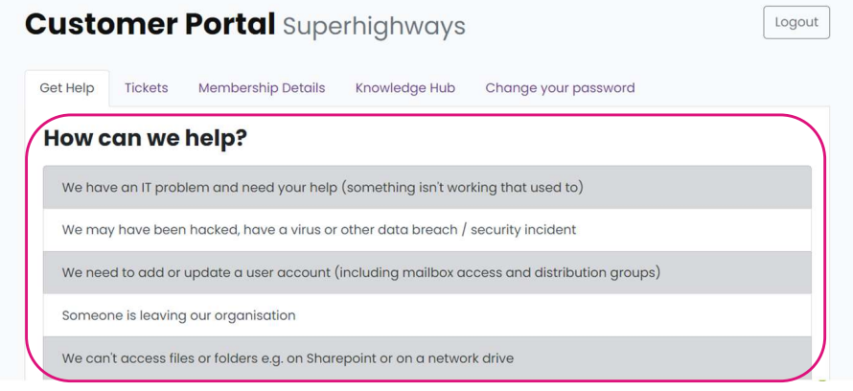
Tech support membership package

Slide 25
Digital Inclusion
Kingston Digital Inclusion Network
Sim cards – National Databank
1:1 basic digital skills support for residents
Better Health Online sessions for communities
Digital Upskill for work ^{New}
Digital Champions training (for your volunteers /staff) ^{New}

Slide 26
“I think the most useful aspect to me personally was the ability to discuss the topics presented as a group and learn from all of our own varied perspectives and ideas together. I found it very useful to see all the different approaches and experiences”

Slide 27
What will help you?
Pause to have a think
Chat with your neighbour about 1 thing
Write it down on a post it (with the name of your organisation & we’ll follow up…)
Notes:
Answers in chat or speak

Slide 28
Thanks for listening
Kate White
katewhite@superhighways.org.uk
www.superhighways.org.uk

