Slide 1
Sported Kingston Meet the Funder 2 April 2025 Onyinye Nkemdirim- London Regional Manager George Clifford – Project Officer

Slide 2
Helping community groups survive, to help young people thrive.
We are the UK’s largest network of community groups supporting half a million young people to overcome barriers to reach their full potential.
Using sport as a tool to make a positive impact that shapes lives.
As part of your team, Sported works with you to reach your goals – and level the playing field.
Reach - Include - Empower

Slide 3
What We do
We use the power of sport to build brighter futures and stronger communities. We achieve this by delivering four key roles across the UK:
Capacity Builder
Funder
Think tank
Advocate
We strengthen grassroots sport groups by supporting their community leaders, volunteers, coaches and workforce with training, networks and advisors.
We distribute vital funding to grassroots groups across the UK. By partnering alongside foundations, trusts and corporates we ensure funding reaches those most in need.
We gather learning on the needs of communities and grassroots sport, how impact is delivered, and encourage collaboration. We share our insight and undertake enquiries with those who share our goals.
We’re the UK’s champion for grassroots sport, we utilise our learning and insight to inform and influence.
We ensure funders and policy makers recognise the power and value of community sport.
Through our place based Connected Communities model we scale-up impact, reach, and power where it matters most.

Slide 4
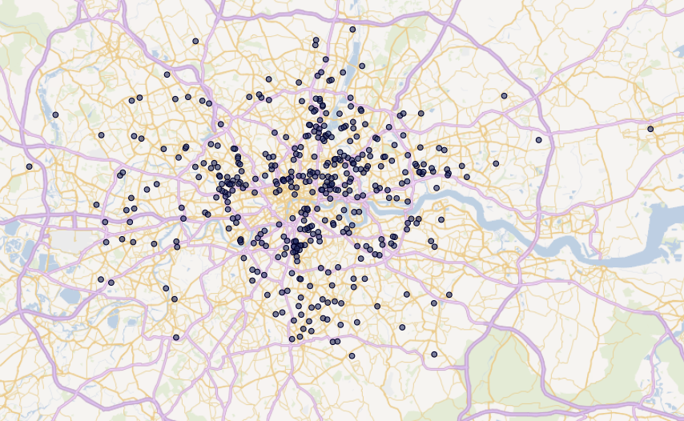
438 30
Sported
in London
Members
Volunteers
Members delivering in London’s most deprived communities
62%
Located in 30%
most deprived areas
Improving young lives and communities across five social outcomes:
26%
45%
58%
24%
47%
Crime & anti-social behaviour
Community Health &
cohesion wellbeing
Education and employability
Inequality in sports participation
But these community groups need our support to survive...
51%
26%
Entirely volunteer led
Have an income under £10k
Number of members accurate as of March 2025
Other figures based on most recent information supplied by Sported members

Slide 5
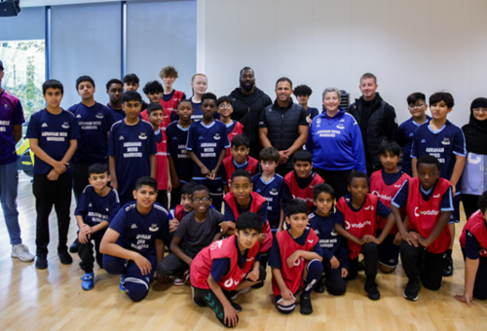
2024 / 2025 Funded Programmes
Notes:
Westminster Foundation - place-based project, aiming to address the specific needs of rural communities.
A dedicated programme targeting two specific areas: the Western Highlands and Lancashire.
Emily and the Scotland team doing a great job!
John – Lancashire Network Coordinator starting 24th March
Comms plan being worked on and developed currently
Evaluation Framework coming together – hopefully we can use this with other place-based work.
Howden -
We have secured a contract with Howdens (insurance not kitchens) to work with them and their sponsorship of the British Lions, - The project will be delivering female coaching qualifications for all the home nations, creation of a network, some club development work and linking with the Well HQ who will be delivering an educational programme that looks at
Space and Culture
Kit
Injury
Coaching and volunteer workforce
Soft launch is the 31st April as the Women's six nations finishes
Vodaphone sports connected:
This programme is live and will run until May 2025.
Groups still have full access to sports.connected page. Please continue to share all that can be accessed with your groups
So far, we have had 70 groups apply for free SIMS, and 25 groups complete the digital survey.
We have 5 small grants that have been allocated to groups who came to us asking for support around tech and digital. We will use Beacon to test the application process etc. in the coming weeks.
6 Nations Tickets were all successfully distributed.
Knight Frank:
In year 1 (September 24-25) we will be supporting the development of 7 model hubs in key locations across Great Britain. These are London, Manchester, Birmingham, Leeds, Bristol and Edinburgh. Across years 2 and 3, we will add a further 11 Hubs to include additional locations in Glasgow, Cardiff and the North East. Hubs will be offered a grant of £20,000 primarily to develop their facility. They will also have key targets around building local connections between young people, other community groups and Knight Frank offices. The corporate volunteer part of the project is being developed and should benefit Sported central and wider network offer once up and running Alongside the capital grants, we will be rolling out a small grants programme offering £1k grants to groups in the local area of the Hub. (60 in total over 3 years)
Ring – theme of community safety - £2,500/£5,000 grant
The Ring community grant programme aims to support not for profit, community groups from across the UK, delivering sport or physical activity to the most underrepresented groups of young people. Organisations should be embedded in their local area, and have a focus on developing stronger, safer communities.
The key themes which define building stronger communities and the areas the grant can be used in support of are:
Inequality in sports participation
Community safety and crime
Community cohesion
Place-based approaches
LMF emergency fund
In response to the race riots going on in the summer of 2024 and how this impacted community groups
Nissan Possibilities Project - The Possibilities Project wants to close the disability ‘Play Gap’ by increasing the number of young people accessing physical activity, widening the opportunities available and lowering the barriers to taking part.
It reflects Sported’s own research that highlights accessibility and training as key issues to resolve. The new programme will connect groups with limited disability knowledge, and those with some knowledge that would like to do more, with experts who can pass on their insight and experience.
With backing from Nissan, who have one of their largest manufacturing plants in Sunderland, a number of clubs and volunteers will be empowered to create action plans to make a long-term difference.

Slide 6
Barclays Community Sport Fund
New 2025 fund after 3 years of success
Tennis Football and Cricket will all be included.
Groups will be able to apply even if they have had funding before.
Applicants must deliver football, cricket, or tennis activities for women and girls, or must be applying for funding to start.
Applicants must operate in an area of high deprivation - only organisations located in or supporting people from IMD areas 1-3 are eligible to apply.
Tickets and mascot opportunities

Slide 7
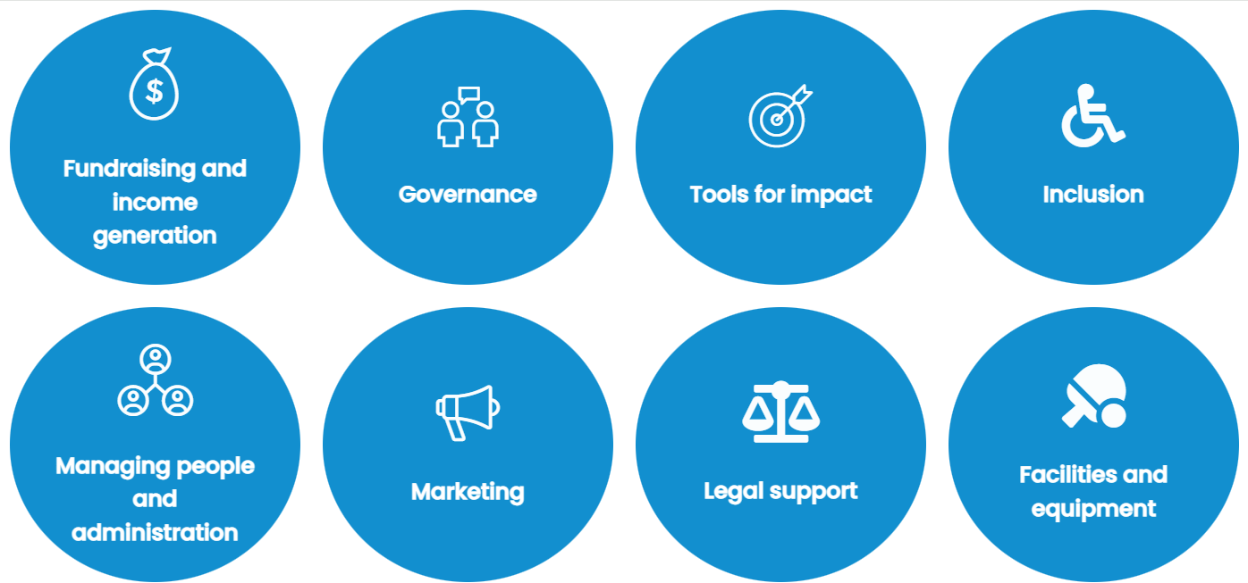
Receive Support from Sported
Online Resources
Professional Expertise
Webinars & Events

Slide 8
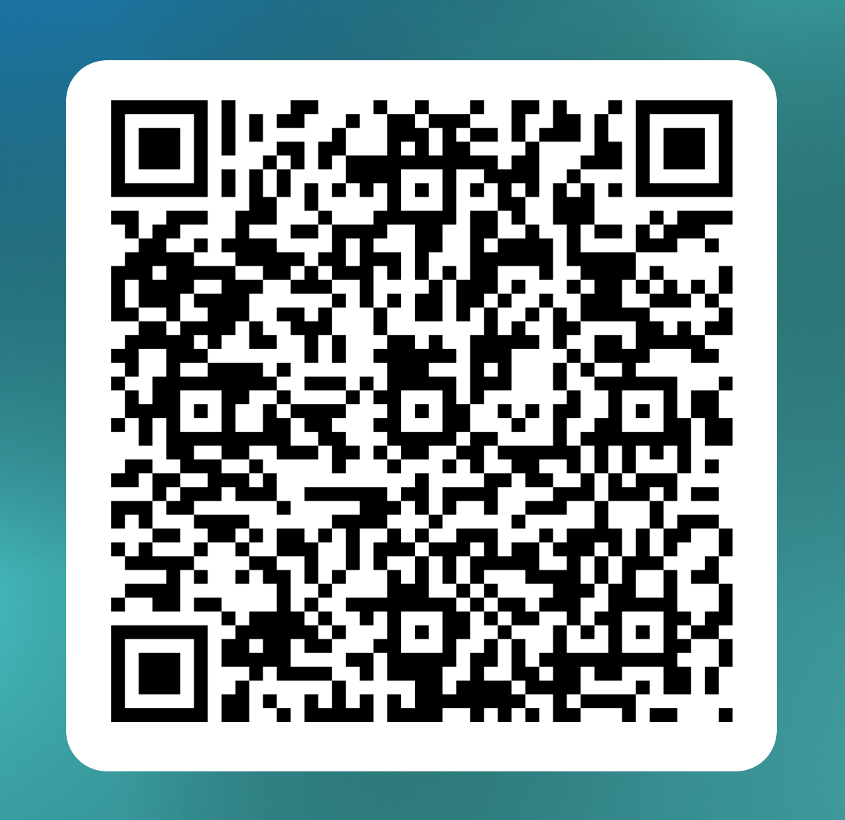
Join us!
If you:
• Directly delivery regular sport/physical activity
• Intentionally use sport / physical activity to improve lives in your community OR need support to start doing this
• Are a non-profit organisation OR were formed for the purpose of advancing social purpose over and above private gain
Sign up here

Slide 9
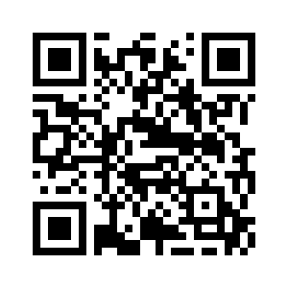
www.sported.org.uk
THANK YOU.
Onyinye Nkemdirim (London Manager) o.Nkemdirim@sported.org.uk
George Clifford (Project Officer) g.Clifford@sported.org.uk

