Slide 1
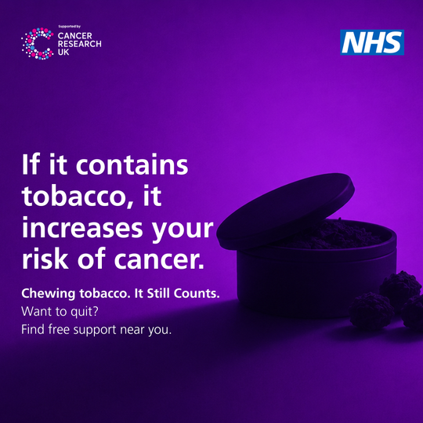
Instagram & Facebook
image
Instagram - Suggested Post 1
🚭 Not all tobacco comes in a cigarette.
Many people are aware of the risks of smoking cigarettes, but fewer realise that products such as shisha, paan, gutkha, naswar and cigars also contain tobacco and harmful chemicals that can increase the risk of cancer.
These products are linked to serious health conditions, including cancers of the:
👄 Mouth
👅 Throat
🫁 Lung
🍽️ Oesophagus
💩 Bowel
💬 If you use any form of tobacco and want to quit, find free support near you or visit your local pharmacy, doctor or dentist for more information.
Find free support near you: https://stopsmokinglondon.com/support/ 🔗 Find out more: https://myhealthandcancerlondon.nhs.uk/
@rmpartnersnhs @cr_uk
#ItStillCounts #CancerAwareness #QuitTobacco
13

Slide 2
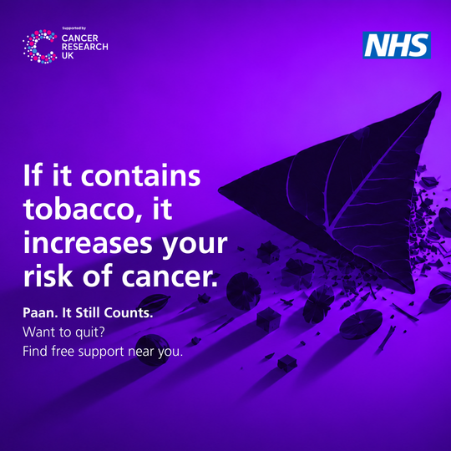
Instagram & Facebook
image
Instagram - Suggested Post 2
Do you use shisha, naswar, paan or chewing tobacco?
Many people don't think of these products as tobacco, so they may not mention them when asked about smoking.
🚨 But they still contain tobacco and can increase the risk of cancer.
Whether it's:
✅ Shisha
✅ Paan
✅ Gutkha
✅ Naswar
✅ Bidis
✅ Cigars
✅ Cigarettes
It still counts.
Speak to your local pharmacy team, doctor or dentist for advice and support.
Find free support near you: https://stopsmokinglondon.com/support/
🔗 Learn more: https://myhealthandcancerlondon.nhs.uk/
@rmpartnersnhs @cr_uk
#ItStillCounts #CancerAwareness #QuitTobacco
14

Slide 3
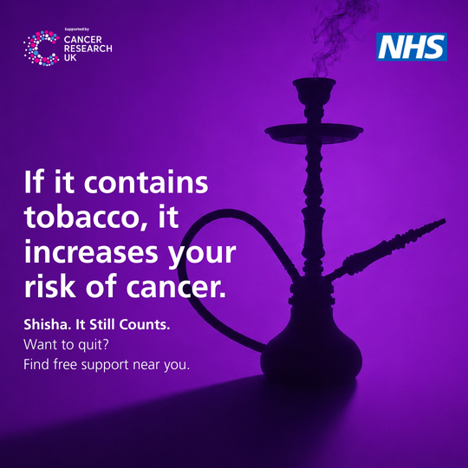
Instagram & Facebook
image
Instagram - Suggested Post 3
Know the risks. Not all tobacco comes in a cigarette.
Shisha, naswar, gutkha, paan, bidis and cigars can increase your risk of cancer.
Talk to your pharmacist, doctor or dentist for:
✅ Advice
✅ Support
✅ Further information
Find free support near you: https://stopsmokinglondon.com/support/
Visit: 🔗: https://myhealthandcancerlondon.nhs.uk/
@rmpartnersnhs @cr_uk
#ItStillCounts #CancerAwareness #QuitTobacco
15

Slide 4
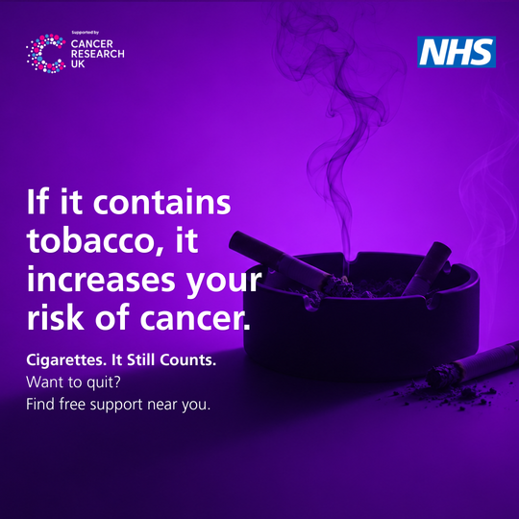
Instagram & Facebook
image
Instagram - Suggested Post 4
Did you know?
🚭 Tobacco is a cancer-causing substance. Every cigarette exposes your body to harmful chemicals that can damage cells and increase your risk of cancer.
Cigarette smoke contains over 5,000 chemicals, and at least 70 cause cancer.
Quitting cigarettes is one of the best things you can do for your health.
Find free support near you: https://stopsmokinglondon.com/support/
Visit: 🔗: https://myhealthandcancerlondon.nhs.uk/
@rmpartnersnhs @cr_uk
#ItStillCounts #CancerAwareness #QuitTobacco
16

