Slide 1
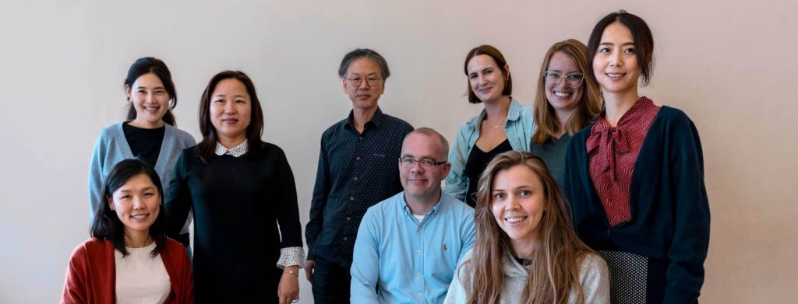
Kingston VCSE Sector How we contribute to better health and wellbeing of Kingston residents – a snapshot
Kingston Partnership Board
24 April 2025

Slide 2
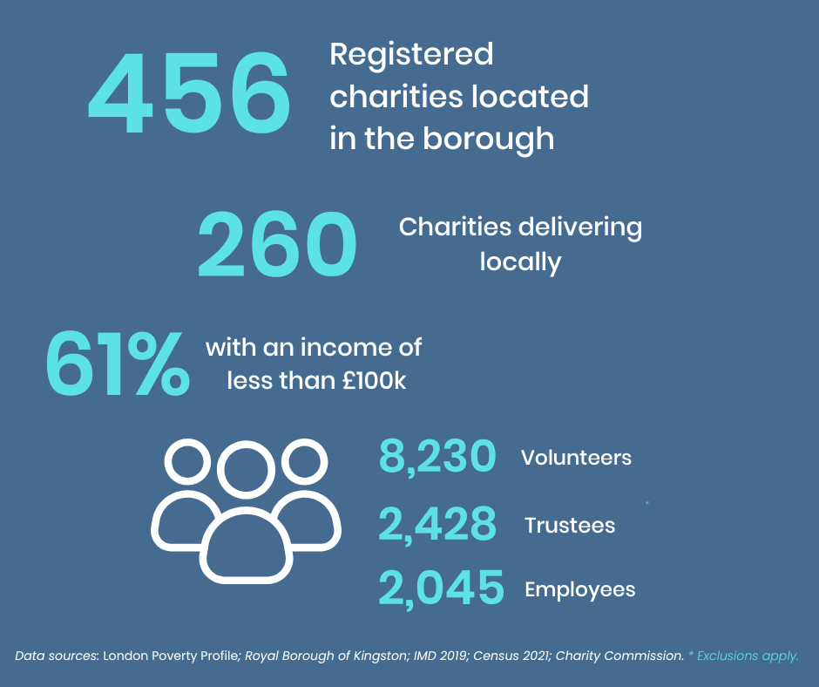
From KVA Survey
From Charity Commission
31 organisations serving 32,098 Kingston residents
19 out of 31organisations reported bringing additional funding of £3.3 million into the borough in 23/24

Slide 3
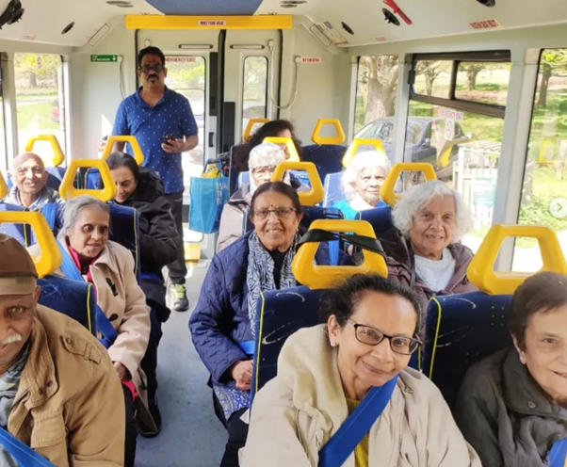
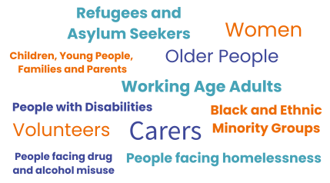
We are not a homogenous group

Slide 4
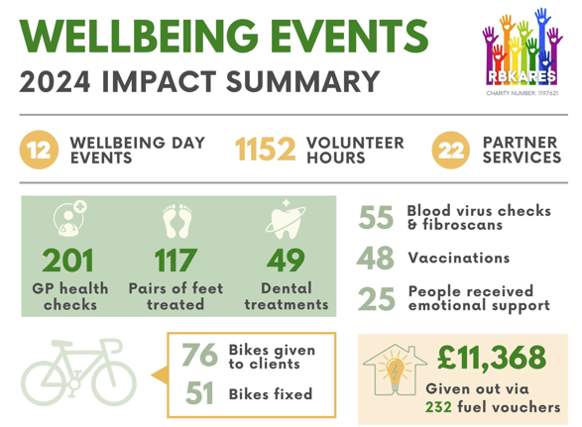
Some of us are very small...
RBKares – an organisation run by volunteers only

Slide 5
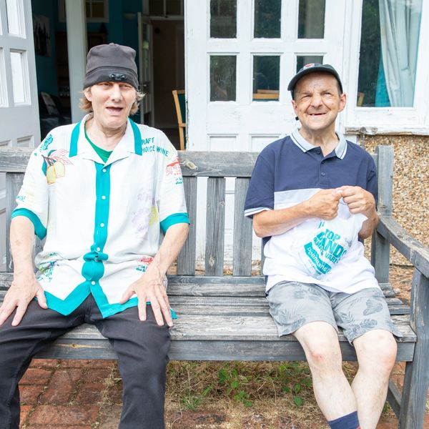
And some much larger...
86 employees
360 clients (140 in Kingston)
Income £4.3 million
Services include supported living houses; employment services; respite for 18–25-year-old adults and much more...

Slide 6
When we collaborate...
60 organisations ​ ​ around 12,000 food interventions
92,900 kg food distributed ​
185,800 meals

Slide 7
How we help statutory partners improve health and wellbeing of our local communities
Trust
Expertise
Skills
Knowledge
Focus
Approach
Value for money
Professionalism

Slide 8
Start Well
Ensuring that all children and young people in Kingston have a good start to life and the right support to thrive and fulfil their potential.
Focus Areas: - Mental Health - Obesity - Children with Special Educational Needs and Disabilities (SEND)
15 organisations out of the 31 responding to the survey supported 3,546 children

Slide 9
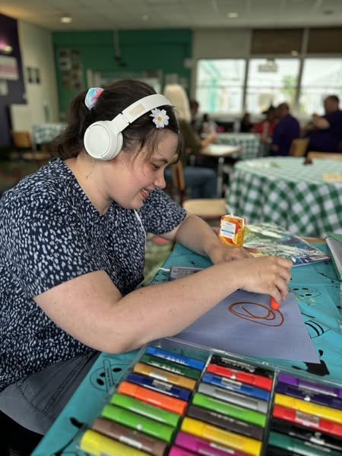
Start Well (example outcomes)
Children at risk of food insecurity introduced to a wide range of new ingredients (particularly vegetables)
Children with significant and complex learning disabilities can be themselves and feel accepted
Refugee children gain skills in English and Maths, increasing their confidence and integration
Young people with mental health issues report improvements in depression and anxiety as well as in relationships
Bereaved children's mental health and wellbeing is improved
Disabled young people have better social skills and engage in activities due to a safe environment
Families at risk of poverty have increased confidence in cooking
Young carers experience improved wellbeing
Visually impaired children play sound football which improves their wellbeing

Slide 10
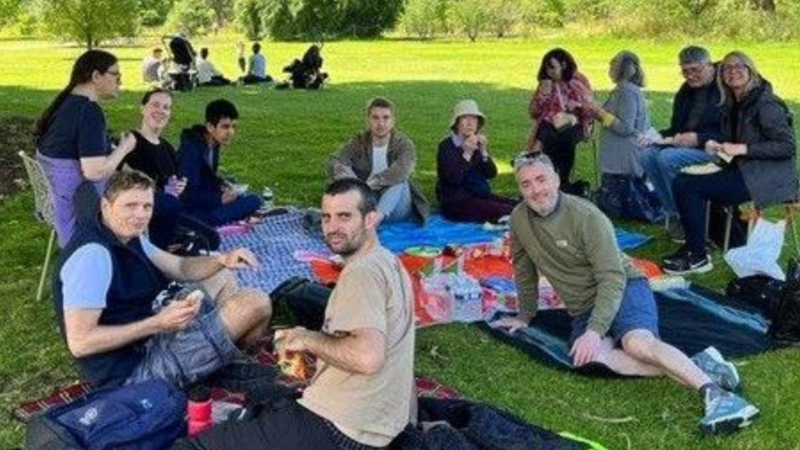
Live Well
Promoting good health in adulthood, with the ambition of preventing the development of many long-term conditions and disabilities, enabling people to live in good health for longer
Focus Areas: - Physical and Mental Health - Long-term conditions - Health inequalities
26 organisations out of
31 responding to our survey
supported 22,318 working age adults

Slide 11
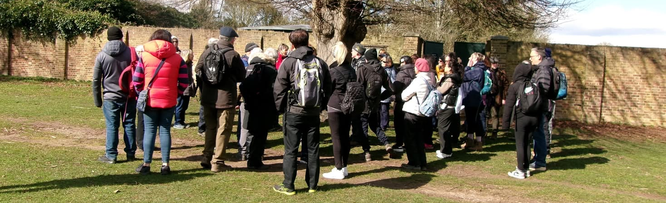
Live Well (example outcomes)
Adults facing financial insecurities navigate complex advice and legal systems which improves their mental health and resilience
Visually impaired adults have increased confidence and independence
Long-term homeless substance users access services they need
Men with mental/emotional health needs maintain stability and continuity, improving their quality of life
Bereaved adults experience improved life/social functioning
Adults with mental health issues, autism or learning disabilities achieve employment and volunteering opportunities
Rough sleepers engage with health agencies on vaccinations, liver function and diabetes testing
Adult carers experience reduced financial hardship
Families facing mental health challenges have improved knowledge and access to healthy food

Slide 12
Age Well
We will promote enjoyable physical activity and make sure preventable conditions are treated as early as possible as well as support social connection and independence for our older residents
Focus Areas: - Maximising People's independence and resilience - Addressing Loneliness and Isolation - End of Life Care
15 organisations out of the 31 responding to the survey, supported 6,234 older residents.

Slide 13
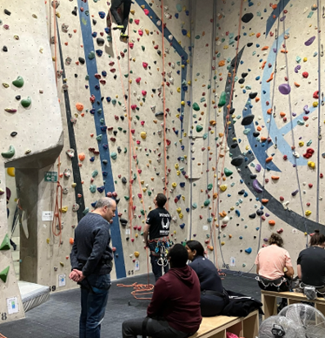
Age Well (example outcomes)
Older people experience less need for unplanned care and GP appointments
There are reductions in the length of hospital stays for older people
Older people have less need for primary/secondary care and social services
Older people have improved mental wellbeing, reduced feelings of isolation and improved quality of life
Older people with visual impairments experience improved health, confidence and independence, and reduced loneliness
Older people are enabled to stay independent in their own home
Older people are supported to die in their preferred place (at home)
Korean older people experience reduced loneliness and sadness and improved mental and physical health through group exercises

Slide 14
Challenges for VCSE in continuing to offer support with health and wellbeing of residents
Sustainability
Sharing data, intelligence and insights
Not enough understanding and awareness in all parts of the system about the potential of VCSE sector

