Slide 1
Voluntary, Community and Social Enterprise (VCSE) sector Resilience Forum
Kingston Voluntary Action & Kingston Resilience Forum

Slide 2
Introduction
Voluntary, Community & Social Enterprise sector Resilience Forum - What we want to achieve
To establish a local VCSE sector Resilience Forum (linked to the Borough Resilience Forum)
To develop and increase the knowledge and understanding of the VCSE Sector about the LA and CAT1* responders’ role in emergency incidents.
Develop roles, communication links and pathways for VCSE organisations to help them support emergency response and recovery
Upskill & train the VCSE sector to be more resilient to disruptive incidents and support their communities during and in recovery.
*Organisations with a statutory duty to respond to emergency incidents as outlined in the Civil Contingencies Act 2004.

Slide 3
Emergency incidents
Short term: Gas leak / kitchen fire - small scale evacuation lasting 5 to 6 hours
Medium Term: large fire, surface water flooding & World War II unexploded bombs (WW2 UXBs) - 1 day to 2/3 weeks.
Long Term: Health pandemic, severe weather such as increased average temperatures or prolonged drought (summer/Winter) & regional flooding

Slide 4
Kingston Borough Resilience Forum
Civil Contingencies Act 2004
Local Resilience Forum: National & London
Borough Resilience Forum (Kingston)
Purpose
Governance
Membership
Borough Risk Assessment
Multi Agency response plans
Review & learn from emergency incidents

Slide 6
Emergency Response Arrangements
Emergency Services - 999 response arrangements
Local Authorities: - Statutory response / on call teams - Emergency response arrangements
* Council Gold * Council Silver * Council Bronze - Local Authority Liaison Officer * Rest Centre Manager * Rest Centre Volunteers
* Resilience Advisor
* Borough Emergency Coordination Centre
London Local Authority Gold (LLAG) Chief Executive

Slide 7
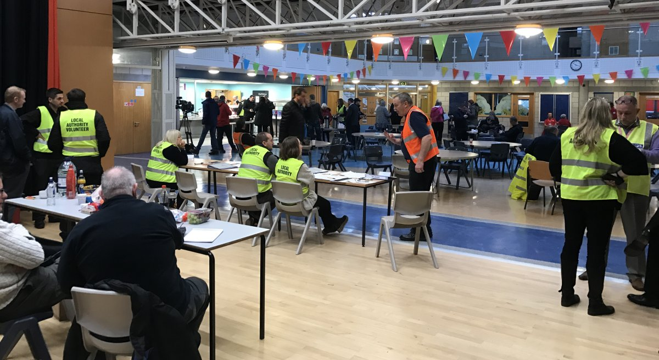

Slide 8
Multi- Agency & Council Emergency Plans
28 Emergency Plans - 6 Multi Agency plans & 22 Kingston Council Plans
Multi Agency Plans: - Borough Risk Register - Multi Agency Flood Plan - Multi Agency Influenza Pandemic Plan - Multi-Agency Recovery Plan - Borough Resilience Telecommunications - Borough Fuel Disruption Plan

Slide 9
Kingston Council Emergency Plans
22 Themed council plans, including:
Major Emergency Plan
Emergency Shelter Plan: - Emergency Shelter - Survivor Reception Centre - Family and Friends Reception Centre - Humanitarian Assistance Centre - Community Assistance Centre

Slide 10
VCSE Support - what we are looking for?
VCSE Contact directory
Skills, Resources and asset mapping
Local Data Sharing Agreement - DSA People in Emergency Incidents
Support roles in medium & long term emergency incidents
Support role training
Local emergency exercises (Desktop and live)
Regional multi agency exercises
Business Continuity support

Slide 11
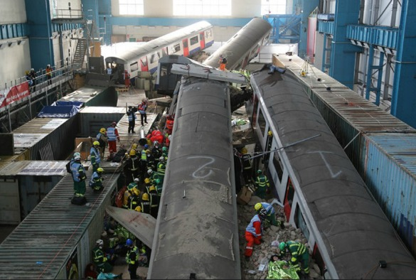
Exercise Unified Response 2016
Notes:
Exercise Unified Response was a large multi-agency emergency services exercise held near London from 29 February to 3 March 2016. The exercise was conducted at four sites simultaneously across central and south east London, with much of the live action taking place at Littlebrook Power Station, Dartford. The exercise scenario was centred around a building collapse onto Waterloo station during rush hour. An area of the exercise site was prepared with London Underground carriages and rubble from which simulated casualties were extracted by rescue services.
The organisation of the exercise was led by London Fire Brigade, and the exercise involved around 70 partner agencies, including the London Ambulance Service, the Metropolitan Police, local authorities, British Red Cross, The Salvation Army, St John Ambulance and specialist teams including Urban search and rescue and disaster victim identification.
The exercise also included activation of the EU civil protection mechanism, with teams arriving from other member countries, Hungary, Italy and Cyprus to assist the local emergency services.

Slide 12
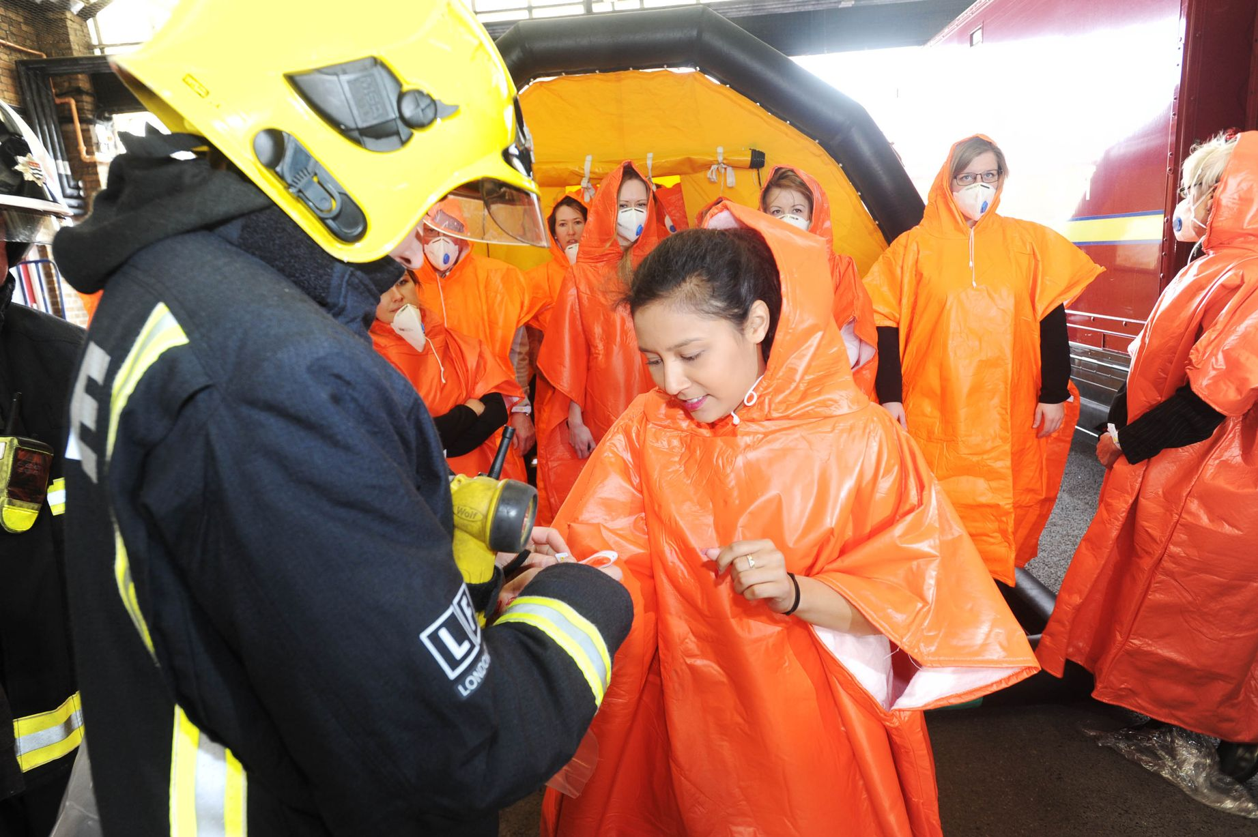
Decontamination exercise Ealing 2015

Slide 13
Horizon scanning
Climate change / Climate Emergency
Cyber Terrorism
Global Terrorism
Fluvial Flooding & Surface Water Flooding

