Slide 1
KVA Community, Voluntary & Social Enterprise Sector Resilience
GLA Project Overview
22/11/2023

Slide 2
Introduction
VCSE Resilience
Questions

Slide 3
Introduction
KVA / GLA CVSE Sector Resilience Project overview Sanja Djeric Kane Chief Executive Officer Kingston Voluntary Action
Kingston CVSE Resilience Chris Begley Resilience Planning Manager Kingston Council

Slide 4
Project overview
Project bid: GLA
Objectives: Build organisational resilience, improve communications and data sharing, community support for wide spread / longer term disruptive incidents
Timescales: 6 months extended to 12 months
Outcomes: A more resilient CVSE sector, development of a community risk register, a data sharing agreement for disruptive incidents, community (organisational) resilience plans, a Community Resilience Forum and developed emergency preparedness, response & support.

Slide 5
What you told us about your resilience – KVA VCSE Resilience Survey

Slide 6
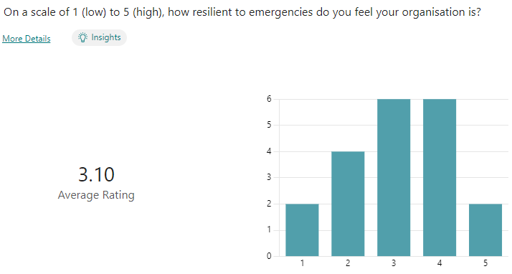

Slide 8
Community Resilience Survey completed by 20 organisations
Results: ​
Overall, 12 respondents estimated their preparedness as 3 and 4 (on a scale of 1-5)​
50% had business continuity plan in place​
80% of those who didn’t have plans would like help with them​
Highest (85%) risk was loss of staff/volunteers through strikes/pandemic​
Second highest (65%) was IT loss/failure​
Nearly 65% had plans in place to mitigate IT loss and slightly fewer to mitigate loss of staff/volunteers​
60% of respondents estimated more than 50% of their users were extremely vulnerable to emergency events (30% estimated over 75%)​
55% of respondents would be willing to assist the local authority with emergency events

Slide 9
Community Resilience Survey completed by 20 organisations
Kind of support/help wanted FROM local authority included:​
Systems in place for important contacts/information about other agencies​
Contingency funding​
Alternative premises​
Help organisations could offer – top three​
Door-knocking​
Transport​
Languages: admin​
Nearly half (45%) could help with a family and friends reception centre, but 35% felt they could not help ​
55% said they would be willing to attend training on emergency shelter training event​
50% would be interested in knowing more about setting up a Data Sharing Agreement for emergency events​
80% would be willing to share their contact details in an emergency

Slide 10
What is VCSE Resilience
The purpose of Community (VCSE) resilience is to encourage people / organisations to plan and be prepared to put in place a self-help response within a community which is affected by an emergency.

Slide 11
How do you become more resilient
Understand local risk: London Risk Register, risk v consequence
Understand your organisations risks, dependencies and single points of failure
Have plans & mitigations in place (business continuity plans & arrangements)
Review and test your plans and arrangements
Emergency / disruptive incident preparedness, training & response support

Slide 12
London & Local Risks
The London risk register 2022 identifies 69 risks (rated high to low) which could affect the geographical area of London, these are themed as:
Accidents & system failure
Human & animal disease
Societal risks
Natural Hazards
Hostile state
Threats

Slide 13
Risk Consequence
Loss of access to your premises
Loss of access to wider area/s
Unplanned loss of utilities: Electricity, gas, water
Loss of IT & Telephone systems
Loss or disruption of a key or main supplier
Loss of staff / key personal
Project aim: To develop a Kingston based community risk register, which residents, businesses and CVSE sector can use to better understand local risk.

Slide 14
Business & Community Resilience plans (Business Continuity)
Identify core/ critical functions / activities
Minimal service requirements: staff, equipment, support services
Single points of failure: knowledge, authority, systems
Mitigations / work arounds to put in place
Test and review
Project Aim: To provide business continuity (BC) advice and information to the CVSE sector and BC workshop in 1st quarter 2024.

Slide 15
DSA: People affected by an emergency
This is a London wide (LRF) DSA that documents how the parties to this agreement will share personal data about people affected by an emergency with organisations that have a responsibility to undertake safeguarding actions and/or offer or provide support services to those people. There is provision for CVSE sign up to this plan on a borough basis, this is voluntary and is only used for emergencies.
Project aim: To explore the development of a Kingston DSA: People affected by an emergency with the CVSE sector to enhance emergency preparedness.

Slide 16
Examples of why and when data can be shared
warning and informing the public
evacuation
provision of rest centres, survivor reception centres, family and friends reception centres
immediate medical treatment, health and social care
longer-term health care (mental, physical and public health) and social care
assistance with temporary accommodation
financial and practical support
bereavement support
Casualty Bureau Receives information relating to persons who are believed to have been involved in an emergency

Slide 17
Emergency response support
An offer from the Kingston Borough Resilience Forum to be trained in some emergency response functions and participate in training and exercise (multi-agency)events:
Emergency shelter (rest centre)
Survivor Reception Centre
Family & Friends Reception Centre
Humanitarian Assistance Centre
Community Assistance Centre
Project aim: To run a emergency shelter training event for CVSE sector in 1st quarter 2024.

Slide 18
Functions
Reception & Registration
Information & communication
Identifying needs of attendees and the centre
Refreshments
Identify any issues or concerns about evacuees
Individual support (vulnerable young to old)
Practical tasks
Administrative tasks

Slide 19
Q & A.

