Slide 2
We are here to fight for mental health.
For support.
For respect.
For you.

Slide 3
About Mind in Kingston
Founded in 1972, Mind in Kington supports the mental health and wellbeing of approx. 1500 people in the Royal Borough of Kingston upon Thames each year
We are user-led – almost all of our trustees, staff and volunteers have ‘lived’ (personal) experience of mental health issues
We are community-based, and collaborate or work in partnership with other local charities, community and statutory organisations
We are one of 114 Local Mind Associations, affiliated to national Mind. We get no financial support from national Mind and work hard to source our own funding through contracts, grants and fundraising

Slide 4
We provide clinical support and information
One to one counselling sessions for up to 12 weeks at low cost, using mixed approaches such as person-centred counselling.
Email vicky@mindinkingston.org.uk for more information.
Information and Advice line provides support, information and referrals to other services.
Please call 0208 255 3939
Emil : info@mindinkingston.org.uk
Art Therapy Group sessions on Zoom with a qualified art therapist to help you through the difficult times and enhance your resilience through art-making.
Email edit@mindinkingston.org.uk for more information.

Slide 5
We provide community-based support
Drop-in Cafés held on Tuesday, Wednesday and Thursday evenings are community and online spaces for people to meet and access advice and support. Email dropincafe@mindinkingston.org.uk
Residential floating support helping people to live independently in the community in shared or their own accommodation. Email simon@mindinkingston.org.uk for more information.
A Peer Support Service funded by South West London & St George’s Mental Health Trust (SWLSGT) and delivered by Mind in Kingston in partnership with local voluntary organisations is will be open to people with severe mental illness (SMI) who are service users of the mental health trust. Partners will work together to offer group and one-to-one peer support. Email michael@mindinkingston.org.uk

Slide 6
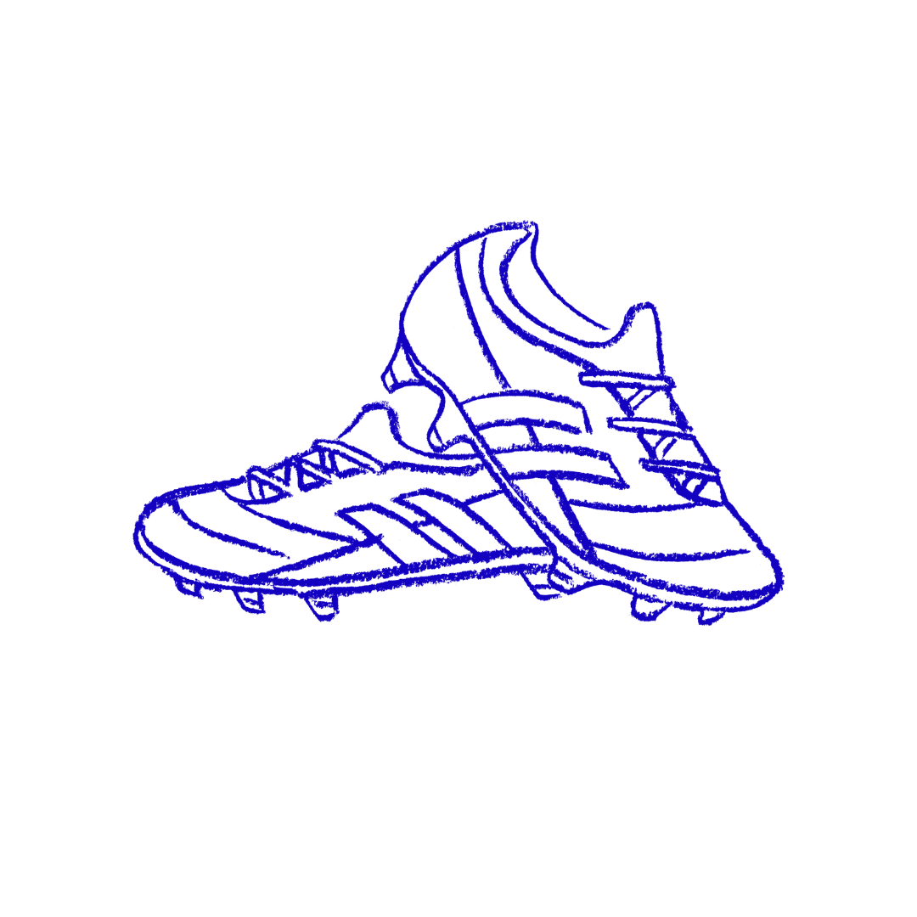
We provide physical activities for better mental health
Kingstonian Mind Football Team provides an inclusive non-judgemental and supportive environment to improve physical and mental health and take part in local amateur football leagues. Email johnny@mindinkingston.org.uk
for more information.
Happy Feet Walking Group meets every Monday, it is open to all walking abilities and provides an opportunity to get some fresh air, exercise and connect with others. Email johnny@mindinkingston.org.uk for more information.

Slide 7
Join our Mindful Art Sessions for local Young People between the ages of 12-25 years
➡️ Running every Tuesday ➡️ 4-5pm ✨ Optional 5-6pm slot to receive mental health support from trained youth workers. 📍Fuse Box Kingston, 2 Buckland’s Wharf, Kingston upon Thames, KT1 1TF
🆓 Free to join and no art experience necessary (we’ll be getting creative and experimenting with different activities like lino printing, graffiti, and drawing in a mindful way).

Slide 8
Alfriston Outreach Service (formerly Alfriston Day Centre) is a one stop shop for supporting older and vulnerable people in the Royal Borough of Kingston.
➡️ Alfriston provides a number of services in the community that can be delivered into people’s homes to help reduce isolation and loneliness, including Hot Lunch Delivery –Laundry –Collecting and Delivering Prescriptions Providing Hearing Aid Batteries ,Shopping ➡️ We provide urgent support such as emergency food bags, bedding, etc to those who have recently been discharged from hospital, or moved into a new address and do not currently have the support in place that they need.

Slide 9
The Magpie Project provides mental health information, advice, support and counselling to local Korean individuals and communities in the Royal Borough of Kingston upon Thames.
➡️ Our team has bilingual (Korean and English) staff and volunteers who support people to feel more confident to use local mental health services and supporting organisations.
➡️ The Magpie Project includes the following services; Counselling, Drop-in Café, 1:1 Signposting, Champions training and mental wellbeing activities.
➡️ In addition to this, wider Mind in Kingston services are available to use, with support from our team. Our aim is to help our local Korean community to challenge mental health stigma and promote positive wellbeing.

Slide 10
We work with you to improve mental health services in Kingston
Champions for Change Kingston: challenging mental health stigma and discrimination through events and campaigns created by people with lived experience of mental health issues. Email sarah@mindinkingston.org.uk to find out more.
Outreach & Engagement:
reaching out to the community to ensure residents can access our services. This includes the Magpie project with the Korean community as well as the mental health awareness training run for schools and businesses. Email Rhiannon@mindinkingston.org.uk to find out more.
Empowering Minds Forum:
providing opportunities for beneficiaries to be involved in the design and development or our services and empower them to have their say about mental health services locally. Email Alice@mindinkingston.org.uk to find out more.

Slide 11
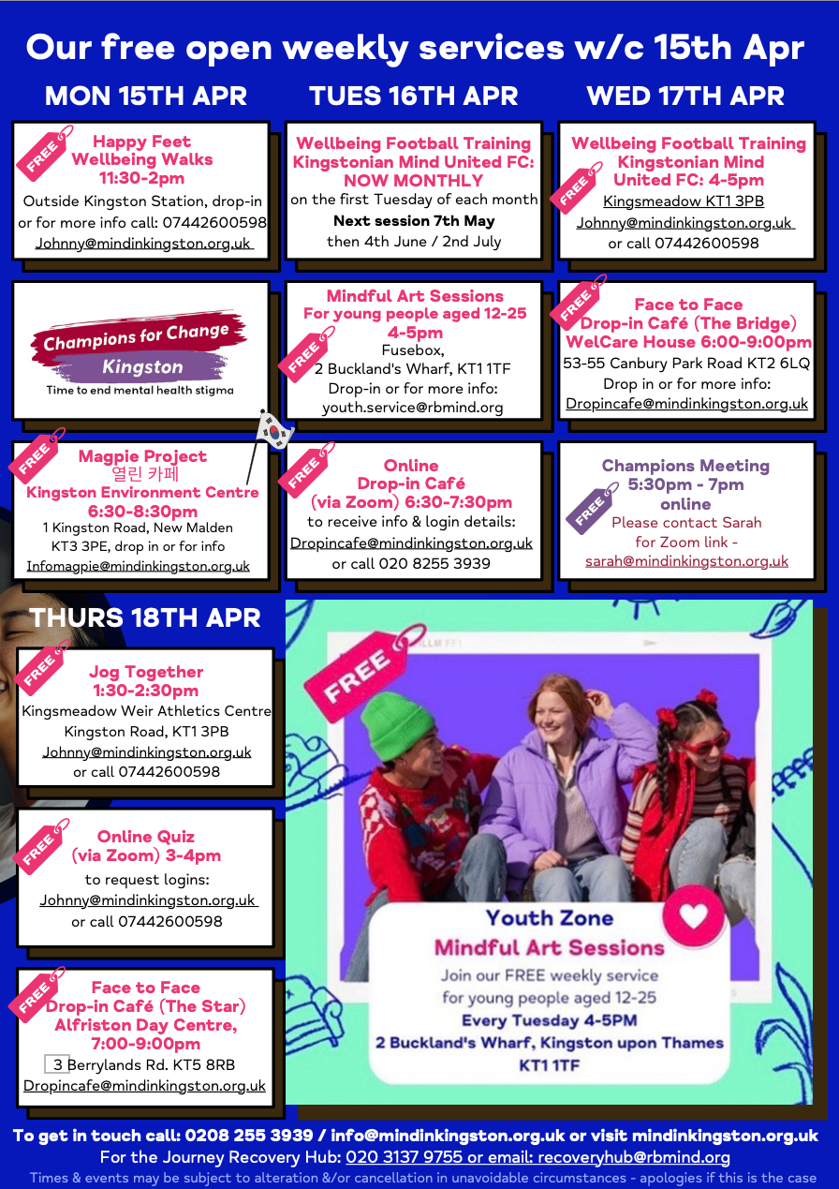

Slide 12
Get in touch with us
Website: www.mindinkingston.org.uk
Email: info@mindinkingston.org.uk
Phone: 020 8255 3939
Social media: @mindinkingston
Sign up to our newsletter
here: http://eepurl.com/hitxN5

