Slide 1
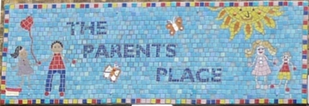

Slide 2
Our mission
The aim of the Charity is to strengthen families by supporting parents and carers in the Borough in a variety of ways, including providing mental health, self-esteem and emotional well-being programs.

Slide 3
Our vision
Our vision is a world where every parent and carer’s voice is heard, their needs are met and they, and their children thrive as fully participating members of the community.

Slide 4
Current Projects: Families Connect
The Families Connect project assist parents in reducing the impact of their mental health issues on their children.
We offer:
Organised workshops.
A wide range of advice, information and resources for parents to access.
Links to community mental health services so you can receive appropriate support.

Slide 5
Parents Place Strengthening families
PlayPlus (Post-natal)
Stay and play
Holiday Activities

Slide 6
Covid 19 impact
Temporary closedown of WelCare house
Services continued on zoom
Loss of funding

Slide 7
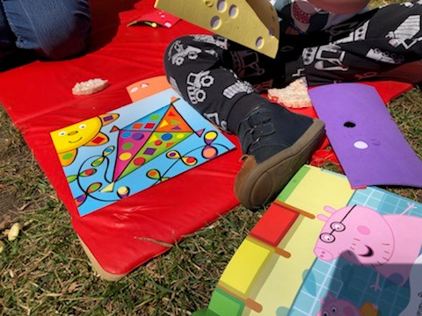
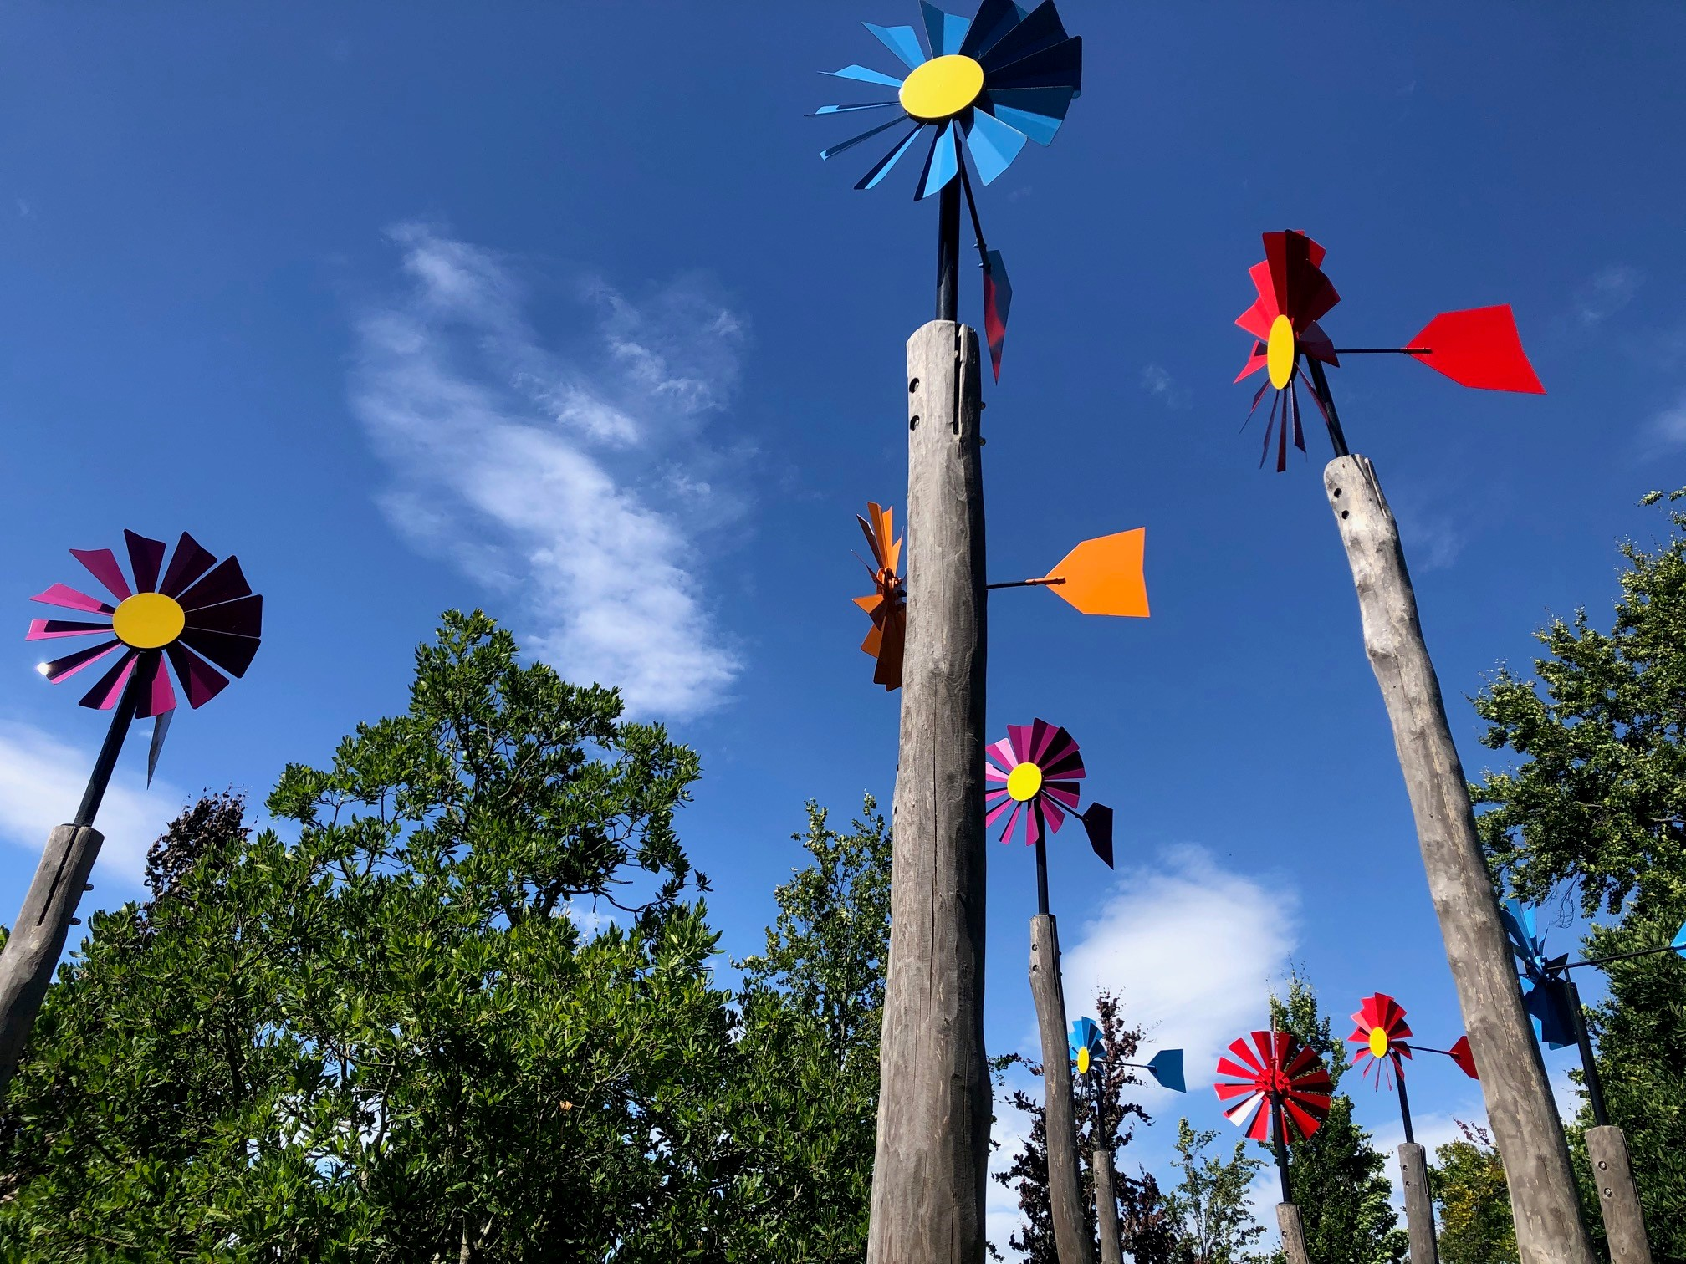
Lockdown projects
Summer 2020 Holidays Activities

Slide 8
Mums2B (Antenatal)
Black and Minority Ethnic (BAME) women giving birth in the United Kingdom (UK) “are 5 times more likely to die in or following childbirth than their white counterparts”

Slide 9
Recent grants
The National Lottery Community Fund
BBC Children in Need

Slide 10
Contact Us
E-mail: manager@welcarekingston.org.uk
Website: www.welcarekingston.org.uk

