Slide 1


Lower Your Cancer Risk
Learn more about making healthier choices to lower your risk of developing cancer

Slide 2
Did you know you can reduce your risk of developing cancer?
Around 4 in 10 cancers in the UK could be prevented by some simple and easy lifestyle changes.
Research has shown that things like stopping smoking, maintaining a healthy weight, staying safe in the sun, cutting down on alcohol and eating a healthy, balanced diet can reduce the risk of cancer.
Not all cancers are preventable but the biggest lifestyle changes you can make to reduce your risk are:
  Increasing your fibre intake
  Eating a balanced diet rich in fruit and vegetables
  Reducing your alcohol intake
  Staying physically active
  Stopping smoking or tobacco use
These changes do not have to happen all at once. Every positive step counts, and even small, sustainable changes can have lasting health benefits.
It’s never too late to start making positive changes to improve your health in the future.

Slide 3
Diet and nutrition
Variety is key! Eating a healthy and balanced diet can reduce your risk of developing cancer.
Eating a healthy, balanced diet can help you to maintain a healthy weight, which can reduce your risk of cancer.
Eating lots of sugary food and drinks, high calorie foods, and foods that are high in fat, can lead to being overweight or obese. Eating red or processed meat, for example bacon, may also increase the risk of bowel cancer, as it damages the cells of the bowel.
When it comes to cancer risk, your overall diet is more important than individual foods.
Plant Points
You've probably heard of the NHS-backed eating your five a day, but do you know about the 30 plant points we're encouraged to eat each week?
The idea focuses on variety rather than volume, aiming for 30 different plant foods across seven days to support gut health.
The theory emerged from the American Gut Project, external, crowd-sourced research involving more than 10,000 people.
A healthy diet means eating mostly:
  fruit and vegetables
  wholegrains such as wholegrain rice, oats and wholemeal bread
  healthy protein sources like chicken, fish, pulses, eggs and low fat dairy
And cutting down on:
  processed and red meat
  alcohol
  foods that are high in fat, sugar and salt

Slide 4
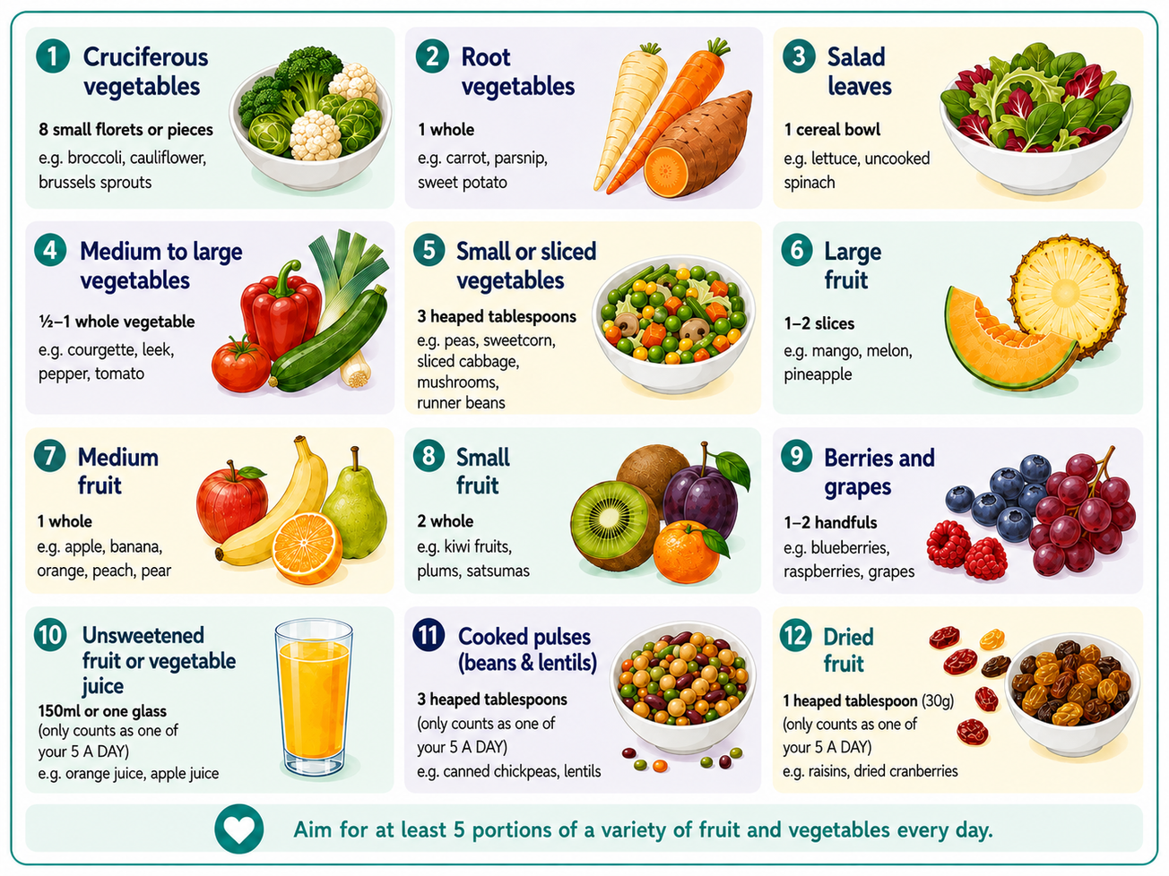


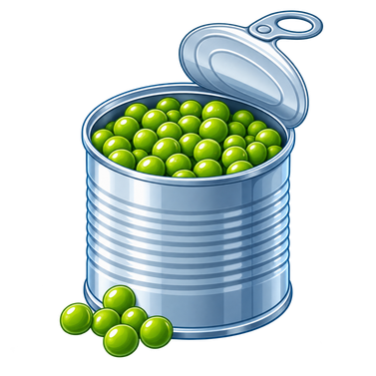
As part of a healthy, balanced diet eat more:
Here are some examples of what counts as a 5 a day portion for an adult. One portion of fruit and vegetables weighs 80g, roughly equivalent to:
Fruit and vegetables: Eating a wide variety of fruit and vegetables is a great first step to eating well and lowering the risk of some cancers. Aim for at least five portions every day.
Remember, fresh, frozen or tinned, it all counts! Frozen and tinned fruit and vegetables are packed with vitamins and minerals and are a great way to enjoy them every day.
Frozen and tinned options are nutritious, affordable, have a long shelf life, and are an easy way to add more nutrients to your meals while reducing food waste. Just be careful to choose options in water (with no added sugar or salt) or in natural fruit juice instead of syrup!

Slide 5
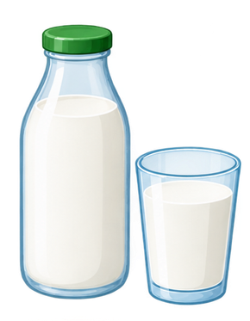


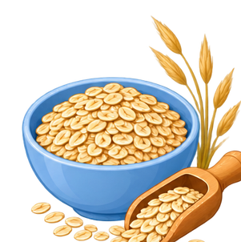
As part of a healthy, balanced diet eat more:
High-fibre foods: A diet high in fibre, including plenty of wholegrains, can help reduce the risk of bowel cancer. Wholegrains are foods like wholewheat pasta, oats and wholemeal bread. All wholegrains are high in fibre.
Foods that are high in fibre help you poo more often and keep the gut healthy. This reduces cell damage in the bowel, which means bowel cancer is less likely.
Dairy: Dairy products, like milk, cheese and yoghurt, can be part of a healthy, balanced diet. Dairy food can provide us with many important nutrients, such as protein, calcium, vitamin B12 and iodine.
However, full-fat milk, butter, ghee and hard cheese can be high in calories and saturated fat (a type of fat we should eat less of), so it’s better to eat these only occasionally and in smaller amounts.
Instead, choose reduced or low-fat versions of dairy:
  skimmed or semi-skimmed milk
  reduced-fat cheese
  low-fat yoghurt
What is fibre?
Fibre is a type of carbohydrate that can’t be fully digested in your gut.
It is found naturally in plant-based foods such as vegetables, fruit, wholegrains (like wholewheat pasta), pulses (beans, peas and lentils), and unsalted nuts and seeds.
Diets higher in fibre are generally healthier as they include more plant-based foods. These types of food also provide a range of different vitamins and minerals. Remember to start low and slow when you begin to increase your fibre intake to help your body adjust!
Adults should aim to eat at least 30g of fibre a day.

Slide 6
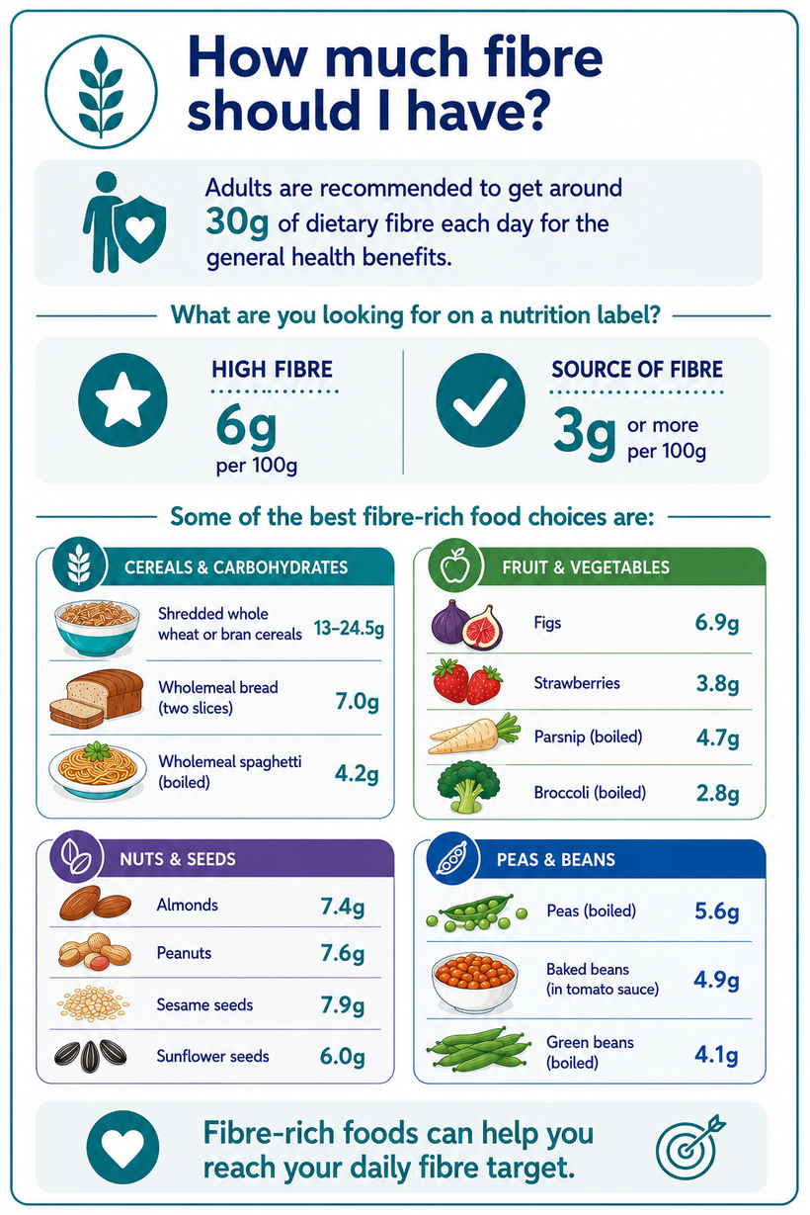
How do I know if a food is wholegrain?
Wholegrain foods are often brown, but not always. Check the name for words like “wholemeal”, “wholewheat” or “wholegrain”. Common wholegrain foods you can find in the supermarket include:
  Wholemeal (brown) bread, wraps, pittas and chapattis
  Wholegrain breakfast cereals such as wheat biscuits or bran flakes
  Wholewheat (brown) pasta and noodles
  Wholemeal flour
  Brown and wild rice
  Quinoa, barley, bulgur and spelt
  Rye bread and crackers
  Oats (including porridge) and
oatcakes
Adults are recommended to get around 30g of dietary fibre each day for the general health benefits.
However, the latest figures suggest that in the UK, the average fibre intake for adults is only 18g, 60% of what it should be.

Slide 7
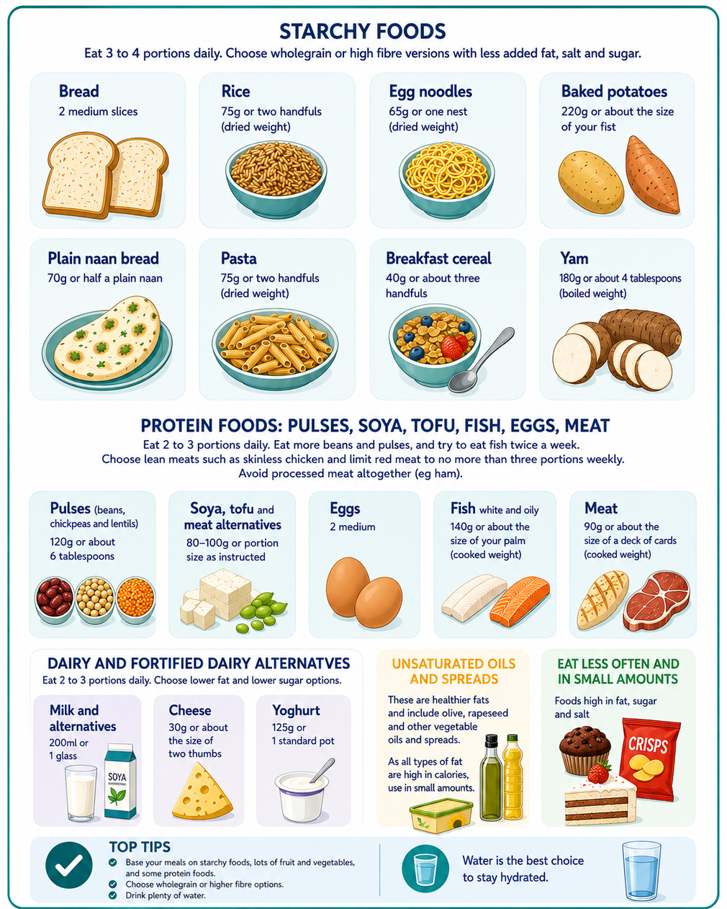
How much should I eat?
Choosing healthy portion sizes from the food groups below can help you get the right balance of nutrients. It also supports a healthy weight, which lowers the risk of many common cancers.
These are examples of what a healthy portion looks like for an average adult.
Eatwell Guide
The Eatwell Guide is also a useful tool to show how much of what we eat should come from each food group to achieve a healthy, balanced diet.
It divides foods into five groups: fruit and vegetables, starchy carbohydrates, proteins, dairy, and foods high in fat/sugar, illustrating how much of your overall diet should come from each group.
  Eatwell Guide
  Eatwell Guide - South Asian
  Eatwell Guide - Black and Caribbean

Slide 8
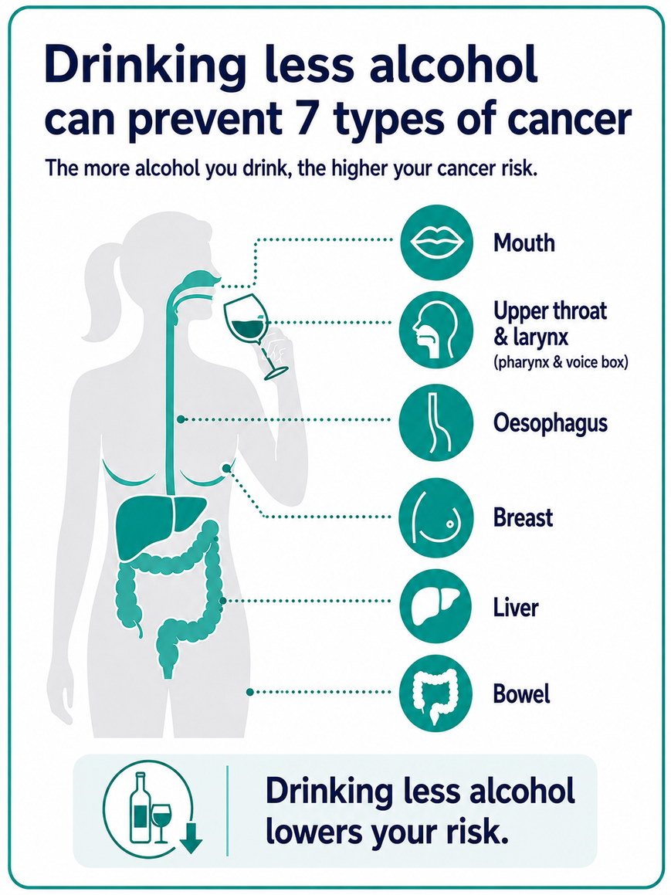
Alcohol
Drinking alcohol is known to cause 7 types of cancer. Drinking alcohol doesn’t mean that you’ll definitely get cancer, but the risk is higher the more alcohol you drink.
People might talk about some alcoholic drinks being better or worse for you than others but all types of alcohol increase the risk of cancer — as it’s the alcohol itself that causes damage, even in small amounts.
The more you can cut down on alcohol the more you can reduce your risk of cancer. Drinking less alcohol has lots of other health benefits too - you can reduce your risk of high blood pressure and liver disease by cutting back.
Did you know?
  Alcohol is typically detectable in blood, saliva, and breath within 15-60 minutes. Whilst it varies from person to person, it takes roughly one hour to process one unit of alcohol. However, the more you drink, the slower the body becomes at processing alcohol.
  Drinking alcohol is worse for you if you also smoke. When used together they increase the risk of cancer even more. This is because tobacco and alcohol have a combined effect that causes greater damage to our cells. People who smoke and drink alcohol are at a higher risk of mouth and upper throat cancers. Alcohol may cause changes to cells in the mouth and throat that make it easier to absorb the cancer-causing chemicals in tobacco smoke. Alcohol may also change how the toxic chemicals in tobacco smoke are broken down in the body, making them even more harmful.
  Around 17,000 new cancer cases in the UK were attributed to drinking alcohol in 2020.

Slide 9
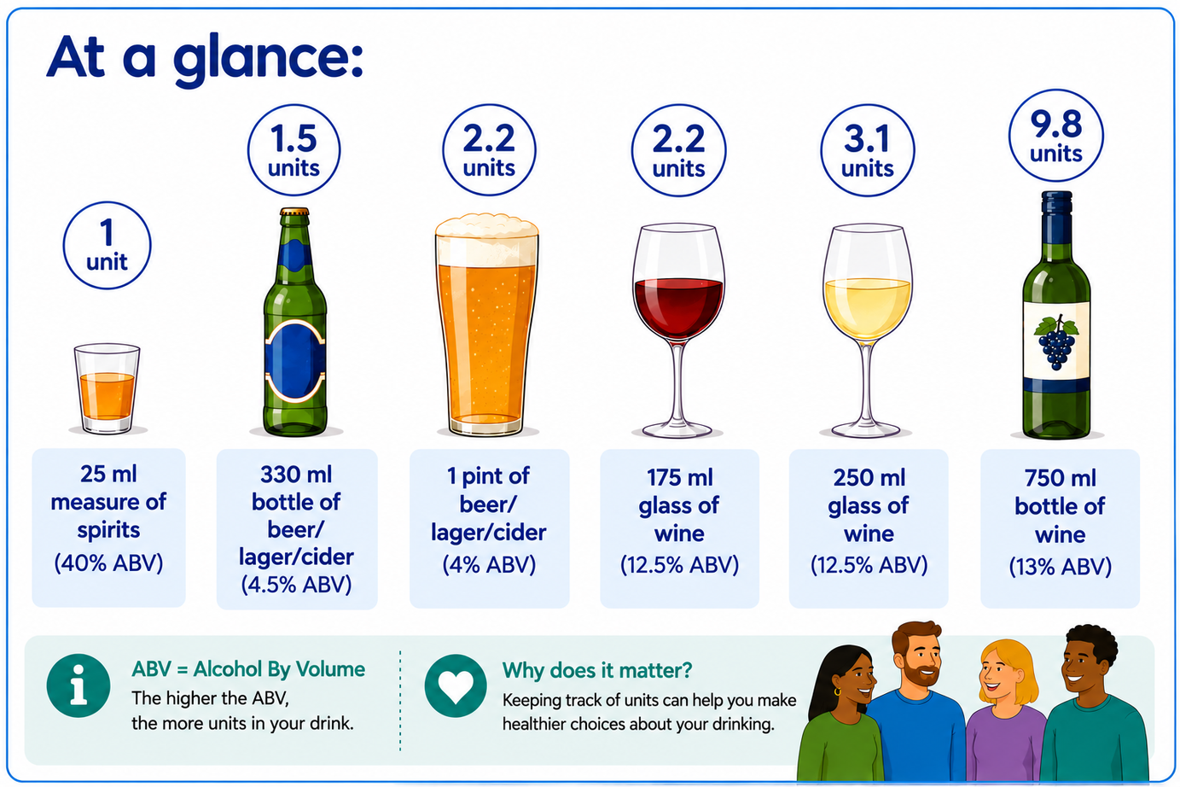
To keep health risks from alcohol to a low level (if you drink) it is safest not to drink more than 14 units a week on a regular basis. If you regularly drink as much as 14 units per week, it is best to spread your drinking evenly over 3 or more days. If you wish to cut down the amount you drink, a good way to help achieve this is to have several drink-free days each week.

Slide 10
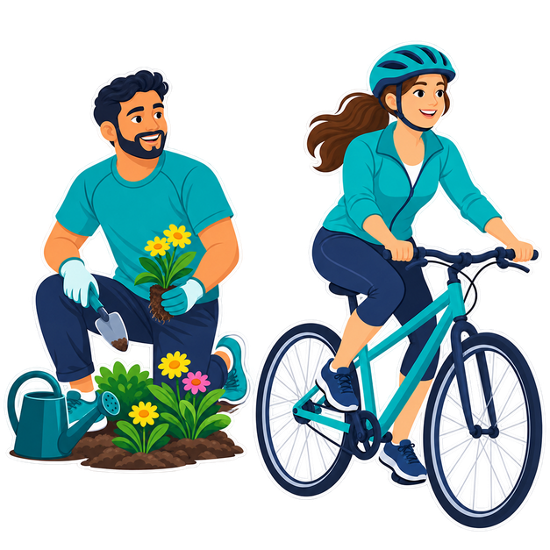
Physical activity
Exercise and physical activity helps us to maintain a healthy weight. Keeping a healthy weight cuts your risk of cancer and other serious diseases.
Being physically active means any movement that uses your muscles and more energy than when you’re resting. Being physically active doesn’t have to mean joining a gym or an exercise class. It also includes everyday activity, like walking to the shops, walking up the stairs and light housework or gardening.
Physical activity can include:
  moderate intensity – this is when the activity makes you feel warmer and breathe faster, but you can still talk. This could include activities like brisk walking, cycling or swimming.
  vigorous intensity – this is an activity that raises your heart rate and makes you start to sweat and feel out of breath. This could include activities like running, aerobics or football.
Adults should aim to:
  do at least 150 minutes of moderate intensity activity a week or 75 minutes of vigorous intensity activity a week
  do strengthening activities that work all the major muscle groups (legs, hips, back, abdomen, chest, shoulders and arms) on at least 2 days a week
  spread exercise evenly over a week
  reduce time spent sitting or lying down and break up long periods of not moving with some activity
“The remarkable physical and mental health benefits of activity are available to all of us.”
Physical activity guidelines: UK Chief Medical Officers, DHSC, updated July 2026

Slide 11
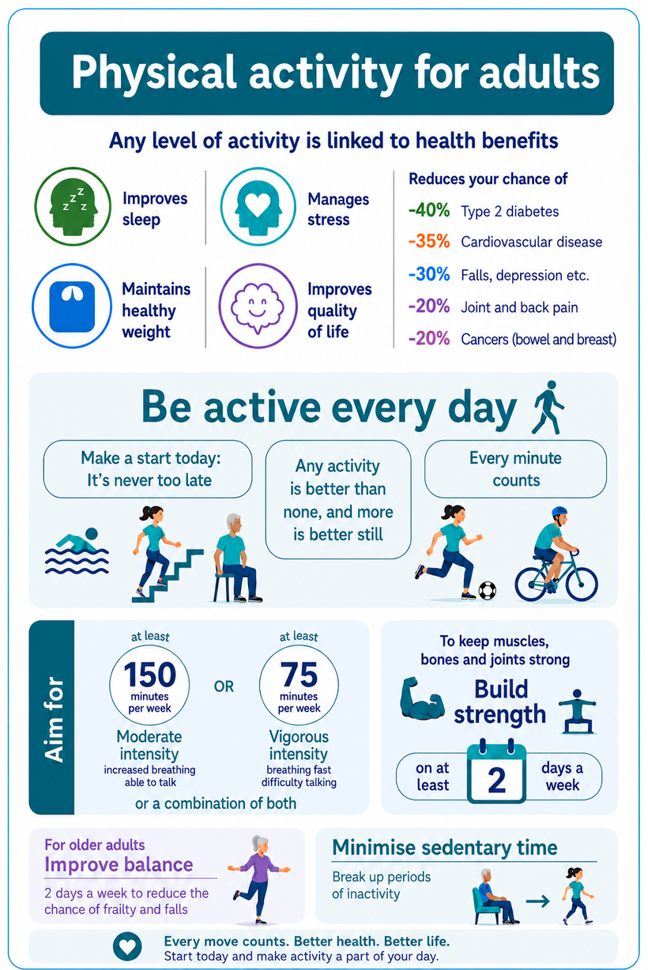
What’s the science behind physical activity and cancer?
Scientists are still investigating how physical activity reduces cancer risk, but studies show that regular activity can:
  Help maintain healthy hormone levels.
  Improve insulin sensitivity, meaning your body uses insulin more effectively to regulate your blood sugar.
  Reduce inflammation in the body.
There is also strong scientific evidence that physical activity lowers your risk of developing bowel cancer. This may be because physical activity helps you maintain a healthy weight and helps food move through the digestive system more quickly.
Overweight and obesity: Being overweight doesn’t mean that you’ll definitely develop cancer, but the risk is higher the more overweight you are and the longer you are overweight for. If you are overweight, losing weight will help reduce your risk of cancer. Obesity or being overweight is the second biggest cause of cancer in the UK and linked to more than 1 in 20 cancer cases.
There are lots of benefits to keeping a healthy weight. Keeping to a healthy weight reduces your risk of developing at least 13 different types of cancer. These include having increased energy, and less risk of conditions such as heart disease, stroke and joint pain.
Aim to be active every day!

Slide 12
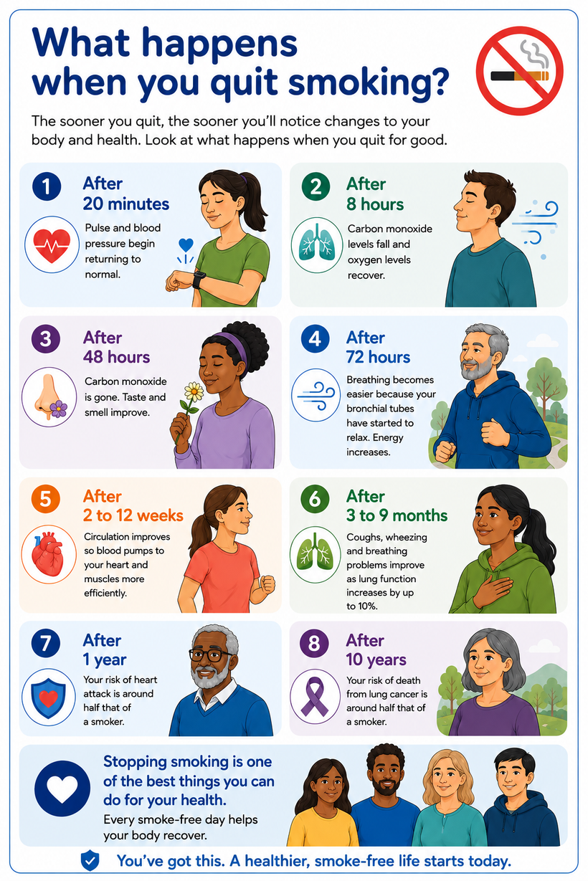
Tobacco cessation
Every time you use tobacco, your body is exposed to thousands of chemicals, many of which are poisonous. Smoking includes all types of tobacco, for example cigarettes and shisha.
Successfully stopping smoking or using tobacco is one of the key ways in which you can help to improve your overall health, not just from cancer, but many other medical problems.
The day you stop, your body starts clearing itself of toxins and the repair process begins. The earlier you quit, the more you're likely to benefit. But it's never too late – because quitting will improve your health whatever your age and no matter how long you have used tobacco.
Paan, bidi and shisha: Tobacco that you do not smoke, including paan, betel quid and chewing tobacco, is not a 'safe' way to use tobacco and can be as addictive as smoking.
Research has shown that using smokeless tobacco raises the risk of mouth cancer and oesophageal (food pipe) cancer.

Slide 13
Additional Resources
  NHS Healthy Choices Quiz: https://www.nhs.uk/better-health/healthy-choices-quiz/
  NHS Better Health: https://www.nhs.uk/better-health/
  NHS Healthier Food Swaps: https://www.nhs.uk/healthier-families/food-facts/healthier-food-swaps/
  NHS Alcohol Advice: https://www.nhs.uk/live-well/alcohol-advice/alcohol-support/
  UK Chief Medical Officers’ Low Risk Drinking Guidelines: https://assets.publishing.service.gov.uk/media/5a80b7ed40f0b623026951db/UK_CMOs__report.pdf
  UK Chief Medical Officers’ Physical Activity Guidelines: https://www.gov.uk/government/publications/physical-activity-guidelines-uk-chief-medical-officers-report/uk-chief-medical-officers-physical-activity-guidelines
  Stop Smoking London: https://stopsmokinglondon.com/
  World Cancer Research Fund: https://www.wcrf.org/
The NHS Health Check: The NHS Health Check is a free check up of the health of your heart and blood vessels (cardiovascular health). If you are aged 40-74, and do not have a pre-existing health condition, you should be invited to an NHS Health Check by your GP or local council every 5 years.
The check takes about 20-30 minutes, when a health professional will carry out some simple tests, such as blood pressure, and ask you some questions about your health.
You will be given your cardiovascular risk score and can discuss ways to lower your risk if needed. The risk factors are the same as for preventable cancers and can help reduce your chances of getting this too. You can also be referred to local services who can support you.

Slide 14

RM Partners Social Media Handles
LinkedIn: linkedin.com/company/rm-partners-nhs-cancer-alliance
Instagram: @rmpartnersnhs
TikTok: rmpartnersnhs
X: @RMPartnersNHS
Bluesky: @rmpcanceralliance.bsky.social
WhatsApp Channel: RM Partners NHS Cancer Alliance

