Slide 1
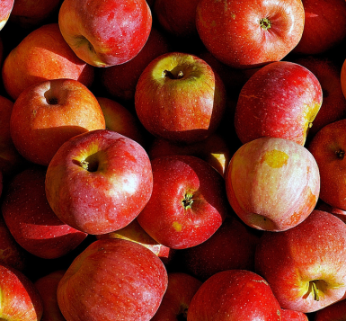



Kingston VCSE Good Food Group Meeting, 29 Nov 2023
Welcome!

Slide 2

Agenda for today
Welcome, housekeeping and outline of the day including updates
Training Opportunities
How to meet additional needs of those you support – risk of homelessness; Healthy Start; avoiding debt and rent arears; Connected Kingston
LUNCH
Sustainable local food system – urban growing; food waste and smart bins; Surplus to Supper

Slide 3
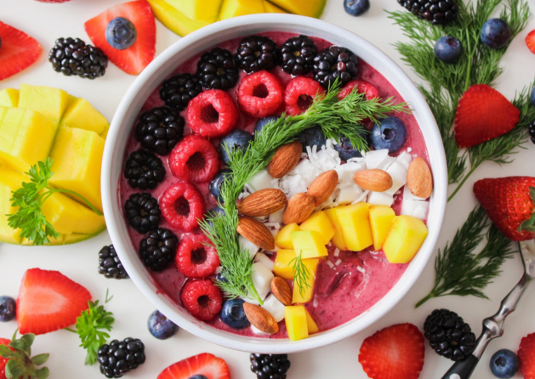
Some fantastic news!

Slide 4
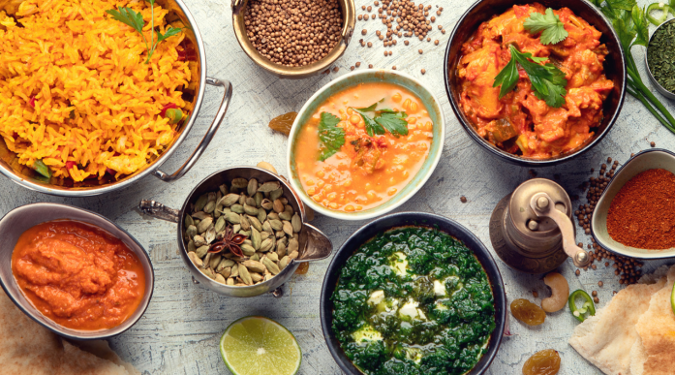
Kingston Surplus Hub
Surplus Hub Café
Food distribution
Surplus Hub Events
Community Cooking Classes
Kingston Kitchens and Supermarkets

