Slide 1
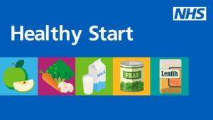
What is Healthy Start?
NHS Healthy Start is a national programme that provides financial support to eligible young families and pregnant women for fruit, vegetables, milk and infant formula, as well as providing free vitamins.
The scheme has moved to digital, with families receiving a pre-paid chip and PIN Mastercard with money pre-loaded every 4 weeks instead of paper vouchers.
The scheme aims to help families who are most in need to buy healthy food and drink including fresh, frozen and tinned fruit and vegetables, fresh, dried and tinned pulses and infant formula milk.
Families will also be able to access free Healthy Start vitamins.
Health Visitors and Children’s Centres can give help with the application if it’s needed
Visit www.healthystart.nhs.uk Or Call 0300 330 7010 to check eligibility & apply

Slide 2
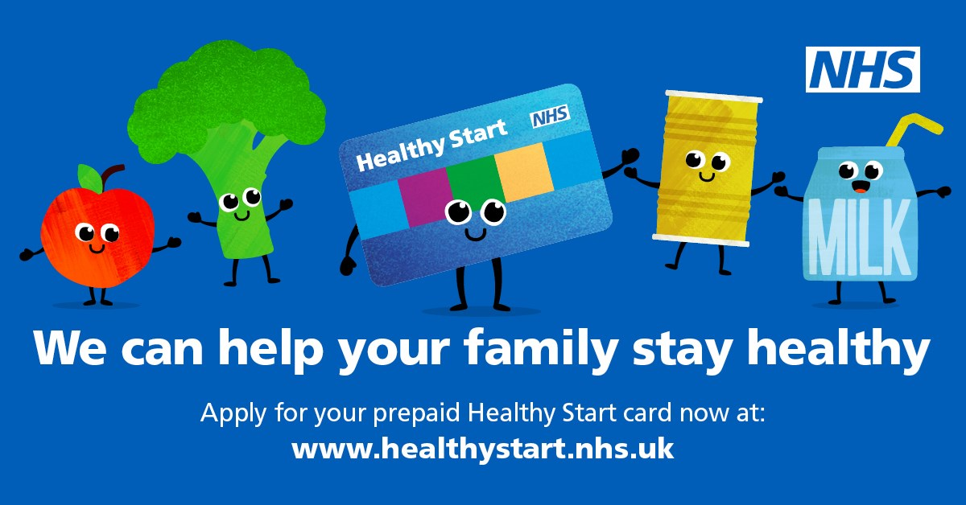
NHS Healthy Start Scheme in Kingston
Call to action
Display posters and leaflets
Actively signpost local residents to check their eligibility and apply
Help residents seek local help to apply if needed
Visit www.healthystart.nhs.uk
Or Call 0300 330 7010
Notes:
https://www.healthystart.nhs.uk/what-youll-get/ You’ll get money added onto your card every 4 weeks to spend on certain food and milk.
You’ll get: £4.25 each week of your pregnancy from the 10th week £8.50 each week for children from birth to 1
£4.25 each week for children between 1 and 4
Your money will stop when your child is 4, or if you no longer receive benefits.
You can also get free vitamins with your card.

Slide 3
Eligibility criteria and benefits
Anyone who is pregnant or families with children under 4 and in receipt of qualifying benefits may be entitled to get help to buy some basic foods and milk.
The payments will stop on the child’s 4th birthday or if they no longer receive the qualifying benefits. They can also get free Healthy Start vitamins
How to apply – Get help to buy food and milk (Healthy Start)
Beneficiaries of the scheme will get:
£4.25 each week of their pregnancy (from the 10th week of pregnancy)
£8.50 each week for children from birth to 1 year old
£4.25 each week for children between 1 and 4 years old

Slide 4
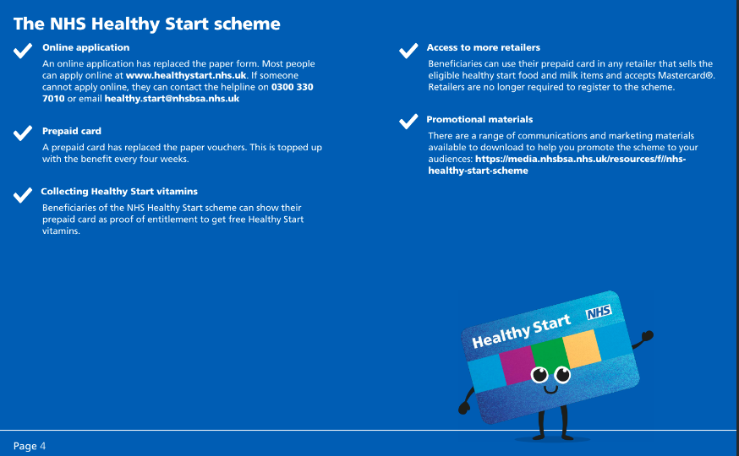

Slide 5
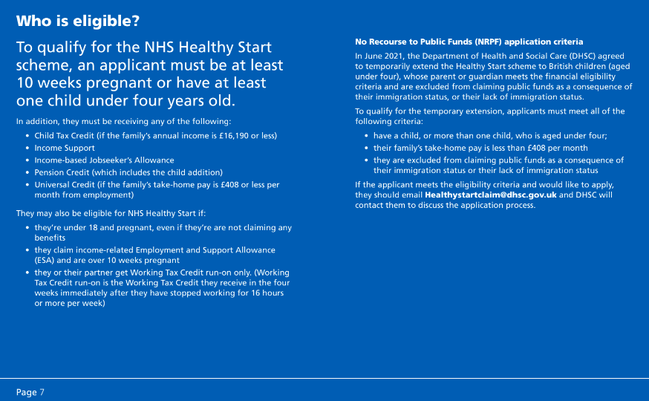

Slide 6
Healthy Start in Kingston
In 2021 it was estimated that if a family signed up from the first opportunity (when pregnant), to when the child turns 4, this equated to approximately £1,250 per family
Kingston monthly data shows around 850 beneficiaries are eligible for this benefit, but only around 500 take this up - so over one third are missing out
By Jan-April 2023 there was an estimated £100K in unclaimed Kingston Healthy Start credit
Parents introduced to the scheme by a professional (opportunistically or at an assessment, appointment etc) are more likely to take it up
NHS Healthy Start - a guide for professionals

Slide 8
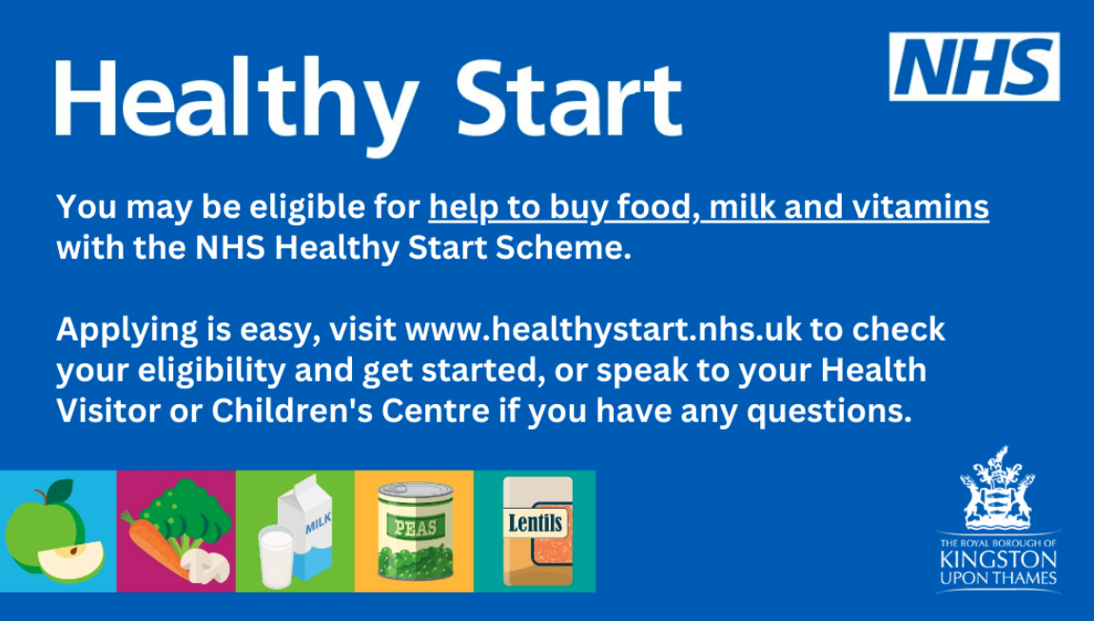
Healthy Start Call To Action
Actively signpost local residents to check their eligibility and apply via www.healthystart.nhs.uk or call 0300 330 7010
Applicants can ask Children’s Centres or Health Visitors for help to apply if they need it.

Slide 9
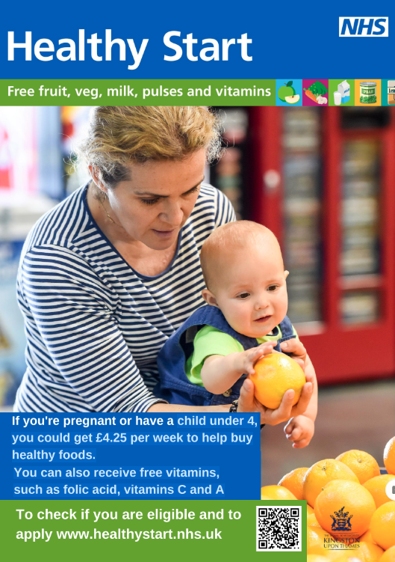
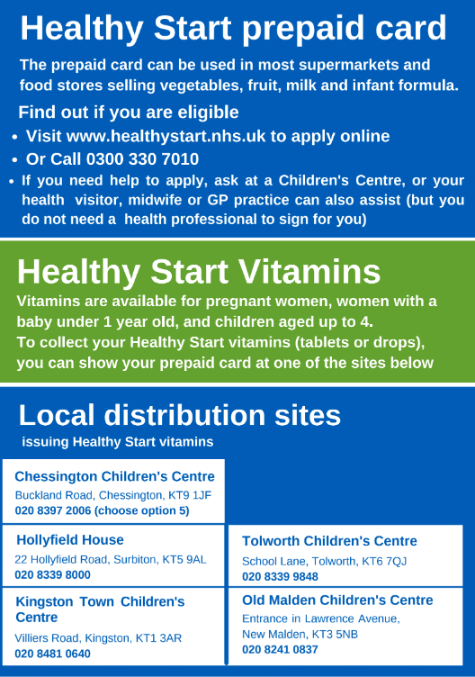
NHS Healthy Start Scheme in Kingston
Contact:
francesca.miller@kingston.gov.uk Public Health
Nutritionist for more scheme information
phps@kingston.gov.uk (Public Health support)
for printed leaflet, poster or business card copies

