Slide 1
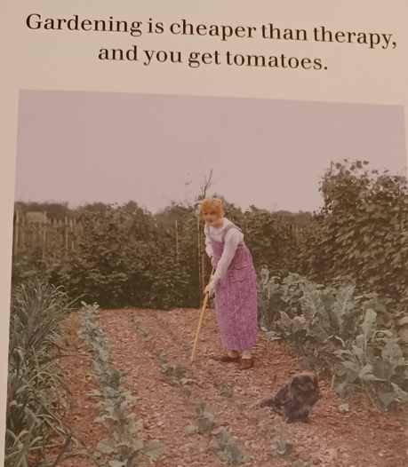
Growing hilda.mulrooney@kingston.ac.uk

Slide 2
Au Law farm: workshops (2)
internships
online mentoring
The Stud: under discussion
Kingston U: final year undergraduate research project (health, wellbeing & sense of community as well as barriers & facilitators)
Milaap & King’s Oak: contacted
Roehampton U: possibility
King Athelstan & Hogsmill Community Garden: to contact Hogsmill; King Athelstan contacted
St Joseph’s & Kingston Grammar: Kingston Grammar to be contacted

Slide 3
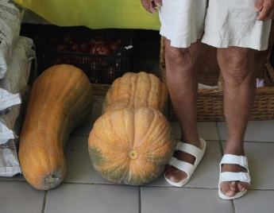
‘This is my grandmother with some squashes that we grew. This summer I spent a lot of time doing agricultural/farm work with her on the family 'Dacha' in Ukraine. It is hard work as we plant a lot on the acre of soil, and it has taught me the value and beauty of growing and collecting the food on your table. The labour makes you appreciate the luxury of everyday life in the city’.
(Wojadzis & Mulrooney, 2023)

Slide 4
Quick brainstorm!
What do you think are the benefits of growing projects?
What are the barriers to being involved in growing projects?

