Slide 1
Tom Lowe,
Senior Programmes Officer (Grants)
Kamrul Islam,
Programmes Officer (Grants)
Notes:
Briefly introduce who we are and our experience in grants.

Slide 2
Groundwork London
Social and environmental regeneration charity.
Work with communities across Greater London to:
Create Better Places
Promote Greener Living and Working
Improve people’s prospects
https://www.groundwork.org.uk/london/grants-london/
Community charity,
including grant management
Notes:
TL
Ask attendees:
- Has anyone heard of Groundwork London before?
- Has anyone applied for a grant programme that we manage before?
Groundwork London is a social and environmental regeneration charity operating within Greater London.
It is part of a wider federation of trusts operating across the UK, with the core aims of creating better places, promoting greener living and working and improving people’s prospects, adapted to the needs of the specific geographical area they operate in.

Slide 3
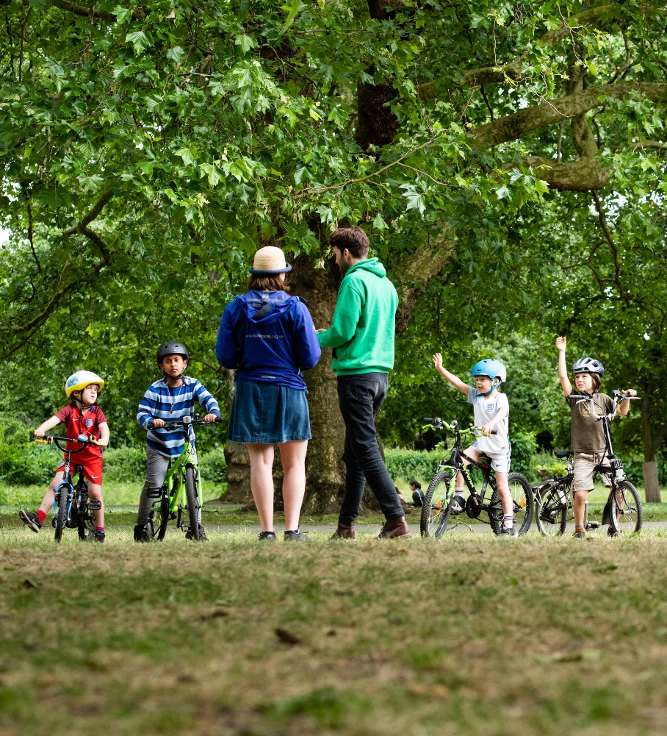
Grants Team
Support environment and conservation aims, including equality of access
Promote democratic engagement
Engage individuals with physical activities
Promote social integration, tolerance and wellbeing
Support community-led cultural events
Help communities create greener, healthier places
Support and advice to migrants
londonprogrammes@groundwork.org.uk
Sign up to our mailing list! my.brevo.com/users/subscribe
Notes:
TL
We oversee the delivery of around 15 grant programmes at any one time for a variety of funders, from public, private and third sectors.
We deliver approx. 300 projects a year
We have a range of experience across different subject matters to deliver grant programmes that meet the aims of funders, our charitable mission and the projects delivering
Every grant programme is different, with different funders and aims.
A cornerstone of our grants management is ensuring that any group or individual that comes into contact with one of our grant programmes gains capacity building or advice, regardless of whether they apply, or are successful or not in securing a grant.
We strongly encourage any groups to contact us for advice or to discuss applications if they are considering one of our programmes. We believe this leads to effective projects and more impactful community action.
Here are a few of the different grant programmes administered recently.
They cover quite a range of themes, say some out loud
Large range of programmes that support a variety of different community projects with different missions. Keep an eye on our grants pages.
Sign up to our newsletter to hear about new grant opportunities as they arise.
Email address for any queries.

Slide 4
Funding Opportunities in 2025
Walking & Cycling Grants London, July 2025 - September 2025
wcgl.London
Community Ideas Grants, July 2025 - September 2025
wcgl.london/what-we-fund
Shared Endeavour Fund, Call 6
https://www.groundwork.org.uk/london/shared-endeavour-fund/
Notes:
TL
-WCGL – up to £5k available for one year projects to encourage underrepresented groups to walk and cycle more regularly and safely. Grants open later July and close early September. Delivery will be from January to September 2026. Since 2015 over 460 projects have been supported and the programme is supported by TfL and London Marathon Foundation.
-CIG –linked to WCGL, where organisations new to delivering walking and cycling projects can adapt a template tried and tested project idea for use in their area/community. One year project up to £5k. Funded by TfL and LMF.

Slide 5
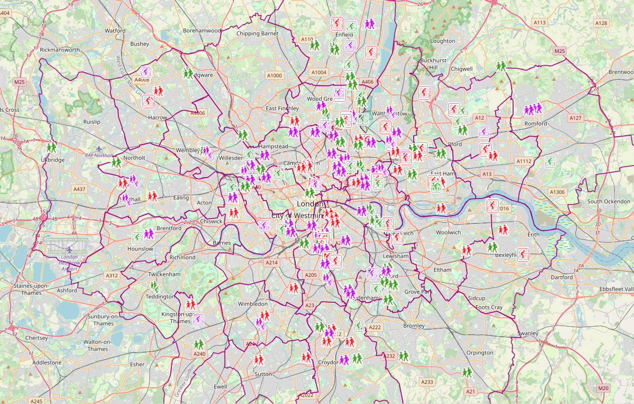
WCGL Project Map - https://wcgl.london/project-map
Notes:
191 Projects
We aim to fund
60 new projects each year.

Slide 6
What are funders looking for?
Funding criteria: Does the project meet the funder’s criteria?
Identified need: Will the project meet an identified need? Does this project address a gap in service provision?
Network: Does the organisation have a presence within the community / borough and established network?
Budget: Is the budget realistic, cost effective and good value for money?
Sustainability: How will the project benefits be sustained / Who will maintain the project?
Notes:
TL
What are funders looking for?
-A clear project plan, which covers how, where and when you are planning to deliver your project, and to whom.
-Have you identified the need for your project in the communities you are working with?
-Is your project budget is realistic and good value for money?
-Will the project benefits will last after the life of the project?
Whilst your application does not need to be perfect, funding organisations will be looking for each of the above points to be addressed in your application.

Slide 7
Questions?

