Slide 1
Kingston Council on Food Waste
Ioanna Rossi & Leonard D’Crus

Slide 2
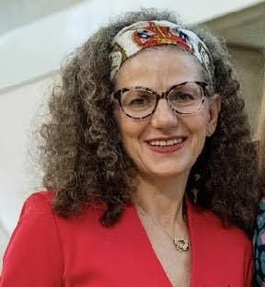

Ioanna Rossi - Green Economy Lead - Royal Borough of Kingston upon Thames Council
ioanna.rossi@kingston.gov.uk
Leonard D’Crus - Waste Reduction Officer - Royal Borough of Kingston upon Thames Council
leonard.d’crus@kingston.gov.uk

Slide 3




Kingston Green Economy
Objective 1
Reducing negative impact on the environment
Kingston Green Business Community - The Aim
Working with partners to provide a forum for businesses and organisations committed to reducing their environmental impact, promoting sustainability, eco-innovating and thriving.
Wide representation - over 80 members so far
Join here
Objective 2
Eco-innovate and securing business growth opportunities
Objective 3
Green Skills

Slide 4
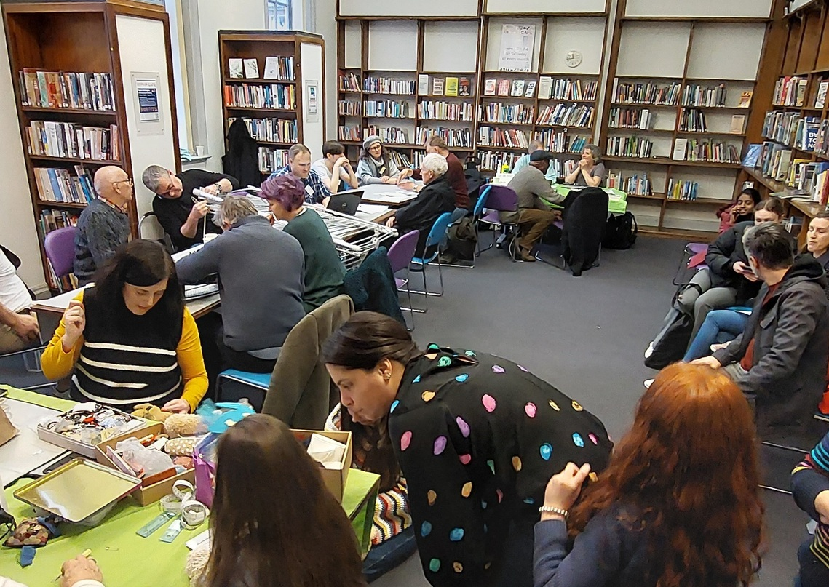
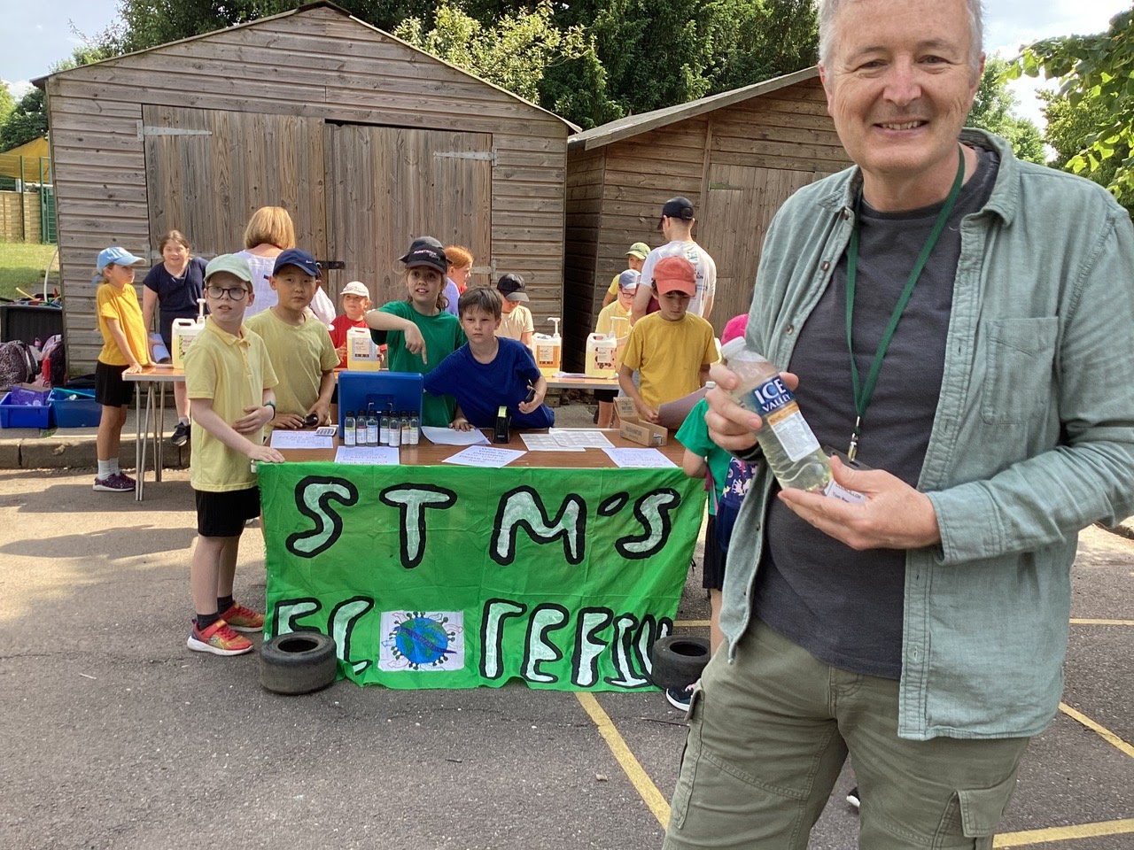
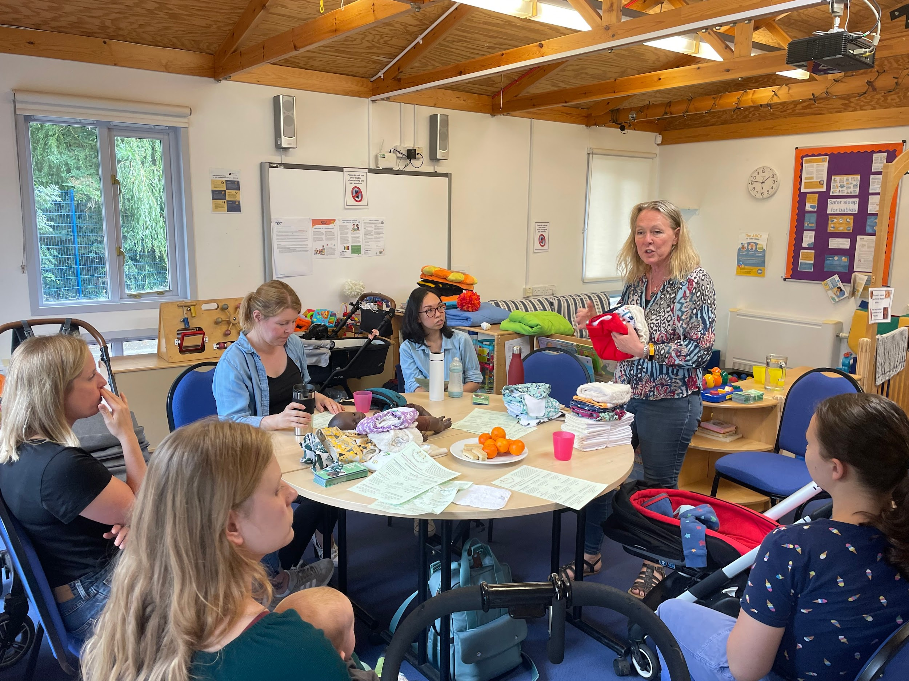
Waste Reduction
Reducing household general waste
  4 key areas: Food, Plastics, Textiles & Electricals
  Enabling reuse, repair, refill, sharing culture
  Buying less and wasting less
  Increasing recycling (particularly for flats)
3 Key Waste Reduction projects for 23/24
  Eco Refill project
  Real Nappies for London x Kingston
  Eat Like a Londoner

Slide 5
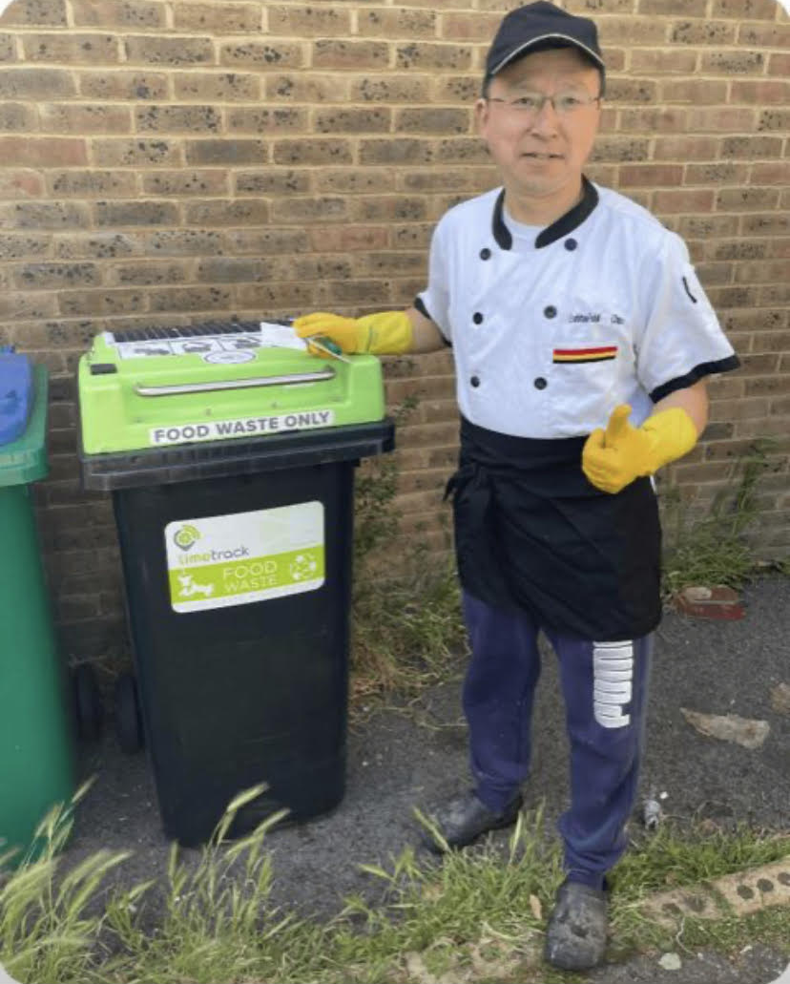
Kingston Business Food Waste (1)
The Challenge:
Hospitality sector businesses do not segregate food waste and dispose it off as general waste
The solution:
A 3 months pilot a pilot project to a) demonstrate how businesses could cut their operation costs and greenhouse gas emissions related to food waste; b) change behaviour
£4000 from South London IoT programme
Who was involved:
RBK, JNDC product design company, Limetrack/Smart Bins
We visited once or more over 35 businesses based in Brighton, Victoria and Mapple Roads

Slide 6
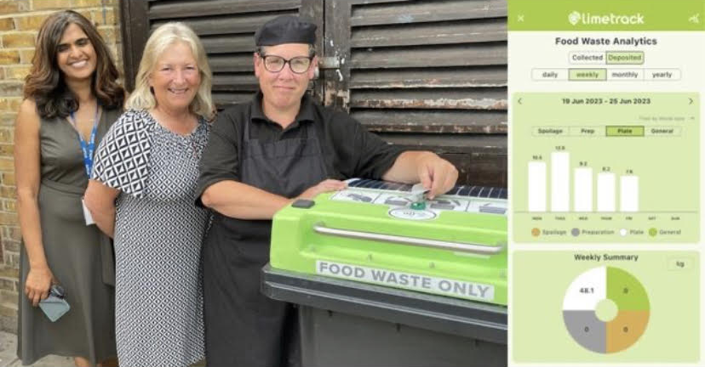
Kingston Business Food Waste (2)
Results:
14 businesses, including 1 school and 1 nursery participated in the pilot lasted over 3 months
Over 1.4 tonnes of food waste have been collected & turned into renewable energy and fertiliser
Over 6 tonnes of CO2e saved
Out of the 14 businesses that had signed up, 4 failed to separate any food waste; reasons given:
  On their list to do, but too busy to start/train their staff
  Residential neighbours complaining about additional external bin storage
  Claimed no, or insignificant amounts of, food waste actually generated
  Use the wheelie bin for general waste (contamination)

Slide 7
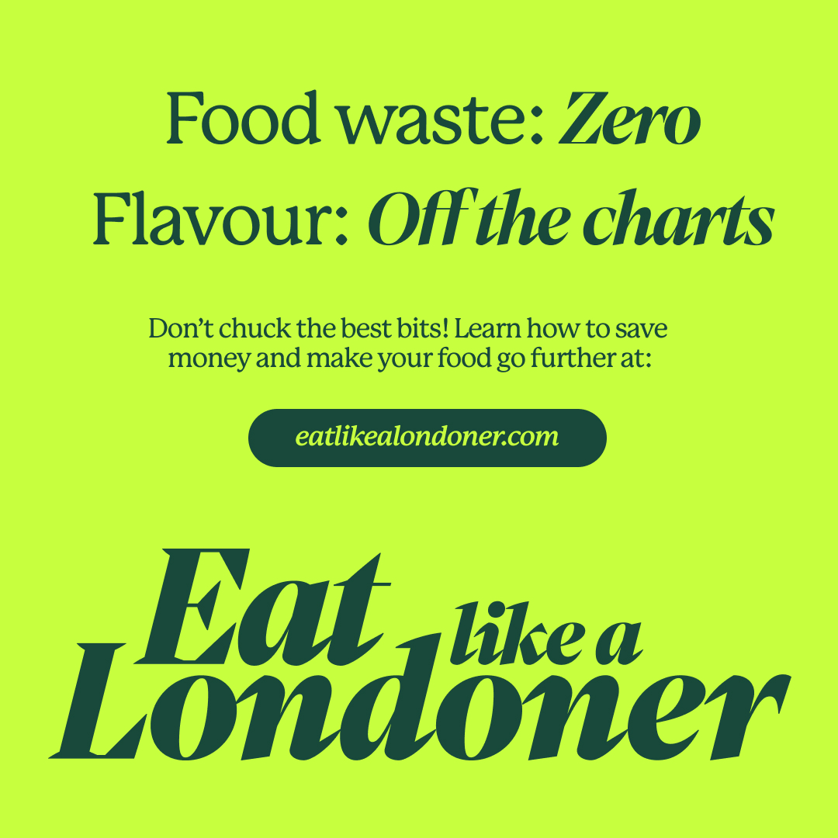

Household Food Waste
Eat Like a Londoner - food waste reduction & planet friendly diets
Veolia - food waste recycling campaign - 19% increase
Challenges
Recycling still low - particularly amongst flat residents
  WCA (2022) results show 26.5% general waste is food
People still wasting good food
  WCA (2022) results show 20% general waste bin is avoidable food waste & 45.5% food waste recycling bin is avoidable

Slide 8
Funding
Voluntary Community and Social Enterprise Funding open until 12th January
£5k & £10k Green Grants to fund 3 year projects
https://www.kingston.gov.uk/neighbourhood-community-safety/community-grants-programme/7
Hubbub - £6k Urban Nature Hubs can go towards community growing
https://hubbub.org.uk/the-nature-hubs-fund?&utm_source=business%20newsletter&utm_medium=email&utm_campaign=business_bulletin&utm_content=urban_greening

Slide 9
Discussion
Suggested discussion points:
How we can engage and motivate residents and businesses beyond giving information?
How can we create less food waste and divert surplus food more quickly to people and organisations who need it before it becomes waste?
How can we make it easy for residents and businesses to engage?
School refill stalls re cleaning products - could this be extended to food? Like School and Family Works eg https://theschoolandfamilyworks.co.uk/our-services/stop-food-waste-food-project/
What support can be offered to community groups, wishing to dispose of food once it is no longer possible to re-use it in any way and also with the costs of recycling?

