Slide 1
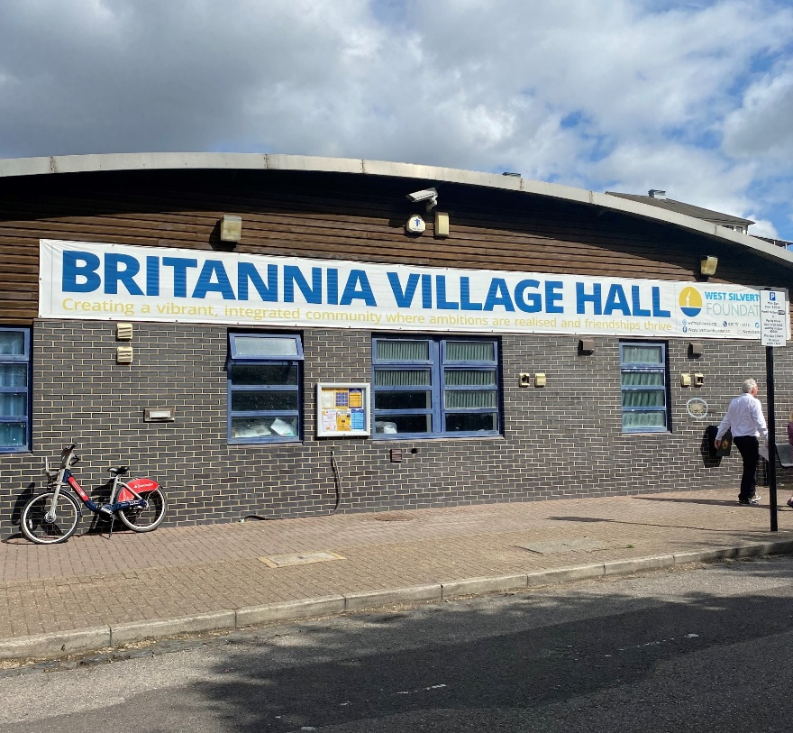
Working with your charity property in 2025
propertyhelp.org
Antonia Swinson Chief Executive
2nd April 2025

Slide 2
Ethical Property Foundation
Incorporated in 2003, Ethical Property Foundation (EPF) is the property advice charity for the voluntary sector working in England and Wales.
Currently our team of 15 includes 11 experienced Chartered Surveyors, supported by a dedicated board of 5 trustees and our Register of 15 solicitors and specialists.
Vision
A voluntary sector which manages its premises safely and sustainably with resilience, knowledge and confidence.
Mission
To deliver high quality advice & education enabling voluntary organisations to manage their premises sustainably for long term success.
Core Belief
Well managed property is vital for an effective resilient voluntary sector.
www.propertyhelp.org

Slide 3
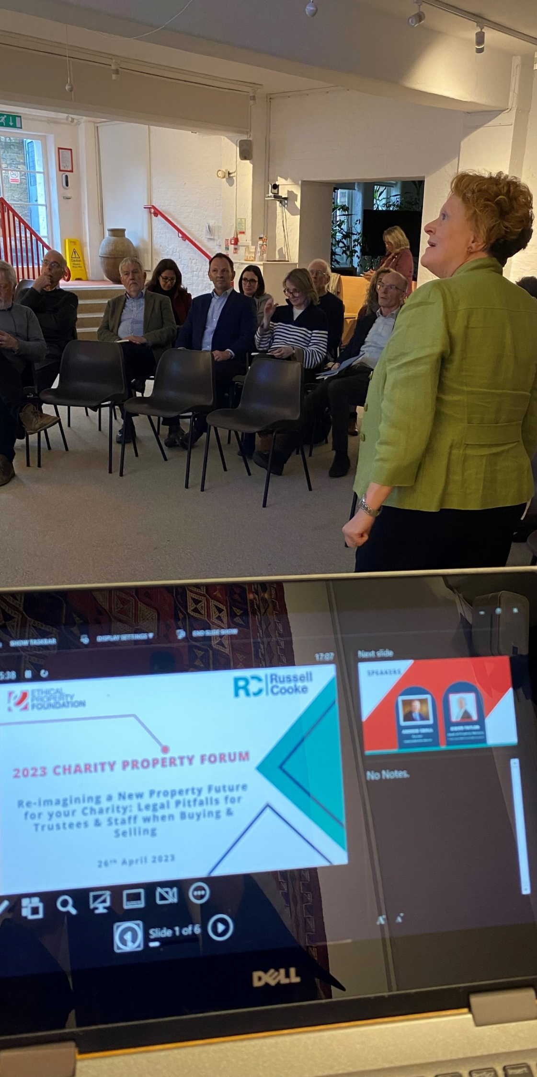
What we do
Free individual guidance for small voluntary groups Ask a Property Expert
Free online expert information
Free education – webinars and seminars
Commissioned in-depth property training for grant making trusts, local councils and social lenders
Affordable expert consultancy commissioned by grant making trusts and foundations, local authorities, social lenders and individual charities
Weston Property Manual – easy read guide to property management

Slide 4
A perfect storm for VCOs
Inflation
Soaring energy costs
Depleted reserves through 2 years’ lost income
Reduced local council support
Hybrid working leading to IT costs and major decision making
Council pressures: out-of-date leases and little security of tenure
Increased compliance and legal requirements e.g., EPCs to let buildings

Slide 5
Client stories
Women’s Aid Charity
needs support to exit from their current property which they own and don’t occupy
support with agreeing a new lease with certain break clauses
Community centre
owns the land but have discovered they don’t own the property on the land due to builder bankruptcy and the property transferred to insolvency practitioner
BME led charity
bought a building without a building survey in order to run a drop-in community centre only to discover asbestos
Social care charity
reviewed 3 leases on 3 properties all expired during lockdown giving advice on which leases to renew and on what basis

Slide 6
Follow / Contact us
LinkedIn
Ethical Property Foundation
Website
www.propertyhelp.org
E-mail
mail@ethicalproperty.org.uk

