Slide 1
Creating Communities in Virtual and Brick Libraries - Tackling Social Isolation
July 2020

Slide 2
Introductions
Giselle Monbiot - Service Development Officer - Community Hub
Katie Erskine - Community Library Service Officer
Nat Neuwirth - Service Development Officer - Digital and Innovation
Fiona Tarn - Development Manager

Slide 3
Context
Short to medium term, the focus of culture and heritage services will align to:
Supporting people with mental health and wellbeing
Supporting people with financial inclusion
Supporting people with reskilling, getting into work and digital inclusion
Supporting families and those at risk of social isolation
Supporting the local cultural ecology through partnership working
Ensuring culture has a role in economic regeneration and growth

Slide 4
Pre and During Covid-19 Lockdown
Pre Covid -19
Community Library Service
Community Hub work at Hook Centre
Event programme for all ages
March 23 - Present
Staff have been deployed into the Kingston Stronger Together Hub
Virtual event programme
Focus on digital resources
Donation of books to homeless in the Travelodge

Slide 5
Kingston Library Service
The Libraries Connected Universal library offer:
Children’s Promise - Inspiration to read, access to materials and digital engagement to improve their well being. Rhymetimes, storytime
Culture and creativity - Explore, create and participate. Celebrate promote and contribute to the local economy
Health and Wellbeing - Signposting, hosting events and working with partners to promote health issues. Stock to empower and improve lives
Information and Digital - Inform, Inspire and Innovate
Reading - Engage, Imagine and Discover

Slide 6
Digital Offer
Pre- covid, we addressed digital inclusion through:
Silver surfers, Job clubs, Tablet and phone drop in clinics, App workshops and various events that inspire people to look at technology as an enabler. Volunteers development.
E-books and E-audio books- magazines and newspapers
Social media network through Facebook and Twitter.
https://llc.ent.sirsidynix.net.uk/client/en_GB/kingston

Slide 7
Digital Offer
We are able to maintain our core offers and we help to address social isolation for those that can access our services digitally.
Events virtual meetings through zoom or live broadcasts through Facebook live. Videos are recorded and can be caught up on via Youtube.
Included Instagram and Youtube.
Weekly rhymetime and storytimes through copyright amnesty, digital delivery
Adult storytimes, health and wellbeing talks, useful app showcases.
Online book groups, book reviews, quizzes, writing competitions and crafting events.
Kingston Libraries (youtube link)
Notes:
Our core library offer became virtual overnight. As our digital offer was in place and staff were made available through the closure of seven libraries we able to maintain a service through digital means.

Slide 8
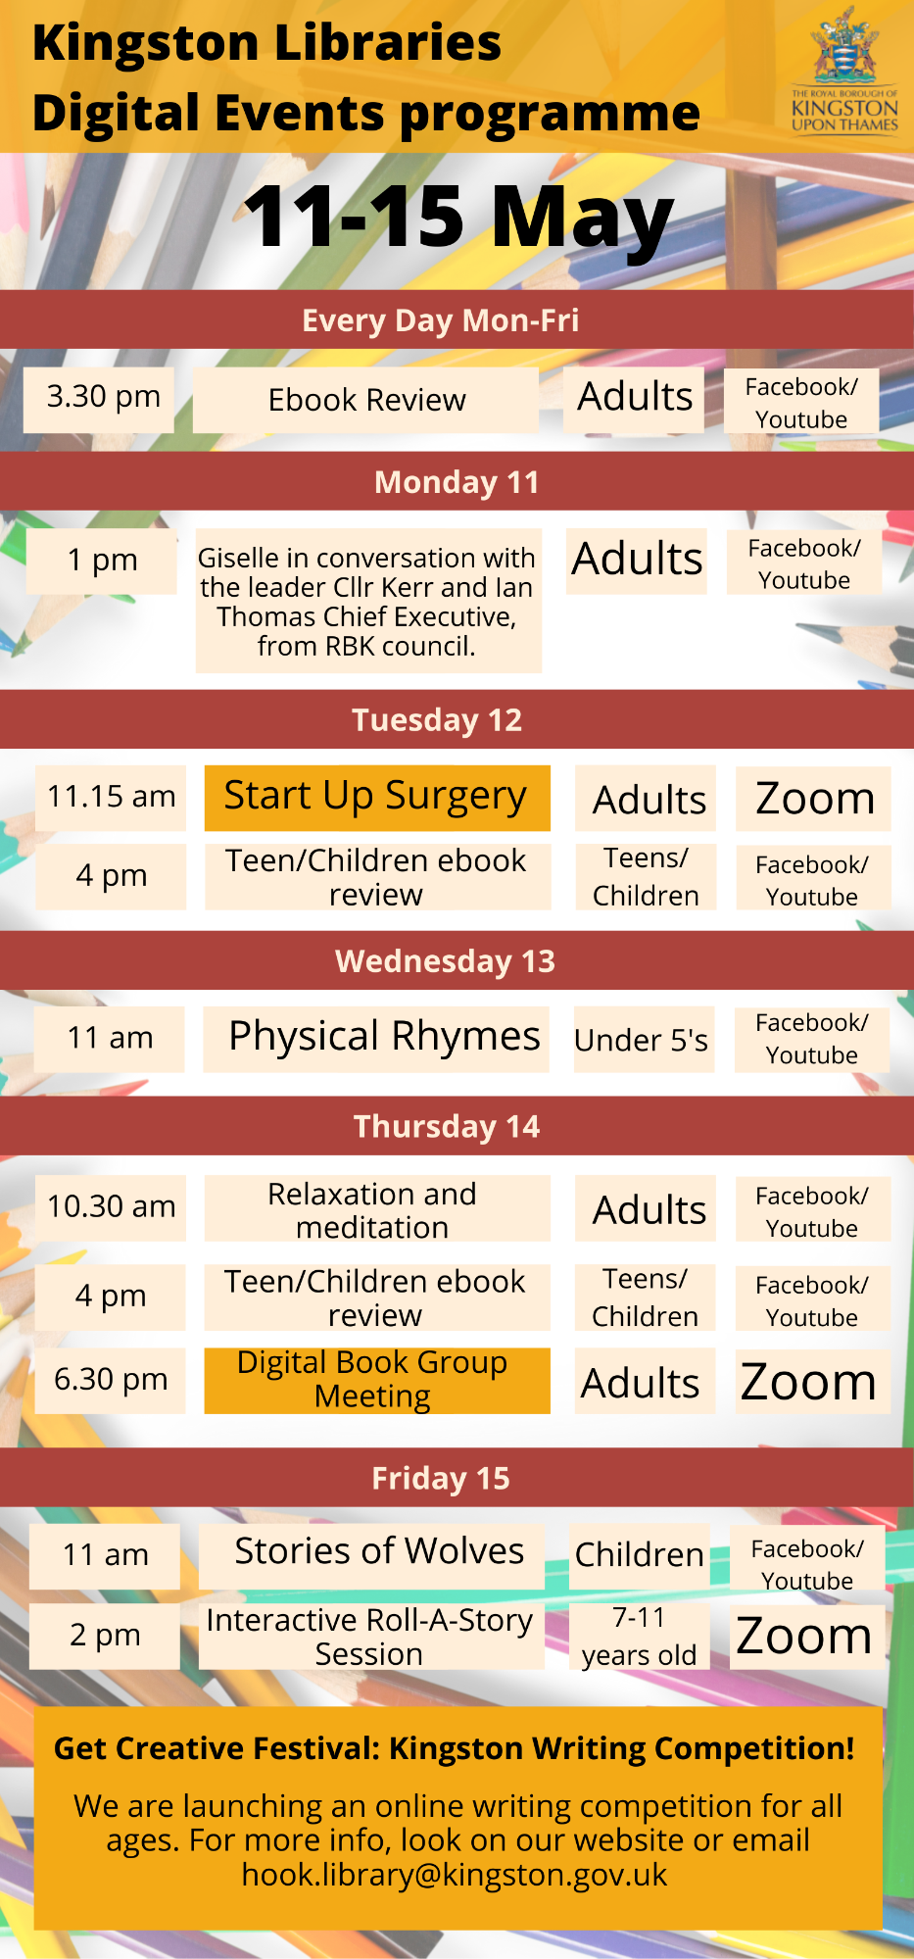
Notes:
Our core library offer became virtual overnight. As our digital offer was in place and staff were made available through the closure of seven libraries we able to maintain a service through digital means.

Slide 9
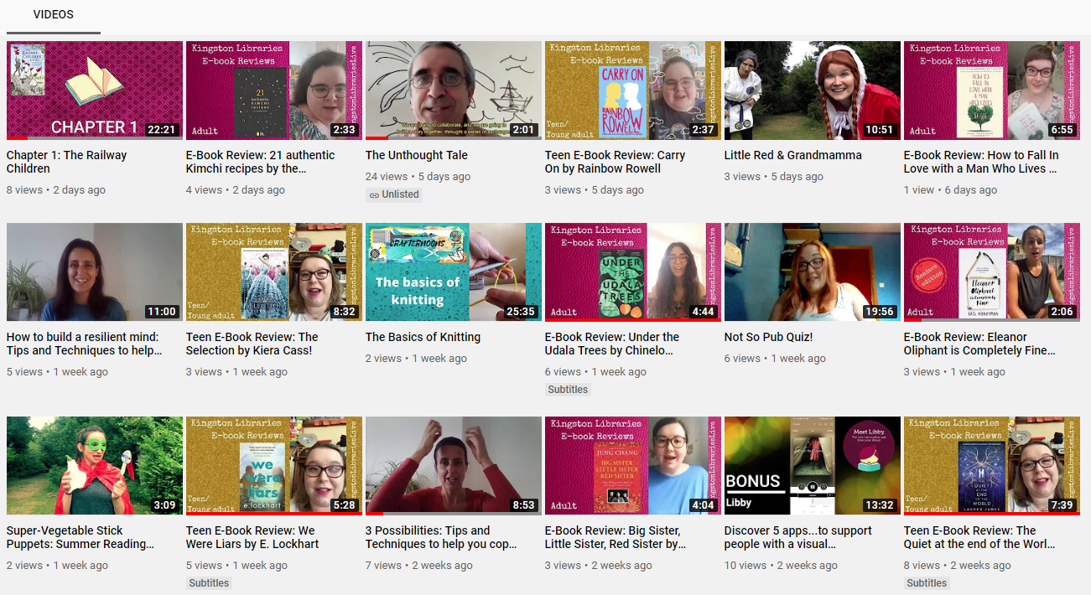

Slide 10
Digital Offer
Online resources for you to consider. You could use these resources if you work with groups - perhaps plan a digital reading group
Relaxed membership criteria to ensure people can join without proof
Supporting videos for access and trouble shooting
Increase in digital stock
Signposting to services through email and phone contact
Pressreader went live - free newspapers and magazines yay!
Ancestry available from home
E-book support from providers
Unprecedented increase in usage for our e-books e-audio.

Slide 11
Digital Offer going forward July - December
Partnership working eg. Playlist for Life
Working with residents to develop and deliver more content - survey
Events programme continued online focus -
Eco Festival - 3-8 August. Talks, workshops around ecology and sustainability
Summer - Culture Summer Programme
September - Digital Author Book Fair
October - Black History Month, Library Week
Working with external partners and council colleagues to deliver physical IT resources, tablet delivery, social interaction, forums, events.

Slide 12
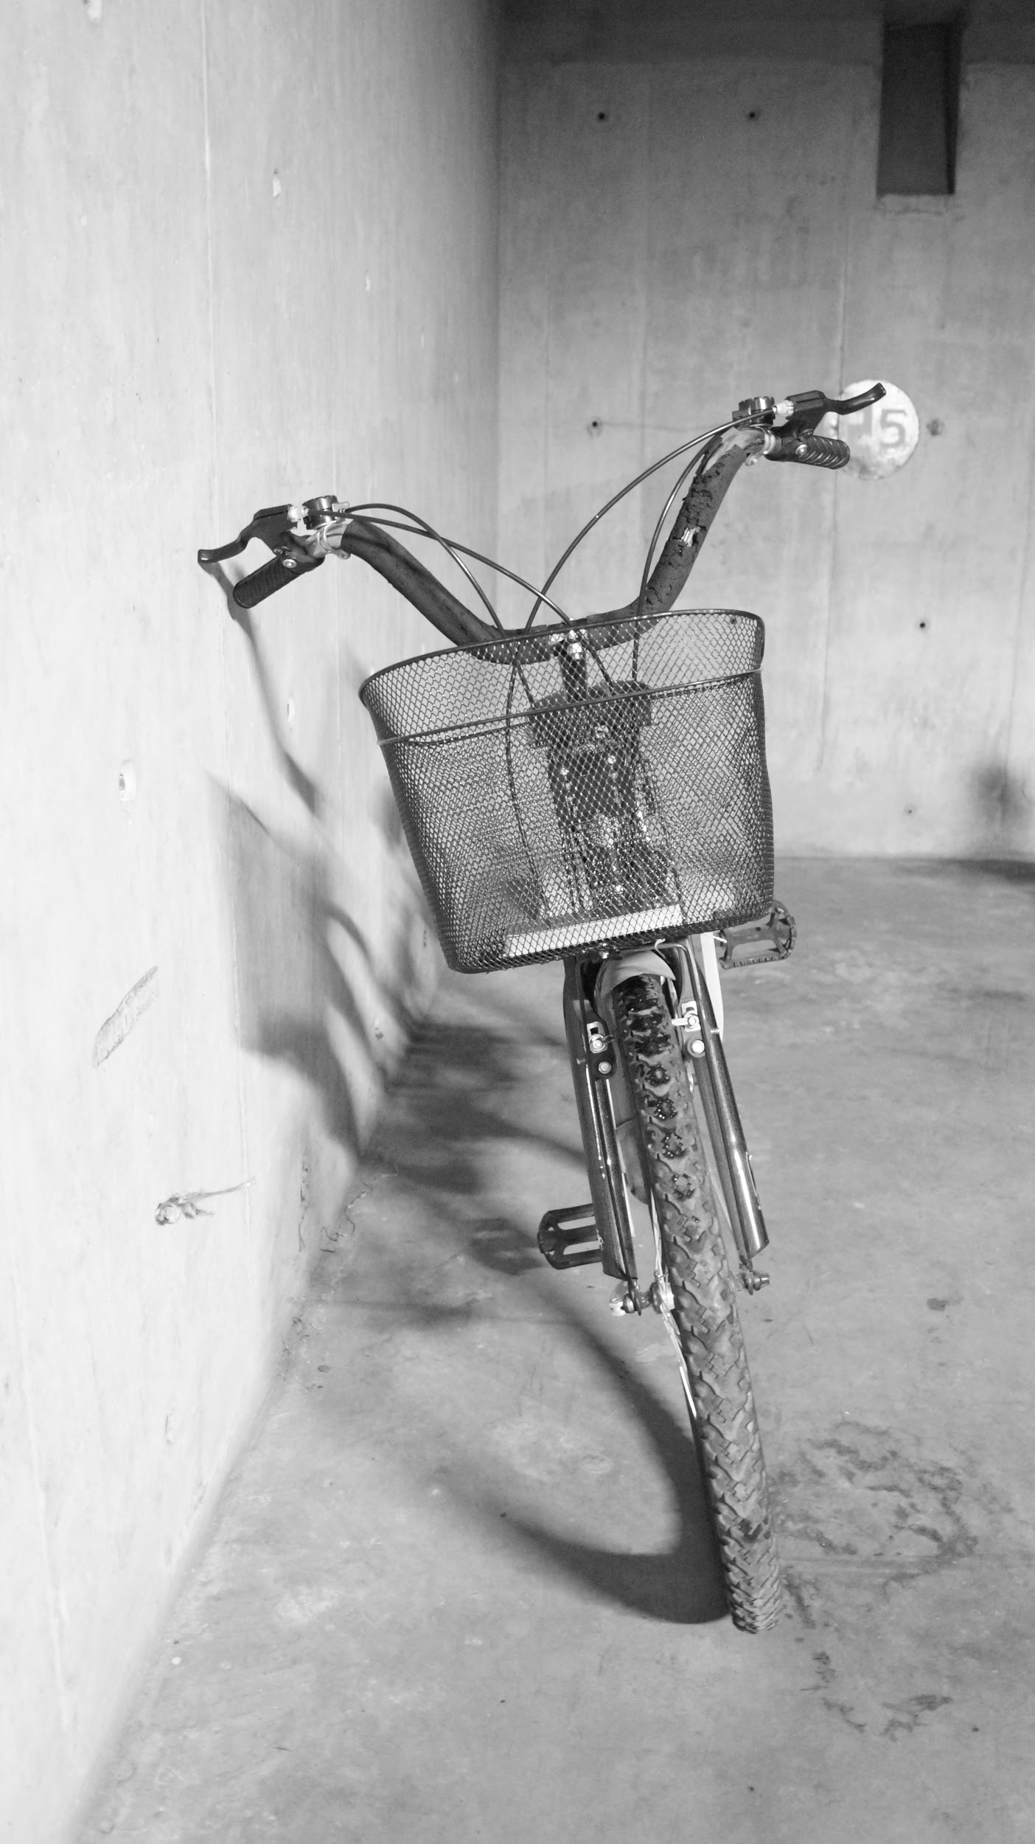
Community Library Service-July to December
The Community Library Service is starting to deliver books and resources to current users on a 4 weekly basis from July - we hope.
We are recruiting long-term volunteers to build up capacity for delivery
Most people will be in cars, but some have offered to run with Good Gym and carry the books on their bicycles.
A call has gone out to shielded residents to ask if they would like the service too
We are meeting different groups around the borough to start 3 pilot projects
Made links with Kingston Association for the blind and are liaising with them about technology.
Some volunteers are keen to help with digital delivery of the service
Notes:
Isolation - Starting with individuals but also contacting Care homes to ask if they want a service.
No expenses at the moment but if we have enough users we will apply for a grant
Will be requesting parking permits for each volunteer

Slide 13
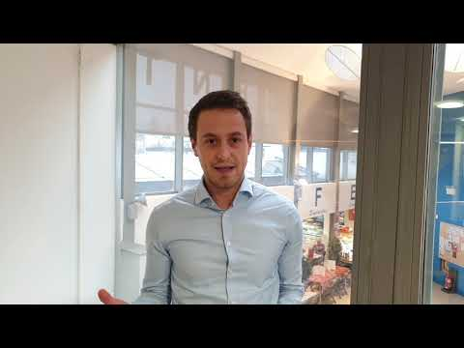
January 2021 - Social distancing dependent
Spaces for all - Community Hubs
Places where the voluntary sector, public sector and communities come together sharing skills, ideas and information to enhance physical and emotional wellbeing within the Borough.
Enabling individuals to connect with others in a safe, friendly and inclusive environment.
Offering our spaces to individuals and groups, providing the support and promotion to enable these groups to flourish and become self-sustaining.
Will include monthly themed events; Ki Gong; art group; crafts; speak with local authority services; promote and run voluntary offers; a timetable of fun events.

Slide 14
Kingston Adult Education
Weekly offering of mental wellbeing workshops online. This online programme will continue into the autumn term to support those who are unable to return to class.
LLDD Learners have had weekly phone calls from their tutors, checking in on them and giving them tasks to do,
16-19 year olds with EHCPs have been kept going with 100% attendance and they remain engaged with staff. They were loaned laptops to ensure they could continue learning.
Applying for funding to access tablet devices and chromebooks for those prospective Learners who don’t have digital access and are socially isolated.

Slide 15
Kingston Music Service
Music benefits both the individuals and the community at large.
KMS supports the work of schools in providing musical opportunities for their students, from group singing to class-wide instrumental groups, as well as offering weekly extra-curricular sessions for youth and adult ensembles, with concerts featuring massed young performers as a focal point.
Running an online programme, running group lessons and small ensembles, hosting events such as a Virtual Band Day when musicians across the borough came together to learn and record music from the Lion King for a split screen recording.
KMS is committed to finding opportunities for all RBK residents to experience the sense of connection and unity that is found when making music with others.
BAME Festival in October

Slide 16
Thank You
Giselle Monbiot - Service Development Officer - Community Hub giselle.monbiot@kingston.gov.uk
Katie Erskine - Community Library Service Officer katharine.erskine@kingston.gov.uk
Nat Neuwirth - Service Development Officer - Digital & Innovation Nathaniel.neuwirth@kingston.gov.uk
Marion Tessier - Service Development Officer - Events, Digital and Innovation marion.tessier@kingston.gov.uk
Fiona Tarn - Development Manager fiona.tarn@kingston.gov.uk
Diane Highet - KIngston Music Service diane.highet@kingston.gov.uk
Annette Brown - Community Learning Manager - communitylearningkae@kingston.gov.uk

