Slide 1



In partnership with
Core20 Infographics
January 2022

Slide 2







Sample 4
In partnership with
Core20
(339k population)
Remaining80 (1.35m population)
Age
35|38
Median
64|70
Healthy Life Expectancy
82|84
Life Expectancy
Ethnicity
16%|14%
Asian
24%|7%
Black
12%|11%
Other
48%|68%
White
2 in 10 are in C20
4.5 in 10 are in C20
2 in 10 are in C20
1.5 in 10 are in C20
Borough
In contrast, only 4% of residents in Richmond and 2% in Kingston are in C20
50% of C20 population are Croydon residents.
40% of Croydon residents are in C20
Long-Term Conditions
29.5%
have a Long-term Condition
28.6%
have a Long-term Condition

Slide 3

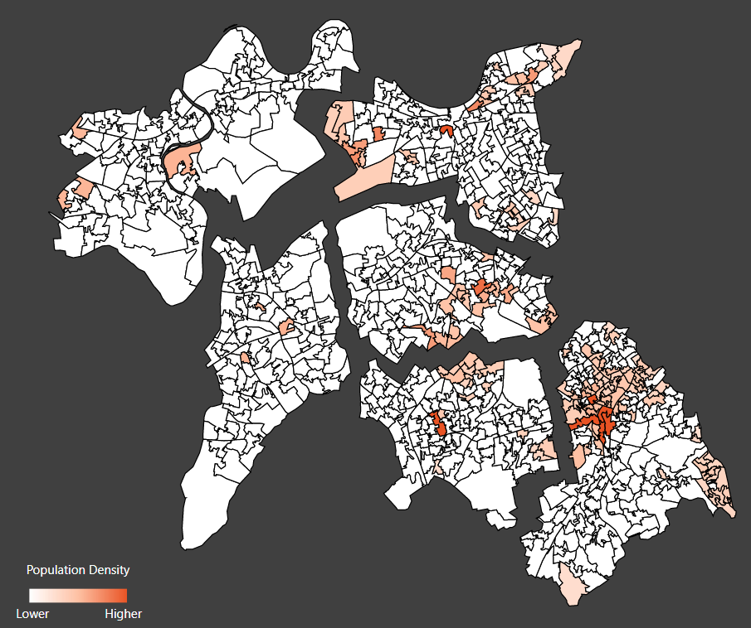

Sample 4
+
In partnership with
Where are our Core20 population of 340k located?
Main features of population:
Queenstown (9K) Young adult to working age population (15-44). Significantly more Black & Chinese ethnicities. Barriers to housing and living environments
RICHMOND
Ham, Petersham and Richmond Riverside (2K) Older population.
Significant White British population.
Latchmere (14K) Younger working age population.
More Black ethnicities. Barriers to housing
WANDSWORTH
East Merton (29K) Deprivation in housing and environment. Significant school aged and older working age (44-64) population. Ethnically diverse.
MERTON
Beverley (2K) More school and young working aged population. More of the Asian & Mixed ethnicities.
CROYDON
KINGSTON
Croydon North (89K) School and working aged population. Significantly more Black & Asian ethnicities. Barriers to housing.
Berrylands (2K) More young working age population. More of the Arab/Middle Eastern ethnicities.
Addington (24k) High school aged population. Very high deprivation driven by income, employment, education and barriers to housing. Significantly White British and Black African
SUTTON
Sutton Central (6K) Significant school aged population. Deprivation in housing, income & environment. Significantly more South Asian & Chinese ethnicities.
St Helier & Wandle Valley (14K) More school & retirement aged population. Significantly more White British and Eastern European ethnicities.
Fairfield (21k) Young adult to working age (15-44), adversity in living environment, housing & crime. Significant Indian ethnicities.
Opportunity for change KEY: High Medium Low

Slide 4




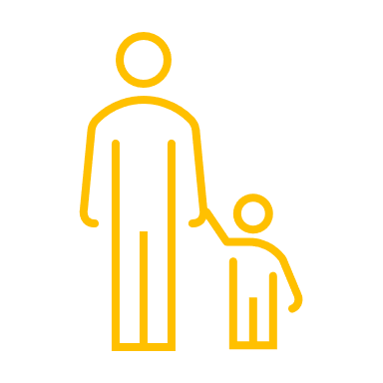
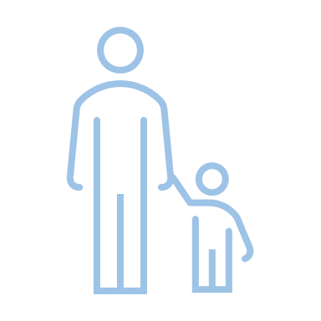
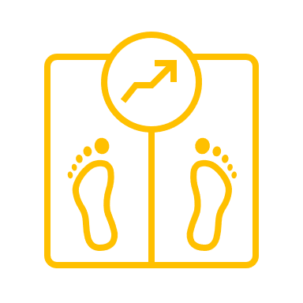
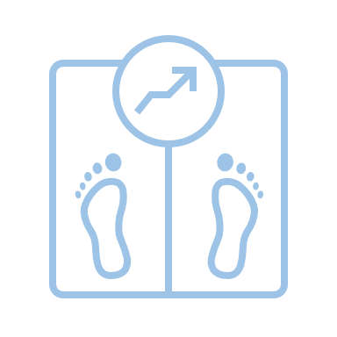



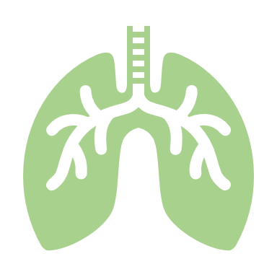
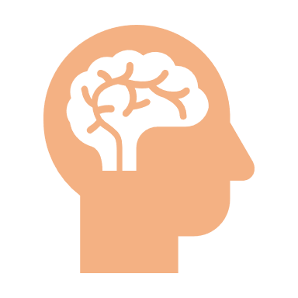


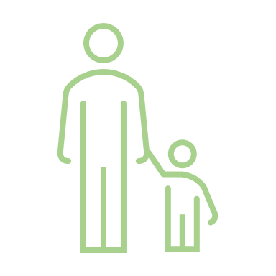

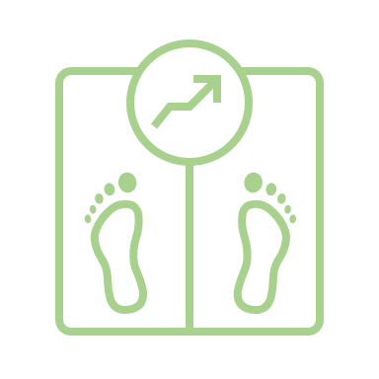
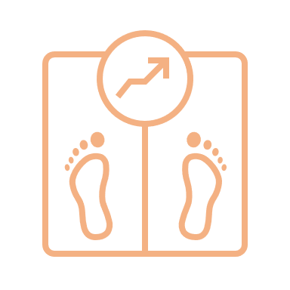



Sample 1
In partnership with
Core20 Conditions
Diabetes (18,578 patients in Core20)
An average Core20 individual is:
Hypertension (33,141 patients in Core20)
An average Core20 individual is:
34%
3%
more likely to be diagnosed diabetic
more likely to be diagnosed with hypertension
4
6
years younger. Average age: 61
years younger. Average age: 63
1
1.4
BMI points higher. Average BMI: 31
BMI points higher. Average BMI: 30
10%
less likely to meet all treatment targets.
Achievement: 31% (Target: 45%)
4%
less likely to meet all treatment target.
Achievement: 51%
x2
more likely to be south Asian than White
COPD (5,894 patients in Core20)
An average Core20 individual is:
Mental Health (4,422 patients in Core20)
An average Core20 individual is:
28%
67%
more likely to be diagnosed with COPD
more likely to be diagnosed with mental health condition
4
1
years younger. Average age: 69
years younger. Average age: 51
0.7
1
BMI points higher. Average BMI: 27
BMI points higher. Average BMI: 29
x5
more likely to be White than Asian and Black
No adversity in meeting treatment targets.
Achievement: 26%

Slide 5






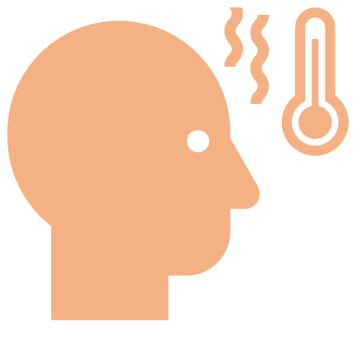

Sample 1
In partnership with
Core20 Conditions
Asthma (28,975 patients in Core20)
An average Core20 individual is:
Covid An average Core20 individual is:
15%
less likely to be get tested.
Patients in C20: 156,838
No adversity to be diagnosed asthmatic
1.3%
more likely to be tested positive
Patients in C20: 28,258
3
years younger. Average age: 36
18%
less likely to be get vaccinated
Patients in C20: 170,622
1.4
14%
more likely die of Covid
Patients in C20: 666
BMI points higher. Average BMI: 28
Learning Disability (2,627 patients in Core20)
An average Core20 individual is:
Flu An average Core20 individual is:
49%
more likely to be diagnosed with Learning Disability
2
14%
less likely to be get vaccinated.
Patients in C20 65+ 9,932
years younger. Average age: 36
0.6
BMI points higher. Average BMI: 28
x2
more likely to be White (most prevalent ethnicity) than Asian and Other (least likely)

Slide 6
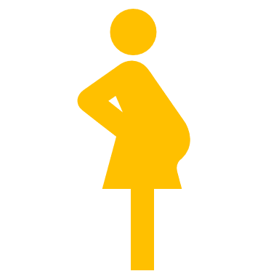

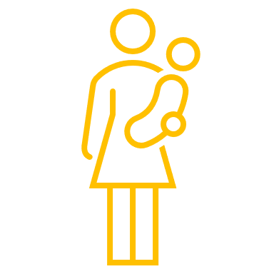
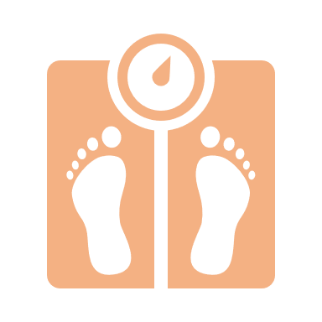



Sample 1
In partnership with
Core20 Conditions
Maternity
An average Core20 mother is:
2.5
years younger. Average age: 38
0.9
BMI points higher¹. Average BMI: 26.3 (overweight range 25 – 29.9)
x2
more likely to be currently smoking¹.
8% compared to 4% in Remaining 80
No significant adversity for mothers booked into Continuity of Carer pathway²
Obesity (37,336 patients in Core20)
An average Core20 individual is:
43%
more likely to be Obese
1
BMI points higher. Average BMI: 36
42%
more likely to be diagnosed with a LTC
3
years younger. Average age: 50
x1.6
more likely to be Black than Asian (where Asian is lowest) and White 49% more likely to be Obese compared to R80
¹ sourced from latest GP records, not at time of delivery
² sourced from MSDS (deliveries between April 2019 and September 2021)

Slide 7
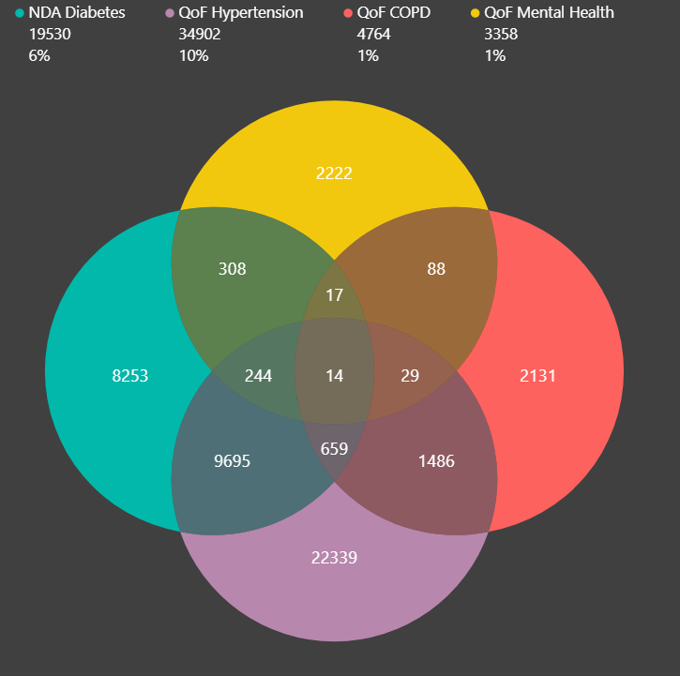




Sample 1
In partnership with
Core20 Long Term Conditions
Number of residents in Core20 (with LTCs: Diabetes, Hypertension, COPD, Mental Health)
34,945 1 LTC
11,577 2 LTCs
949 3 LTCs
14 4 LTCs
Profiles of the 14 residents with all 4 LTCs
All age 50 +
Mostly Males
Predominantly White British, followed by Mixed ethnicities
Mostly live in Croydon (Addington, Waddon), Wandsworth (Latchmere) and Kingston (Berrylands).
Most with medium risk of hospitalisation

