Slide 1

Michael O’Sullivan

Slide 2


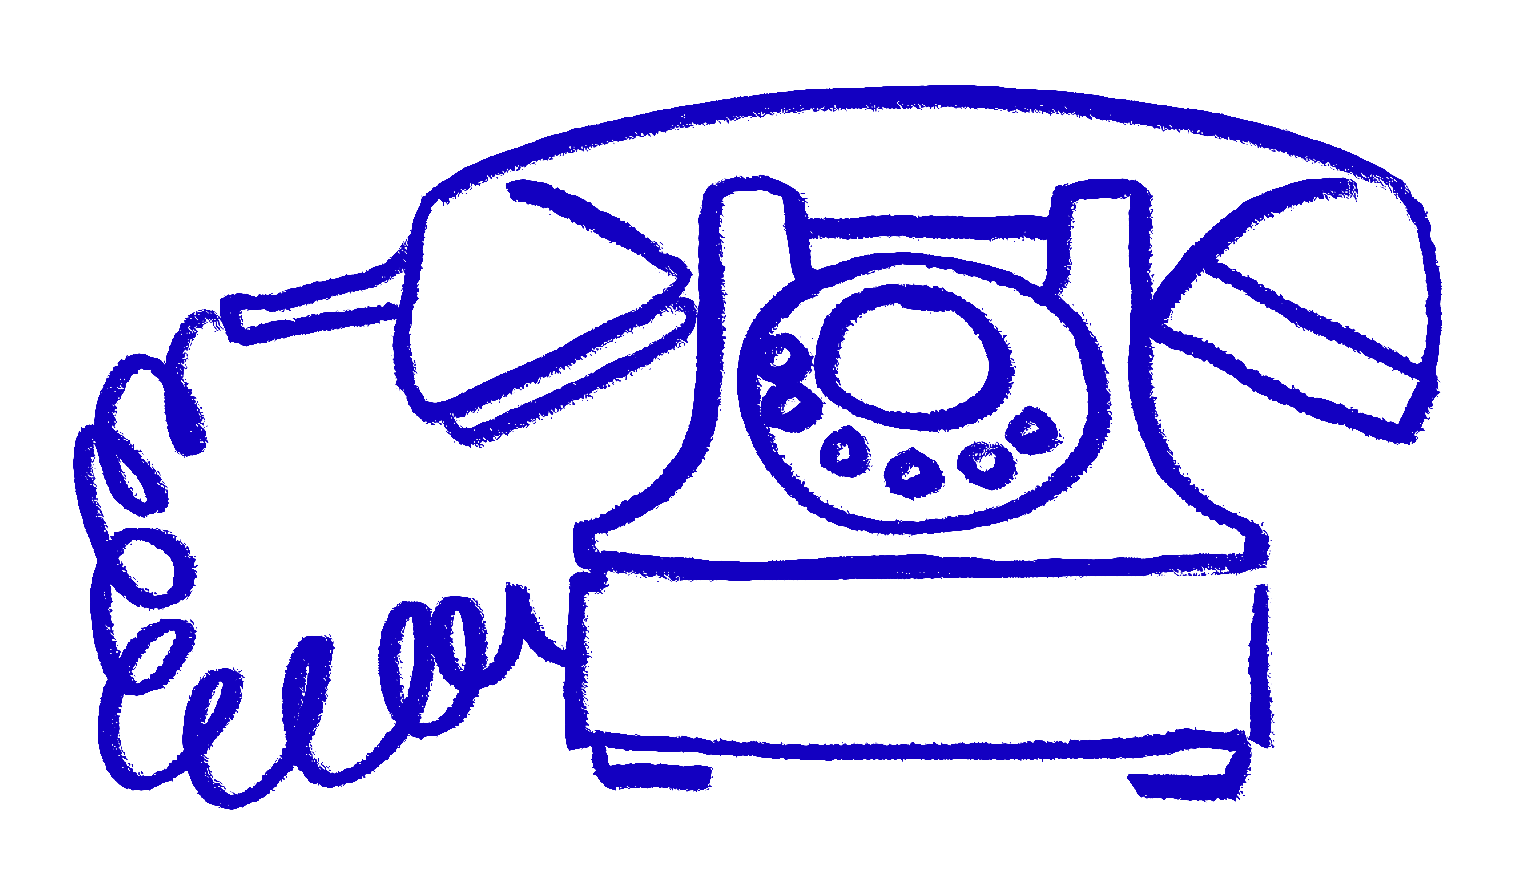
Approach to bid and tendering writing.
How we communicate
The voice of service user / stakeholders
Passion / Emotion / Warmth

Slide 3
Bid and Tender Writing Approach
Common Mistakes
Statutory v Trust / Foundations
Structuring
Research & Preparation
KEY ELEMENTS
- TEAM APPROACH
Understanding priorities;
Identifying alignments between the funder and project;
Reviewing successful bids.
  Articulating the need;
  Project details;
  Impact measures;
  Budgeting.
Differences in approach;
Compliance and legal considerations.
  Overcomplicating language;
  Ignoring guidance;
  Lack of evidence of need.

Slide 4

Case Studies

Slide 5
Follow up and relationship management
If Successful – Acknowledge the funding with a thank-you letter and commit to reporting progress.
If Unsuccessful – Request feedback, refine your approach, and explore other funding options.
Build Relationships – Even if a bid is unsuccessful, maintaining contact can lead to future opportunities.

Slide 6
Q + A
Questions

