Slide 1
Community Grants
Updated links and information on -
Boroughwide Community Grants
Neighbourhood Community Grants
Councillor Ward Funding
Community Hub Grants
Active Kingston; Sports Development Grants
Service Area Grants

Slide 2
Introduction to Boroughwide Grants 2024
Boroughwide Community Grants can award £2,000 to fund projects, activities and services that support the local community in ways that contribute to the Council’s strategic priorities: ‘Healthy’, ‘Safe’ and ‘Sustainable’. The Boroughwide grants committee can allocate up to £20k every year.
These Grants are open once every year.
The Boroughwide Community Grants guidelines are available here.
We specifically encourage and award extra points to grants that:
support the needs of vulnerable communities and reduce health inequalities
are adapted to address Cost of Living priorities
support the borough’s commitment to being a ‘City of Sanctuary’
Eligible groups must be not-for-profit organisations, voluntary or community sector groups or faith groups.

Slide 3
Boroughwide Grants 2024
What the grant will fund:
New activities to test ideas.
One-time projects finished within 12 months.
Money for venue hire or equipment.
Money for staff working on the project.
What Grant will not fund:
major building works
a minibus or minibuses
political activities
teaching community languages
activities that are part of normal day-to-day running
activities that are normally undertaken by Statutory organisations
organisational fundraising activities

Slide 4
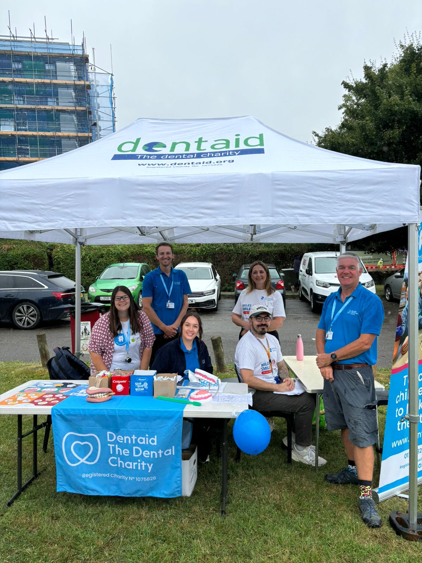
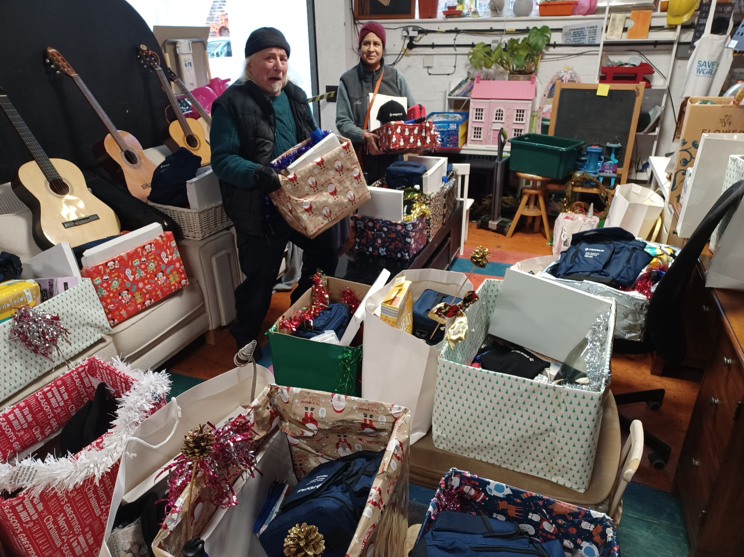
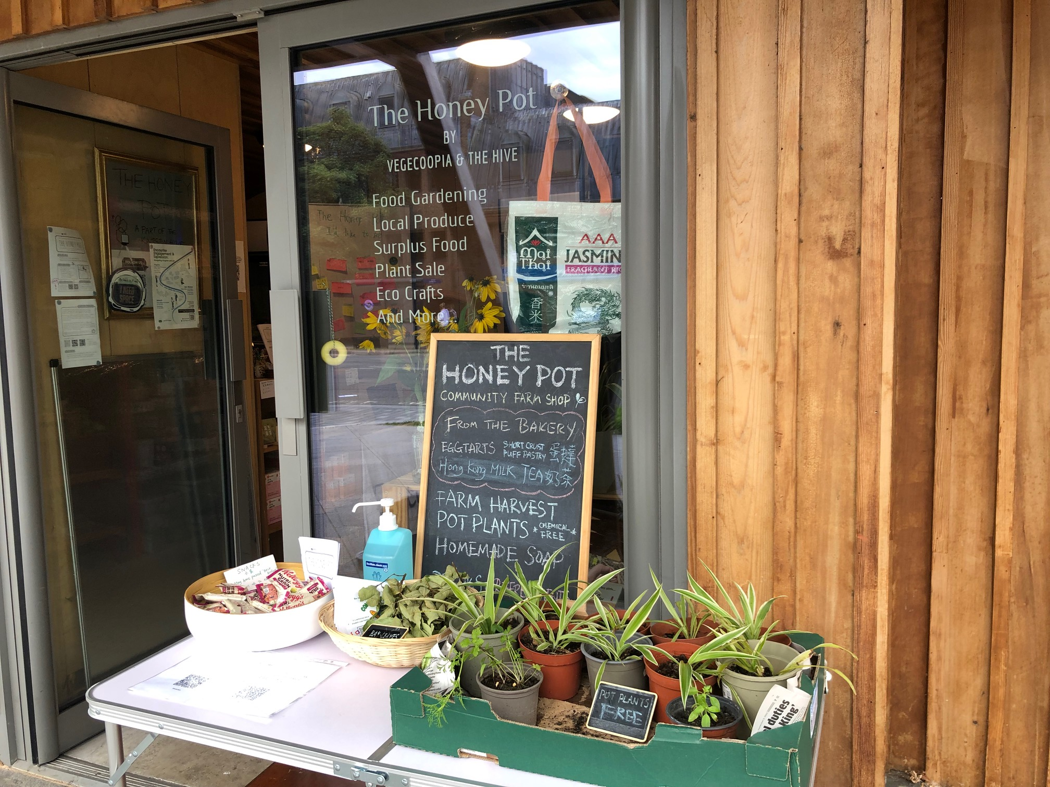
Boroughwide Grants 2024

Slide 5
Introduction to Neighbourhood Community Grants
Neighbourhood Community Grants can award £3,000 per application, to benefit communities in each of the four neighbourhood areas. Each neighbourhood committee can allocate up to £20k of Neighbourhood Community Grants every year. These grants are available all year round.
The Neighbourhood Community Grants guidelines are available here.
Application links for each Neighborhood
Surbiton
South of the Borough
Kingston and North Kingston
New and Old Malden
Neighbourhood committee specifically encourage and award extra points to grants that:
focus on meeting the needs of marginalised or isolated people or communities
focus on funding local initiatives provided for community benefit
Eligible groups are not-for-profit organisations, voluntary or community sector organisations and faith groups.

Slide 6
Neighbourhood Community Grants
What the grant will fund:
New activities to test ideas.
One-time projects finished within 12 months.
Money for venue hire or equipment.
Money for staff working on the project.
What Grant will not fund:
major building works
a minibus or minibuses
political activities
teaching community languages
activities that are part of normal day-to-day running
activities that are normally undertaken by Statutory organisations
organisational fundraising activities
Find out more about what grants will not fund for here.

Slide 7
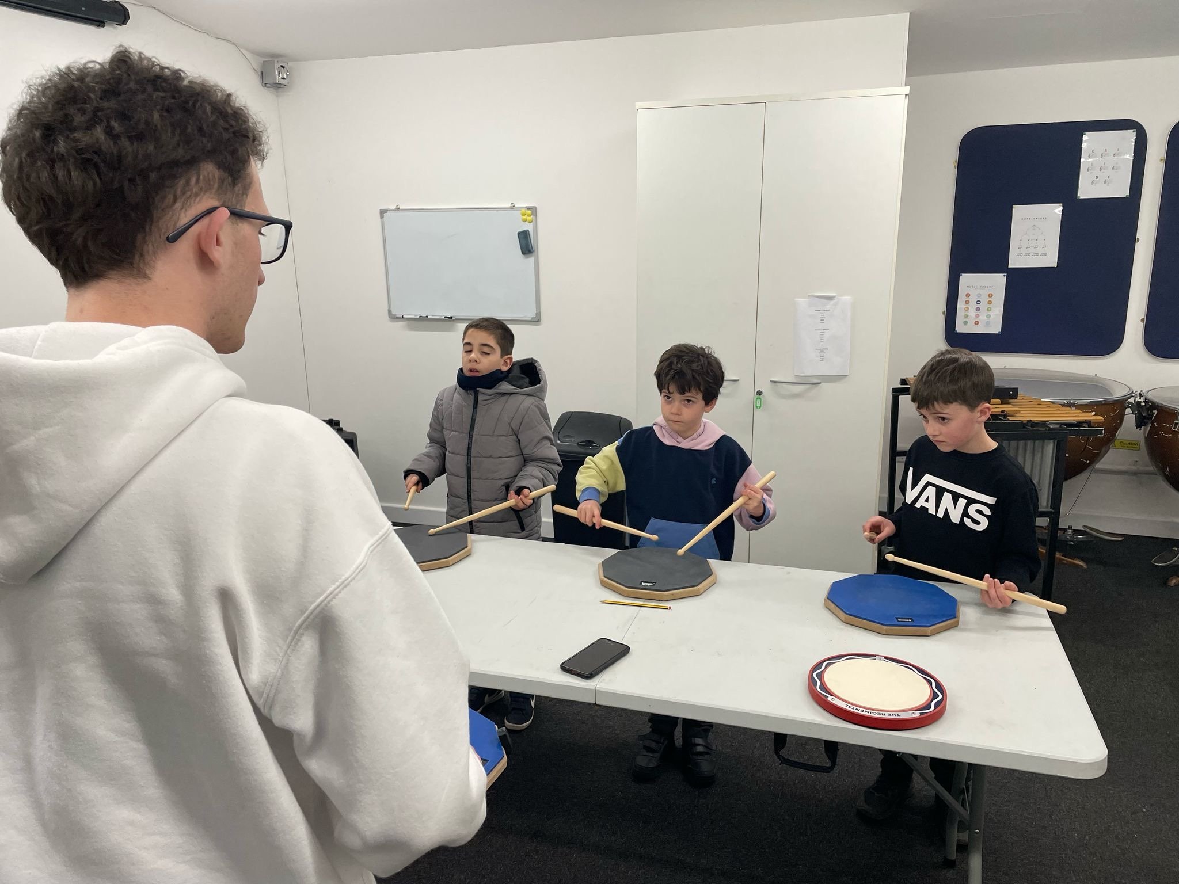
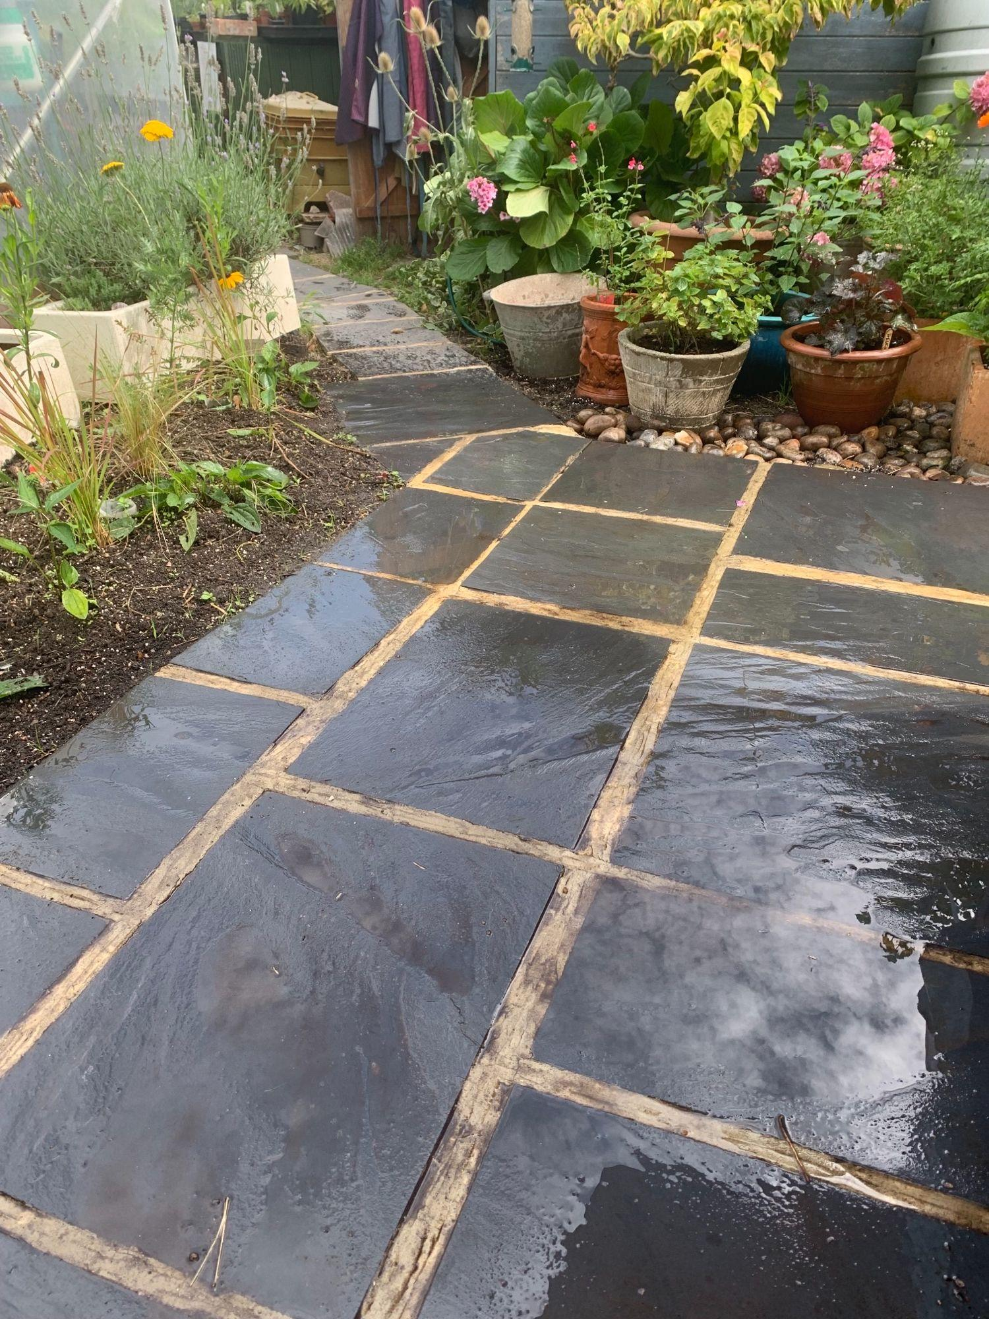
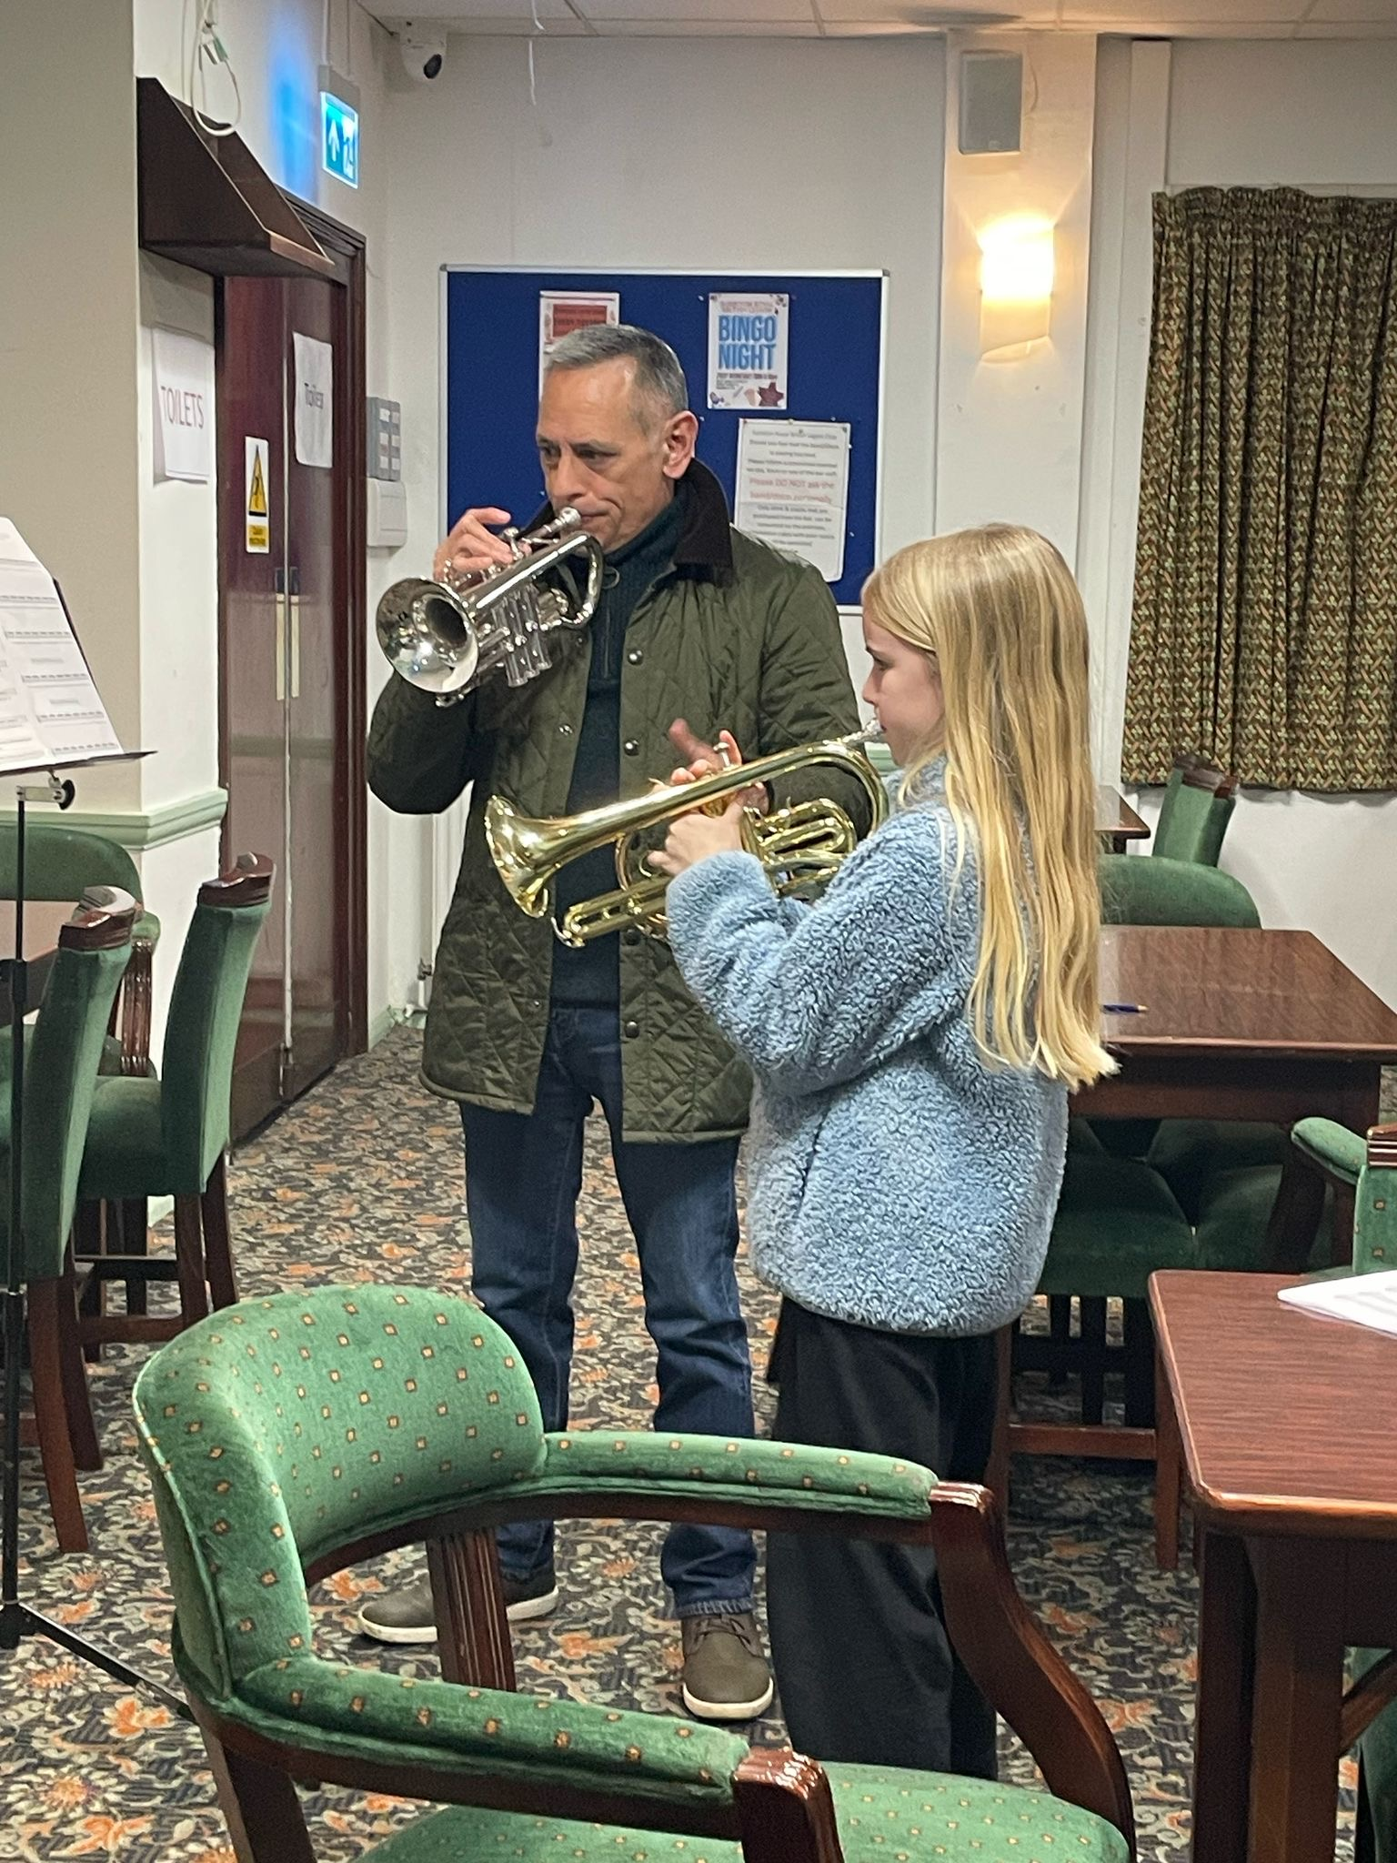
Neighbourhood Grants 2024

Slide 8
Councillor Ward Funding
The budget for Councillor Ward Funding is allocated at £2,000 per Councillor. Aimed at providing local Councillors with the ability to support the award of flexible, small and timely funds for local initiatives within their Ward.
Ideally, projects/activities should enable communities to help themselves and lead on delivering local solutions.
Overall the fund should enhance the social, economic or environmental well being of the Ward community and residents quality of life.
If you are interested in applying for Councillor Ward Funding then you should contact your ward councillor.
Find your local councillors by ward

Slide 9
Introduction to Community Hub Grants 2024/25
Community Hub Grants can award grants ranging from £100-£500 allowing residents and small community groups to apply for funding for projects in one or more of our Community Hubs, located in libraries and other community spaces across the borough.
Hub Grant applications are reviewed on a monthly basis, and are available till March 2026.
If your project does not require funding, you may contact the community hubs directly to use the space for FREE.
The Community Hub Grants guidelines are available here.
The Application form link can be found here.
The Community Hub committee specifically encourages and award extra points to grants that:
Identify a gap in the current local offer for community projects or activities.
Highlight a clear benefit for community engagement.
Demonstrate enthusiasm to sustain the project consistently and with longevity.
Eligible applicants can be individual borough residents or voluntary or community sector groups.

Slide 10
Community Hub Grants 2024/25
What the grant will fund:
New activities to test ideas.
Regular and sustainable projects.
Money for equipment and supplies
What Grant will not fund:
Salaries or service fee
Venue hires
Travel expenses
One-time events

Slide 11
Introduction to Active Kingston; Sports Development Grant
This is a £20,000 fund which makes awards of between £500 and £1,000 to clubs, community groups, and organisations to 'kick start' new sport, fitness and physical activity opportunities in Kingston for the residents of the borough.
We programme is particularly aimed at projects designed for residents who are less likely to take part in physical activity or require support to take part.
Who can apply:
registered charity
not-for-profit organisation
Who can’t apply:
statutory body or educational establishment - including academies and universities
national governing body or Active Partnership
commercial/for-profit entity

Slide 12
Sports Development Grant 2024/25
What Grant will not fund:
Existing project delivery (must be a new activity or delivery to a new group)
Other staff running costs (not direct delivery of project)
Utility bills
Loss of income
Construction/refurbishment projects
Replacement of existing equipment
Projects not ready to begin within six weeks of the grant provision
Costs benefitting an individual (e.g. membership fees)
Costs benefitting participants under five years of age
Costs that aren't a direct responsibility of the applicant to cover
What the grant will fund:
Equipment
Coaching delivery costs
Venue hire costs
Training for coaches, volunteers and staff to deliver a new activity
NGB first affiliation/membership fees
For more information on the Sports Development Grant please visit the council’s website: https://www.kingston.gov.uk/parks-sports-leisure-1/active-kingston/4
Or contact: sports@kingston.gov.uk

Slide 13
Various Service Area Grants
The Royal Borough of Kingston service areas/departments have provided grant funding to local voluntary, community, and social enterprise organisations to support projects that reflect the council’s strategic priorities and deliver meaningful benefits to residents across the borough.
These grants are designed to:
Address specific needs within council service areas (e.g. health & wellbeing, community safety, environment, adult social care)
Enhance service delivery through community-led initiatives that complement local authority efforts.
Encourage collaboration between the council and grassroots organisations to build resilient, inclusive communities.
Specific service area grants are typically made available at different points throughout the year, depending on the objectives and priorities of each service area.

Slide 14
Top tips for applying council grants
Have clearly defined objectives that fill a local need
Be specific how you will monitor the success of your project
If you are applying for our Neighborhood or Boroughwide grant, please make sure to have key documents to hand e.g. bank statements, constitution, risk assessments, etc.
A clear breakdown on how you will budget your grant.
Show that the organisations is open to the whole community, no matter the gender, race, disability, religion, age, marital status or any other protected characteristic group

Slide 15
Good example for a good Budget Breakdown
Category | Details | Cost (£)
Staff Costs | Staff/volunteer stipends (15 hours at £12/hour) | 180
Venue Hire | Rental of community space (3 days at £500/day) | 1,500
Equipment & Materials | Supplies for activities (crafts, tech, etc.) | 250
Marketing & Outreach | Flyers, ads, social media promotions | 150
Training | Workshops for volunteers/staff | 300
Travel Costs | Transport for staff or participants | 200
Admin Costs | Printing, postage, and stationery | 100

Slide 16
Good example for Monitoring
Attendance registers
Photos of events (with consent)
Feedback forms from participants
Example - Jane, a 45-year-old single mother, attended the workshops and reported a significant reduction in stress. She has now formed a peer support group with other attendees, fostering ongoing community engagement.
Feedback from Participants:
"This has been a lifeline for me. I feel less isolated."
"The resources provided were so helpful; I’ve already recommended them to friends."

Slide 17
Thank you!
grants@kingston.gov.uk
veerali.patel@kingston.gov.uk
james.geach@kingston.gov.uk

