Slide 1
Climate Change Awareness Taster
VCS Forum, 22 November
Terezie Wickenden - RBK Climate Action Officer

Slide 2
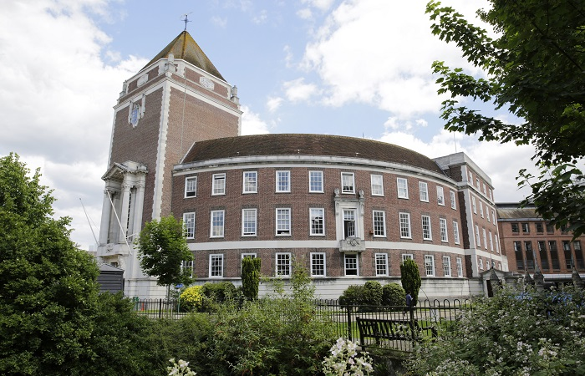
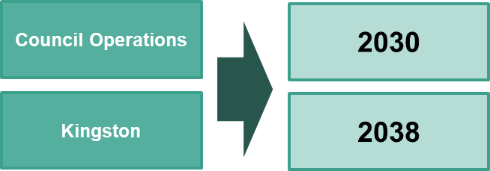
Kingston Council and climate action
June 2019
Kingston Council declared a Climate Emergency
March 2022
Kingston’s Climate Action Plan was approved

Slide 3
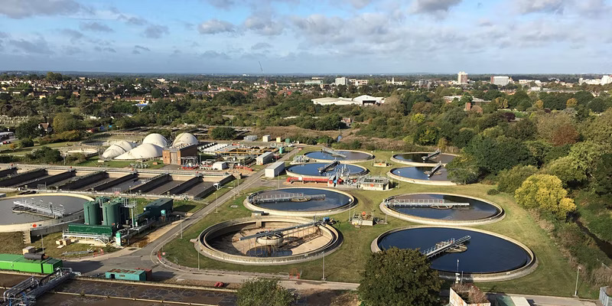
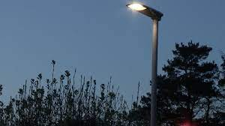
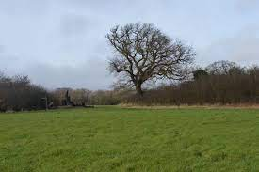
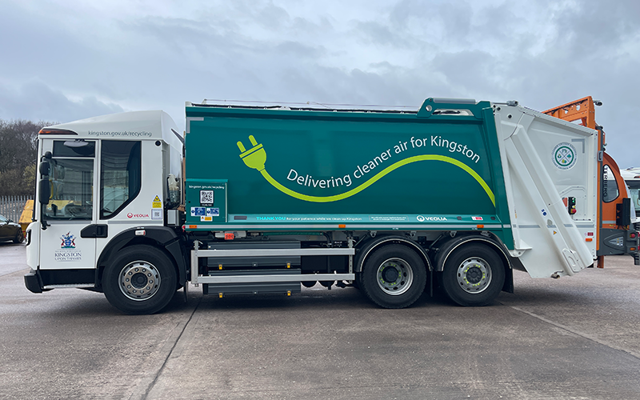
District Heat Network
Street lights converted to LED
Rewilding of Tolworth Court Farm Fields
Senior Officer training
Electrification of waste fleet

Slide 4
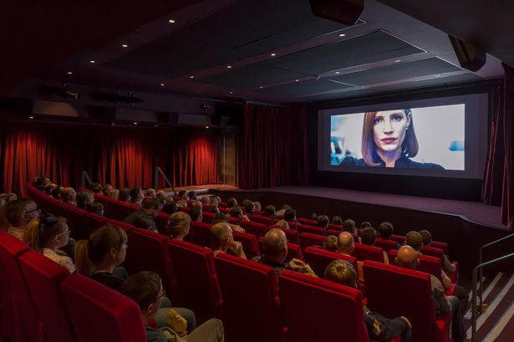

Slide 5
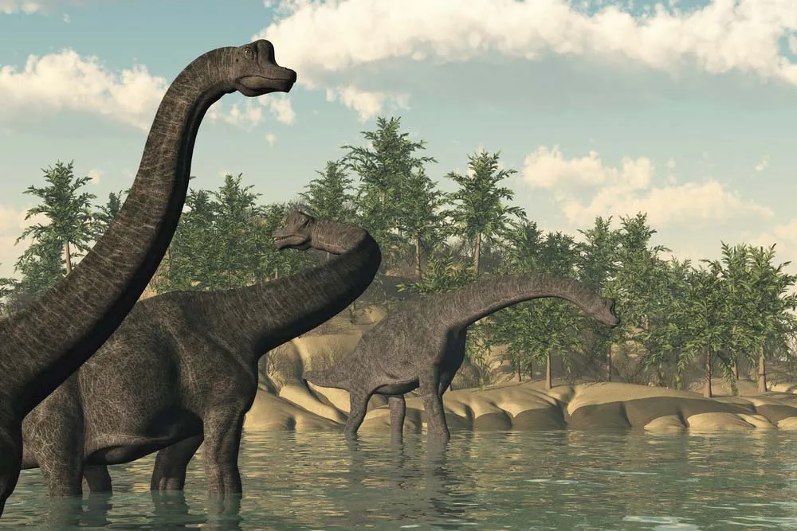
Climate has always been changing

Slide 6
TRUE!
Climate Action Plan p. 7 - ‘We will ensure the climate implications of our actions are a key factor in decision-making’

Slide 7
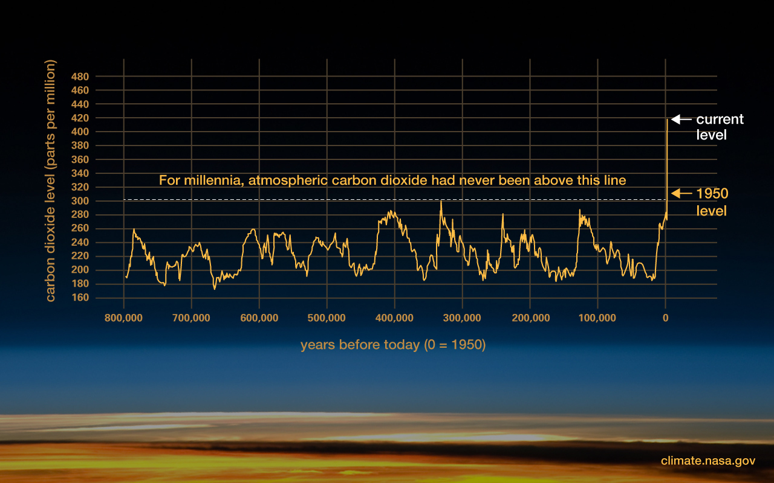

Slide 8
Plants need CO₂ so more of it is a good thing.
Climate Action Plan p. 7 - ‘We will ensure the climate implications of our actions are a key factor in decision-making’

Slide 9
Plants need CO₂ - TRUE!
so more of it is a good thing FALSE!
Climate Action Plan p. 7 - ‘We will ensure the climate implications of our actions are a key factor in decision-making’

Slide 10
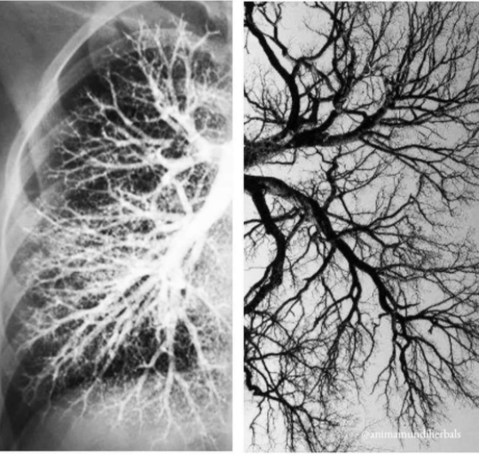
Climate Action Plan p. 7 - ‘We will ensure the climate implications of our actions are a key factor in decision-making’

Slide 11
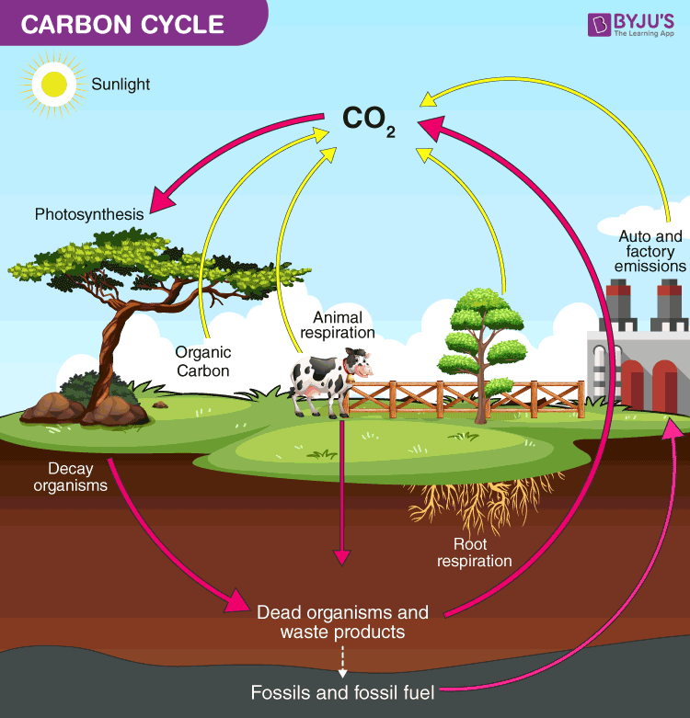

Slide 12
https://youtu.be/LwRTw_7NNJs Visualisation of temperature increase

Slide 13
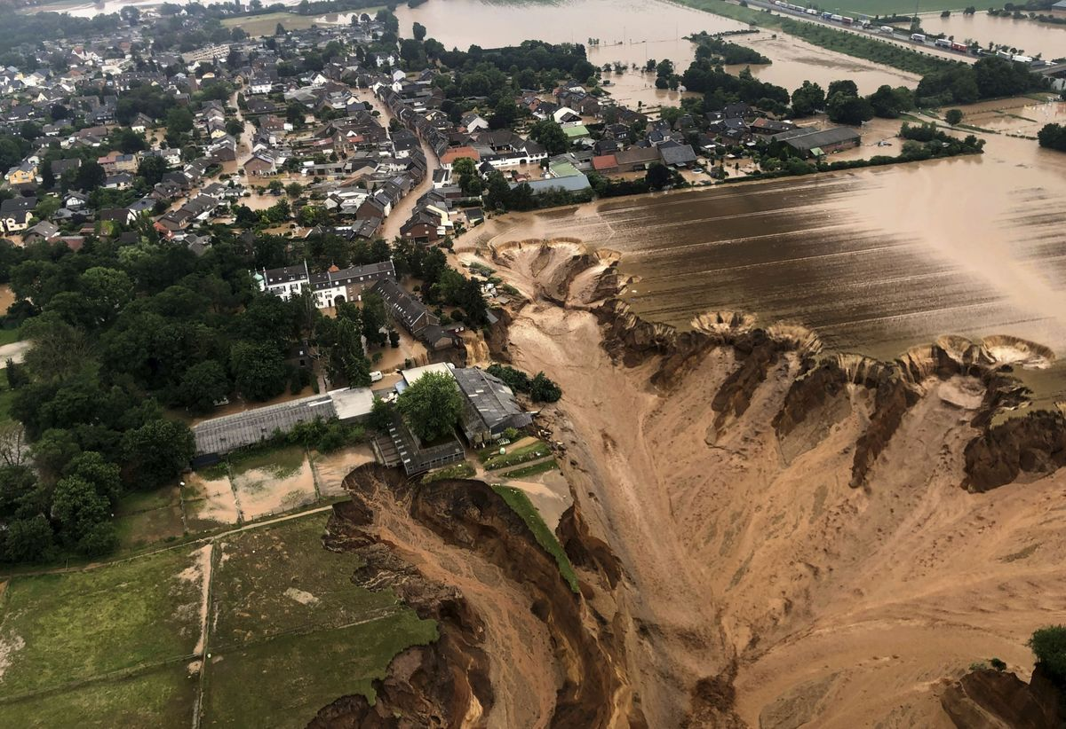
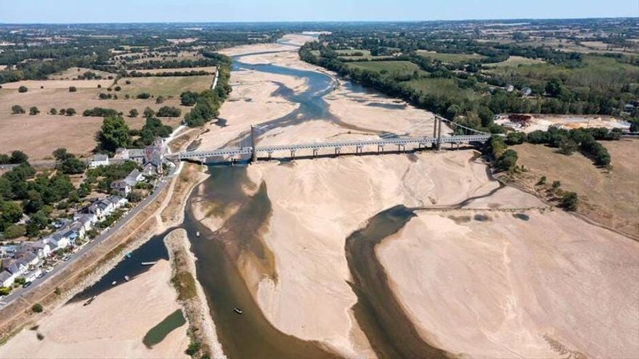
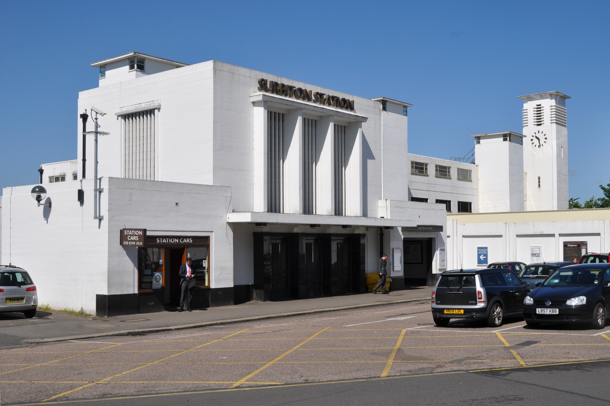
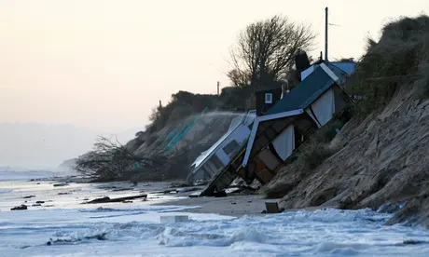
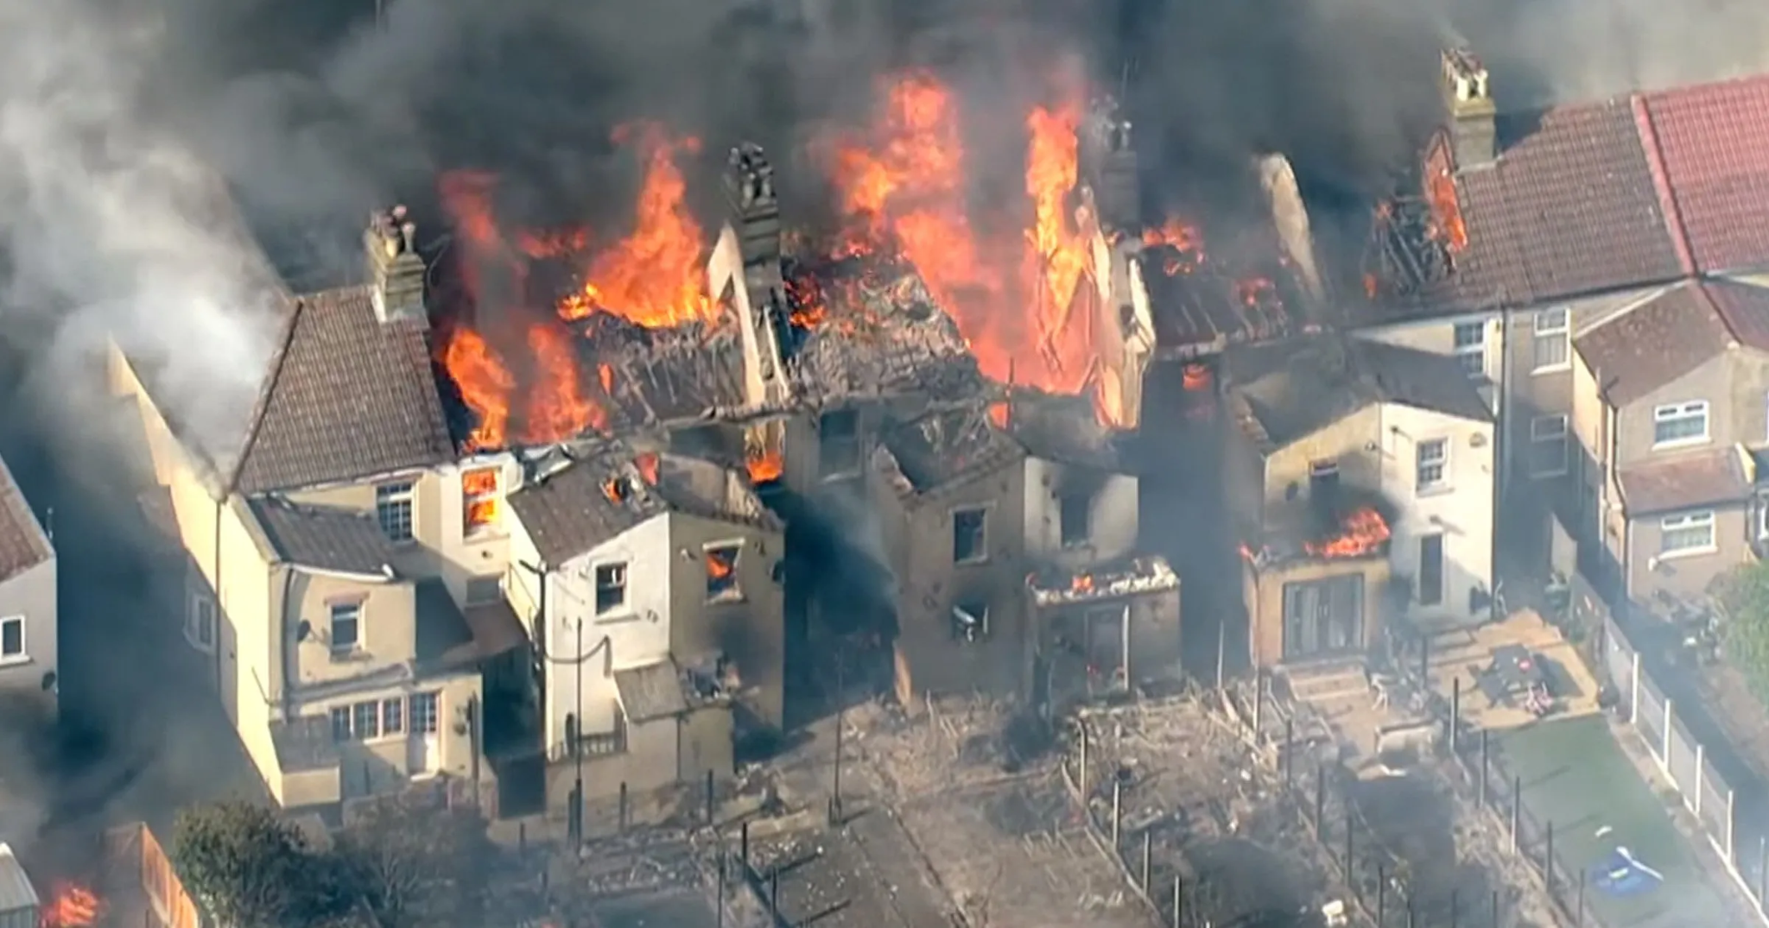

Slide 14
Where are we heading (by 2100)?
Safe limit for humanity 1.5°C
Policies & actions 2.7°C
Impacts will not be equitable across the planet, countries or communities.

Slide 15
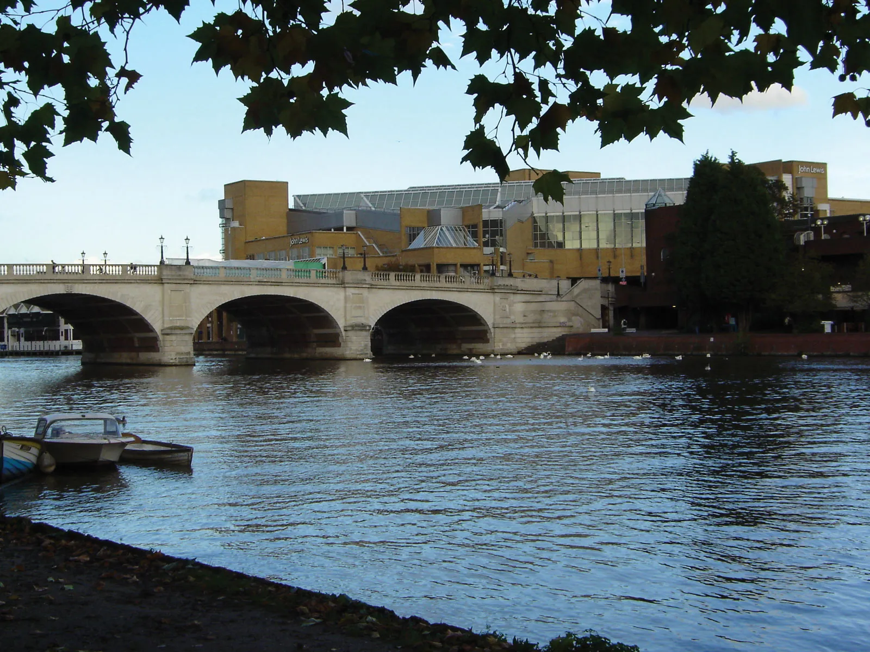
What can we expect locally
Flooding
Extreme heat and wildfires
Drought and water shortages
Health impacts
Food security impacts
International dimensions - conflict, migration, societal collapse
High impact low likelihood events, cascading impacts

Slide 16
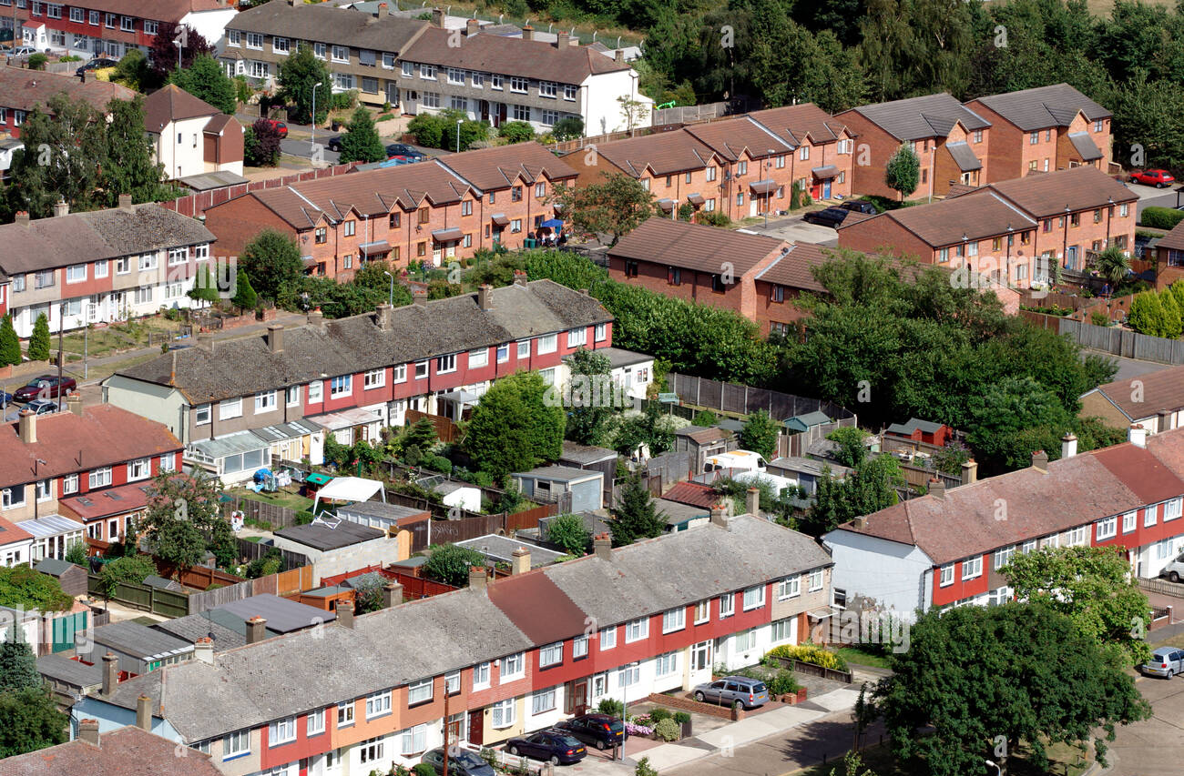
Sources of emissions - THE problem is…
T - Transport
H - Heat
E- Electricity
Waste
Natural environment

Slide 17
Acting on climate change
Name 3 most impactful things anyone can do to tackle climate change

Slide 18
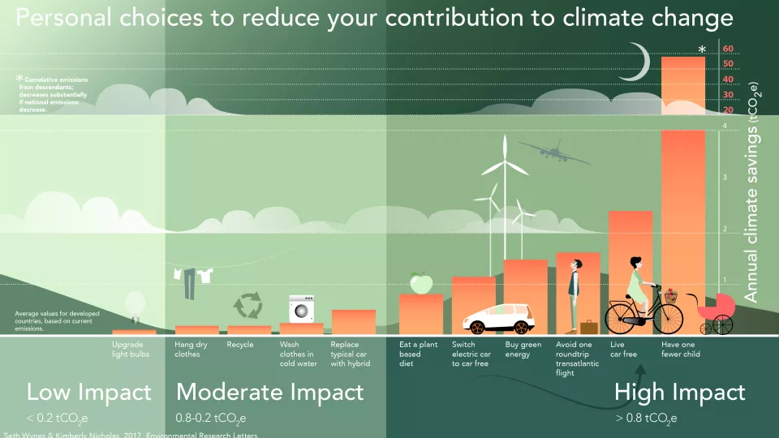
Acting on climate change
Stop or reduce car use
Stop or reduce flying
Energy at home - green tariff or producing your own energy & heat
Plant-based eating

Slide 19
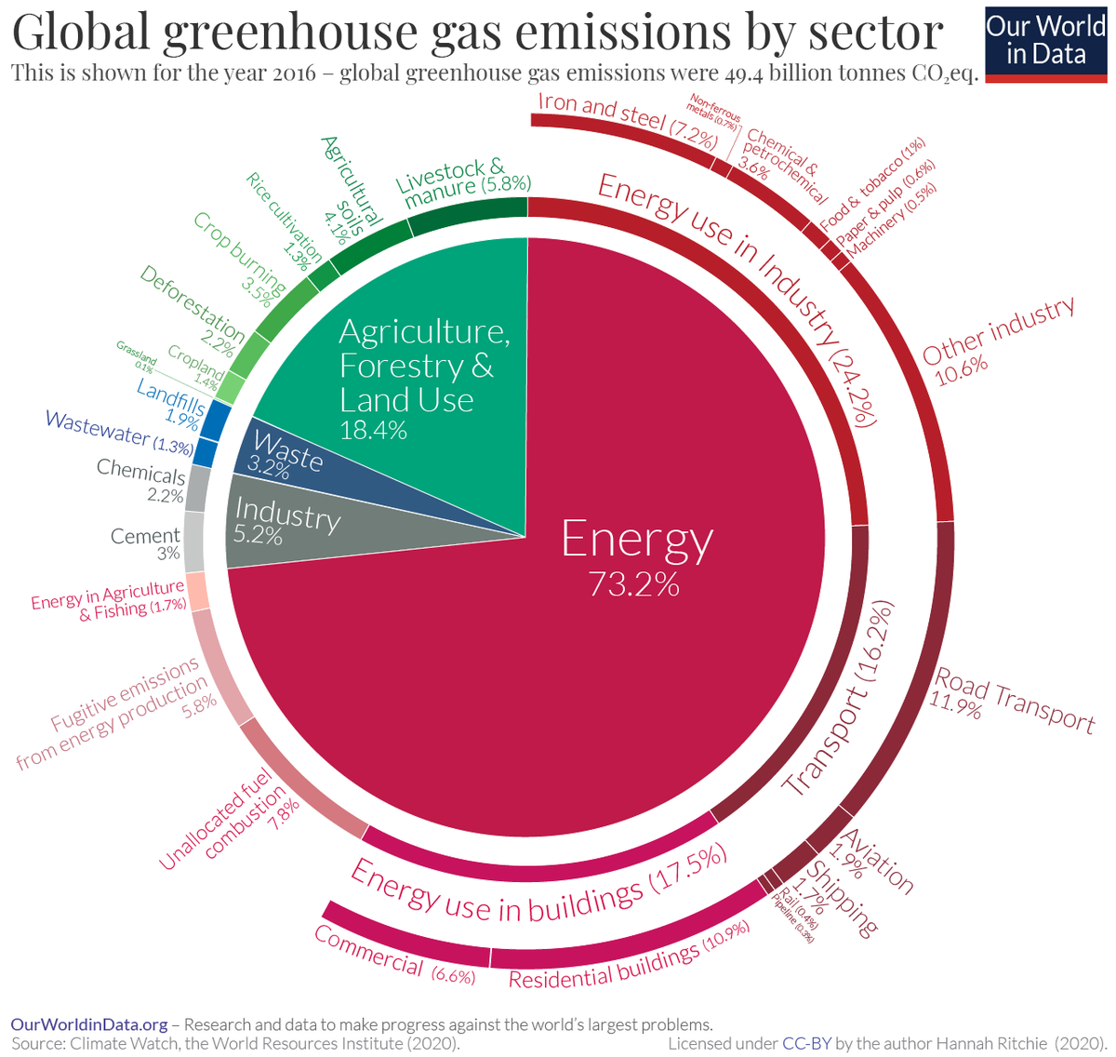

Slide 20
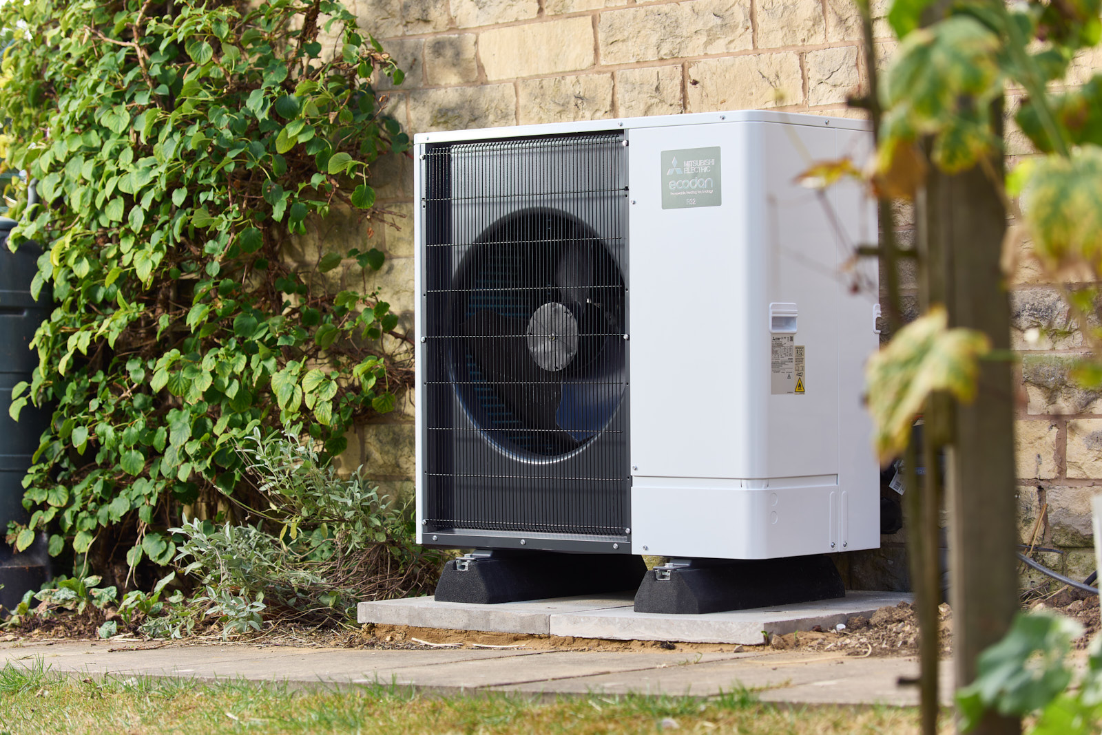
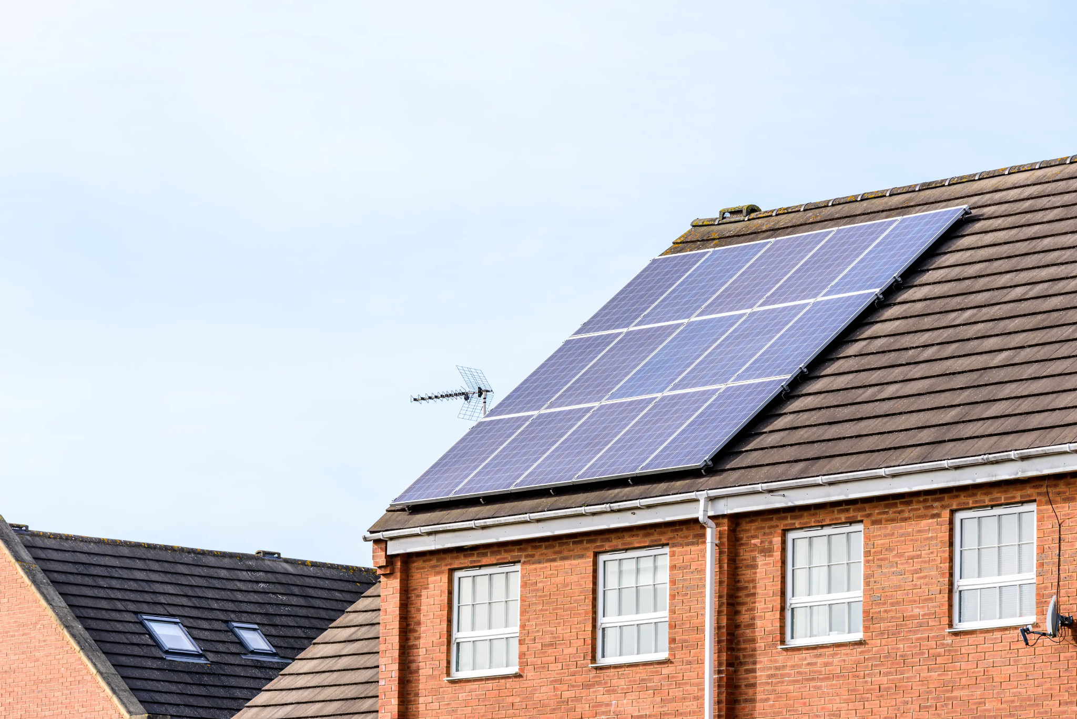
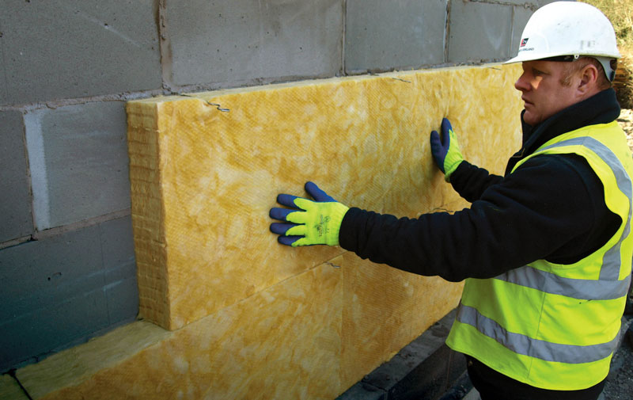
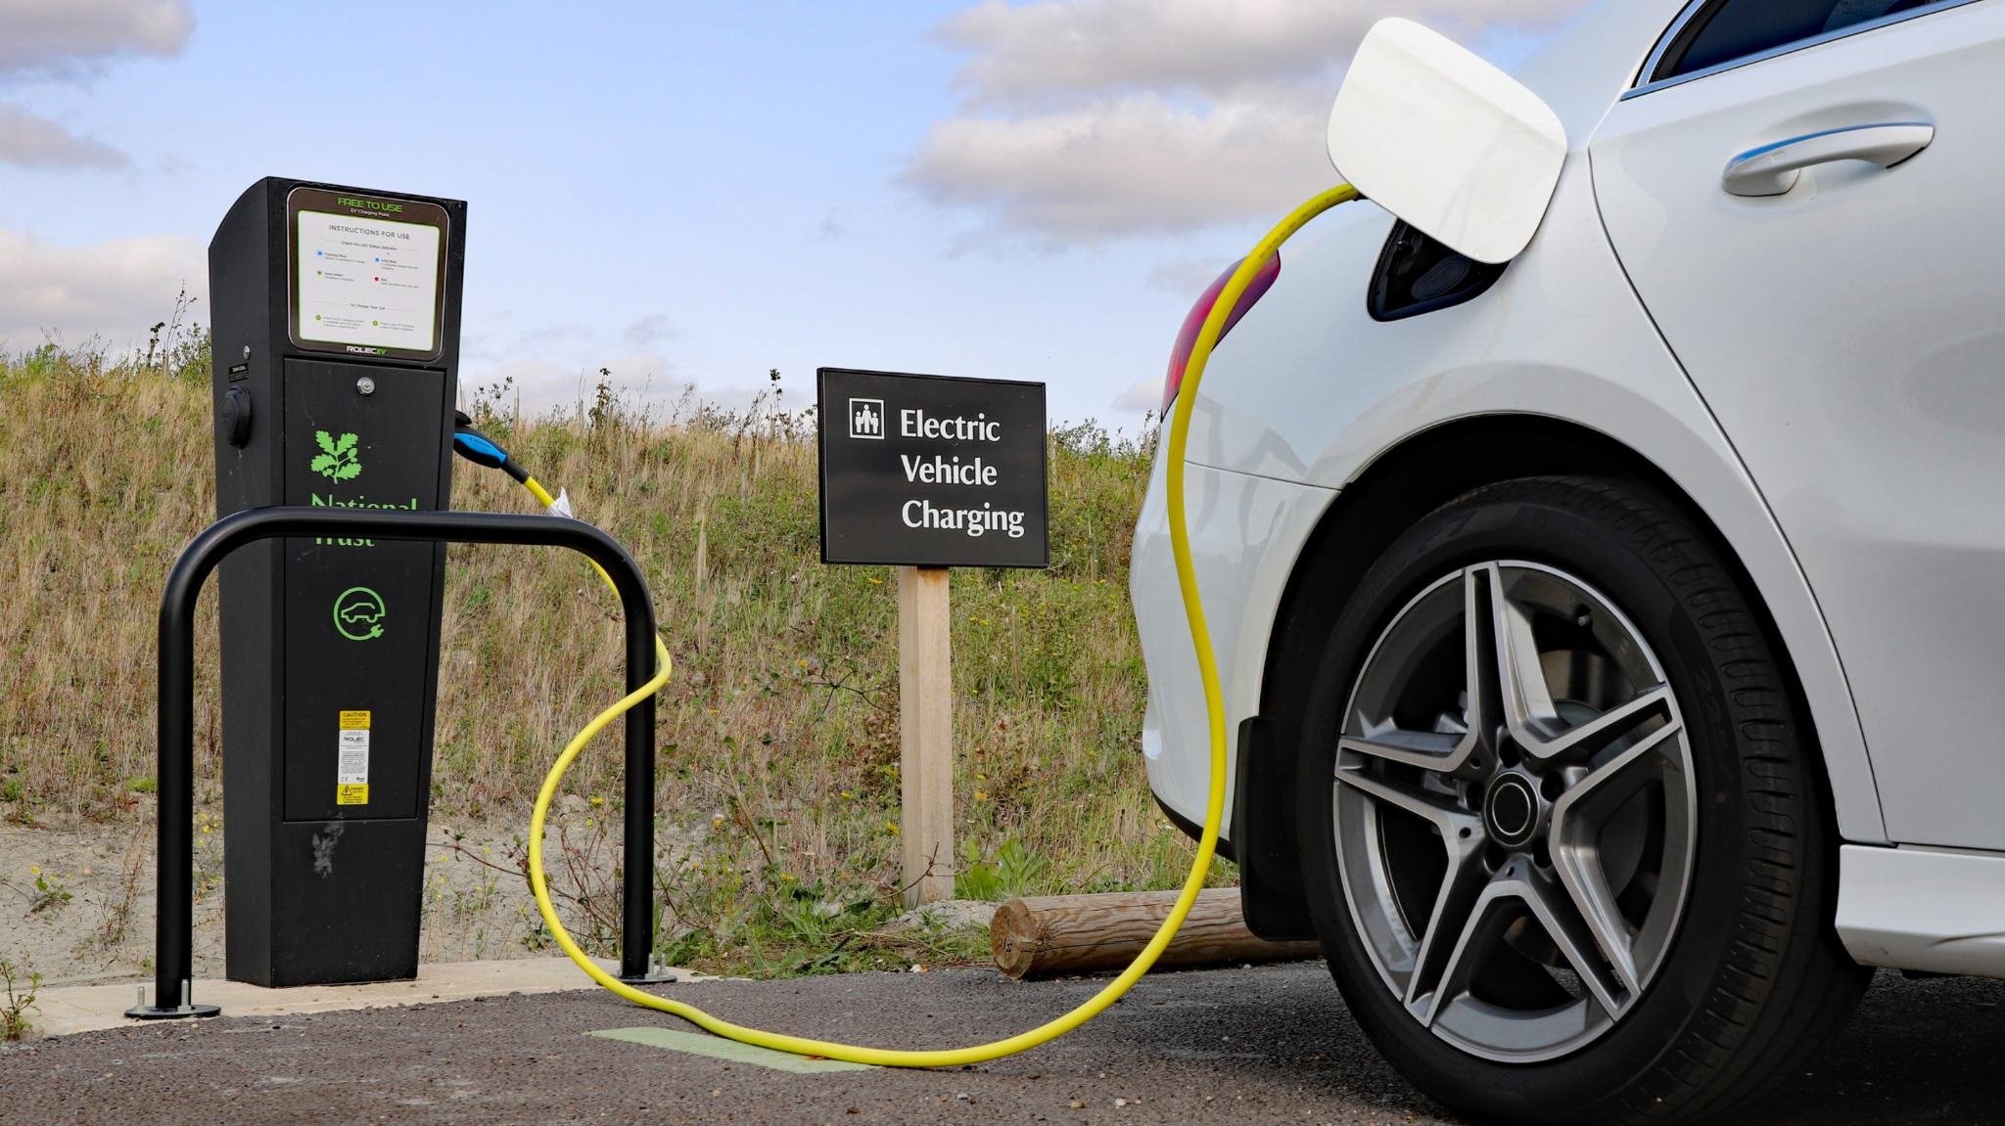
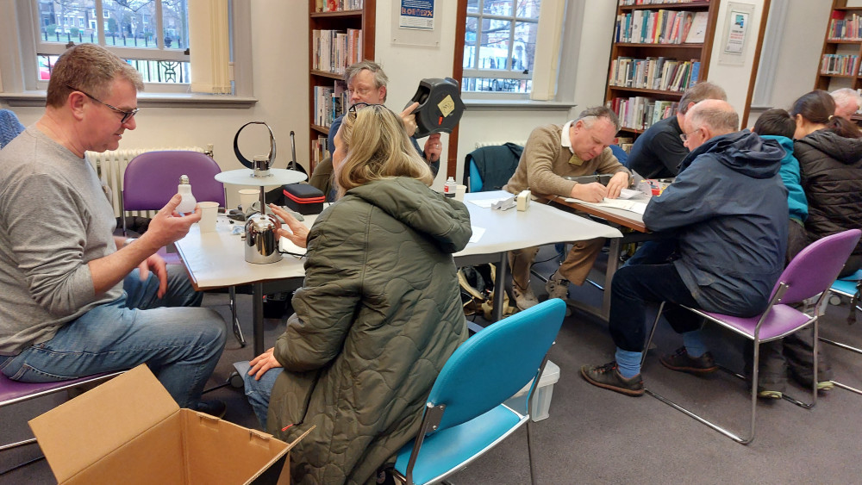
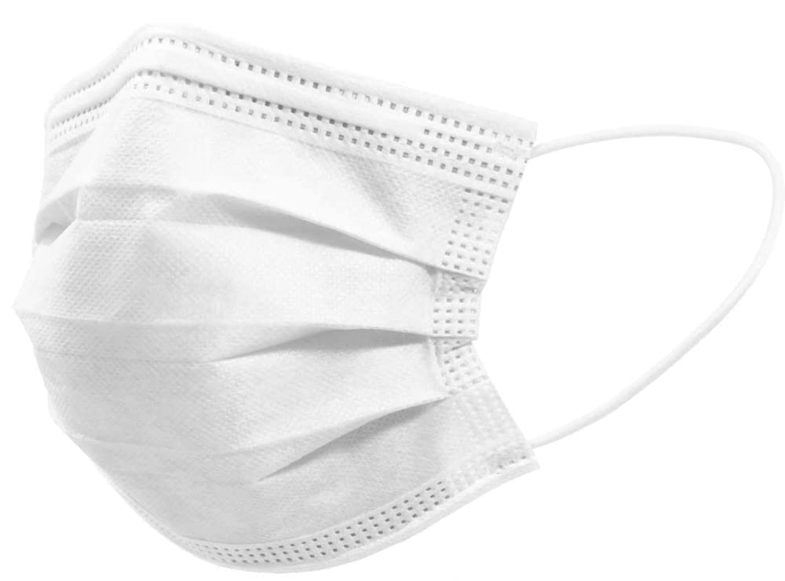
Solutions

Slide 21
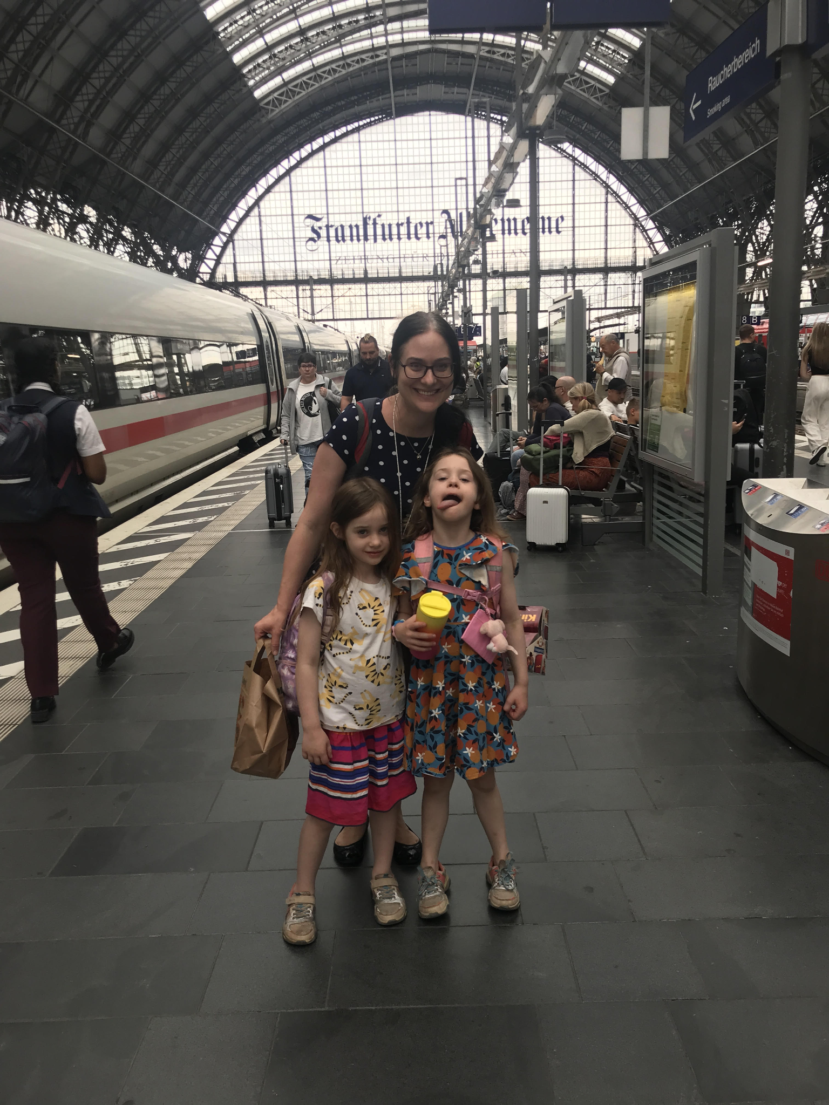

Slide 23
Thank you for your attention!
Please stay in touch:
Terezie Wickenden - Climate Action Officer
terezie.wickenden@kingston.gov.uk

