Slide 1

It Still Counts.
Shisha, Paan with tobacco, Naswar, Gutkha, Bidi, Cigars
If it contains tobacco, it increases your risk of cancer.
Notes:
Stephanie

Slide 2

Campaign Overview
It Still Counts is an RM Partners awareness campaign, supported by Cancer Research UK, focusing on all forms of tobacco products including shisha, paan with tobacco, gutkha, naswar, bidis and cigars.
The campaign will run across north west and south west London from November 2026 to March 2027 using community engagement, primary care, community pharmacy, dentistry, outdoor advertising, social media and digital channels.
The campaign is designed to:
increase recognition of different tobacco products
promote conversations about tobacco use
support access to local cessation services
Notes:
Stephanie

Slide 3
Why this matters
Tobacco smoking is linked to 16 different cancer types
Smoking shisha at least doubles the risk of lung cancer compared with non-users
Some communities experience higher exposure to non-cigarette tobacco products
Cancer incidence remains higher in more deprived communities, largely driven by higher rates of tobacco use
Identifying non-cigarette tobacco can be challenging. Many users do not consider themselves as smokers
Tobacco in all forms is harmful and increases your risk of cancer.
Research has shown that you can inhale the same amount of smoke in a 45-minute shisha session as if you smoked 100 cigarettes.
This means high amounts of toxic substances are taken in, even during one session.
4 x increase in the number of people in England exclusively use non-cigarette tobacco products from 2013-2023
33% increase in shisha cafes has been observed across the UK in the past five years
Notes:
Maria

Slide 4
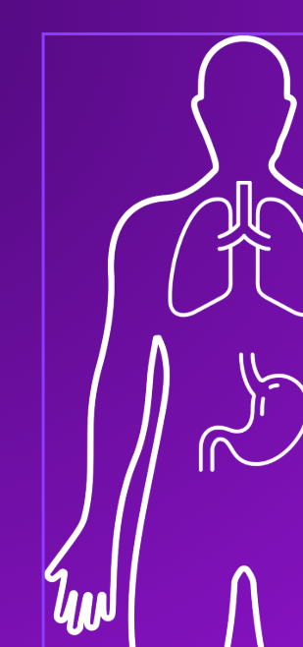
Learning objectives
By the end of the session participants will be able to:
Recognise common forms of non-cigarette tobacco
Understand associated cancer risks
Support conversations in their communities about tobacco use
Notes:
Maria

Slide 5
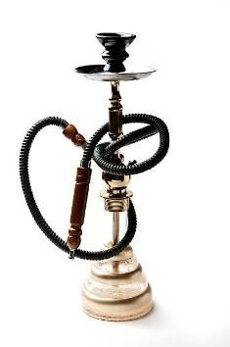
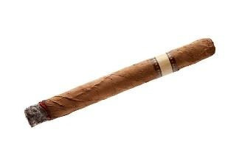
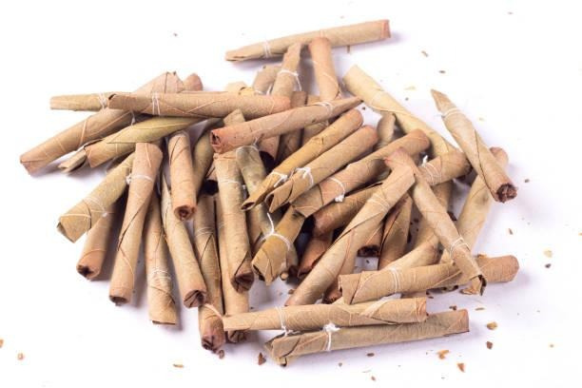
What products are we talking about? Smoked
Image Potential
Image Potential
Image Potential
Bidi
Shisha (waterpipe)
Cigars
  Shisha: Smoking device used to inhale heated, flavoured tobacco through a waterpipe. Products include tobacco-based mixtures and “herbal” alternatives.
  Users: • Arab • Pakistani • Bangladeshi • Popular among younger people in the UK
  Cigars: are made primarily from fermented and dried tobacco leaves. It is typically smoked by drawing smoke into the mouth rather than inhaling deeply.
  Users: Used across all ethnic groups
  Bidi: Thin, hand-rolled cigarette made from tobacco wrapped in a dried brown tendu leaf. Smoked like a conventional cigarette.
  Users: • Indian • Pakistani • Bangladeshi
Notes:
Maleeha

Slide 6
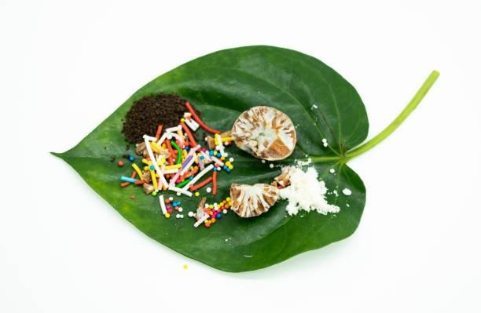
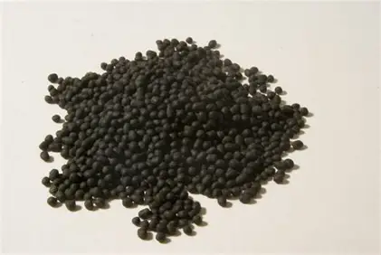
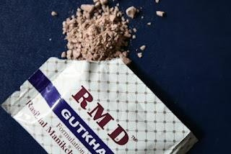
What products are we talking about? Smokeless/chewed
Paan
Naswar
Gutkha
  Paan: Preparation made by wrapping areca nut (betel nut), slaked lime, and sometimes tobacco or sweeteners in a betel leaf. When it contains tobacco, it is known as tambaku paan. Paan is associated with an increased risk of cancer even when it does not contain tobacco as areca nut is also a recognised carcinogen.
  Users: Indian • Pakistani • Bangladeshi • Sri Lankan • Nepalese
  Naswar: A moist, green, powdered smokeless tobacco made from sun-dried tobacco leaves with slaked lime, ash, and occasionally flavourings or colourants. Consumed orally, often as small balls placed under the tongue to absorb nicotine.
  Users: • Afghan • Pakistani • Uzbek • Tajik • Iranian
  Gutkha: Product made from tobacco, areca nut, slaked lime, and flavourings. Chewed and held in the mouth to release nicotine and stimulant effects.
  Users: Indian • Pakistani • Bangladeshi
Notes:
Maleeha

Slide 7
Oral (Mouth) Cancer
A mouth ulcer that has not healed after 3 weeks
A lump on the lip, in the mouth or in the neck
Red or white patches in the mouth that do not go away
Symptoms of tobacco related cancer
Anyone who uses tobacco, including shisha, naswar, gutka, paan with tobacco, bidis or cigars, should be aware of possible cancer symptoms.
Oral (Mouth) Cancer
A mouth ulcer that has not healed after 3 weeks
A lump on the lip, in the mouth or in the neck
Red or white patches in the mouth that do not go away
Throat or Voice Box Cancer
A hoarse voice that does not improve
A lump in the neck
Persistent sore throat or difficulty swallowing
Notes:
Maria

Slide 8
Oral (Mouth) Cancer
A mouth ulcer that has not healed after 3 weeks
A lump on the lip, in the mouth or in the neck
Red or white patches in the mouth that do not go away
Food Pipe (Oesophageal) Cancer
Difficulty swallowing food or drinks
Pain when swallowing
Persistent indigestion or heartburn, especially if accompanied by weight loss
Lung Cancer
A cough lasting more than 3 weeks
Shortness of breath
Chest pain
Unexplained weight loss
Loss of appetite
Repeated chest infections
Passive smoking, or second-hand smoking, means breathing in other people’s tobacco smoke, also known as second hand smoke.
For further information about the risks of passive smoking, visit: What is passive smoking? | Health risks of second hand smoke | Cancer Research UK
Stomach Cancer
Ongoing indigestion that does not improve
Persistent pain in the upper abdomen
Feeling or being sick regularly
Difficulty swallowing
Unexplained weight loss
A lump in the upper abdomen
Notes:
Maria

Slide 9
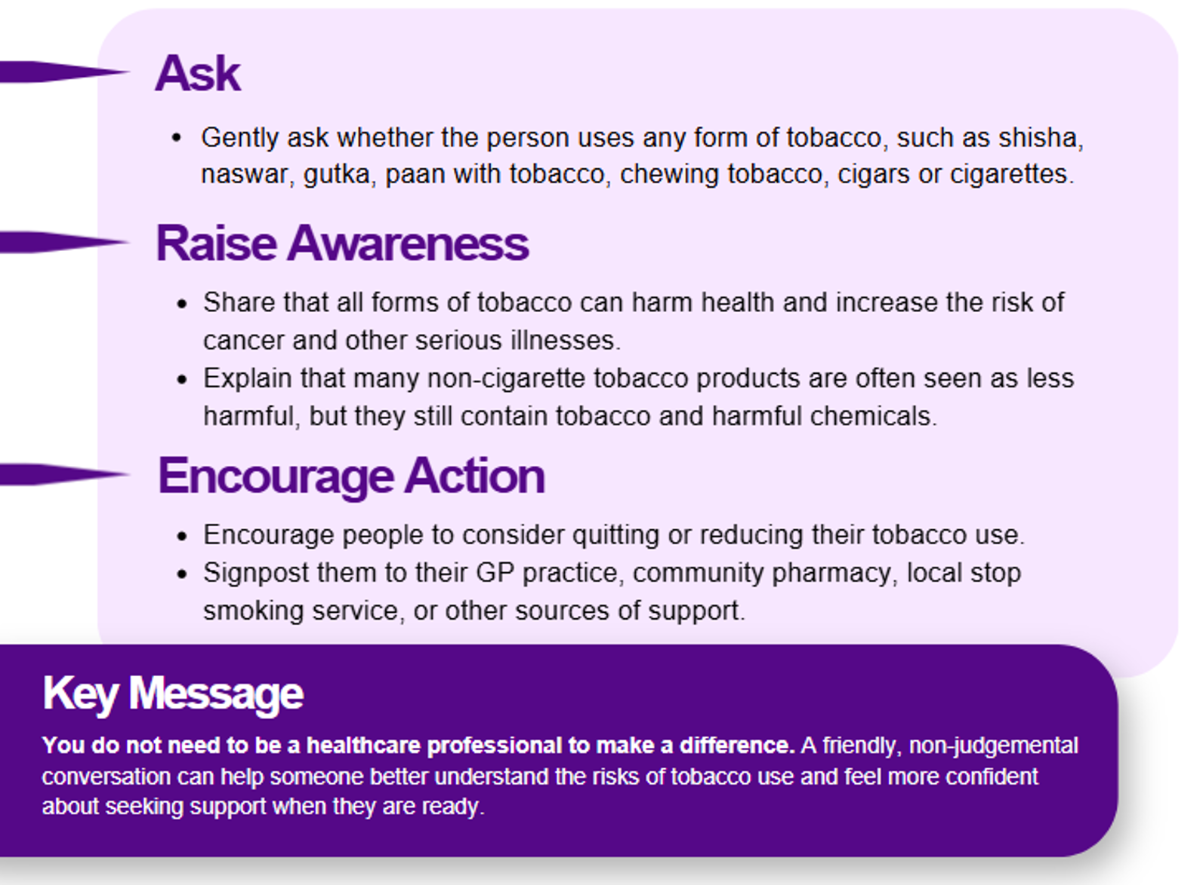
A Simple Conversation
Community leaders are trusted voices within their communities and can play an important role in raising awareness of the harms of all forms of tobacco use.
Simple, supportive conversations can help people understand the risks, challenge common misconceptions, and encourage those who use tobacco to seek support when they are ready.
Notes:
Maria

Slide 10


Referral pathways and support services
Actively refer people to local tobacco cessation services
Every London borough has a local tobacco cessation service. Some of these may support people who use either smoked or smokeless tobacco products, including paan with tobacco, chewing tobacco and shisha.
Find local services and further information at:
Stop Smoking London
https://stopsmokinglondon.com/support/
Smoke Free App for London
https://stopsmokinglondon.com/smokefree-app-for-london/
Notes:
Maria

