Slide 1
Tom Lowe,
Senior Programmes Officer (Grants)
Kamrul Islam,
Programmes Officer (Grants)

Slide 2
Groundwork London
Social and environmental regeneration charity.
Work with communities across Greater London to:
Create Better Places
Promote Greener Living and Working
Improve people’s prospects
https://www.groundwork.org.uk/london/grants-london/
Community charity,
including grant management

Slide 3
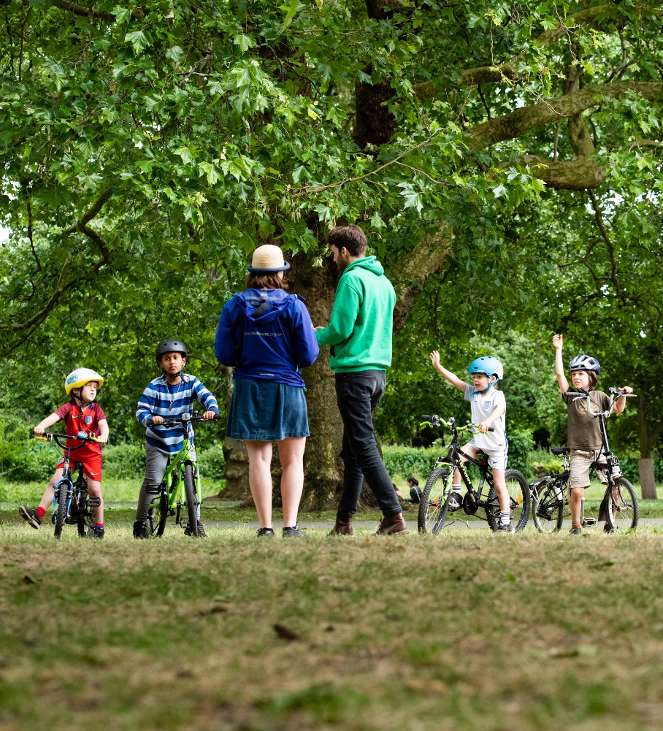
Grants Team
Support environment and conservation aims, including equality of access
Promote democratic engagement
Engage individuals with physical activities
Promote social integration, tolerance and wellbeing
Support community-led cultural events
Help communities create greener, healthier places
Support and advice to migrants
londonprogrammes@groundwork.org.uk
Sign up to our mailing list! my.brevo.com/users/subscribe

Slide 4
Funding Opportunities in 2025
Walking & Cycling Grants London, July 2025 - September 2025
wcgl.London
Community Ideas Grants, July 2025 - September 2025
wcgl.london/what-we-fund
Shared Endeavour Fund, Call 6
https://www.groundwork.org.uk/london/shared-endeavour-fund/

Slide 5
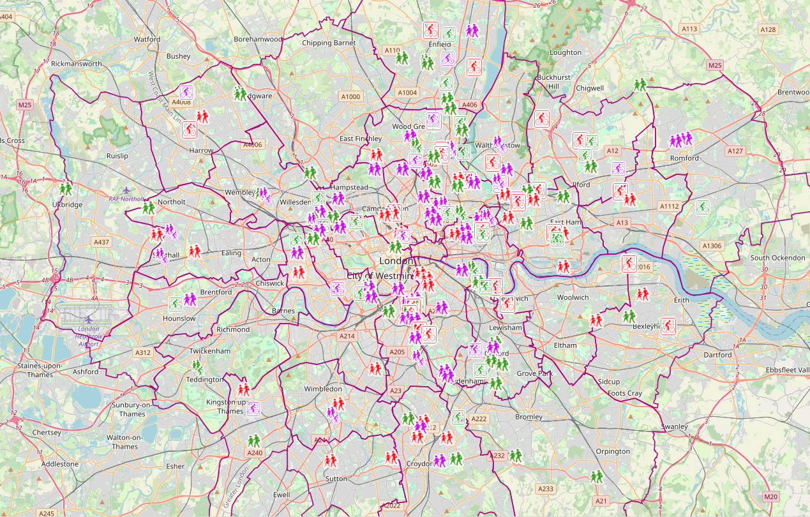
WCGL Project Map - https://wcgl.london/project-map

Slide 6
What are funders looking for?
Funding criteria: Does the project meet the funder’s criteria?
Identified need: Will the project meet an identified need? Does this project address a gap in service provision?
Network: Does the organisation have a presence within the community / borough and established network?
Budget: Is the budget realistic, cost effective and good value for money?
Sustainability: How will the project benefits be sustained / Who will maintain the project?

Slide 7
Questions?

