Slide 1
Four Year Volunteering Strategy for Kingston
Volunteering Kingston

Slide 2
Volunteering Kingston
Notes:
2 mins
Volunteering Kingston is part of Groundwork London
Some of you may recognise me as I started working with the Volunteering Kingston team in December 2019 and then moved to working for Groundwork in East London in December 2021 – which was a very uneventful 2 years. My name is Molly Sweeney and I’ve been called back to my roots to help with the community engagement for Kingston Council’s four year volunteering strategy

Slide 3
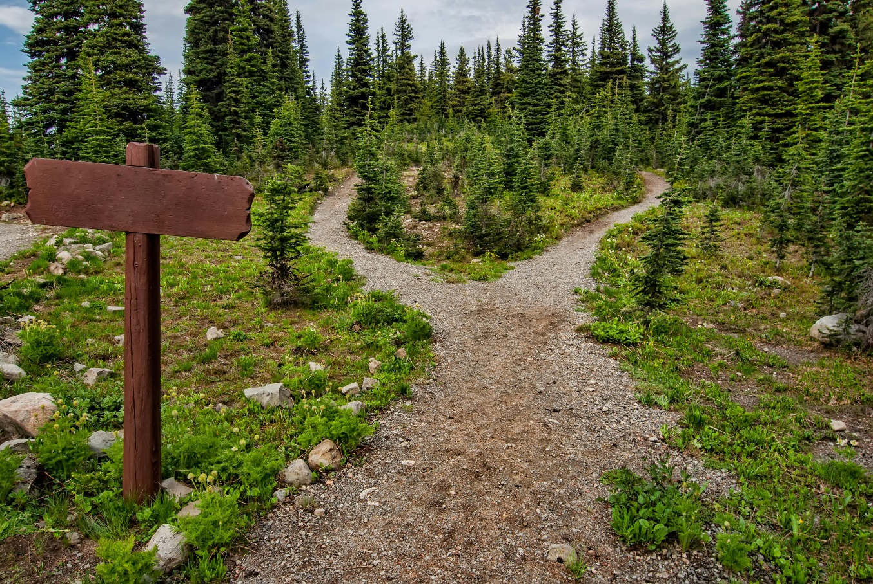
What is the strategy?
Notes:
5 mins
I’m aware that they strategy won’t be brand new to you all, but I’m just going to recap quickly
Volunteering Kingston is working with partners across Kingston Stronger Together to help with the development of a new strategy to share the next 4 years of the involvement of volunteers in Kingston. This strategy will guide and develop the approach of Kingston Council, Volunteering Kingsotn and other partners as we work to make Kingston the best borough in which to volunteer.
We want to hear from organisations and groups which involve volunteers, whether they are big or small, formal or non-formal, registered with Volunteering Kingston or not. We’re co-creating Kingston’s volunteering strategy for the next four years.
If you completed our survey, thank you so much – we still really welcome responses as well as more engagement

Slide 4
Result from the survey so far
We’ve had a great response
Here are some selections of key info to spark your interest
Notes:
We’ve had surveys out for people engaged in formal volunteering, those not engaged in formal volunteers, as well as volunteer involving organisations.

Slide 5
Volunteer Word Clouds

Slide 6
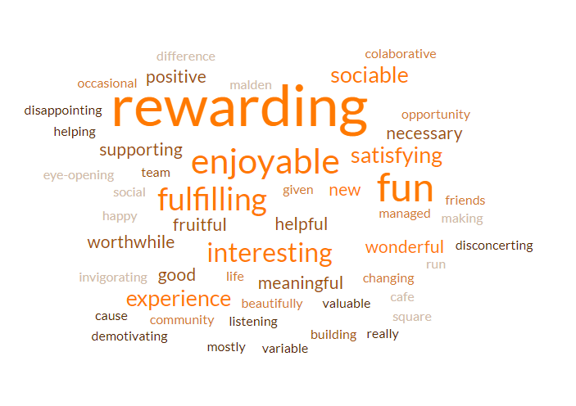
Please describe your volunteering experience in 3 words?

Slide 7
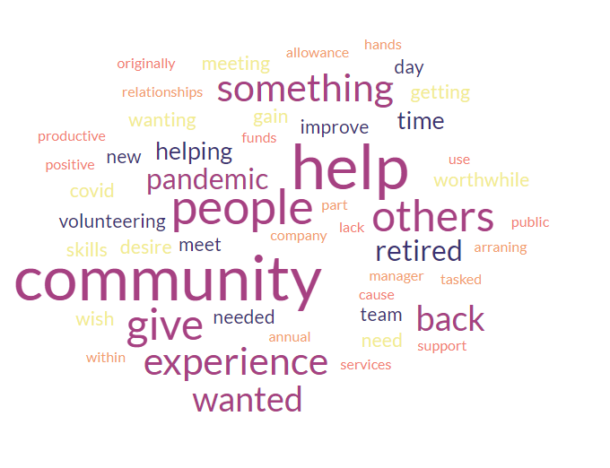
What motivated you to volunteer?

Slide 8
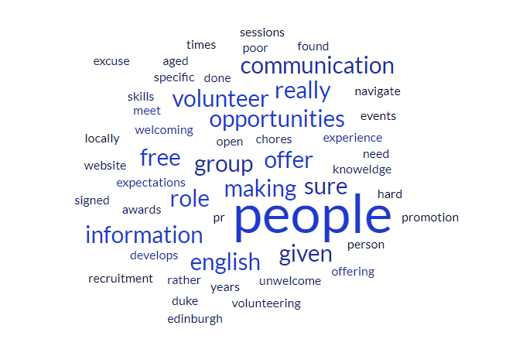
How to improve the experience of volunteers?

Slide 9
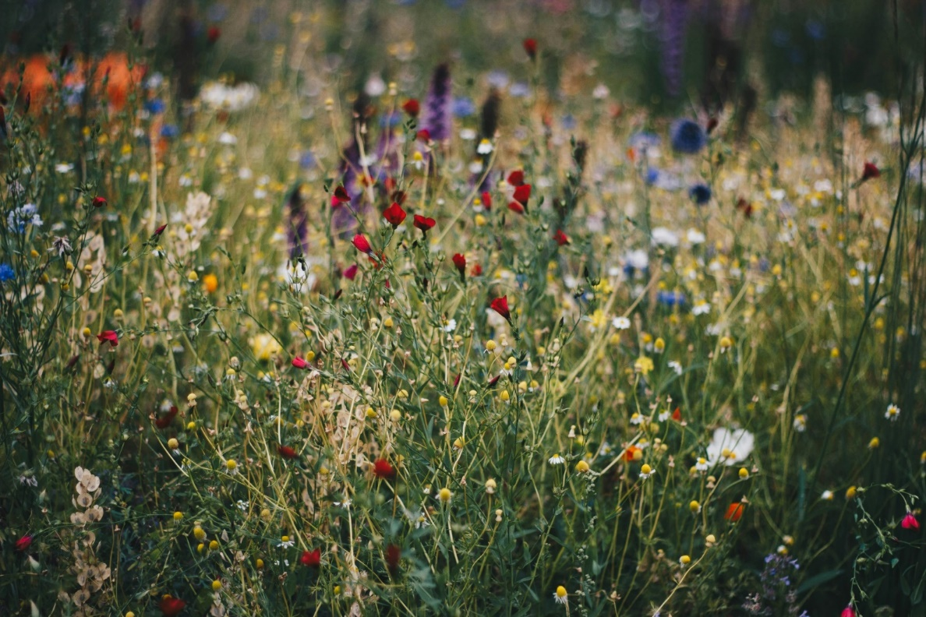
Thinking forward to 2028…
Notes:
10 mins
Let’s take a minute and dream. Where do we want to be in 2028?
We’re facing a lot of challenges right now and the weight of that can feel heavy, especially if we take that responsibility as part of the voluntary and community sector. It was nearly four years ago to this day that we had our first lockdown, and it doesn’t feel like we’ve had a break since.
But let’s take a second to dream – to close our eyes – what are your hopes for 2028? – take 1 minute
Turn to the person next to you and share for 1 minute – Take 1 minute
Does anyone have any they’d like to share?
Hear some and summarise

Slide 10
Also John Boyega is James Bond

Slide 11
Thoughts from the VIO survey
Notes:
WE asked the question: “How do you see Volunteering evolving over the next four years?”

Slide 12
Glass half full/half empty
Positive | Negative/Challenges
Increased flexibility of volunteering roles | Volunteers will stay for less time.
Embracing technology | Harder to recruit and retain volunteers with the level of experience and qualification that we need.
Good intentions | Harder to recruit volunteers.
More young people interested and involved in volunteering.
More recognition of the personal and social benefits of volunteering (I hope!)

Slide 13
Increased need requires more volunteers …
Volunteering will become an even more vital part of capacity building as services come under more pressure to deliver more for less
Volunteering will become an even more vital part of capacity building as services come under more pressure to deliver more for less / The need for volunteers will only increase in the coming years

Slide 14
Challenges
“Some volunteers are experienced in other fields and want to support their community by giving time; others want to gain experience to assist them in future opportunities and we need to ensure a good mix”

Slide 15
Rank the challenges
https://www.mentimeter.com/
Code: 5555 1141
Notes:
5 mins
We’re going to use MentiMeter! It’s a great way of hearing your views.
We’ve had a moment of positivity – now let’s digdown into the challenges

Slide 16
Which of the following is the most important for volunteering in the borough?
https://www.mentimeter.com/
Code: 5555 1141
Notes:
5 mins
We’re going to use MentiMeter! It’s a great way of hearing your views.

Slide 17
Finally, what is your wish for volunteering in the borough?
https://www.mentimeter.com/
Code: 5555 1141
Notes:
5 mins
We’re going to use MentiMeter! It’s a great way of hearing your views.
Write your wish and then we can also co-sign/vote for those you agree with, up to 3 times.

Slide 18
Other ways to share your thoughts
My email is molly.sweeney@groundwork.org.uk
Notes:
I’ll have a handout flyer with my contact details and a link to sign up for a meeting with me or a colleague

Slide 19
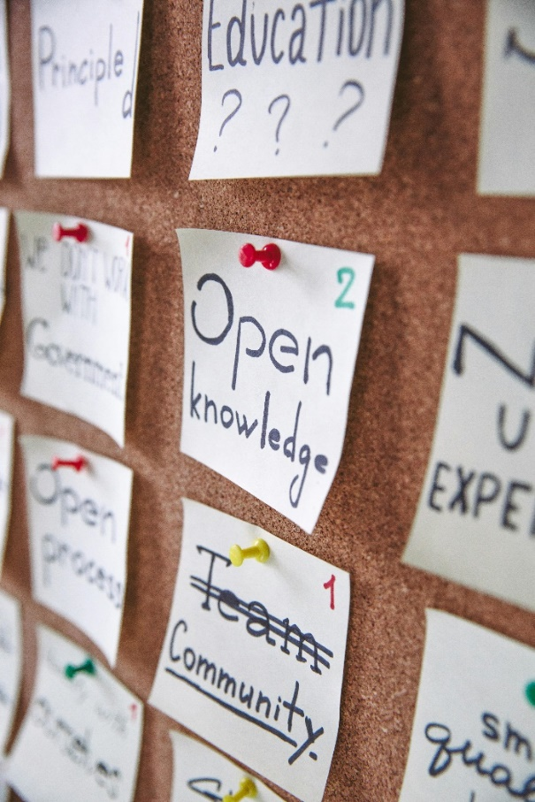
Hearing the views of people who use your services
Notes:
As well as co-creating with volunteering-involving organisations, we’re also excited to hear from people who use your services. We’d especially like to hear from people who are less likely to engage in volunteering or where there are barriers to them taking part. We’d be very excited to attend a regular meeting or session and run a focus group or workshop to capture their views on volunteering. These would be fun and engaging sessions which we are happy to adapt the needs and interests of the group – for example, exploring volunteering through creative activities.

Slide 20
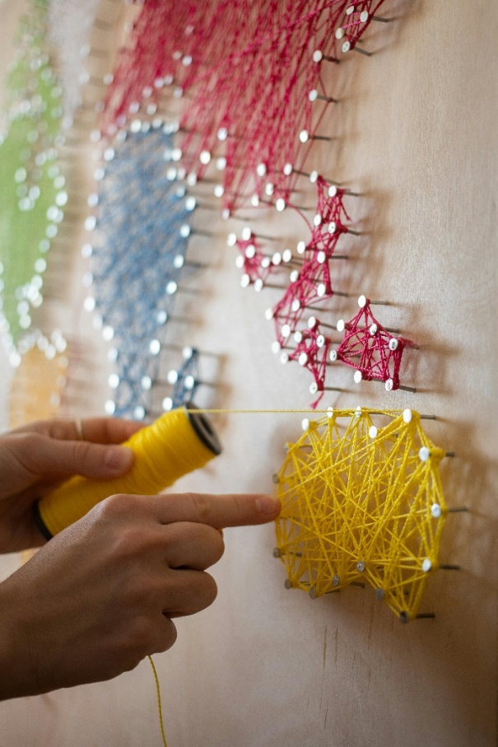
Summing up

Slide 21
GLA London Community Resilience Toolkit ​

Slide 22
About the toolkit
London to face increasing climate challenges & emergencies in the future.
Tasked by the GLA to develop a community resilience toolkit to support the Greater London communities
Would like your help to ensure the toolkit is fit for purpose, relevant and what you and your communities need.
Toolkit to provide information, guidance and tools to support community resilience activities.
Notes:
Working with Groundwork South – funded by the GLA
We know that climate challenges and emergencies are likely to increase in the future, such as floods or heatwaves.
We are creating a toolkit to support the development of community resilience
Bringing together practical guidance, support, templates to communities in an accessible and digestible way
To support the work already taking place, to help bring together community resilience activities
We want to make sure the toolkit is right for you and your communities, so it would be great to get your insights and inputs so we can incorporate and adapt the toolkit to meet your needs.

