Slide 1

KVA – Health and wellbeing network
3 October 2023
Tara Ferguson Jones,
Director of Communications and Engagement, HRCH, Kingston Hospital, Kingston & Richmond SWL ICB
1
Notes:
1

Slide 2
Agenda
Kingston Place based partnership – a reminder of what it is and who is involved.
Introduction to Community Voices Kingston
Examples of our Kingston Place based engagement work.
Information Sharing – All
2
Notes:
Tara – run through what we will be covering with you this morning.
Last item – keen to hear from you what you are hearing from your clients about local health and care services.
2

Slide 3

We are an integrated care partnership
Our acute and community providers
Our two mental health providers
Our 39 primary care networks
GP Federations in each of our six boroughs
The London Ambulance Service
Our six local authorities
Our six local Healthwatches
Our South West London voluntary and community and social enterprise (VCSE) sector
Our NHS provider collaboratives
South West London Integrated Care Partnership launched on 1 July 2022 bringing together all the local health and care partners.
The ICS replaced the South West London Health and Care Partnership, taking on new statutory roles and responsibilities.
Notes:
Reminder:
South West London Integrated Care System (ICS) launched on 1 July 2022 alongside NHS South West London. The ICS replaced the South West London Health and Care Partnership, taking on new statutory roles and responsibilities
Our ICS is a partnership of primary care, hospital, social care, mental health and voluntary and community health and care services.
Together we plan and deliver joined-up services to improve access and quality and to reduce health inequalities.

Slide 4
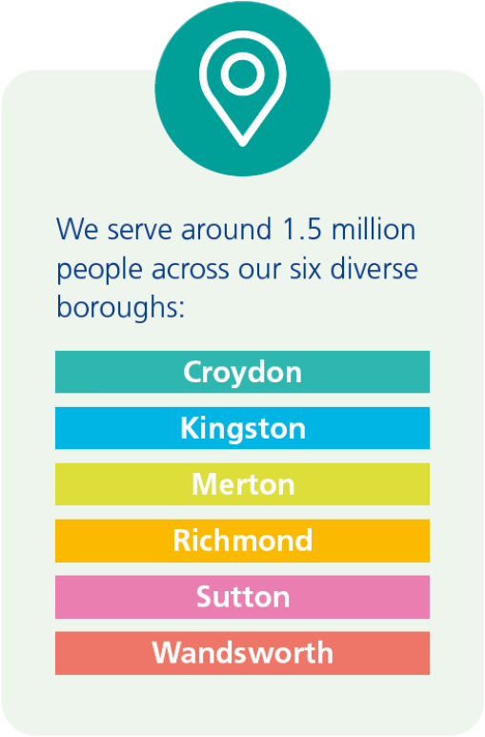
The ICB’s role
NHS South West London Integrated Care Board is a member of the partnership. The ICB was also established on the 1 July 2022, taking on many of the functions delivered formerly by NHS South West London CCG.
The ICB is a statutory organisation bringing together the NHS to improve population health and establish shared priorities for local people, as well as being responsible for deciding how the NHS budget for South West London is spent.
Notes:
As NHS South West London Integrated Care Board (ICB).
We serve around 1.5 million people across our 6 diverse boroughs, Croydon, Kingston, Merton, Richmond, Sutton and Wandsworth. Each borough has established a Place based partnership covering primary care, local hospitals and community services, Council - social care, mental health and voluntary and community health and care services.
We are responsible for investing the funding we receive from the government to maximise the health of the local population and overseeing the delivery of NHS services in South West London.

Slide 5
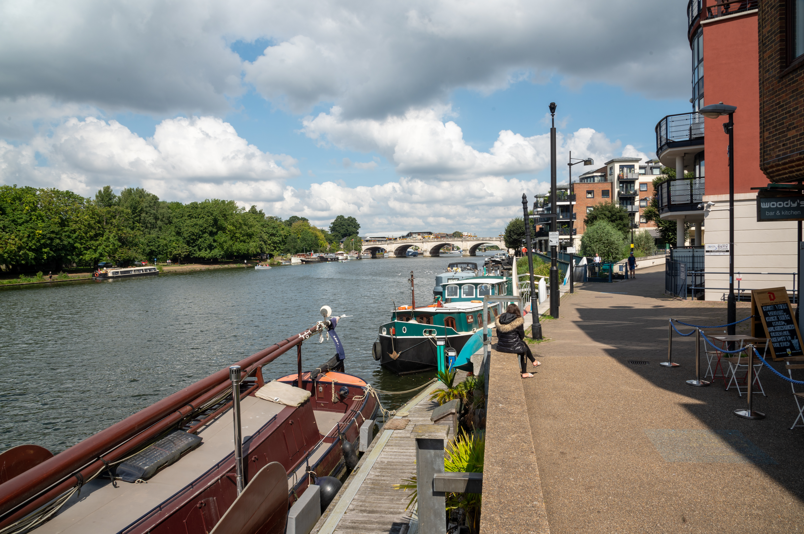
Kingston ‘Place’
In Kingston, our place-based partnership includes representation from:
Kingston Council
Achieving for Children
Kingston Hospital NHS Foundation Trust
Your Healthcare
Primary care
South West London & St. George’s Mental Health NHS
Trust
Healthwatch Kingston
Kingston Voluntary Action (voluntary and community
sector)
Kingston Carers Network (carers)
NHS South West London ICB
You can find out more at https://www.southwestlondonics.org.uk/kingston/kingston-place-based-partnership-committee/
5
Notes:
Reminder of which organisations are involved in our Kingston placed based partnership.
List on the slide and you can find out more about the Place committee using this link.
Sanja is the Kingston VSC lead on the Place Committee and I am the C&E lead.

Slide 6
Community Voices Kingston
Who are we?
Community Voices Kingston aims to bring together local communities in Kingston and the groups and organisations supporting them to work with Kingston Place health and care partnership.
We want to gather insight on experiences of health and care services with a hope to improving local services. We especially want to hear from those most likely to experience health inequalities and the worst health outcomes to try and capture voices we don’t typically hear from.
To achieve this, we have joined with Kingston Voluntary Action and Healthwatch Kingston, working in partnership to engage our local communities.
To avoid groups and organisations having to attend multiple meetings and forums, we will be tapping into existing ones, to further the reach of Community Voices Kingston.
Community Voices Kingston will have a regular slot at KVA’s Health & Wellbeing Network and Healthwatch Kingston’s Open Meetings.
6
Notes:
Reinder of what we are trying to achieve by establishing Community Voices Kingston.
Also about helping us test ideas about how to engage with communities and particular patient groups.
It is one way of involving local people and communities but there will be other opportunities to get involved in project specific work and we are working on a forward plan for engagement which we will share with Emma.
6

Slide 7
Overview
The following slides provide an overview of our engagement work at Place between April and June 2023 – Quarter 1
This report will be reviewed and assured by each Place
We group our engagement work at Place in these areas – as illustrated by the overview slide to follow:
  Demand management and pressures
  Infrastructure and relationships
  Health inequalities and community outreach
  Primary care and Primary Care Networks (PCNs)
  Prevention and early intervention
  Horizon scanning and issues management
  Service improvement and change
These slides include:
  An overview slide for Place
  Worked examples of Place based engagement work – demonstrating the impact and the difference made for local people and communities
  A case study - a local example of our engagement work and its impact on services.
Notes:
The next few slides are taken from our quarterly engagement assurance report which is reviewed by our Place Committee and then by SWL engameent assurance group.
It provides some worked through examples of Place based engagement demonstrating the impact and difference it is making for local people.
I don’t intend to go through each slide but happy to take questions.
Projects included this quarter where:
Engagement around LD and autism to inform the SWL JFP working with Kingston all age LD partnership and Kingston eco-op.
Working with HWK – Youth Out Loud and K&R Youth Council to hear from YP about online mental health resources
Review of post diagnostic services for Autism and ADHD working with local groups and parent forums to gather experiences of these service to make improvements.
Ends with a case study of the great partnership working with voluntary sector,. NHS, and GP practices to support carers.

Slide 8









Kingston
Demand management and pressures
Getting people to the right place at the right time
Prevention and early intervention
Behaviour change – communicating to support demand management
Reassurance and Confidence – outlining the robust health and care system response to winter pressures
Preparing, connecting and responding
Working with senior leaders to manage the comms and engagement elements during issues and crisis management and link between SWL and place during incidents as part of ICB EPRR role
Staying aware of current issues to advise on and plan for media
or stakeholder interest and management
Examples of current activity:
z
Mental health:
New online directory of MH services for CYP in K&R
Promoting local MH services through winter outreach with VCSE groups
Pharmacy campaign
Urgent and emergency care
Horizon scanning, issues and crisis management
For longer, happier lives
Health inequalities and community outreach
The NHS long term plan set out our responsibilities to not only treat people, but
also prevent them from getting ill in the first place. This activity supports Kingston
residents to live longer happier lives and allows us to treat avoidable illness early on.
Building trust and identifying health gaps sooner
KINGSTON
ICS Strategy – collating feedback from Kingston & Richmond residents to influence the development and delivery of the ICS Strategy and priorities
Understanding our communities and potential barriers – to access, we need a meaningful, ongoing conversation with communities we serve, in an appropriate way
and in places familiar to them.
Building relationships, improve trust and increase health literacy – to reduce the gaps we see amongst our population. We also collate insights, identify emerging themes to influence the way we provide services and ultimately reduce health inequalities.
Place–based
communication and
engagement
Examples of current activity:
Vaccines: Covid-19, flu, childhood immunisation
Cost of living information and sign posting
Thriving Transformation Programme 2023 - 2028
Health Inequalities & PHM
SWL NHS Joint Forward Plan – Closing feedback loop by updating partners at community voice forum with the progress of the ICP strategy and Joint Forward Plan engagement – Focus groups to be delivered to engage on mental health, and learning disabilities and autism.
Examples of current activity:
Community Champions/Core Connectors: recruitment, training and retention of community champions in health inequalities groups across the borough, in partnership with Richmond Council and Kingston Voluntary Action, hearing what they tell us, acting on it, feeding back and building trust
Community led health & wellbeing project (LTCs): recruitment and training of volunteer community health coaches who will be empowered to work within their communities completing health checks and promoting health lifestyles
Community Voice Groups: To hear from those experiencing health inequalities and bringing together and sharing what local people are telling us, we launched our community voice groups in February 2023 for each Place
Supporting primary care and PCNs
Service improvement and change
Meeting legal responsibilities
Being receptive to local needs
Legal duty to involve – people where services or access to services change from the earliest stages
Understanding changes – making sure that residents, external stakeholders and staff understand what the changes might involve, why we are making them and any potential implications
Supporting primary care networks to hear from their
patients and the wider communities they serve.
Examples of current activity:
Supporting PCNs to engage with local communities e.g.
New Malden & Worcester
Park PCN with carers event
Examples of current activity:
Proactive and Anticipatory Care Model

Slide 9
Kingston: Joint Forward Plan learning disabilities and Autism engagement
Engagement Lead: Caroline O’Neill, Lead Engagement Manager, Kingston and Richmond
April to June 2023
Why did you seek the views of local people and or communities? | What activities did you do? | Who did you speak to and why? | What were the key themes that people raised? | What difference has this feedback made? | Are you planning any further engagement work on this programme or a related programme?
The NHS Joint Forward Plan was published in March 2023 – as an initial draft of the five-year delivery plan for NHS South West London (SWL). This plan was informed by insight and views from the experiences of thousands of residents, collated in the analysis of over 180 reports from partners including Healthwatch, community and voluntary sector, NHS Trusts, local authorities and our NHS place-based engagement teams. Since publishing in March, the NHS place-based engagement teams have carried out engagement to seek feedback from our local people and communities on this first draft of the plan that covered the context, our ambitions and a summary of what we have heard from local people (based on the above analysis). | Our engagement activities included: SWL wide survey Focus groups – led in partnership with trusted community and voluntary sector organisations and advertising to specific population groups One-to-one conversations with people who needed additional support Outreach at existing events and forums – particularly those led by the community and voluntary sector. | Across South West London, we identified the following areas of focus: Urgent and Emergency Care Primary Care with a specific focus on prevention Maternity Long term conditions Children and young people Mental health specifically hearing from Autistic people and people with a learning disability People who identify as LGBTQIA+. In Kingston we were advised by Kingston All Ages Learning Disability Partnership Board on how best to involve local people with a learning disability. We then worked with Kingston Eco-op for adults with learning disabilities (LD), profound and multiple disabilities and autistic people to run a focus group covering the areas of learning disabilities and mental health. 15 service users and 6 support staff took part in the focus group. | Key themes were: Importance of accessible, flexible services & accessible communication Preference for face to face rather than online. Mixed experience of GP practices. Initial contact can be difficult. Some experienced a lack of respect and feeling judged by services. More services needed in the community. Importance of doctor understanding patient’s history and listening.to them. Seeing the same doctor is important. Clinicians perceived as too quick to prescribe medication Health passports are helpful Need an alternative to A&E for when person with a LD is in crisis. More LD nurses and training for staff on understanding LD. Would be surprised if much changed due to the current workforce issues. Our engagement with people and communities report outlines all the engagement that happened across SWL to help shape the Joint Forward Plan. | The South West London NHS Joint Forward Plan was published in June 2023. Please see page 63 of the Joint Forward Plan for the actions we will take to address this feedback. The ambitions outlined in the plan are built from our understanding of the health needs of people in South West London, the health inequalities that exist and importantly the views, experiences and concerns of our people and communities, which this engagement has been an integral part. | The SWL NHS place-based engagement teams are currently exploring how this plan can support our strategic plan for engagement for the remainder of 2023/24 and 2024/25. We are currently agreeing priorities for autumn / winter 2023.
Notes:
Projects included this quarter where:
Engagement around LD and autism to inform the SWL JFP working with Kingston all age LD partnership and Kingston eco-op.
Working with HWK – Youth Out Loud and K&R Youth Council to hear from YP about online mental health resources
Review of post diagnostic services for Autism and ADHD working with local groups and parent forums to gather experiences of these service to make improvements.
Ends with a case study of the great partnership working with voluntary sector,. NHS, and GP practices to support carers.

Slide 10
Kingston: Young people’s mental health directory
Engagement Lead: Caroline O’Neill, Lead Engagement Manager, Kingston and Richmond
April to June 2023
Why did you seek the views of local people and or communities? | What activities did you do? | Who did you speak to and why? | What were the key themes that people raised? | What difference has this feedback made? | Are you planning any further engagement work on this programme or a related programme?
In response to local headteachers identifying the need for a resource to support them and parents to find local mental health (MH) support/services, the SWL mental health team mapped and developed an online directory of local mental health support for young people in Kingston & Richmond. The directory can support parents, carers, teachers & people who work with young people to find mental health and emotional wellbeing information, advice, support and services in one place. The directory can be found at: https://www.southwestlondon.icb.nhs.uk/services/ After some great feedback from local teachers, we wanted to hear from young people about how useable the directory is for them and how best to promote it to young people. We also took the opportunity to ask them about their experience of accessing MH services. | We organised two discussion sessions with local youth groups. At both sessions we asked: Is the directory user friendly? Is the language clear (especially around the referral element)? How can we raise the profile of the directory with children and young people (poster in school toilets? Using mental health champions in schools? Social media) Their experience of local mental health services. | In April 2023, we took the directory to Youth Out Loud! and Kingston and Richmond Youth Council. Youth Out Loud! are young people aged 13-17 years working with Healthwatch Kingston across Kingston and Richmond. The group work to make health and care services better for young people. We attended an online session with a mix of young members and those who work with them. After discussing the project with Achieving For Children & Youth Services we were invited to the Kingston and Richmond Youth Council. The Council have a focus on addressing mental health issues for local young people. We attended an in-person session with 8 young people plus youth participation staff. | Key feedback was: The website was easy to use but had not been designed for young people; “descriptions were wordy” and used terms such as “referral pathway”. Suggested adding categories: support for LGBTQI+ young people, bullying and addiction support. Adding more filters: how quickly you will be seen after a referral, services are online or in person and if services are open out of hours. When promoting use emotions rather than terms they wouldn't understand like 'anxiety' or 'PTSD’. Use different channels to appeal to different young people. Lots of information promoted via schools, youth centres, and social media would be better channels. Materials should be colourful, use direct, personable language and images of young people. Frustrated by CAMHS’ wait times and the lack of support whilst wating for a referral. | The insight has been shared with mental health colleagues who are considering how best to update the categories that services are listed under to reflect the suggestions made. The Insight will be used by SWL mental health team and shared with the other borough teams as they move forward with the other borough sections of the directory. Insight around communication channels and materials will be considered for future campaigns e.g. reflect local young people and not look ‘too corporate’. This engagement has also strengthened our partnership working with local youth services. As a result, we attended the Beautiful Minds event hosted by the Youth Council to gather insight as part of the engagement for the Joint Forward Plan and more recently an LGBTQI+ event for young people. | We plan to feedback to the groups on the difference their views have made on both the directory and future campaigns when changes have been made. We will continue to work with Youth Out Loud!, the Youth Council and local youth services to ensure voice of local young people can help shape our local transformation projects..
Notes:
Projects included this quarter where:
Engagement around LD and autism to inform the SWL JFP working with Kingston all age LD partnership and Kingston eco-op.
Working with HWK – Youth Out Loud and K&R Youth Council to hear from YP about online mental health resources
Review of post diagnostic services for Autism and ADHD working with local groups and parent forums to gather experiences of these service to make improvements.
Ends with a case study of the great partnership working with voluntary sector,. NHS, and GP practices to support carers.

Slide 11
Kingston: Post diagnostic services for Autistic people and people with ADHD
Engagement Lead: Caroline O’Neill, Lead Engagement Manager, Kingston and Richmond
April to June 2023
Why did you seek the views of local people and or communities? | What activities did you do? | Who did you speak to and why? | What were the key themes that people raised? | What difference has this feedback made? | Are you planning any further engagement work on this programme or a related programme?
As part of the Kingston and Richmond Autism pathway review there have been ongoing discussions with service users, families and carers at groups such as at parent carer forums, Skylarks, Fast Minds and ADHD Embrace. From these discussion the gap in post diagnostic support became clear and the need to gather wider feedback was identified in order to inform a new pathway for post diagnostic services for Autistic people and people with ADHD. | To gather wider feedback the project group (local partners including NHS, local authority and community and voluntary) agreed to run a survey to capture experience of both children and adult services as well as views on how to develop services for the future. Working with the user and carer groups we developed seven questions covering experiences of post diagnostic support – what was good and what didn’t go so well; where they found out about support available, what information they would have liked to have known, how best to receive information, when is the best time to receive support, post diagnosis, These became an online survey that was promoted through a range of partners across health, social care, voluntary sector and through lived experience groups. | The survey was open to residents in Kingston and Richmond who have experience of both child and adult post diagnostic services for Autistic people and people with ADHD . It was open from 18 May – 16 June and promoted through partner channels and networks, including local Autism/ADHD interest groups - Action Attainment, Mind, K&R parent carer forums, National Autistic Society (Richmond), Skylarks, Express CIC, ADHD Embrace and Fastminds. We had 95 responses all under 65 years old. The majority related to children’s services -.16% for aged 0-5 and 73% for 6-18 years. 10 responded about adults' services. Most respondents identified as female (88%) and white British (63%) | Key feedback included: Many felt there was little, if any, support after an Autism diagnosis. This is for adults with Autism, and parents of children with Autism. They felt dismissed and alone after the diagnosis. Those who felt they had some support did not feel it was enough, and had negative experiences, including long waiting times and a confusing system to navigate. They said they were also not advised about support through NHS services and felt it was up to them to seek it out using other channels. Following diagnosis respondents wanted more information on the support and services available to them post diagnosis. | This insight will be used by the Autism pathway review project group to inform new pathway for post diagnostic services in Kingston and Richmond. | Service users are involved in the project’s steering group and service development meetings. We are aiming to run further engagement for the different stages of the pathway e.g., the screening, assessment/ diagnosis and pre diagnosis. A linked project is being established to look at how we evaluate the new Autism social prescriber pilot and service users have been invited to be part of the project group, with a first meeting in September.
Notes:
Projects included this quarter where:
Engagement around LD and autism to inform the SWL JFP working with Kingston all age LD partnership and Kingston eco-op.
Working with HWK – Youth Out Loud and K&R Youth Council to hear from YP about online mental health resources
Review of post diagnostic services for Autism and ADHD working with local groups and parent forums to gather experiences of these service to make improvements.
Ends with a case study of the great partnership working with voluntary sector,. NHS, and GP practices to support carers.

Slide 12
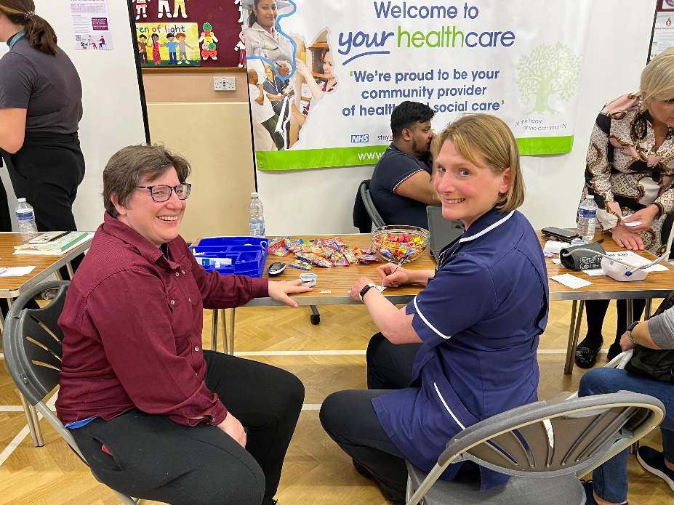

Supporting the health and wellbeing of local carers
Over 130 Kingston residents with caring responsibilities attended an event aimed at improving their health and wellbeing on 4 May.
The event was held in partnership between New Malden and Worcester Park Primary Care Network, Kingston Hospital and Kingston Carers’ Network and featured a range of stalls with attendees invited to find out more about benefits they may be entitled to, how they can best plan for their future and about simple steps they can take to stay healthy. There was also an opportunity for them to have a basic health check and to meet others with similar responsibilities and for local surgeries to make a note of their status of carer on their notes.
As a result of the event a new monthly one stop shop for carers has been added to the services offered at the Living Well Hub, held each week in The United Reformed Church in New Malden when it became clear that this group could benefit from a more regular offer of support.
I didn’t realise so many services would be here and it was lovely to speak to people who recognise carers and really refreshing to be able to come out for the evening. It was also great to be able to get my blood pressure taken and to chat with a GP.”
NHS South West London
Primary Care New Malden & Worcester Park PCN
Kingston Hospital
Kingston Carers Network
Local carer from New Malden
Notes:
Projects included this quarter where:
Engagement around LD and autism to inform the SWL JFP working with Kingston all age LD partnership and Kingston eco-op.
Working with HWK – Youth Out Loud and K&R Youth Council to hear from YP about online mental health resources
Review of post diagnostic services for Autism and ADHD working with local groups and parent forums to gather experiences of these service to make improvements.
Ends with a case study of the great partnership working with voluntary sector,. NHS, and GP practices to support carers.

Slide 13
Information Sharing
Opportunity for network members to share with health and care partnership what you are hearing (the good and the not so good) on the ground about local health and care services
13
Notes:
CVK is about hearing from you. Share what you are hearing about local services (the good and the not so good) to help us improve services and showcase services that are working well for local people.
The next CVK session will be part of HWK open meeting in January – share more information nearer the time.
13

Slide 14
Stay in touch
Please send any questions or additional feedback on local health and care services to
kingston.engage@swlondon.nhs.uk
Sign up to receive our monthly Place update https://swlondonics.org.uk/p/790E-5A5/kingstonupdate
14
Notes:
How to stay in contact with us.
Also how to sign up to receive monthly Place newsletter.
14

