Slide 1
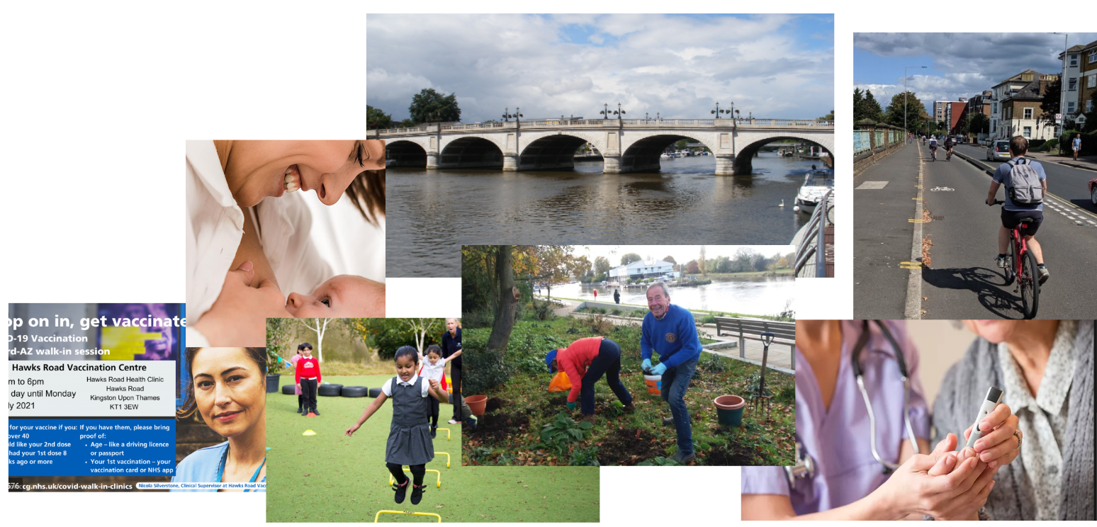
Kingston’s Joint Strategic
Needs Assessment (JSNA) 2023
KVA Health & Wellbeing Network, 3rd October 2023
Iona Lidington, Director of Public Health, Kingston Council

Slide 2
What is a JSNA and what is for?
JSNAs are assessments of the current and future health and social care needs of the local community (needs that could be met by the local authority or local NHS services)
Produced by Health and Wellbeing Boards ‘HWB’ (Kingston Partnership Board) - a Kingston Steering Group prepared the new JSNA 2023 on behalf of the HWB
The purpose of the JSNA is to assist Health and Wellbeing Boards to also consider wider factors that impact on their communities’ health and wellbeing, and local assets that can help to improve outcomes and reduce inequalities.
The purpose of JSNAs and Joint Health and Wellbeing Strategies (Health and Care Plan) (which are informed by JSNAs) is to improve the health and wellbeing of the local community and reduce inequalities for all ages.
The core aim is to develop local evidence-based priorities for commissioning (including for wider determinants of health) which will improve the public’s health and reduce inequalities.
will be used to help to determine what actions local authorities, the local NHS and other partners need to take to meet health and social care needs, and to address the wider determinants that impact on health and wellbeing.

Slide 3
How was the Kingston JSNA 2023 done and what does it look like?
The 2023 JSNA has focused on the ‘Top 5’ causes and risks of mortality and morbidity by major-age groups: childhood, adulthood and older age. (Note: some Top 5 data precedes COVID-19 impact)
This included: overall borough and Primary Care Network (clusters of GP practices, x 5 across Kingston) mortality and morbidity risks in key age bands, hospitalisation, long term conditions
The data review included analysis of male/female differences, income, ethnicity and geography where data was available, to look at any disparities
The number one wider-risk-to-health in Kingston - climate change - opens the document and is referenced throughout
Wider determinants of health were reviewed and compared with other regions
There are additional special sections on Health Protection, COVID-19, Communication and Cost of Living
Recommendations are included
Structure of the documents:
Summary Document,
Main Document
PLUS
7 special themed sections (chosen after Top 5 data analysed):
1. Healthy Weight & Physical Activity
2. Alcohol
3. Smoking & Respiratory Health
4. Geographies
5. Mental Health
6. COVID-19 Implications
7. Immunisation & Education: The Basics for Good Health
Notes:
While there are many other conditions and issues for health and care, this approach gives a chance to review some of the main factors leading to the use of health and care systems - and some of the underlying risks that could be addressed to reduce health and care needs and help people keep themselves healthier for longer.

Slide 4
What are some of the key findings in the new Kingston JSNA 2023?
Notes:
The Kingston data shows that good health is not found equally in all. Some of the ‘Top 5’ conditions show a link with deprivation - with higher levels found as deprivation increases. These conditions contribute to the actual shorter length of life of residents in the most deprived areas of the borough - with male residents in these areas living around 5 years less than those in the least deprived, and women around 3 years less. There are some geographical ‘hotspots’ for poor health, most notably the Cambridge Road Estate (CRE) but some other locations also. Some health conditions are found at higher rates in some ethnic groups, compared with others. Education, a key ‘wider determinant’ of health, shows that children in Kingston in the lowest income groups (eligible for Free School Meals) do less well than not only other more well off children in Kingston, but also children also eligible for Free School Meals in other parts of London.

Slide 5
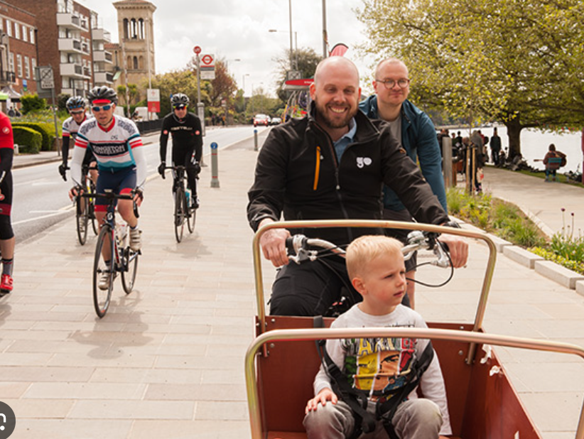
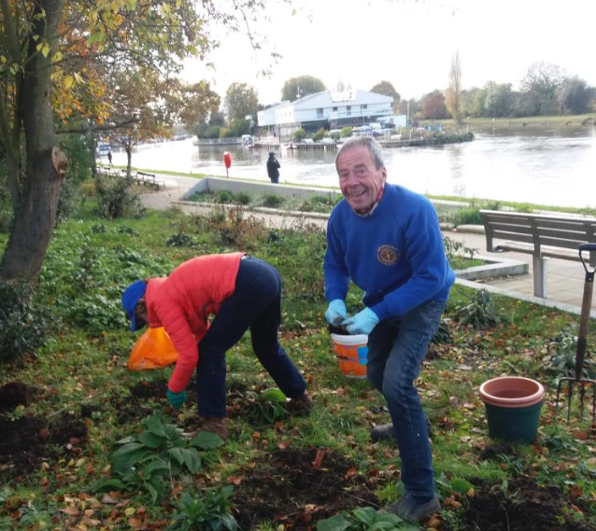
Climate and Health:
According to the World Health Organisation (WHO), climate change is currently the single biggest health threat facing humanity
The current and future health, care and wellbeing needs of the local community are therefore going to be closely linked to the impacts of climate change but are also linked to the potential to reduce carbon emissions.
Reducing being overweight and increasing physical activity through active travel can also help decrease our carbon footprint while also keeping people healthier for longer.
The recent Marmot report highlights that mitigating climate change will also help mitigate health inequalities.
Areas of our housing estates (Cambridge Road, Alpha Road) as well as south Tolworth and parts of New Malden and North Kingston scored highest in terms of overall climate risk of its residents (sensitivity and exposure combined)
Integrated health and social care systems will play an important role in both carbon reduction and climate adaptation.
See the Kingston Climate Action Plan for more details of local data and actions: https://www.kingston.gov.uk/downloads/download/442/kingstons-climate-action-plan

Slide 6
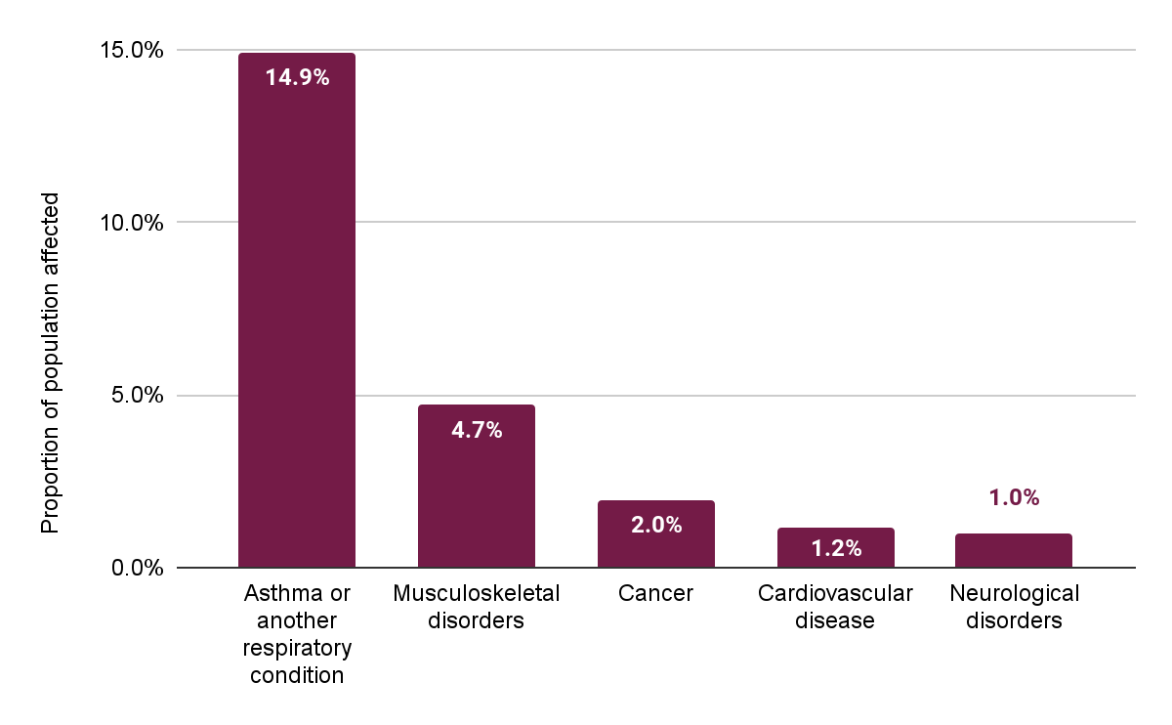
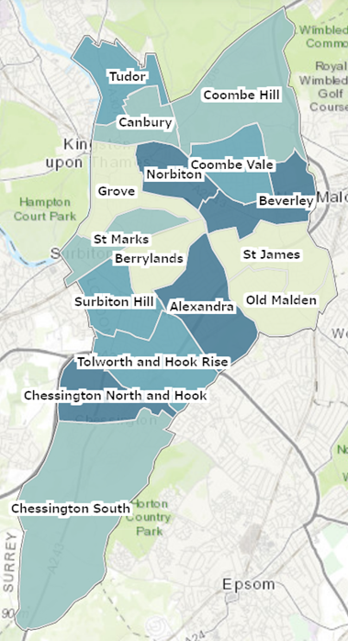
Children (0-19 years) - long term conditions
The top five long term health condition categories in childhood in Kingston in 2022 are:
5,488 1,691 771 454 407
Number of people affected
Levels of ‘asthma and respiratory conditions’ in young childhood vary from just over 10% in Berrylands to almost 20% in Chessington North and Hook (2022)
The prevalence of asthma and other respiratory conditions in childhood outweighs all other classes of disorder

Slide 7
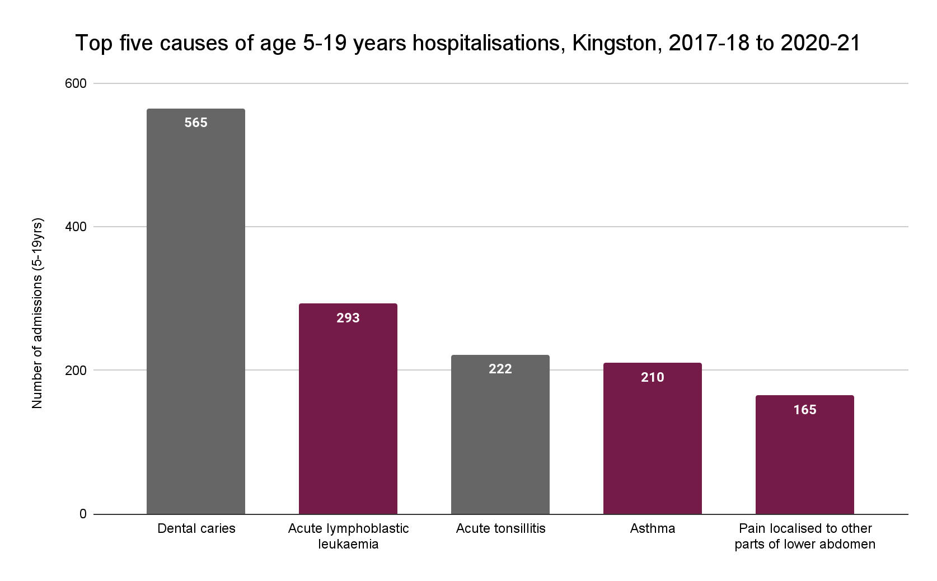
Children (5-19 years) - in-patient hospitalisations (HES)
The top five causes of older childhood hospitalisations, in Kingston from 2017-18 to 2020-21 are:
Dental decay is by far the most common primary reason for child hospital admission in Kingston (1 in 21 of all admissions)

Slide 8
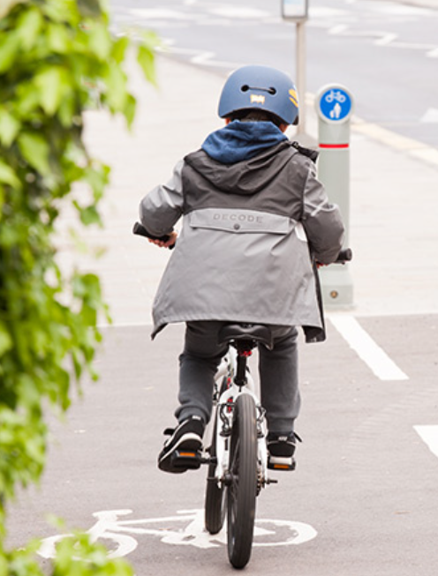
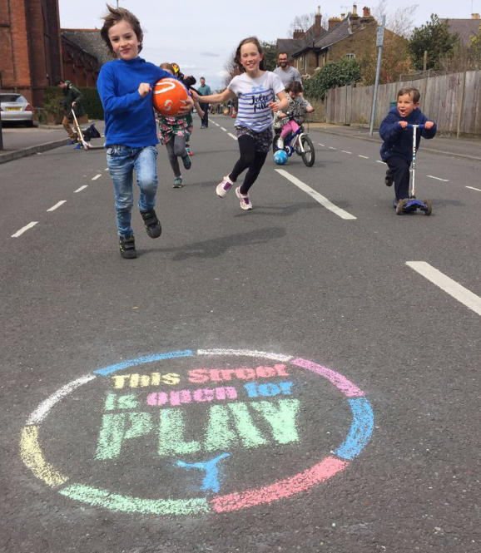
Children - Levels of overweight/ obesity doubles at primary school
Levels of excess weight nearly double while children are in primary school in Kingston
Around 1 in 6 children (16.8%) in Reception (aged 4-5 years) were overweight or obese.
In Year 6 (10-11 years), almost 1 in 3 children (29.8%) were overweight or obese.
Nationally link between deprivation & higher levels of obesity
Recommendations on healthy weight include making use of opportunities to:
Increase active travel to school
Ensuring that physical activity targets met in schools
Lead by example on healthy food offers in our organisations
Enhancing oral health promotion work
Expanding community offers and initiatives eg Play Streets
Ensuring new housing has adequate play space
Notes:
Childhood obesity and excess weight are significant health issues for children and their families.
While Kingston’s children show better (lower) levels of being overweight than most other London boroughs, children being overweight is still a very significant issue for the borough.

Slide 9
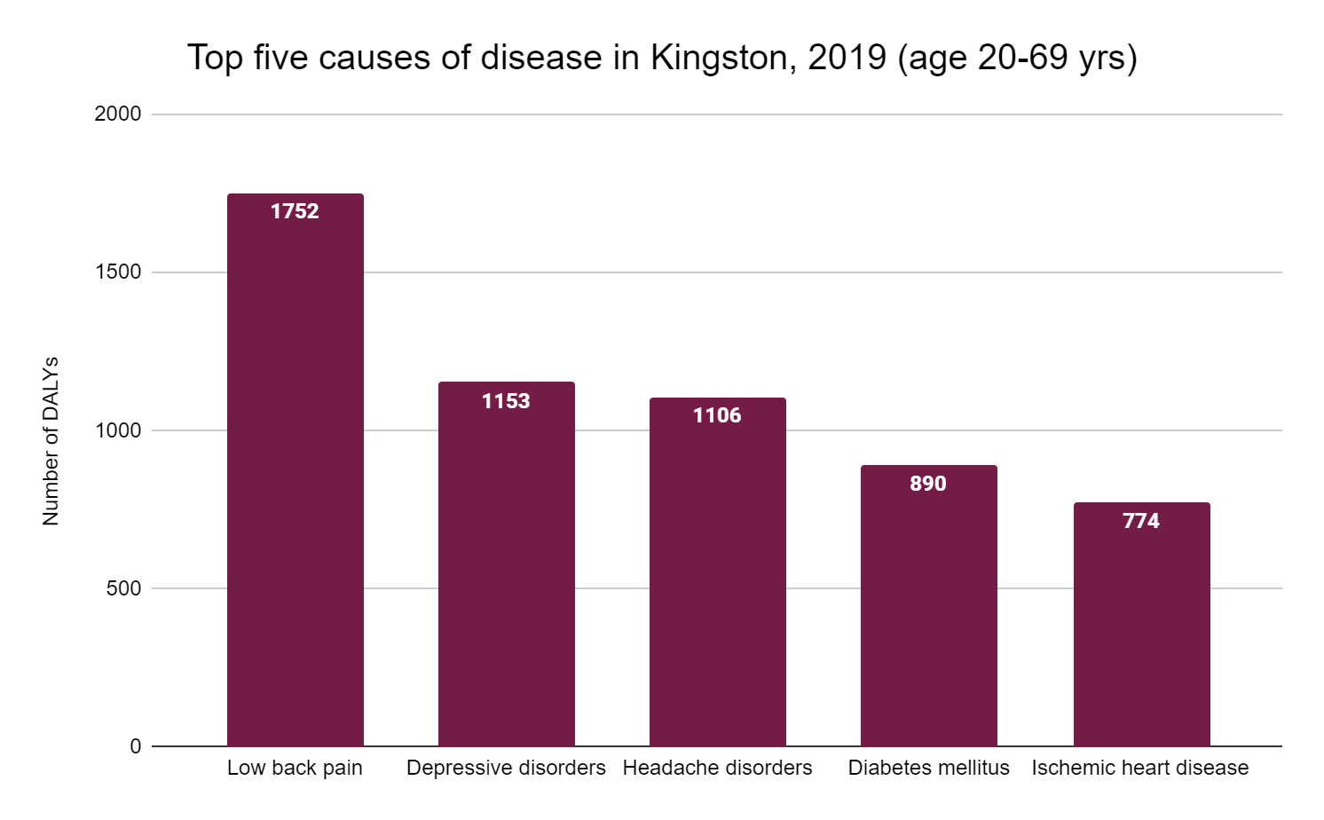
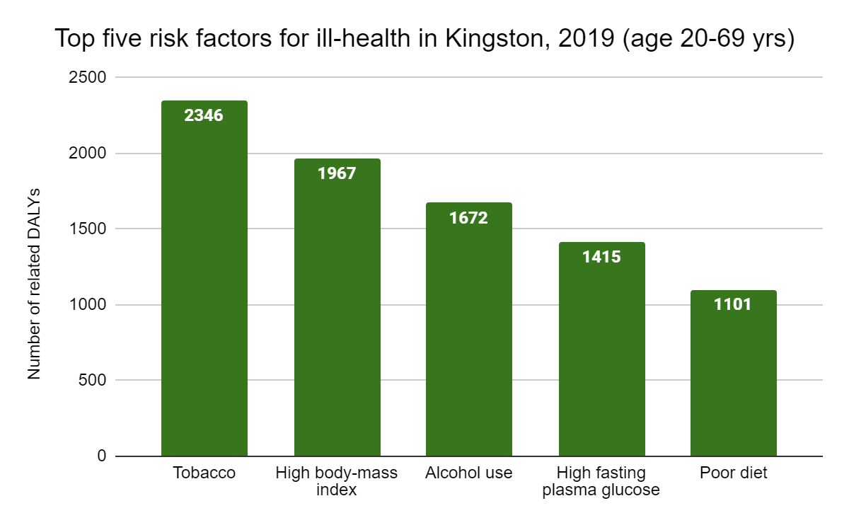
Adults (20-69 years) - top 5 causes of disease & risk factors
The top five causes of adult disease, and risk factors, in Kingston in 2019 are:
Half of adults in Kingston are overweight (21/22)
SYNERGY: Many opportunities to reduce overweight in Kingston and improve health - these can also support the carbon reduction goals
Smoking holds the greatest risk for morbidity, as well as mortality. Overweight and obesity and excess use of alcohol are also major risk factors for ill health in Kingston
Note that the numbers are ‘DALYs’ (Disability Adjusted Life Years, Data source:a measure of Global Burden of Disease)
Notes:
Note that the numbers are not people - they are ‘DALYs’ (Disability Adjusted Life Years, Data source:a measure of Global Burden of Disease)

Slide 10
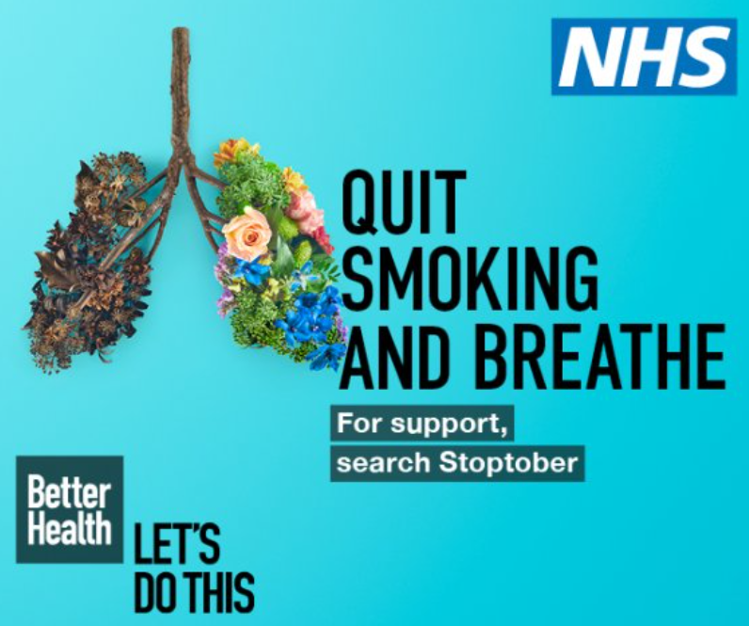
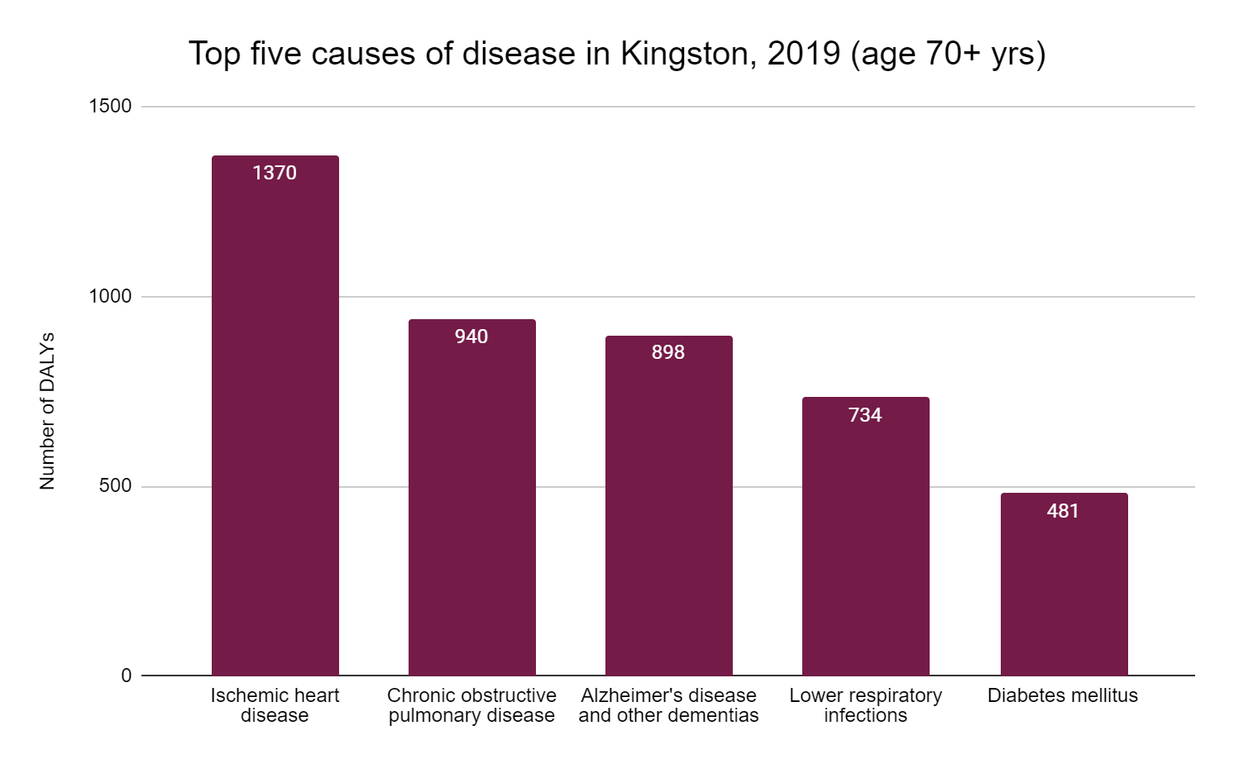
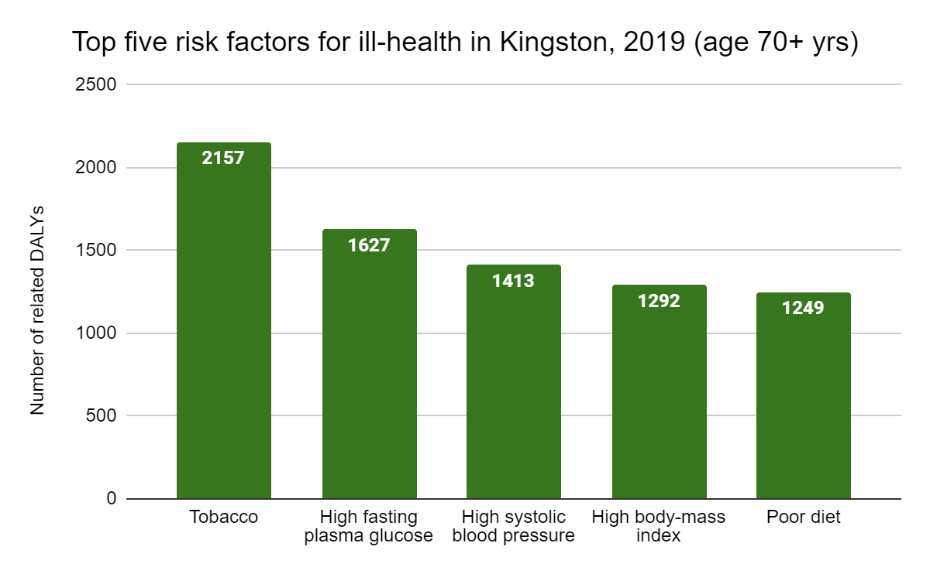
Older Adults (70+) - top 5 causes of ill health in Kingston (2019)
Smokers need care with every day tasks 10 years earlier than non smokers, on average - at age 63 years
Notes:
Source for Smoker and Care Needs data is ASH: https://ash.org.uk/media-centre/news/press-releases/over-1-5-million-people-need-social-care-because-of-smoking

Slide 11
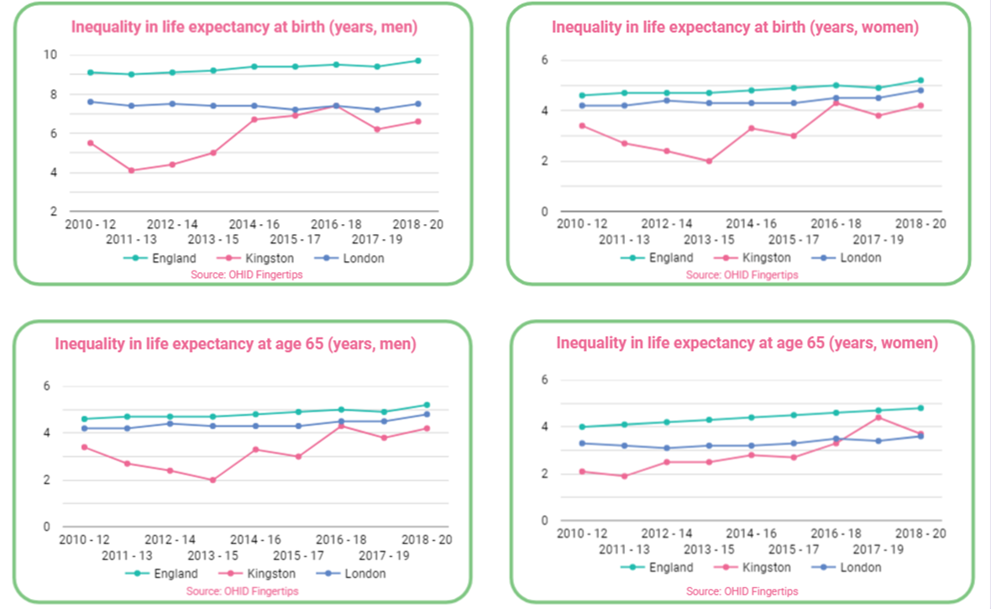
Inequality in life expectancy in Kingston: increasing

Slide 12
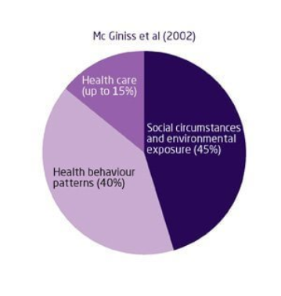
What influences health in Kingston? The conditions in which people are born, grow, live, work and age (‘wider determinants’)
We looked at:
Education
Crime
Housing
Work and the labour market
Natural and Built Environment
(Please see the JSNA documents for full detail and links to the data sources for updated data)

Slide 13
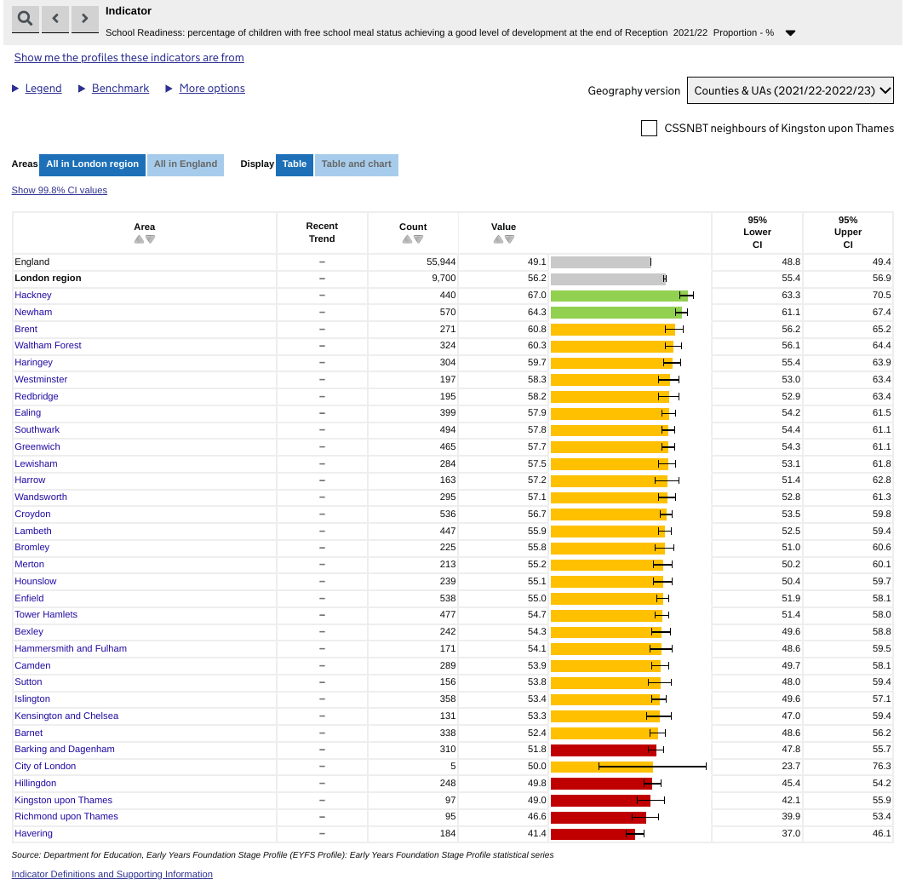
Some example findings about influences on health in Kingston
Our poorest children (eligible for FSM) are doing less well on school readiness than similar children across London
2,277 children under 16 years in absolute low income families in Kingston in 2020
The Cambridge Road Estate and Alpha Road area are both within the 20% most deprived small areas (‘LSOAs’) nationally with regard to income deprivation
For 2021/22, Kingston was an outlier (significantly worse than London as a whole) for emergency hospital admissions due to falls in people aged 65 and over.
Housing and overcrowding: According to the 2021 Census, 6% of households in Kingston were ‘overcrowded’. (Norbiton (11.3%)
Notes:
According to the 2021 Census, 6% of households in Kingston were overcrowded (with fewer bedrooms than required). This varies across the borough, with the highest concentrations of over-occupied bedrooms found in Norbiton (11.3%), Green Lane & St James (8.4%) and Tolworth (7.0%) wards

Slide 14
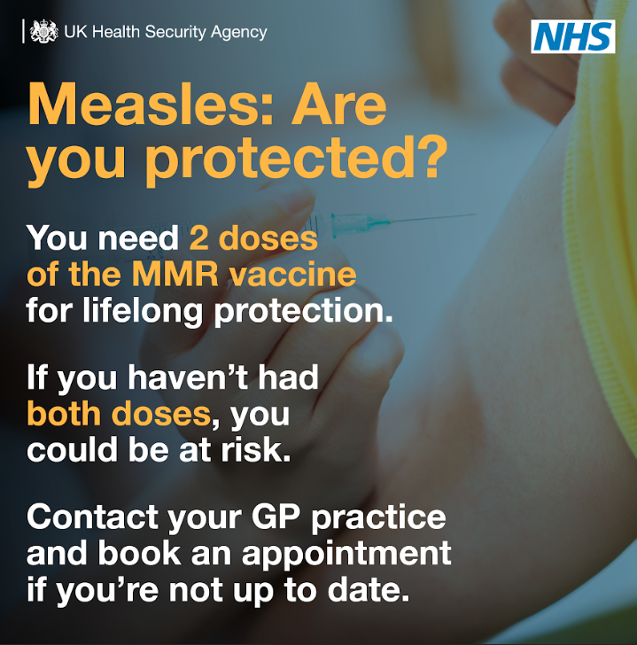
Health Protection: 5 key areas of focus
Childhood immunisation - focus on measles and polio: recently generally improving but not yet meeting targets, risks
Adult immunisation - focus on maternal whooping cough, flu, and COVID-19: not yet meeting flu targets
Adverse weather and associated health risks: excess mortality, need for preparation and action
Cancer screening: not meeting targets, missed opportunities to reduce health impacts
Sexual health: need to understand high reinfection rates of STIs in young people
Notes:
Childhood vaccination in Kingston, like many other London boroughs, has not met national targets for at least 10 years and was not meeting these targets prior to the onset of the COVID-19 pandemic in 2020. Although Kingston has often had higher vaccination rates than many other London boroughs, by not meeting national targets, the vaccination levels are not high enough to prevent community spread of vaccine preventable illnesses. This is putting children in Kingston and beyond at risk of serious illnesses.

Slide 15
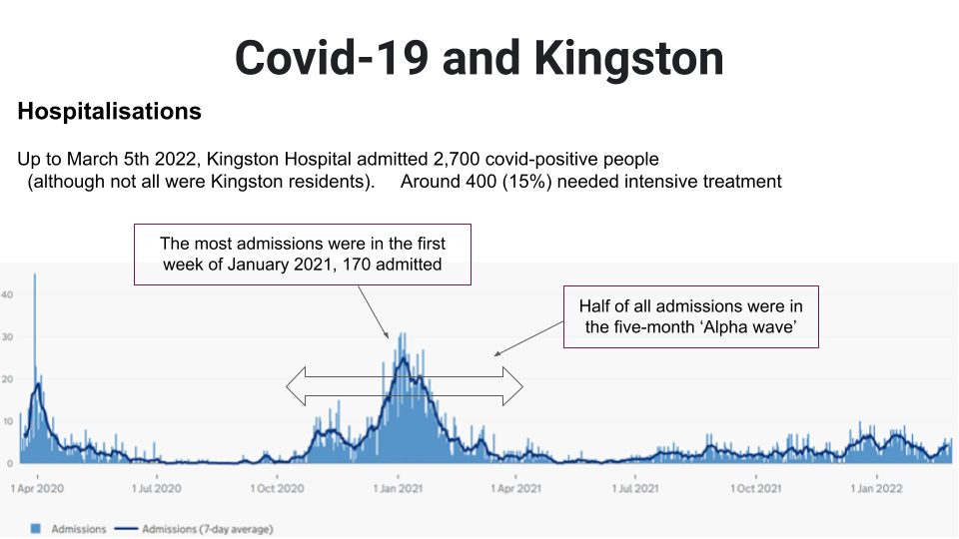
COVID-19
Ongoing impact on health services
Continued need to follow ‘Living with COVID-19’ guidance
Vaccination

Slide 16
Health inequalities in Kingston: some examples
Differences were found for a range of conditions between different groups or by income or geographically. Some examples include:
Poor health HOTSPOT: Cambridge Road Estate area (and to a lesser extent, Alpha Rd Estate) - this area is a POOR HEALTH OUTLIER for many conditions and risks
Educational attainment for low income children: children eligible for Free School Meals ‘FSM’ (low income) are getting poorer outcomes than children eligible for FSM in other London boroughs - major LONG TERM HEALTH RISK for this group
Male/female differences in some key risk factors such as overweight, obesity
Census data shows higher levels of ill health, deprivation and disability in the South of the Borough - are preventive and treatment services accessible?
Differences in diabetes rates by ethnicity - higher rates found in Asian population (SWL)

Slide 17
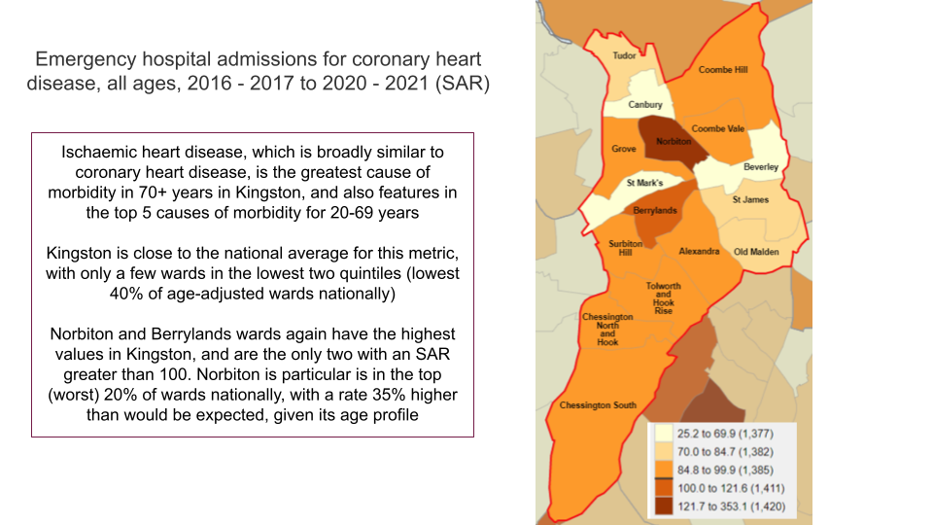
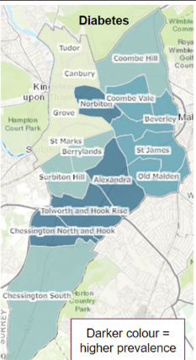
JSNA Special Themed Sections
Obesity and Physical Activity,
Alcohol
Smoking and Respiratory Health,
Geographies
Mental Health,
COVID-19 implications
‘Immunisation and Education: basics for good health’
Communications and Navigation
Smoking:
people in routine and manual occupations have much higher smoking rates than others in Kingston - nearly 1 in 5 people
Amongst people with long term mental health conditions in Kingston, nearly 1 in 3 of these smoke (28.7%).

Slide 18
What about areas that are not covered?
We are completing a process to agree the next topics to be covered
Other data, including new Census 2021 data, is available here: https://data.kingston.gov.uk/
Helpful data is available (for borough level) at the OHID ‘Fingertips’ site: https://fingertips.phe.org.uk

Slide 19
Using the JSNA, where to find it:
Using the JSNA:
the data should be useful for focussing local work to where the needs in Kingston are
it can be used to inform funding bids and service planning
Find the Kingston JSNA 2023 here (we will add further sections, more user friendly versions shortly): https://data.kingston.gov.uk
Thank you - any questions?

