Slide 1
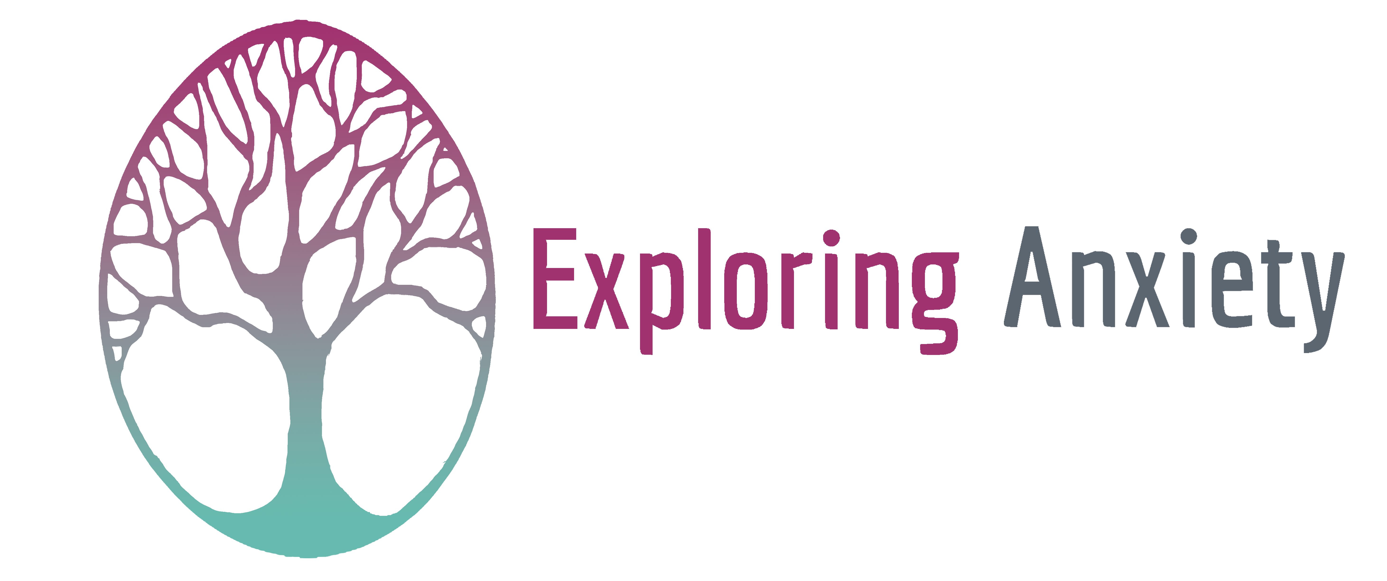
The Exploring Anxiety Project

Slide 2
The Impact of Anxiety
Social Anxiety
Generalised Anxiety
The Workplace Health Report:
6 in 100 people are diagnosed with anxiety in the UK
822,000 of UK employees are experiencing anxiety costing the economy 8 billion a year & 17 million working days are lost.
Health Anxiety
Climate Anxiety
High Functioning Anxiety

Slide 3
Feeling judged
Feeling lonely
Digestive problems
Experiencing phobias
Worrying about the future
Feeling overwhelmed
Experiencing panic attacks
Lack of motivation
Wanting everything to be perfect
Not wanting to do new things
Trouble sleeping
Trouble concentrating or brain fog
Worrying about getting ill
Feeling stressed & under pressure
Physical pain
Lack of confidence
Feeling breathless
Feeling irritable & frustrated

Slide 4
Disidentification

Slide 5
A Different Approach To Anxiety
Current interventions that support people experiencing anxiety concentrate on providing medication & CBT therapy. However, with increasing waiting times and our NHS under pressure, many people are left having to find their own ways to cope with their symptoms.
The Exploring Anxiety Project offers a different approach to anxiety. We don't want to patholigise it, fix it or medicate it... instead as a group of 10 people over 10 weeks in nature to explore it, understand it and learn how to distance ourselves from it, and we offer these community programmes for free!

Slide 7
It's Time To Explore Anxiety
Through taking part in weekly discussion groups, participants experience a variety of psychosynthesis-informed activities and relaxation techniques, whilst sharing their own experiences and resources. We use nature as a lens to explore and the sessions take place in local natural settings, like Hogsmill Community Gardens in Kingston, to encourage volunteering and a sense of community.
The Exploring Anxiety Project also provides an online community full of resources (including our manifesto and Exploring Anxiety Toolkit), along with advice from experts and peers. The community helps to remove the stigma associated with anxiety and provides immediate access to anxiety support.

Slide 8
Exploring Anxiety Programme
10 individuals meet for 2 hours weekly for 10 weeks to experience discussion groups, mindful exercises and direct interaction with nature.
The Participants Gain:
Time out every week to discuss how participants are feeling in a safe group of peers
The opportunity to experience different relaxation techniques to help when participants are feeling anxious
To be part of a supportive community of people who all have lived-experience of anxiety
Experience of self-care activities in nature
A practical toolkit full of resources to support them with anxiety
Every corporate programme sponsors a community programme to run for free.

Slide 9
Contact Us
To learn more about the Exploring Anxiety social impact project, please visit:
www.psychosynthesistrust.org.uk/social-impact
Or email Kelly Tyler:
ktyler@ptrust.org.uk

