Slide 1

NHS engagement in Kingston 2022/23
KVA Health & Wellbeing Network – 12 July 2023
Hannah Keates – Engagement Manager (Kingston & Richmond)
Communications & Engagement
SWL Integrated Care Board

Slide 2
Winter outreach programme
Why did we seek the views of local people and or communities?​ | What activities did we do?​
Winter outreach programme – focusing on our core 20 communities in areas of high deprivation and health inequalities. ​ ​ To ensure people understand and know how to access local support during the winter. ​ ​ To gain insight on local health services to feed back into operational plans. ​ Ran from November 2022 – March 2023. | We reached out to local community and voluntary groups by email and telephone calls offering to talk to their communities and clients. Through partners (KVA, RBK & Healthwatch) who helped us get in touch with new groups Funding available up to £500 for community groups to put on events during winter where we could have conversations and spread messaging about how to stay well in winter. 16 events with nearly 100 people directly spoken to providing feedback on winter messaging and experiences of local health services. ​ ​
2
Notes:
2

Slide 3
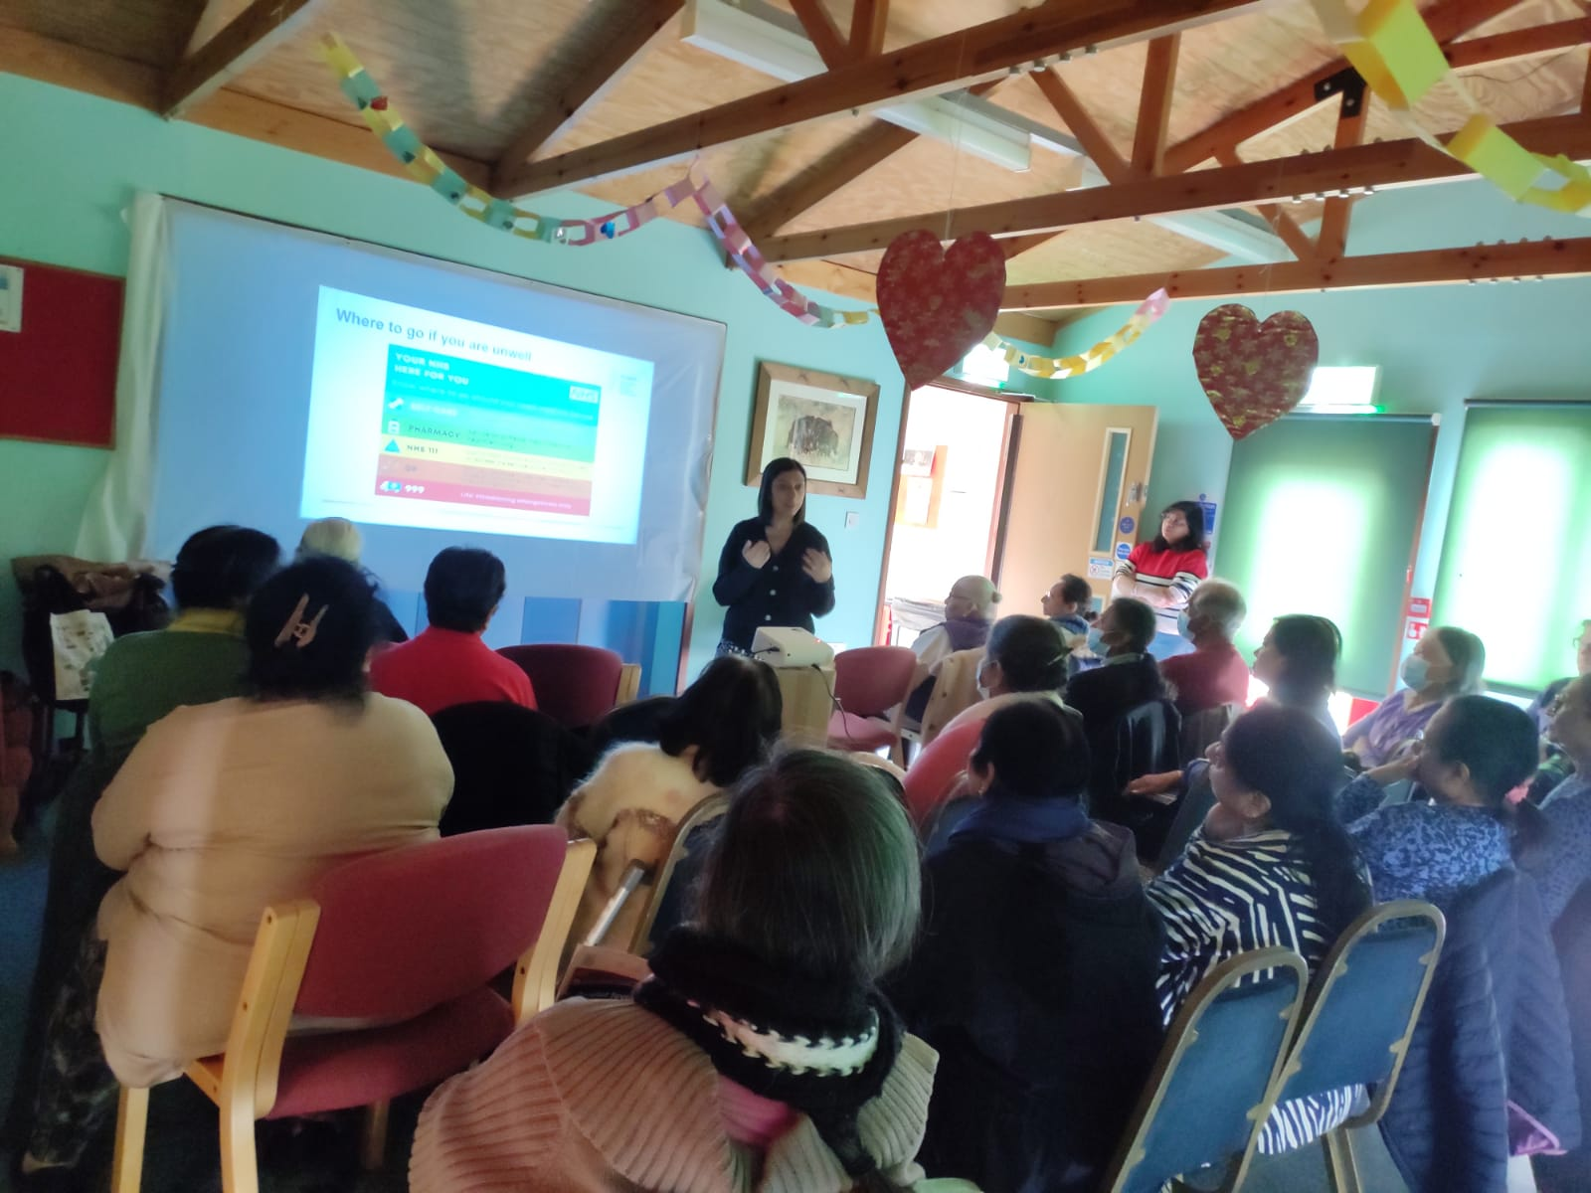
Who did we speak to?
Refugees and those seeking asylum Those experiencing homelessness Those experiencing drug/alcohol dependence Gypsy, Roma, traveller community at Swallow Park KVA Core Connectors A football team for those experiencing mental health issues​ A mental health drop in café for the Korean community​ Those with complex physical/ mental health issues through a community choir ​ People living in areas of deprivation: Cambridge Road Estate​ Carers and those they care for​ People with diabetes​ Women from Asian community​ Young people ​
3
Notes:
3

Slide 4
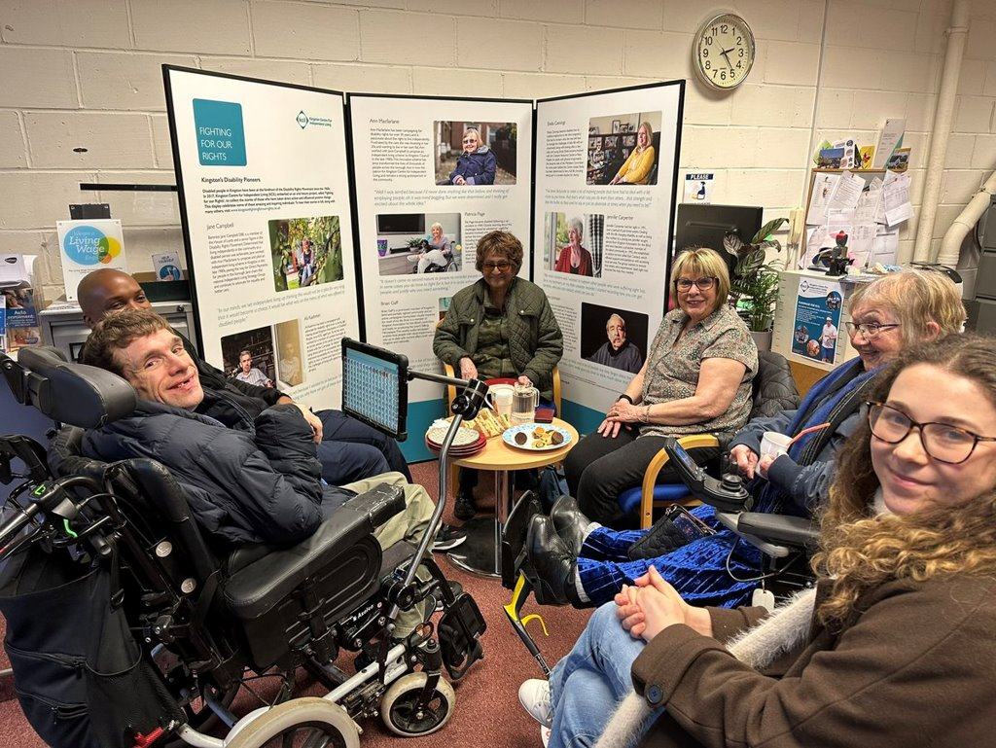
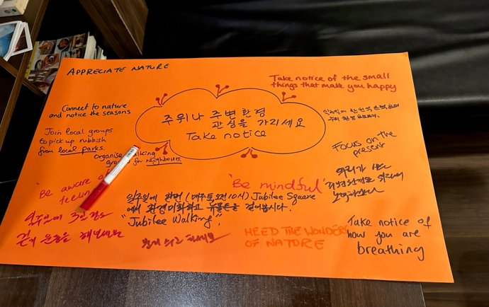
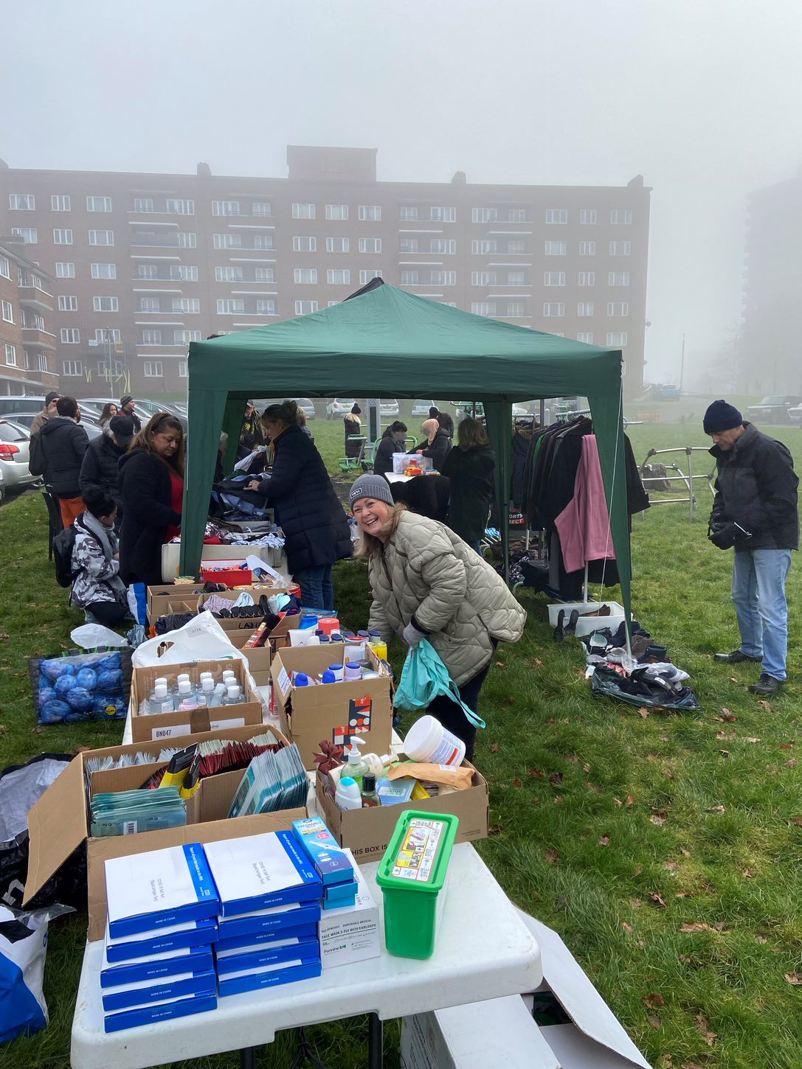
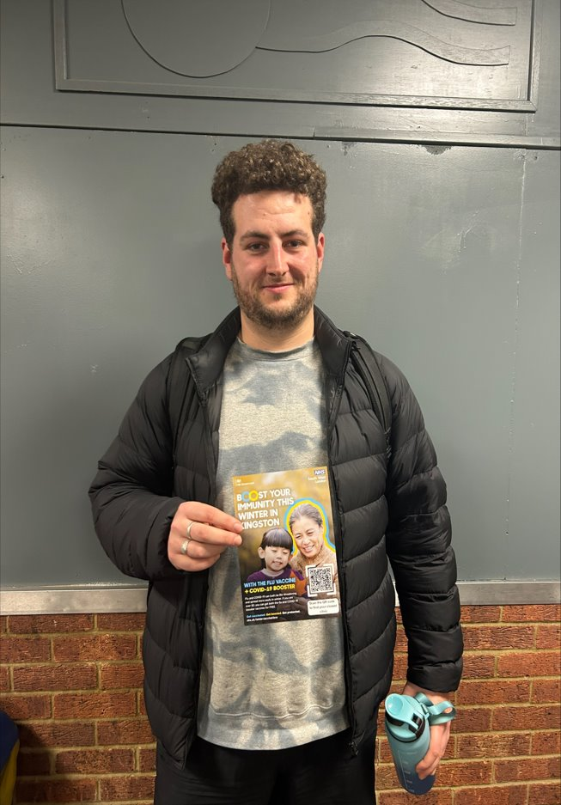
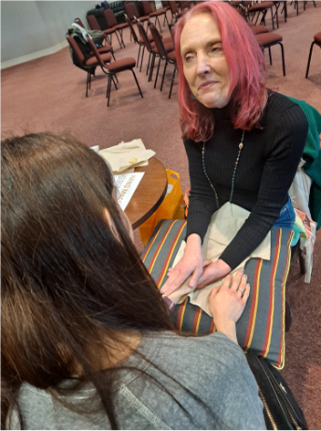
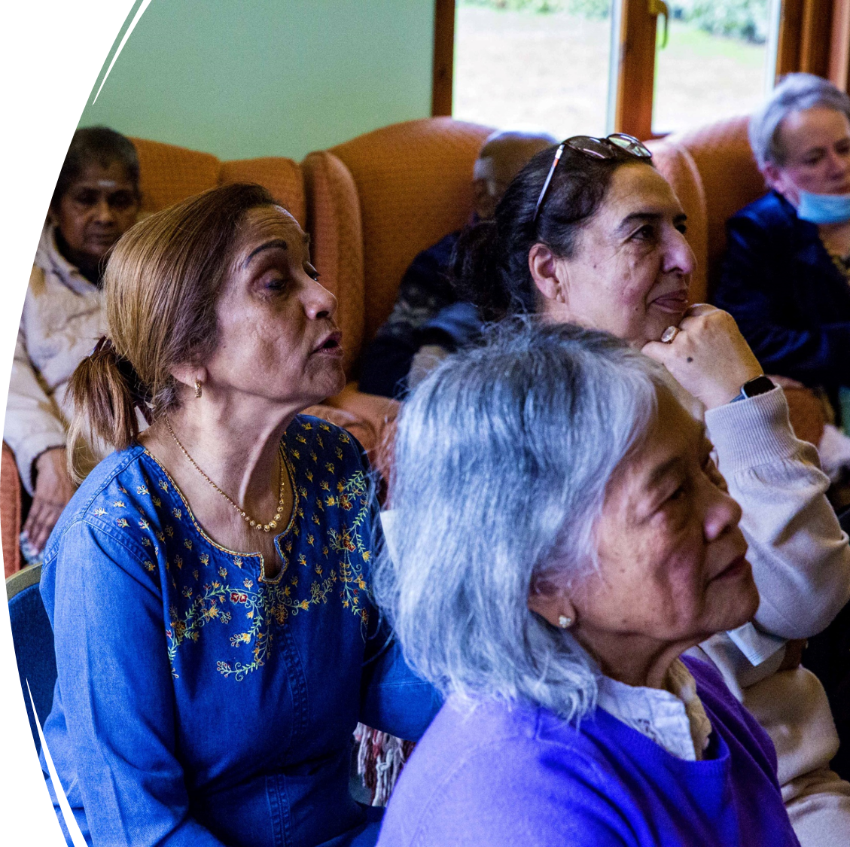
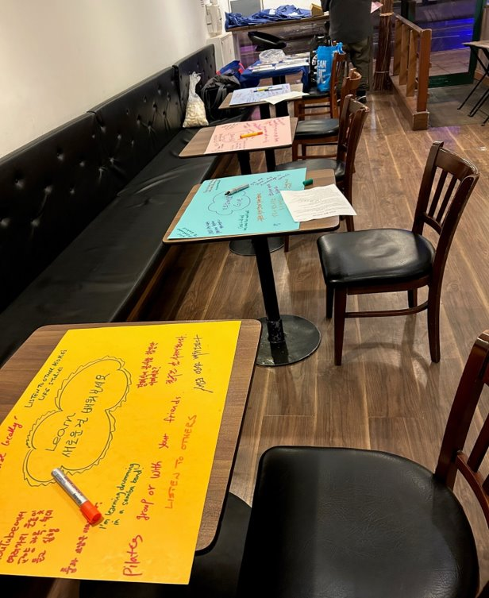
Winter outreach programme 2022/23

Slide 5
Winter outreach programme – key themes
What were the key themes that people raised? ​​
Main themes:​​ People rely on the organisations and groups that support them for trusted health advice and information.​​ All groups feedback on GP practices - online triage systems are a barrier to those who don’t speak English as a first language, and to those who have low literacy levels, difficulties in getting urgent appointments and variation in how practices work across Kingston.​​ Impact of rising cost of living, particularly for homeless, asylum seeker/refugee and areas of deprivation - cost of medication, heating and food all impacting. Covid vaccination – hesitancy to get boosters due to previous side effects and not knowing in advance the brand of vaccination ​​that will be used Long wait times for hospital appointments and routine outpatients appointments being cancelled ​​ Young people struggling to access mental health services ​​
5
Notes:
5

Slide 6
Winter outreach programme
What difference has this feedback made?​ | Are we planning any further engagement work on this programme or a related programme?​
Through our networks of voluntary groups and strong community links we were able to provide information on health services and information to residents through trusted voices. ​ ​ We changed our local winter messaging, e.g. our local signposting leaflet now includes Connected Kingston as a direct result to local issues/concerns.​ ​ Feedback is shared with Place Quality Delivery Group and Kingston Place Committee, with a view this will start to influence and shape operational plans for local health services.​ | The Winter Engagement Fund ended at the end of March 2023. We have an ongoing borough programme of outreach and are planning our spring/summer 2023 programme to strengthen the links we have made with communities. ​ ​
6
Notes:
6

Slide 7
Find out more...
Find out more about the work we do locally
https://www.southwestlondonics.org.uk/local-stories/
How we involve people and communities - South West London ICS
7
Notes:
7

Slide 8
Joint Forward Plan – engagement update

Slide 9
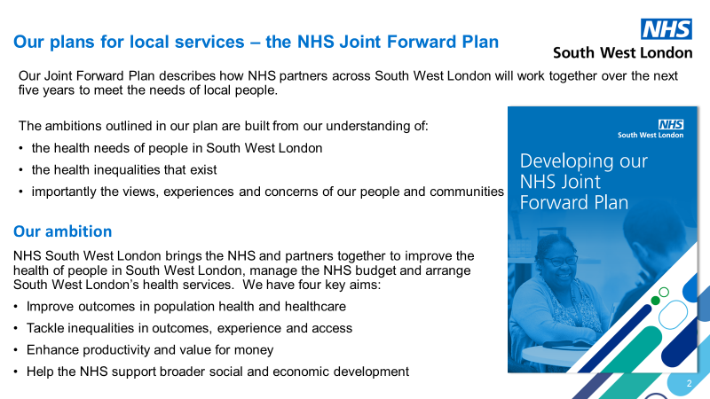

Slide 10

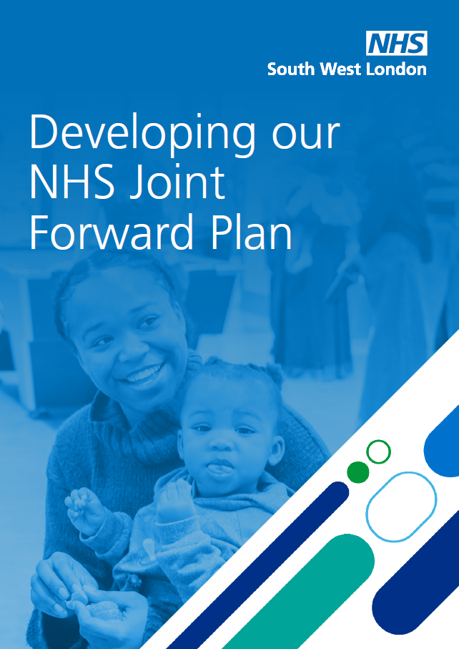
Engagement on the Joint Forward Plan
Engagement Phase 1
January and February 2023
Advice from our Healthwatch and VCSE leaders on engagement approach
Views of people and communities summary for each setting of care - to inform the ‘ambition’ set for each chapter
March 2023
‘Developing our Joint Forward Plan’ published for feedback in March 2023
Engagement Phase 2
April and May 2023
6 partner responses to ‘Developing our Joint Forward Plan’
‘Views of people and communities’ - updated each setting of care chapter to inform and influence plans and actions
7 focus groups
599 responses to our online survey
Gap analysis on where we needed more insight for the next phase
June 2023 onwards
NHS South West London Joint Forward Plan for 2023 to 2023 published in June 2023
5 outreach events
131 one-to-one conversations
Ongoing engagement with people and communities in delivery of the Joint Forward Plan, with advice and collaboration from our Healthwatch and VCSE leaders
Analysis of 180 engagement reports collected from across our six places and partner organisations

Slide 11
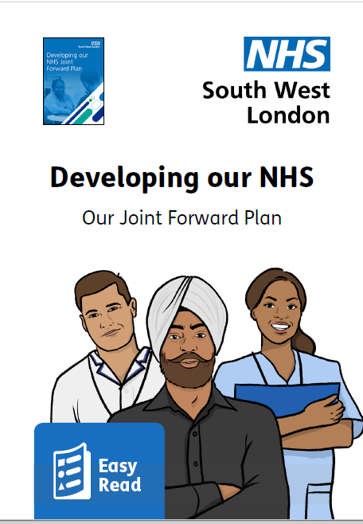
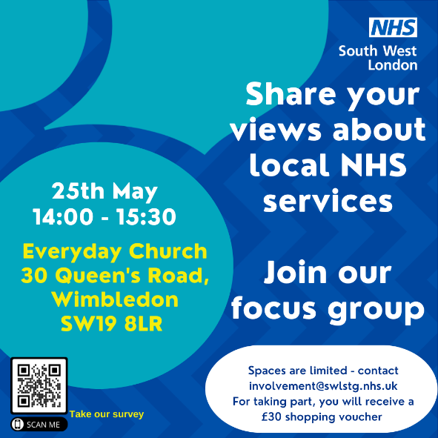
Engagement on the Joint Forward Plan
Informed by the insight of over 180 reports of insight from partners in South West London over the last 18 months.
Gap analysis from those reports and cross-checked against EQIA – further engagement on key populations groups, geographies and care settings areas where we have gaps.
Healthwatch and Voluntary sector leads feedback – as partners on ICB but also with their specialist people and communities experience and strategic overview.
Place engagement infrastructure – feedback and engagement with our six community voice forums/networks.
Survey – Responses from people who live, work or study in South West London to build on what we have already heard from people and communities and testing our ambitions.
    Reaching out to our people’s panel.
    Targeted social media to support breadth in responses from across our communities in our six boroughs.

Slide 12
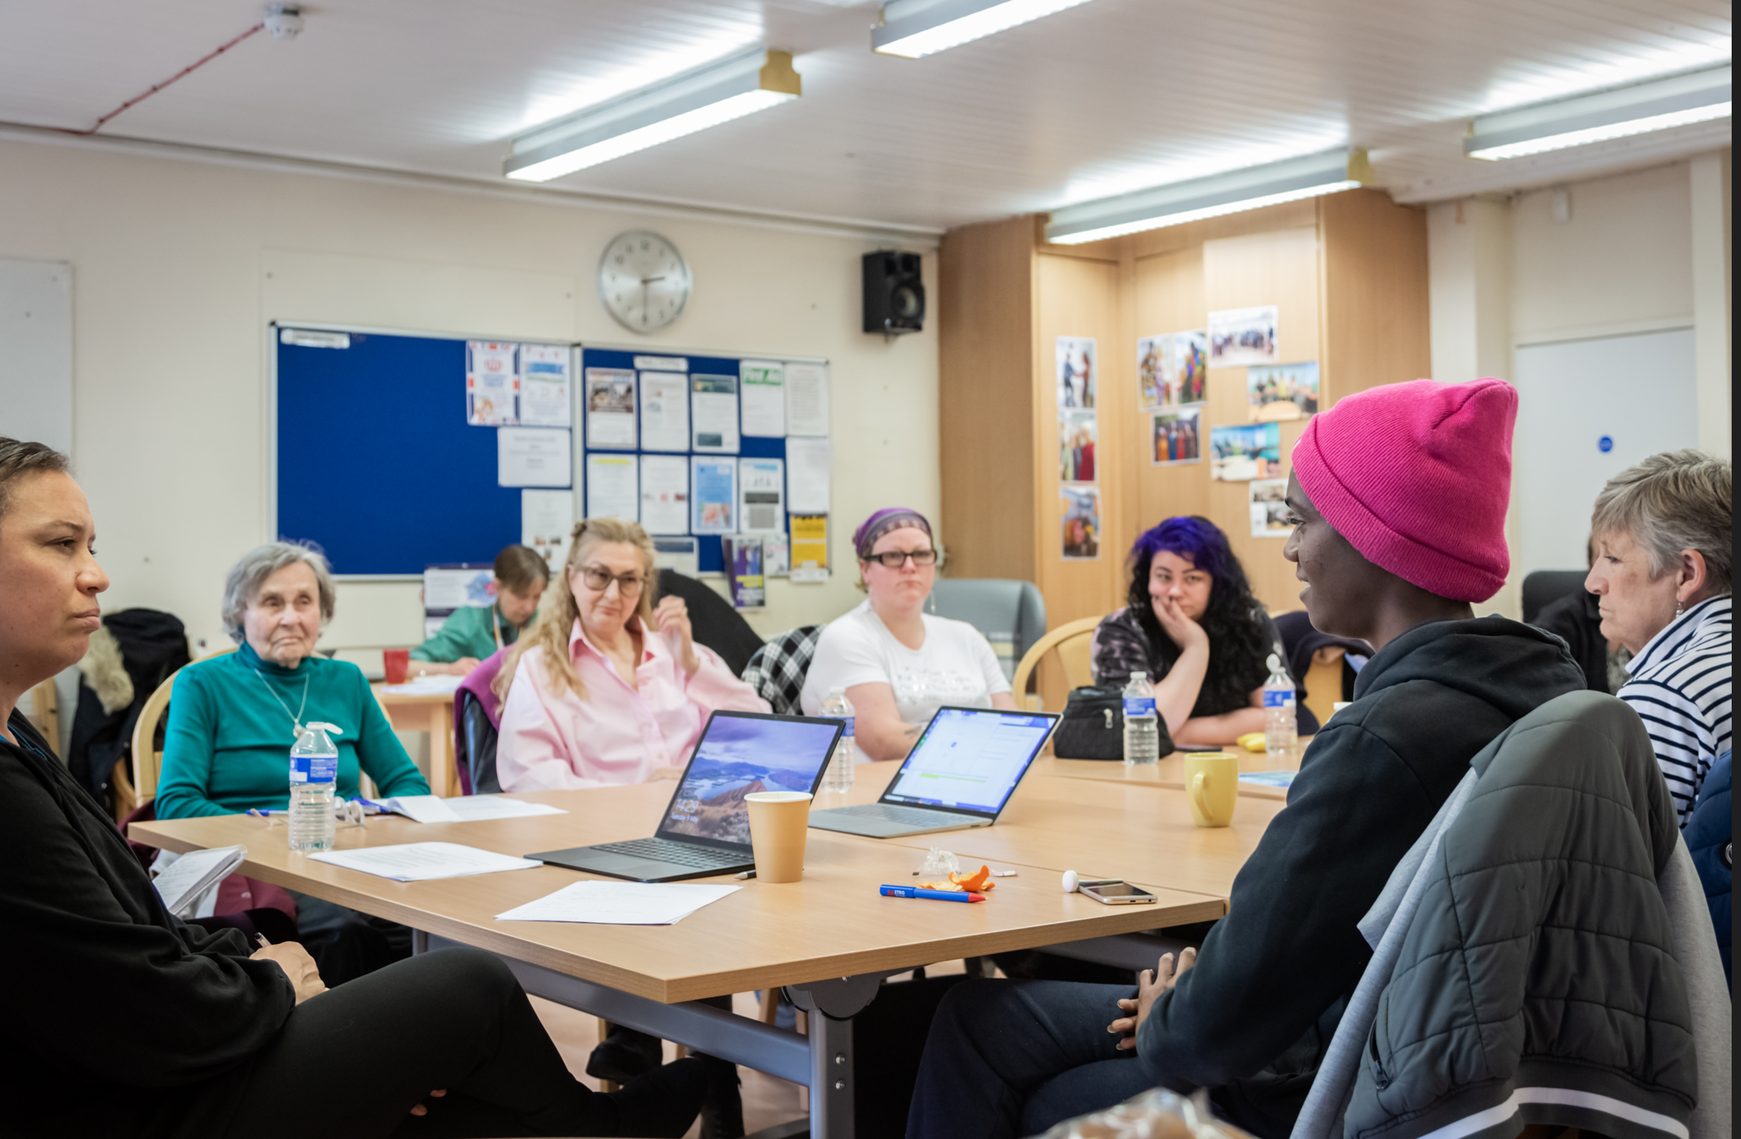
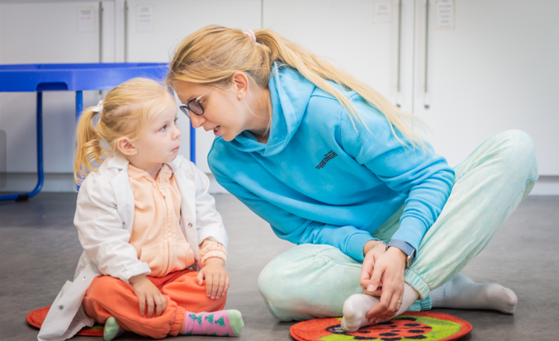
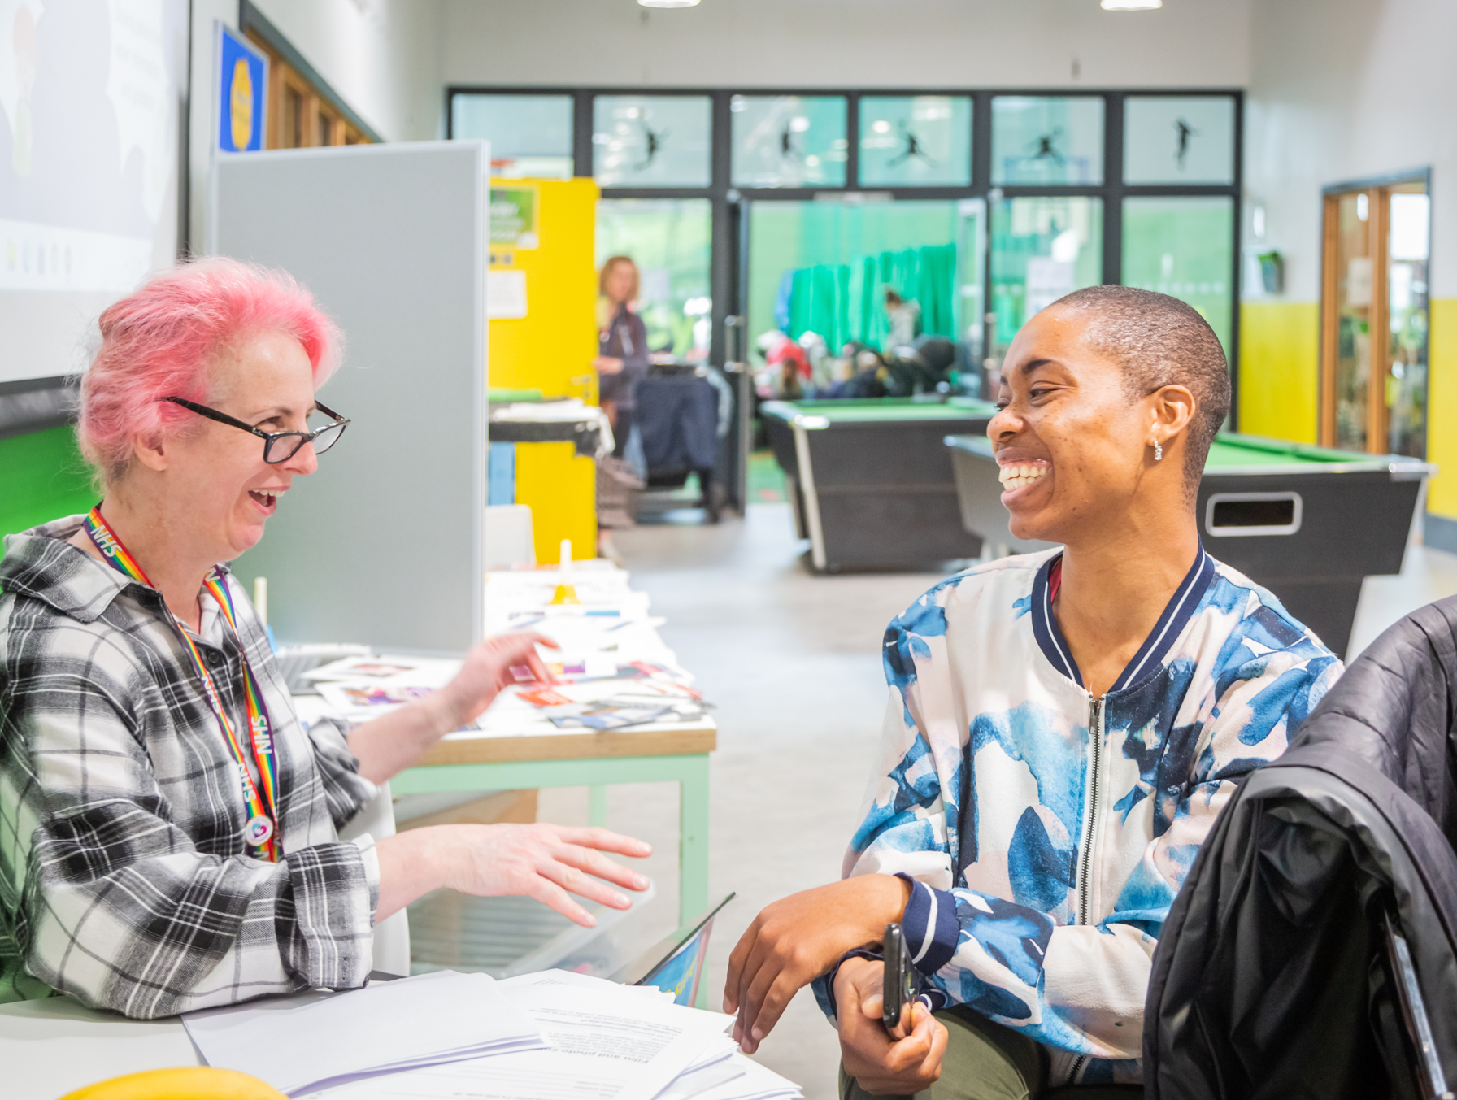
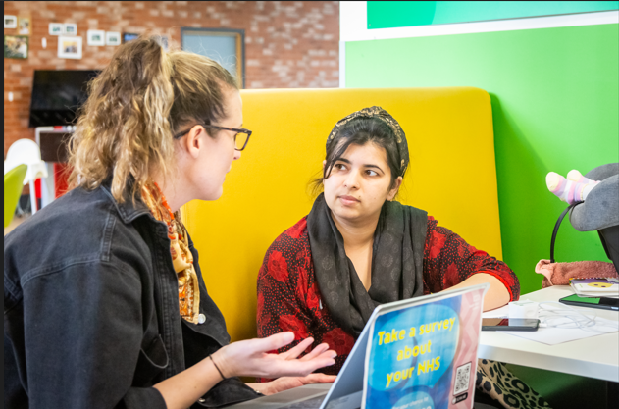
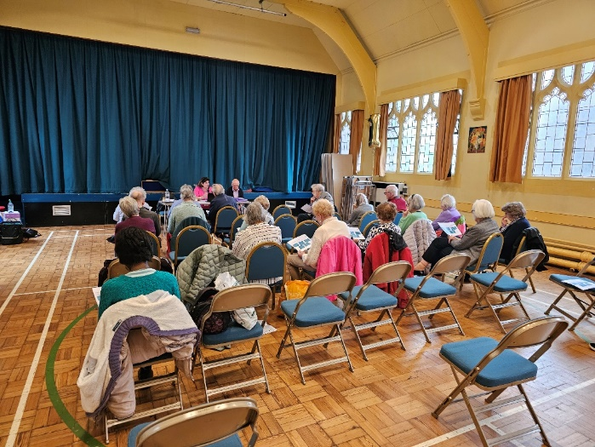
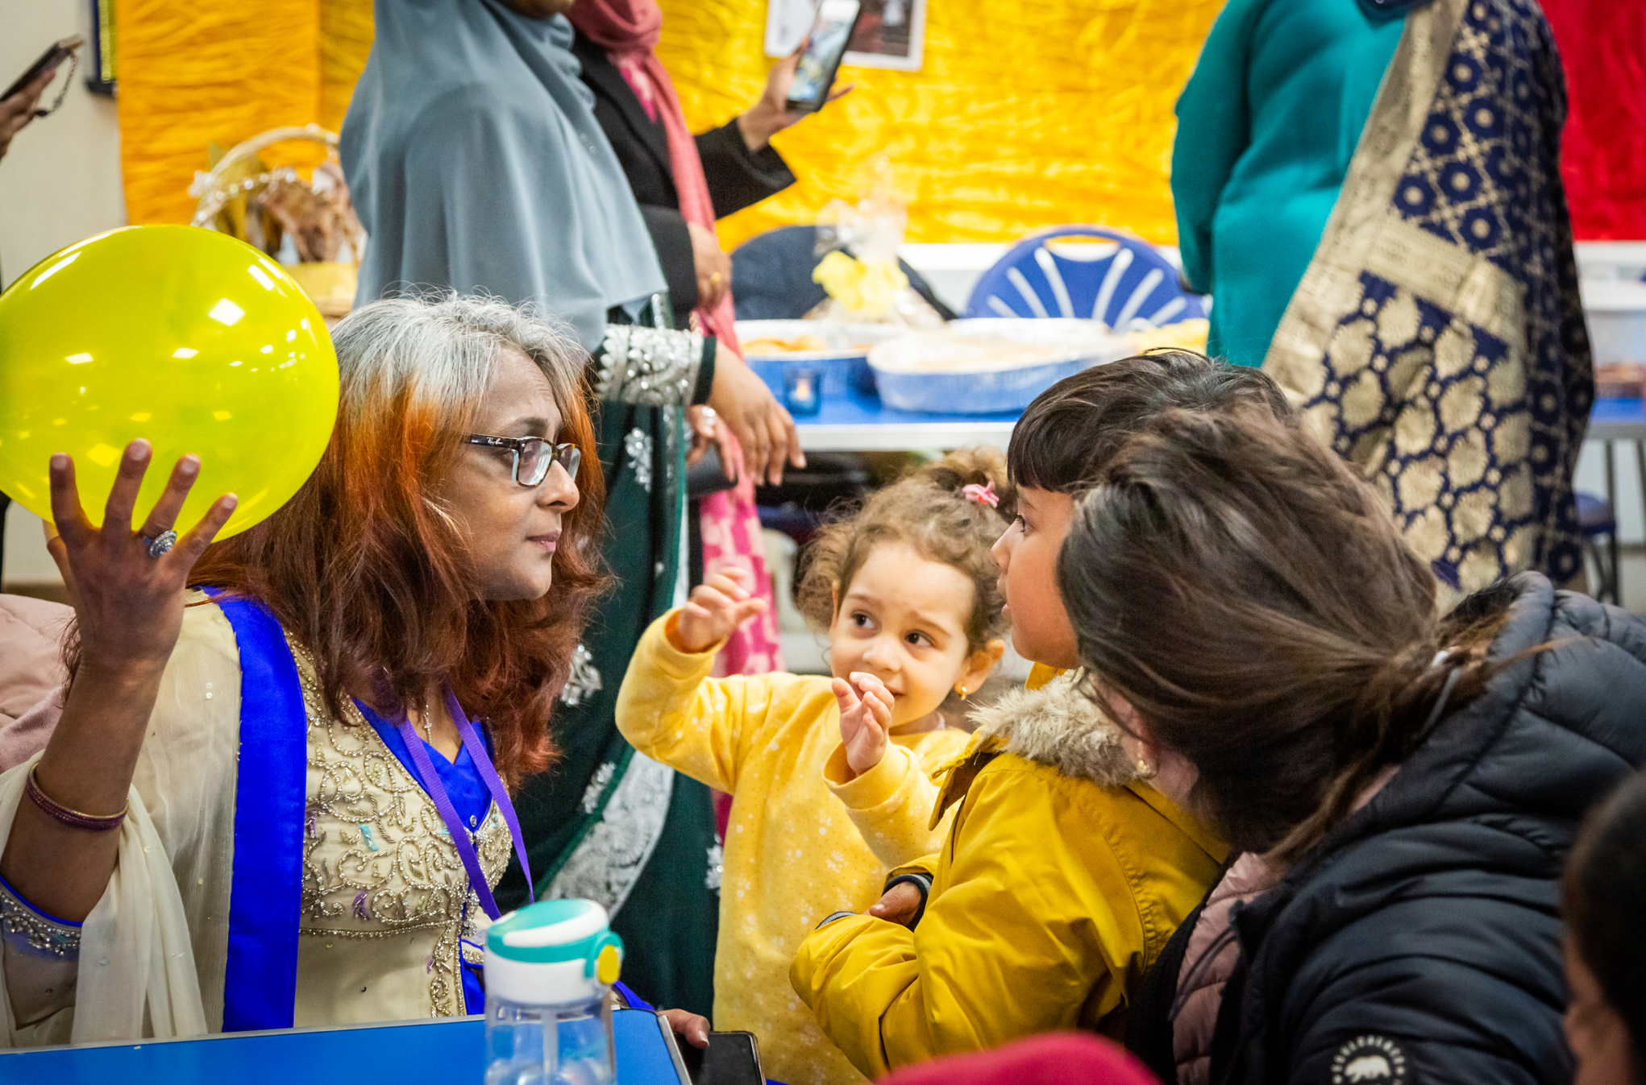
Snapshot of our engagement and outreach
We prioritised our activity to reflect the ‘settings of care’ sections within this Joint Forward Plan, using a range of approaches including:
  Partner views – asking partner organisations and their leaders to share their views on our published document
  Survey – hearing from people who live, work or study in South West London for example, from communities, frontline staff and students
  Focus groups – led in partnership with trusted community and voluntary sector organisations and aimed at specific population groups, for example with refugee and asylum seekers in Mitcham Library and adults with learning disabilities in a community centre in Kingston
  One-to-one conversations with people who need additional support for example parents and carers at a Croydon Babyzone drop-in event
  Outreach engagement and discussions at existing community events and forums for example secondary school young people at a Beautiful Minds school event in Twickenham

Slide 13
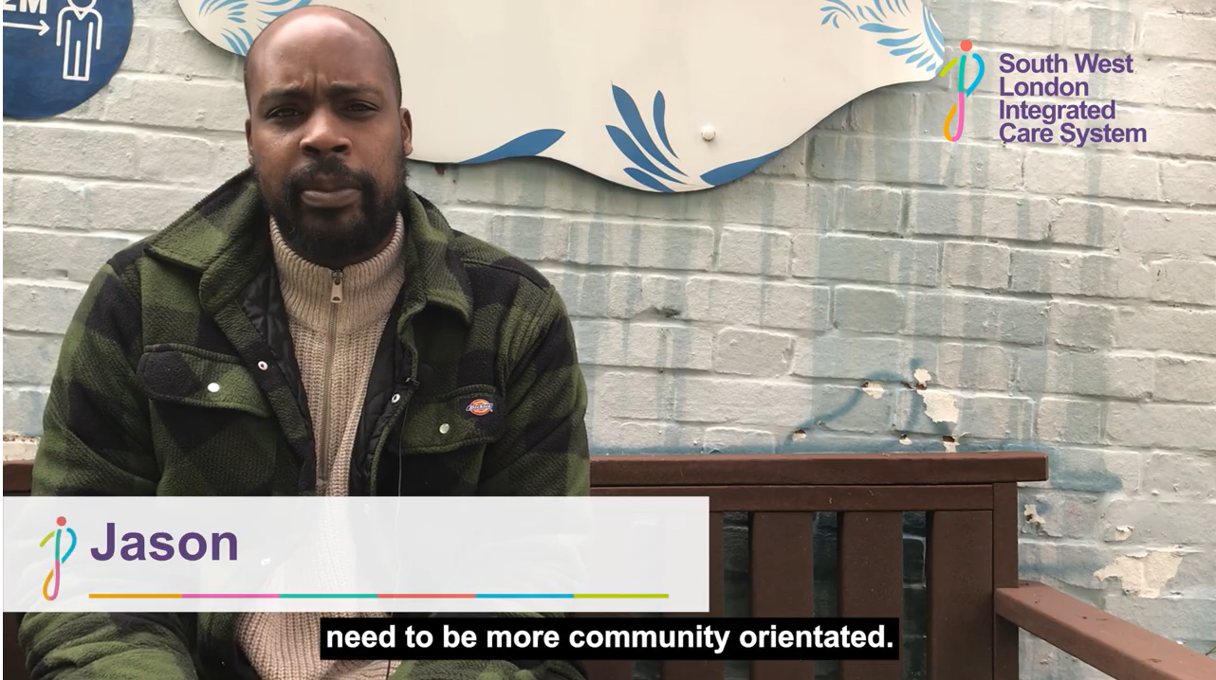
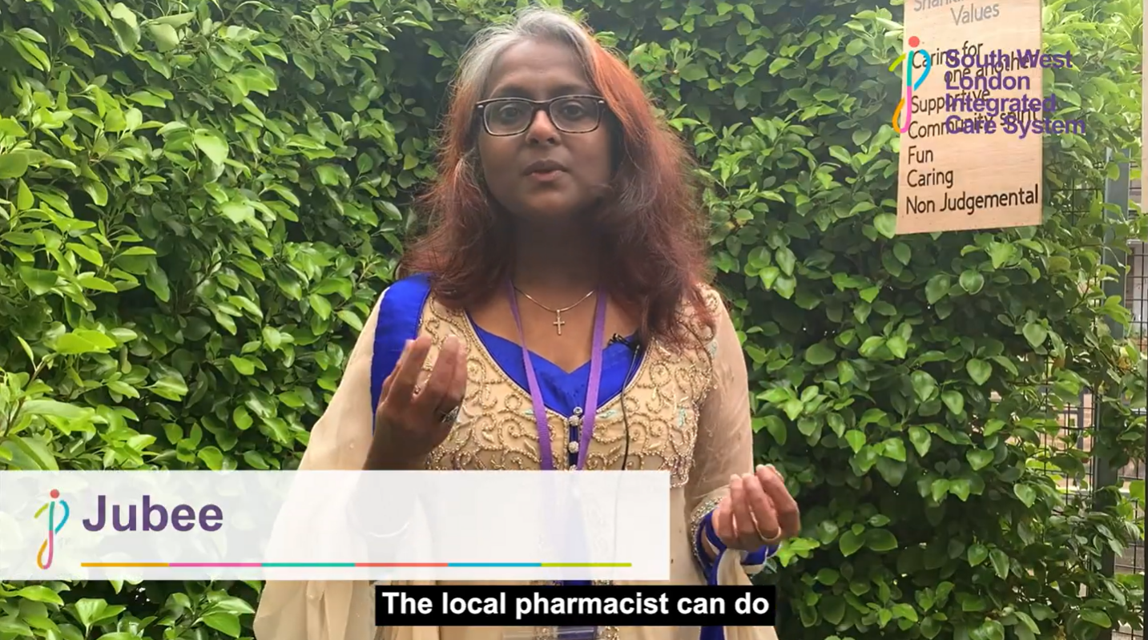
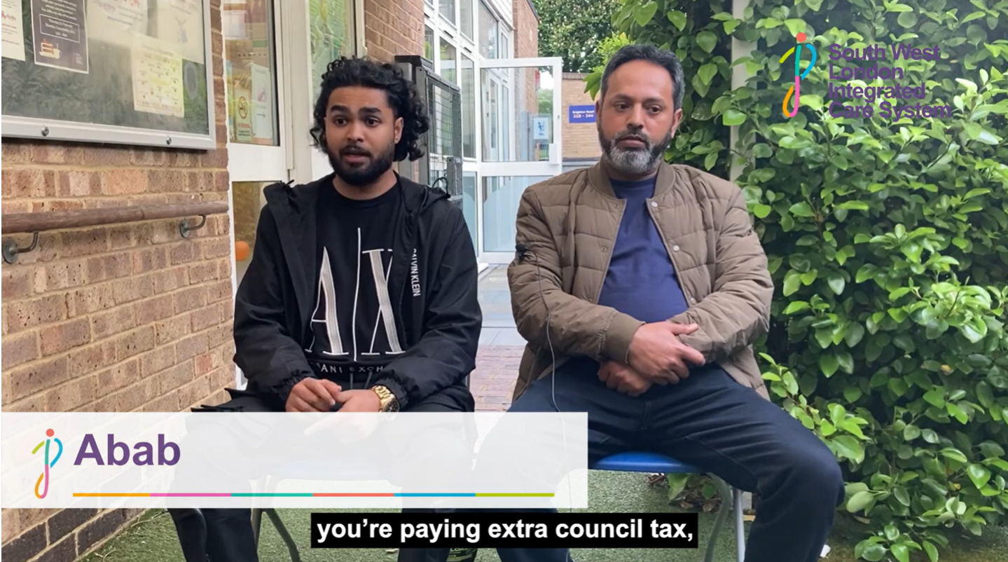
A short film….
During a number of our Joint Forward Plan engagement events we asked local people to share their views on camera. We have put these views together into a short film that we played at the beginning of our Action Workshop for the South West London Integrated Care Partnership.
You can view this short film summary of local views here

Slide 14
Responses by borough and workplace
(as at 18 May)

Slide 15







Who we have heard from...
56% were aged 25 to 54 years old (n=573) | 72% identified as a women (n=577) | 63% identified as White British (n=569)
40% identified as having daily activities limited or somewhat limited because of a health problem or disability (n=582) | 16% described themselves as unpaid carers (n=578) | 24% were a parent or guardian of a child under 18 (n=578)
Notes:
Other ethnicities did include people who identify as 7 people – Polish people and Black British, Black Caribbean, Nigerian, Ghanian, Asian, Indian, Bangladeshi, Pakistani, Chinese, Sri Lankan, mixed ethnicities but did not specify and people from South and Latin America.

Slide 16
Headlines: Primary care
We want people in South West London to access primary care in the way that suits them best so that they can get the information, care, and support they need quickly. We want fully digital and connected primary care which eradicates clinical variation, improves health outcomes, and looks proactively at the needs of patients so that we improve the continuity of care for those who need it and keep people healthier for longer.
Insight and feedback:
Agreement to enable people to access primary care in the way that suits them best, with many people talking about the problems of digital exclusion and the need to have face to face appointments.
Strong feelings towards the importance of continuity of care aided by seeing the same GP (‘family doctor’).
The highest number of comments related to not being able to access an NHS dentist and the cost of dentistry.

Slide 17
Our on-going plans for engagement
In the short term, this will include making sure that everyone we have heard from gets feedback on how their voice has been listened to which we hope is also reflected in this plan.
In the longer term, this will include:
A themed engagement forward plan to inform our plan’s delivery with partners support and informed by our equality impact assessments.
Taking advice from and work collaboratively with our Healthwatches and voluntary, community and social enterprise organisations to maximise the opportunity to reach deep into communities and influence the planning and delivery of services.
Regular cross-checking of what we hear from our people and communities is feeding in to our plans and delivery and produce an annual update on progress including a ‘you said, we did’ section in March 2024.
Join up our engagement on this plan alongside our integrated care partnership priorities and strategy.

Slide 18
Community Voices Kingston
  Community Voices Kingston aims to bring together local communities in Kingston and the groups and organisations supporting them. We want to gather insight on experiences of health and care services with a hope to improving local services. We especially want to hear from those most likely to experience health inequalities and the worst health outcomes to try and capture voices we don’t typically hear from.
  To achieve this, we have joined with Healthwatch Kingston and Kingston Voluntary Action, working in partnership to engage our local communities. To avoid groups and organisations having to attend multiple meetings and forums, we will be tapping into existing ones, aiming to further the reach of Community Voices Kingston. Community Voices Kingston will have a regular slot at Healthwatch Kingston’s Open Meetings, as well as at KVA’s Health & Wellbeing Network and/or VCSE Forum.
  For more information and to be added to the invitation list, please contact charlotte.jones@swlondon.nhs.uk
18
Notes:
18

