Slide 1
Community Engagement ‘Working Together’

Slide 2
Meet Howard:
Howard is the Borough’s Corporate Head for Registration, Nationality, Bereavement, Coroner, Pathology, and Public Health Funeral Services as well as the statutory Proper Officer for Registration Matters.
Howard has worked across the UK within the public and private bereavement sector for many years and experienced a variety of roles as a gravedigger, cremator operator, funeral arranger/director, cemeteries and crematorium manager and Superintendent Registrar of Births, Marriages and Deaths.
Throughout the pandemic Howard was a core team member of the London response for mortality planning as Chair of the ‘Cemeteries and Crematoria Cell’ and expert practitioner member of the ‘Funerals’ and ‘Faith, Belief and Life Philosophies Cells’. Currently he is a member of a SWL network looking to develop a more sustainable model for end of life and supportive bereavement care, sitting on the Palliative End of Life Steering Group and Kingston Bereavement Think Tank sub group.

Slide 3
Introduction
I want to talk about how through community engagement and partnership working across SWL we are striving to improve the bereavement experience for our Kingston communities and our residents.
Whether it was sudden, expected after an illness or from natural causes, it can feel overwhelming when having to balance the emotions being experienced on the death of a loved one with the need to make practical funeral arrangements.
As well as being distressing, arranging a funeral can be expensive. The average cost, before optional items like flowers and catering, is around £4,000, although this can vary a lot depending on area and the type of funeral chosen

Slide 4
Arranging a funeral has been described by a funeral director as, “the ultimate distress purchase ... made infrequently by inexpert, emotionally vulnerable clients under time pressure... Clients don’t know what to expect, spend little time thinking about the provider and feel under pressure to sort things quickly
In 2017, there were 607,000 deaths in the UK, 513,000 of which involved a funeral that had to be paid by the bereaved at the time of death
The number of bereaved people is growing and ONS data suggested that alongside increases in the population, by 2040, it has been estimated that annual deaths in England and Wales are projected to rise by 25.4%
Funeral Data
Source: CMA Funerals market Study- Interim Rpt & Consultation Nov 2018
The cost of a funeral will amount to nearly 40% of the annual expenditure of someone on the lowest income.This is more than what they would spend on energy, food and clothing combined in a given year
The average spend on a funeral varies very little by household income, which means that the poorest are disproportionately affected by funeral costs
The bereaved are not able to exercise some of the most basic commercial judgements that customers typically display in more normal circumstances: according to the CMA research, only 14% of people organising a funeral compare more than one funeral director and only 4% search for a funeral director on the internet. Only 6% and 5% of people respectively consider that the prices or range of funeral options on offer were important factors in their choice of funeral director
For a considerable number of years the largest firms of funeral directors have implemented consistently large annual price increases, without reference to underlying operating cost pressures leading to the term ‘funeral poverty’ being widely used across all media channels
The extreme vulnerability of customers has been a major factor in enabling suppliers to charge high prices in this sector, …. it is very difficult for people to compare funeral directors, with limited information being provided online

Slide 5
Community Engagement
In order to build a more comprehensive picture of the impact of bereavement on our local population, and to gather further insight into views on our current service provision, Healthwatch Kingston (HWK) and Kingston Voluntary Action (KVA) were commissioned by South West London Clinical Commissioning Group (SWL CCG) to undertake a pilot research project into people’s experiences of bereavement services and support.
We adopted a community engagement approach and explored the lived experience of those accessing bereavement services,need for ongoing support, what mattered most when grieving and the intersection with culture, faith and language barriers. Bereavement Services and Support in Kingston: Community Engagement Report (18.08.2022)
The SWL Integrated Care System (ICS) brings all aspects of health and social care, including the voluntary sector, together, with refreshed commitment to tackling inequalities in outcomes, experience and access. This research identifies a clear need for better coordination of bereavement support and services, as well as higher quality resources. It recognises that many people in the early stages of grief will be engaging with a range of difficult bureaucratic processes of which they may have no experience.

Slide 6
Gathering Feedback
Three online surveys were designed collaboratively by the ‘Bereavement Think Tank’ made up of representatives from HWK, KVA, SWL CCG/ICB, faith leaders, hospital chaplaincy teams, primary care teams, local bereavement services, funeral directors, local residents, Princess Alice Hospice, Royal Borough, SWL EOLC (End of Life Care) and bereavement commissioning team, Staywell and Your Healthcare
Surveys were shared across communities via the communications teams associated with the membership of the group,by the Royal Borough communications and engagement team and local media channels
We also ran nine focus groups following a request for expressions of interest from community groups in Kingston, representing a variety of faiths, ethnicities, disabilities and ages

Slide 7
‘What to do after a death?’ Lack of understanding of processes and their significance
Health service advice and information was out of date and fragmented
Locating services is difficult due to structure of websites, outdated service details
Bereaved people do not think to look on LA websites for bereavement information
Majority of bereavement services provided by charities
What you told us!
What does a Coroner do?
Communities want to deliver services through current structures, want bereavement training
Community organisations want to educate bereavement service specialists on cultural competence
How do I register the death? What is a qualified Informant?
Bereavement training is needed for all frontline staff, NHS to funeral services, appropriate to their role
Funding is needed across all bereavement services for capacity building to strengthen existing infrastructure
Lack of uniform roles in LAs covering bereavement services

Slide 8
Community Engagement Report Recommendations
The community pilot Bereavement Services and Support in Kingston: Community Engagement Report delivered seventeen recommendations which should be considered within the four pillars of the work being delivered through the SWL ICS:
Primary Care Quality Improvement - improve coding of ethnicity, cultural/spiritual needs, bereavement status
Community development - baseline mapping, gap analysis, community dialogue, service reach vs needs, enhancing networks
Acute transformation - improve coding/information
Compassionate community charter - leadership to enable cultural change and support
17 Recommendations across Place:
For the attention of ICS/Place leaders
For the attention of Council Senior Leadership Team/Place Leaders
For the attention of Commissioners/Providers/Community Leaders
Services
Frontline Staff
Pre-Bereavement Care

Slide 9
During the research it was established that a rich source of free and impartial practitioner knowledge/information is available within Local Authority Registration, Crematorium and Cemetery Services. As a foundation on which to build and to gain traction in delivering positive outcomes we decided to focus on what we could achieve utilising and sharing the existing resources and practitioner knowledge of our Royal Borough colleagues.
Under the umbrella of the South West London End of Life Care action plans, other relevant strategies and support the life-long approach (Start Well, Live Well, Age Well) set out in South West London local Health and Care Plans we focussed on six recommendations.
Encourage collaborative working between the borough ‘bereavement officer’ and organisations within Place
Create a multi-agency task and finish group to develop services and set bereavement service standards in consultation with our diverse communities
Provide bereavement services, crematoria and burial sites to meet the needs for all faiths, beliefs, and life philosophies, being mindful of community demand for culturally sensitive rapid burials or cremations
Co-produce a multi-cultural leaflet/document steps on how to arrange a cremation or burial support services
Make Connected Kingston the digital hub for bereavement services and ensure all information is accessible to all residents
Introduce voluntary ‘bereavement champions’ to connect communities with bereavement services and support - RBK Hub/Bereavement Cafes VCS
What can we do now?

Slide 10
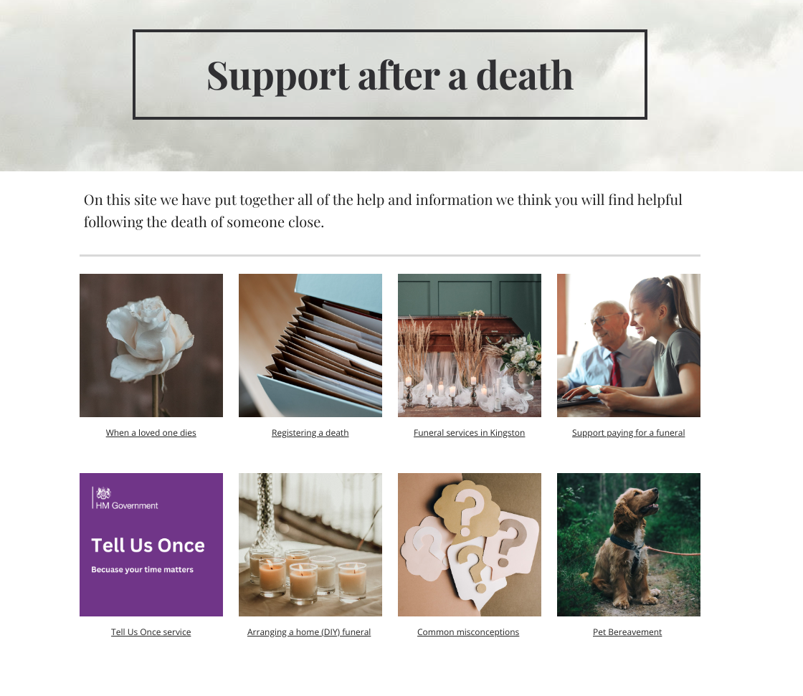
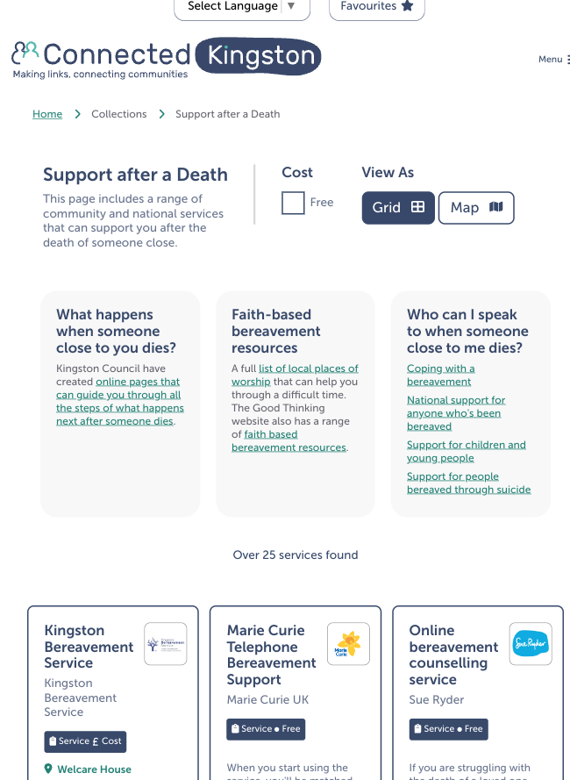
https://www.connectedkingston.uk/collections/support-after-a-death

