Slide 1
Alzheimer’s Society Kingston
Dementia Friendly Kingston

Slide 2
DEMENTIA FRIENDLY KINGSTON
Raise the profile of dementia
Promote services
Dementia Friendly information sessions
Work with community partners
EXAMPLES
Dementia Friendly Walk launching
Staywell Nurse placements
Lost Chord and Kingston Library
Connected Kingston

Slide 3
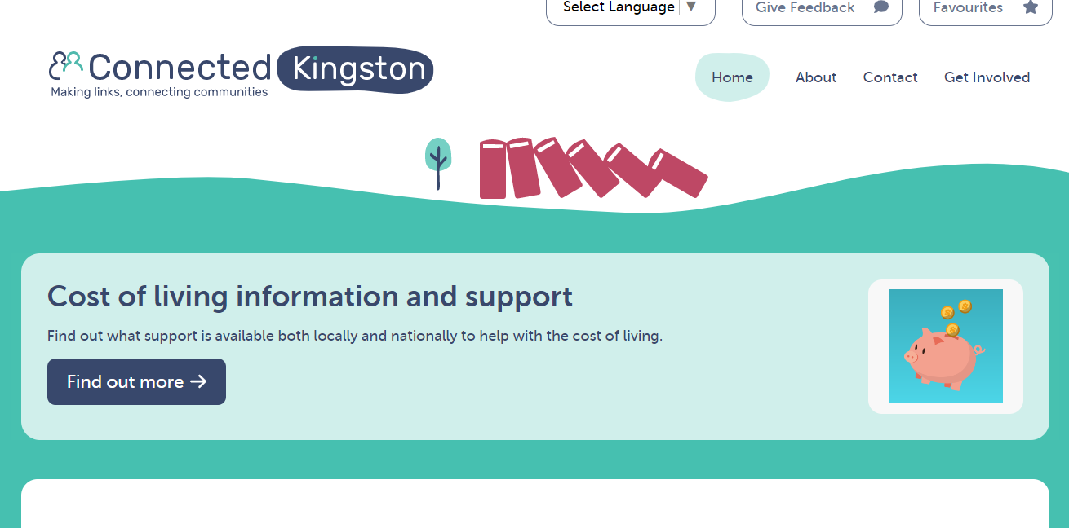

Slide 4
Alzheimer’s Society Kingston
Dementia Support
Services & Information

Slide 5
Our Dementia Adviser Service
Alzheimer’s Society in Kingston provides support and information for anyone affected by Dementia. We support people living with dementia and carers, friends and family.
What we do:
Face-to-face or telephone support including personalised support plans.
Signposting to other organisations working with people living with dementia.
Carers Support including monthly Peer Support Groups and our Carers Information and Support Programme.

Slide 6
Referral to the service can be via:
GP
Memory Clinic
Health clinic or health and/or care professional
Social services
Self Referral
Other voluntary agency

Slide 8
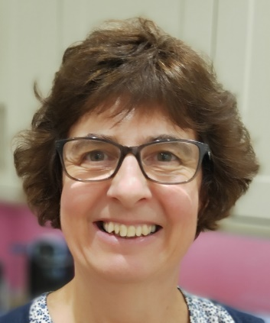
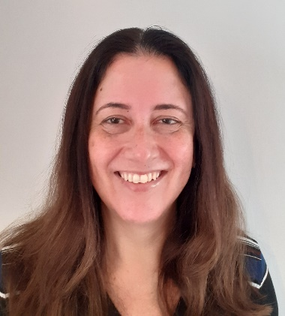
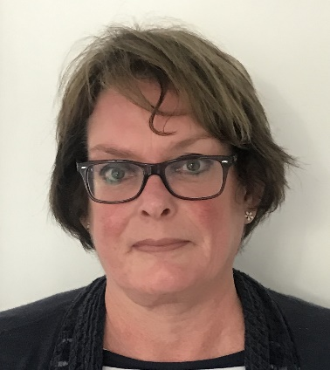
Who we are
DA Rachel Carver
DA Leila C D Chillingirian
DA Joanna Newton
Megan Comber –
Dementia Friendly Community Coordinator
Telephone: 0207 423 5115
Email: Kingstonoffice@alzheimers.org.uk
Website: www.alzheimers.org.uk
Services Manager :
Monique Gardiner

Slide 9
Next: Kingston Carers
CEO Diane White

Slide 10
We are a voluntary sector organisation, providing independent support to unpaid carers in the Royal Borough of Kingston since 1994.
We are currently supporting over 3,600 adult carers and nearly 800 young carers.
Our website has online resource hubs for carers and professionals.
You can quickly refer carers via online form at www.kingstoncarers.org.uk.

Slide 11
Our Holistic Model of Carer Support
Lunch club for carers of people with dementia
Support to complete Lasting Power of Attorney and Deputyship
Carers’ Assessments
Information, advice and guidance
Benefits and tribunal support
Free counselling
Peer support groups for carers
Carers’ breaks and respite activities
Health and wellbeing programme
Access to discounted complementary therapies
Outreach in Kingston Hospital and an out-of-hours advice service
Young Carers’ Project for carers aged 5-16
Young Adult Carers’ Project for 16-20 year olds
Identify & include
Putting Kingston’s Carers at the
heart of carer
support
Whole
Carer led
-area
approach
^ KCN provides this service to some extent
* KCN will refer or signpost for this service

