Slide 1
Warm Spaces & Cost of Living
January 2023
Joanne Moulton, Programme Director - Community Hubs

Slide 2
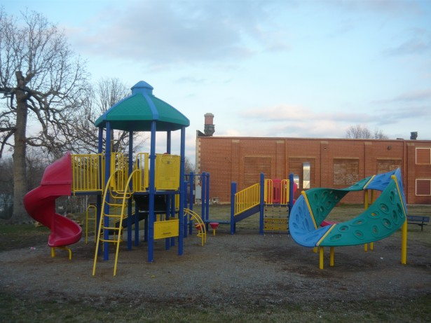
Cost of living support
All support is offered in collaboration - voluntary and community organisations, the council and partners
Warm spaces
Digital
At home
Where people are
Notes:
Physical Space - warm spaces where residents can sit, have a hot drink and potentially access WiFi, activities and information, guidance and advice
Digital Space - relevant information to support residents - council website, Connected Kingston and through digital voluntary sector networks such as Citizens Advice Kingston
At Home - Information and advice at home EG Community Library Service and Adult Social Care services
Where people are - schools, workplaces - providing info/working with others

Slide 3
Warm spaces
Offers of physical spaces around the borough - include
faith venues, community centres, childrens centres, libraries
Easily accessible to residents, offering warm, welcoming and safe
spaces for residents to come together.
Collaborative approach across the borough with VCSE, building on Covid-19 response
Spaces for people to sit and have a hot drink - potentially also access wifi and advice
services, advice and signposting can be accessed
Engage with residents and offer activities to reduce isolation such as board games, reading groups, health advice
Offer tailored to space
Community organisations offered space in council buildings

Slide 4
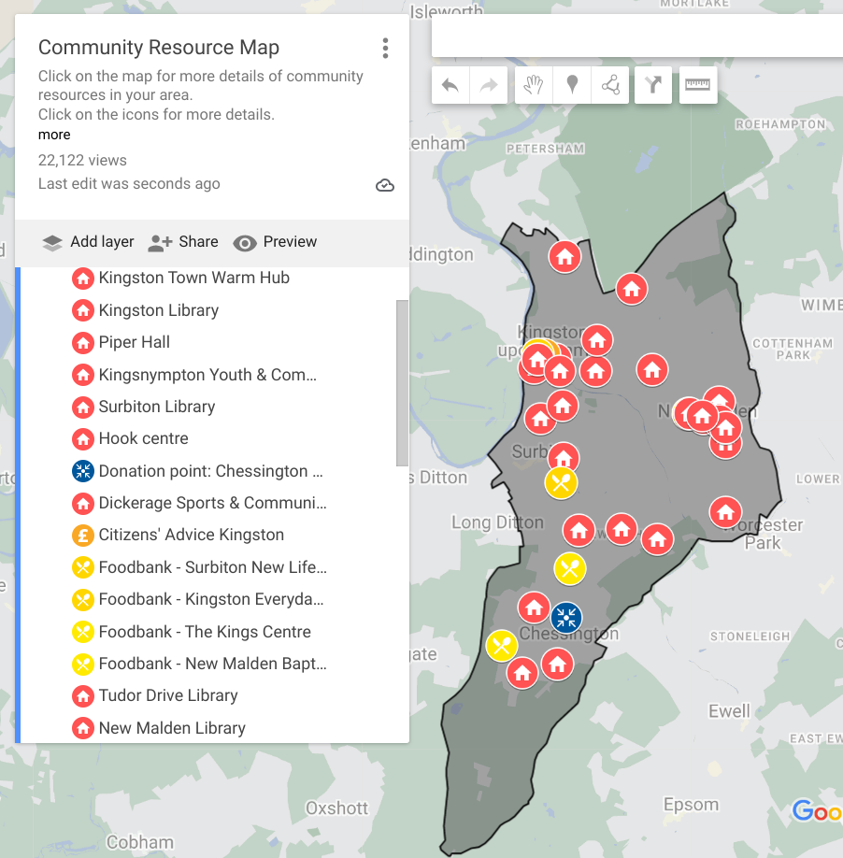
Community Resource Map - Cost of Living
The Council publicises this map heavily
Recently renamed the ‘Community Resource Map’ - adjusting the messaging
Click here to view the map and to add in a response
Notes:
Published in December 20,000 views - updated all the time
KVA have sent this out for VCS organisations to consider using this map to publicise their activity.

Slide 5
Data - trends
Material poverty
1,124 households are likely to be facing food poverty
3,695 households are likely to be facing fuel poverty
7,255 households are likely to be facing water poverty
938 of these households are likely to be facing both food and fuel poverty
938 households are likely to be facing food, fuel, and water poverty
Impact of welfare reform
39 households are affected by the benefit cap. 8 of these households are also in a cash shortfall and may benefit from targeted support.
287 households are affected by the two-child limit
352 households are losing more than £30 per week due to welfare reforms

Slide 6
Household support fund - residents
Kingston’s grant allocation: £862,867.15 for 1 October 2022 to 31 March 2023
To date: 1,088 applications received so far throughout this round. 551 eligible applications processed, worth around £170,000
To promote take up - attended wellbeing sessions at number of locations e.g. Piper Hall and warm spaces to offer help with applications
Promotion to residents in social housing and residents eligible for the Warmer Homes schemes
Supported over 2,500 households in the two previous rounds of this scheme.
HSF will be extended for a further 12 months.
In partnership with AFC, a total of 13,500 Free School Meal vouchers will be provided costing £270,000 (4,500 vouchers for each holiday - October half term, Christmas (2 weeks) and February half term)
We have spent a total of about £544,134.97 so far including grant applications and the Free School Meals
Square One Cafe, The Corner House, Save the World, Kingston Association for the Blind,St Vincent de Paul, Thinking Works, Enhanceable, Migrant Advocacy Service and City Changer Project (includes Food Bank and Grow Baby)

Slide 7
Trends and next steps
Monitoring emerging trends and need - what’s in warm spaces/support
Information from partners/data - families struggling to cope, more people becoming homeless with a range of needs, water poverty
Worst financial impacts still to come - next few months, to end of year and beyond
Complexity of need coming through from community groups
In work poverty - e.g. working families who do not qualify for additional support via benefits as they earn just over the Universal Credit limit. Potential impacts on housing
Families - Children's Centres seeing many single parents with children under 2 unable to return to work due to the cost of childcare
Reaching hidden need - e.g. families not known to us / families of young people (12 upwards) trying to raise money to help support family
Trusted sources - to reach with support

Slide 8
Questions, comments and thoughts

