Slide 1
Empowering People,
Strengthening Communities
Collective Action and the Voluntary, Community and Social Enterprise Sector
2023 - 2027
Louise Footner, Assistant Director Culture, Communities and Engagement

Slide 2
Our vision
Kingston is a welcoming and inclusive borough where inequity has no place
The VCSE and the council have come together to agree a vision for this strategy

Slide 3
The five objectives of the strategy

Slide 4
Maintain the strength of the partnership ready for new challenges
We will work together to:
Develop equitable relationships between the voluntary, community and social enterprise sectors and the council, hearing the full range of voices with different needs, skills and experiences
Be open about challenges and opportunities and tackle them together
Understand, acknowledge and maximise the resources of our partnership, and collaborate to bring additional resources to the borough
Nurture emerging and established organisations to build resilience
Notes:
Photo credit - RAK

Slide 5
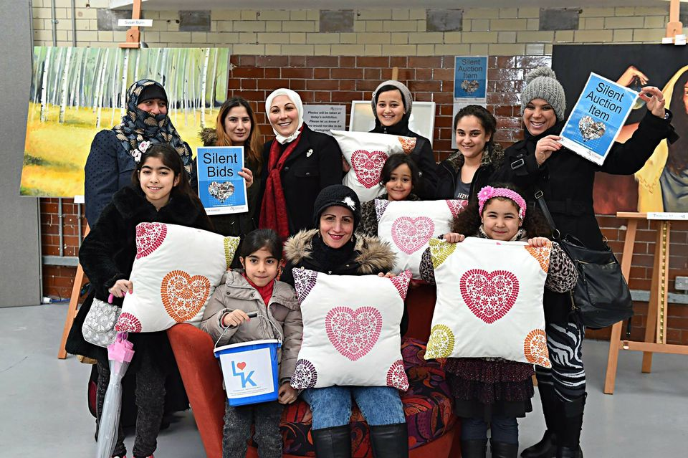
Identify need using data, evidence and community voices
We will work together to:
Use all of our networks and partnerships to engage and co-produce with residents and stakeholders
Improve the evidence we hold and share insight widely. Collectively shape intelligence-led approaches to community need
Understand our collective impact and identify emerging trends and gaps, through engaging across the Kingston Partnership*
Understand who we are not talking with through our networks, and overcome the barriers to reach them
*more information about the Kingston Partnership

Slide 6
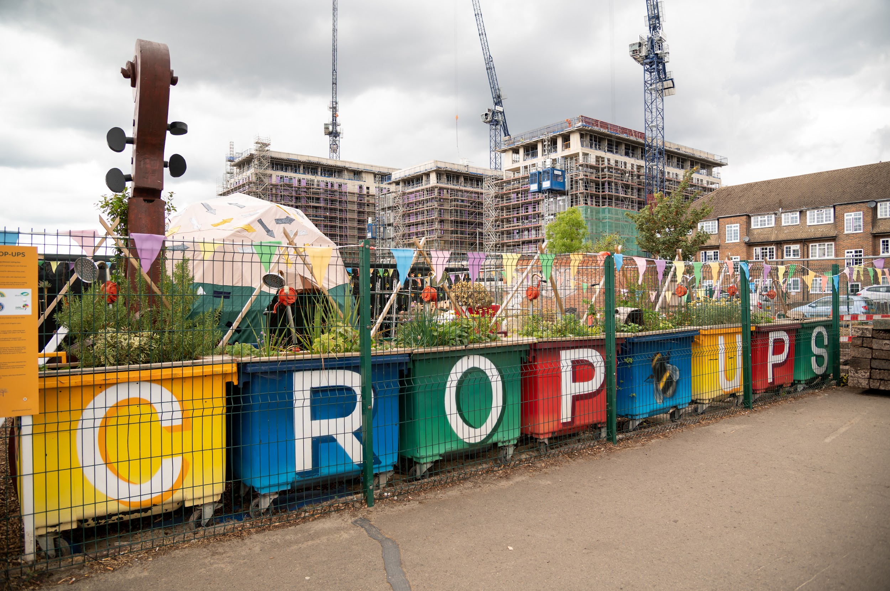
Transform and adapt to meet emerging need and respond to inequality
We will work together to:
Target resource towards those who need it most
Focus on where we can make a difference
Target prevention where it can have the most impact

Slide 7
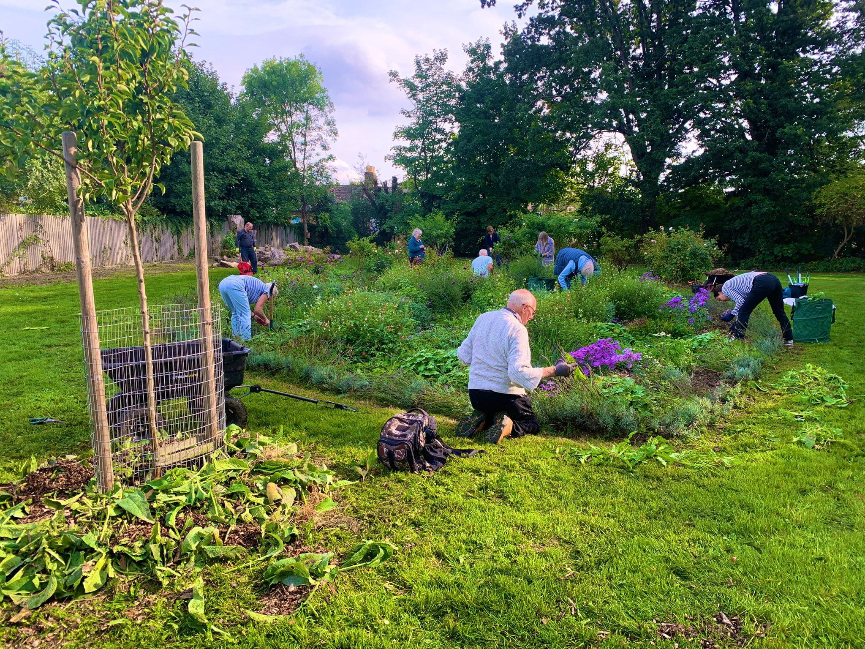
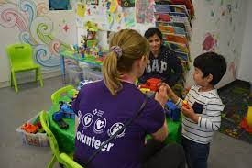
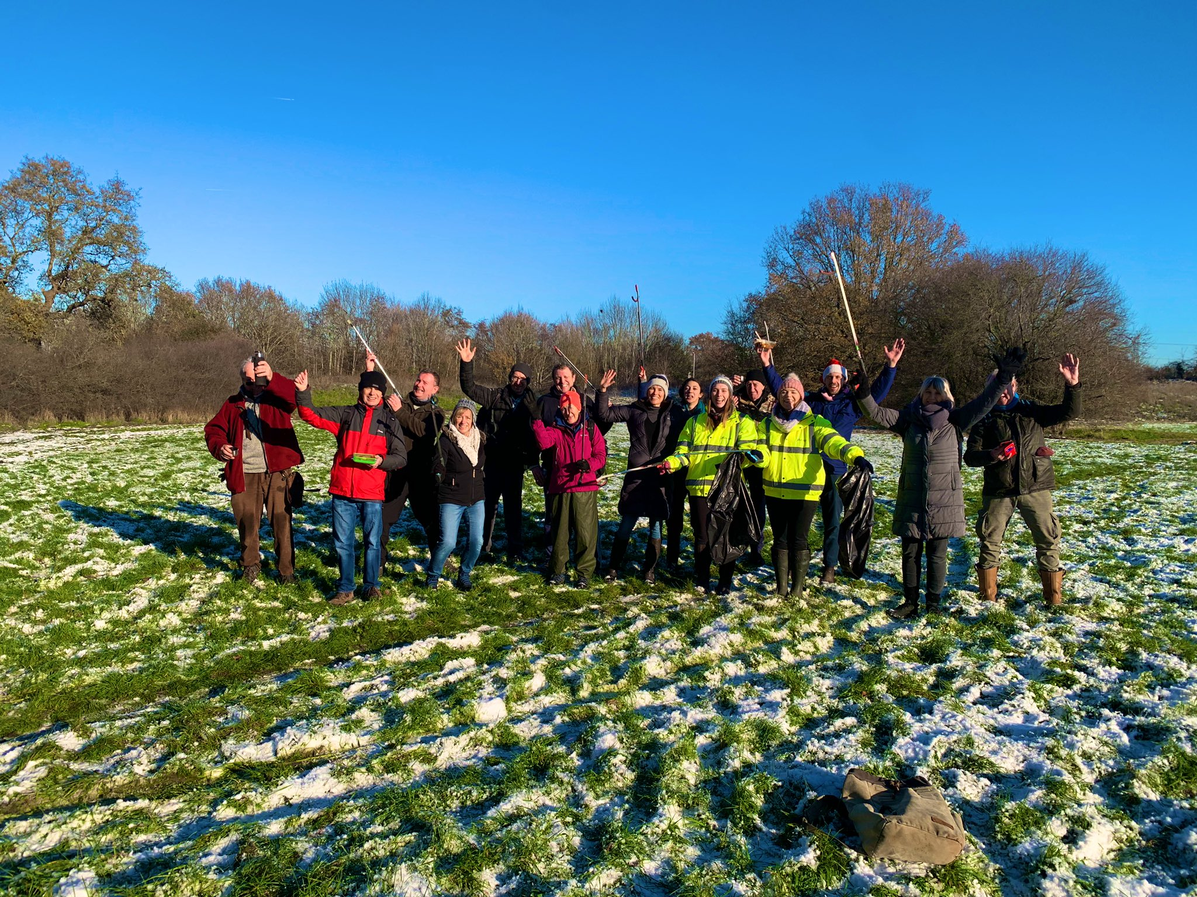
Build on the diverse strengths of communities
We will work together to:
Share skills, experience and joy through volunteering and community connections
Support local businesses and other stakeholders to actively contribute
Develop how we use and share space, making resources more accessible to communities across the borough
Celebrate Kingston and champion our achievements

Slide 8
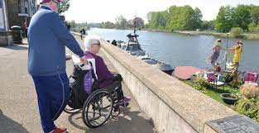
Actively promote equality, diversity and inclusion and reject discrimination
We will stand together to:
Understand inequality, and work to be the most inclusive borough
Embrace our role in actively rejecting discrimination
Notes:
*picture credit - healthwatch

Slide 9
Next steps
Working together to deliver the strategy

