Slide 1

VCSE work with SW London ICS
Towards a VCSE Alliance
Sanja Djeric Kane
CEO, Kingston Voluntary Action

Slide 2





VCSE leadership group
Consists of CVS CEOs (or equivalents) from the 6 boroughs (working with colleagues from SWL ICS)
Aim is to find ways to ensure that the VCSE sector is an integral part of the SW London ICS, structurally positioned with parity of esteem, mutual understanding and trust

Slide 3






VCSE Leadership Group: key achievements

Slide 4

Highlighting how the VCSE sector:
contributes to SWL ICS and its aims:
Improve outcomes in population health and healthcare
Tackle inequalities in outcomes, experience and access
Enhance productivity and value for money
Help the NHS support broader social and economic development
adds significant value through its engagement with communities, focus on collaboration, use of community assets, adaptability, and preventative delivery at community level

Slide 5
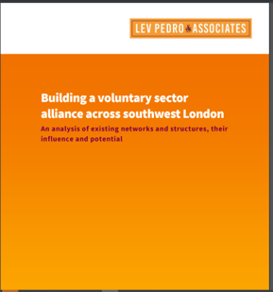
Commissioned research from Lev Pedro Associates on existing VCSE structures and networks in SW London to inform the development of an Alliance (as recommended by NHS guidance).

Slide 6
Recommendations and actions from the report
Increase knowledge and understanding of both sectors to each other
01
Work up a codesigned leadership and representation strategy for VCSE roles; there needs to be resource and commitment to ensure these roles have parity with other partners
02
Facilitate more effective involvement of the VCSE in all stages of the commissioning cycle
03
Establish how smaller VCSE organisations want to be involved or kept informed
04
Improve the systematic use of data and intelligence held by the VCSE
05
Build a VCSE alliance structure, agree a shared vision, values and principles of joint working that is right for SW London and make a case for resourcing
06

Slide 7
The Leadership group has continued to meet to lead the development of the SWL VCSE Alliance, including starting to develop a shared vision, values and structure
The group developed a business case to SWL ICS (which has been agreed) to fund a full-time director post and continue to support and expand the leadership group
The recruitment for the Director post is currently underway

Slide 8
Building the SWL VCSE Alliance
The VCSE Alliance Director role will be an observer of the Integrated Care Board, a member of the Integrated Care Partnership and is also invited to sit on other sub-committees as part of SWL governance structures.
The chief executives or equivalent of the six partner organisations have formed as an initial VCSE leadership group for the VCSE Alliance. This membership will broaden out to include a frontline VCSE leaders from each Place.
For example, the VCSE Alliance will lead on the development of the VCSE leadership and engagement strategy codesigned with the wider VCSE sector.
SWL VCSE Alliance
Croydon Voluntary Action | Kingston Voluntary Action | Merton Connected | Richmond Community Voluntary Sector | Community Action Sutton | Wandsworth Care Alliance
Frontline VCSE leader (Croydon) | Frontline VCSE leader (Kingston) | Frontline VCSE leader (Merton) | Frontline VCSE leader (Richmond) | Frontline VCSE leader (Sutton) | Frontline VCSE leader (Wandsworth)
SWL VCSE Alliance Director
Integrated
Care Board
Integrated Care System Partnership

Slide 9
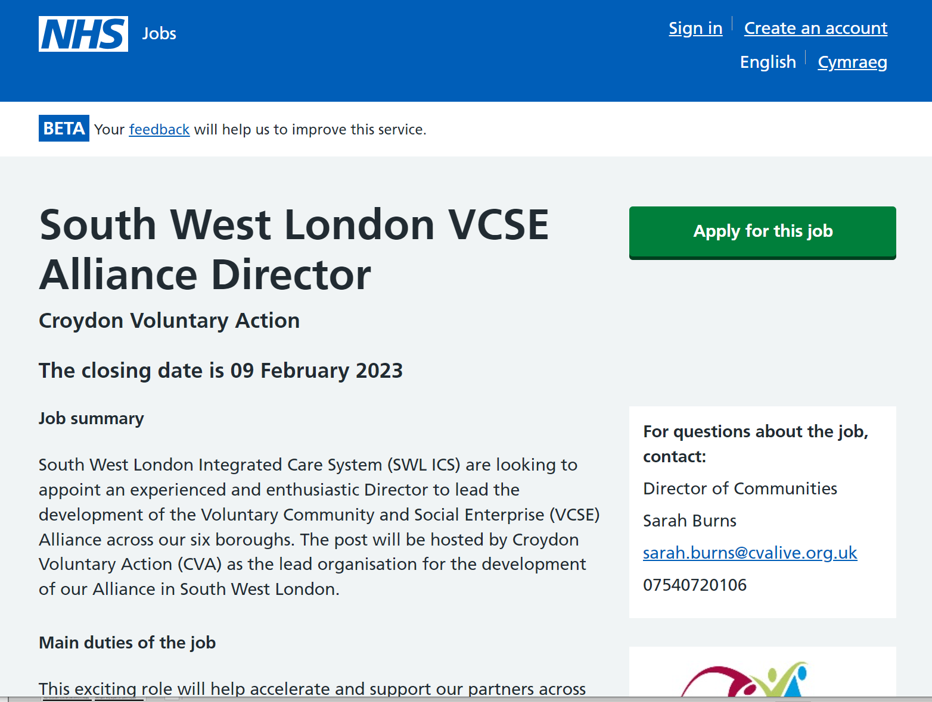
Recruitment for the VCSE Alliance Director
South West London Integrated Care System are looking to appoint an experienced and enthusiastic Director to lead the development of the Voluntary Community and Social Enterprise (VCSE) Alliance across our six boroughs. The post will be hosted by Croydon Voluntary Action.
How to apply:
You can apply online at NHS jobs: jobs.nhs.net
Closing date:
Thursday 9th February 2023 at 17.00
Short listed candidates will attend an in-person interview to be held at CVA Resource Centre, West Croydon. CR0 2TB on 2nd March 2023
This job has been re-advertised; previously unsuccessful candidates do not need to re-apply.

Slide 10

Questions?

