Slide 1
Building a South West London Voluntary, Community, Social Enterprise (SWL VCSE) Alliance
Kingston
Denise Madden, Deputy Executive Lead for Kingston and Richmond

Slide 2
We are here to listen and learn...
As the new integrated care systems develop, NHS, local authority and voluntary sector organisations working in health and care in England are coming together and working in partnership to improve the health and wellbeing of local populations.
In SW London and in Kingston we have done some great work, but we recognise we can do far more, to understand each other better and to work more closely together.
We recognise that our partnership has the potential to really support local people and their health and well-being.
We are keen to understand today from you what it will take to help our partnership and the Alliance for SW London to succeed.
The NHS in SWL is committed to funding the VCSE Alliance and within that, a new VCSE Director post who will act as a strategic link between the VCSE and partners within the SW London.

Slide 3
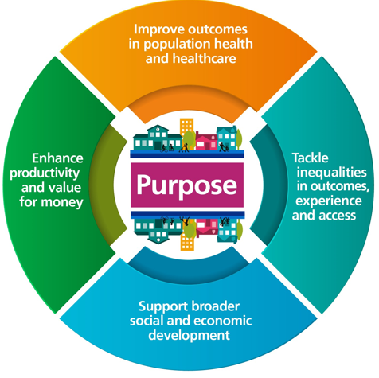
Background: what are Integrated Care Systems?
Integrated Care Systems are partnerships of organisations that come together to plan and deliver joined up health and care services to improve the lives of people in their area. They will be responsible for how health and care is planned, paid for and delivered.
ICSs have four key purposes:
  improving outcomes in population health and healthcare
  tackling inequalities in outcomes, experience and access
  enhancing productivity and value for money
  supporting broader social and economic development

Slide 4
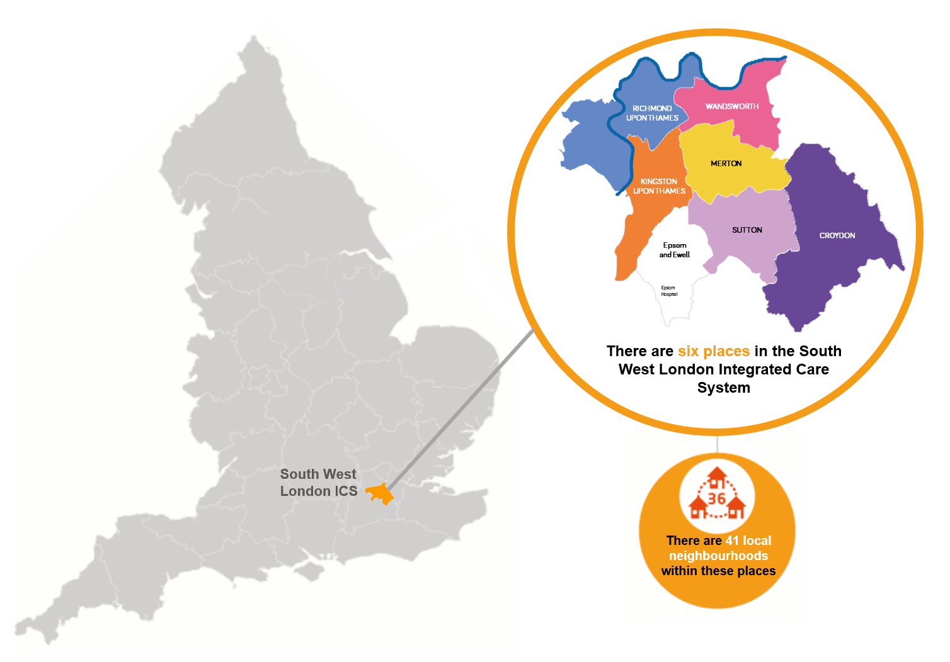
South West London Integrated Care System
Bring together NHS organisations, councils, Healthwatch, charities, community and voluntary organisations to improve local health and care services and to improve the health and wellbeing of local people.
SWL ICS is made up of six ‘Places’ – Croydon, Kingston, Merton, Richmond, Sutton and Wandsworth.
Place-based partnerships lead the detailed design and delivery of integrated services across their localities and neighbourhoods.
Notes:
There is a place based committee for Richmond and one for Kingston.
A great deal of overlap between the membership and the work programmes. Where it makes sense to join forces and work together we do this – for example, in the work we have done to support people with long COVID for example, Youth Out Loud is a Healthwatch Group across the two boroughs, and in transformation programmes such as the work we are doing so support frail elderly people in both boroughs.

Slide 5
ICS and voluntary sector
On 1 July 2022, the South West London Integrated Care System (ICS) was established .
The ICS is made up of two parts:
  Integrated Care Board
  Integrated Care Partnership
NHS England (NHSE) have set out clear expectations that Integrated Care Boards (ICBs) develop a formal agreement for engaging and embedding the voluntary, community and social enterprise (VCSE) sector in system level governance and decision-making arrangements.
We know the VCSE sector can play an important role in helping improve, deliver and shape services to tackle the wider determinants of health.
The VCSE Alliance is being set up to embed the VCSE sector in these arrangements giving equal voice and influence around the table.

Slide 6
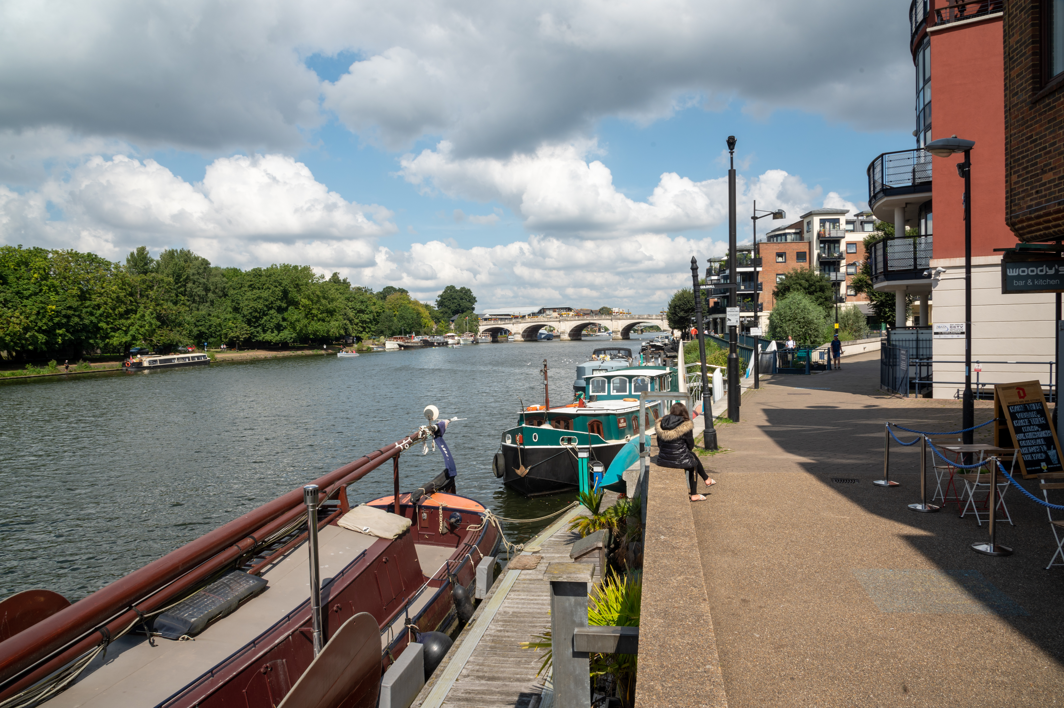
Kingston ‘Place’
In Kingston, our place-based partnership includes representation from:
Kingston Council
Achieving for Children
South West London and St. George’s Mental Health NHS Trust
Kingston Hospital NHS Foundation Trust
Healthwatch Kingston
Your Healthcare
Hounslow and Richmond Community Healthcare NHS Trust
Kingston voluntary sector organisations
NHS South West London

Slide 7
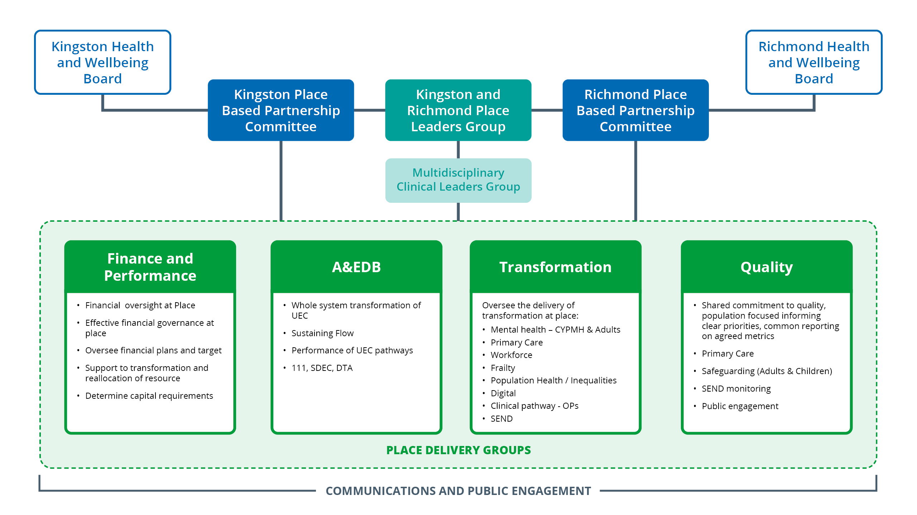
Kingston & Richmond Places: Emerging governance

