Slide 1
VCS Forum
Latest Council Financial Position

Slide 2
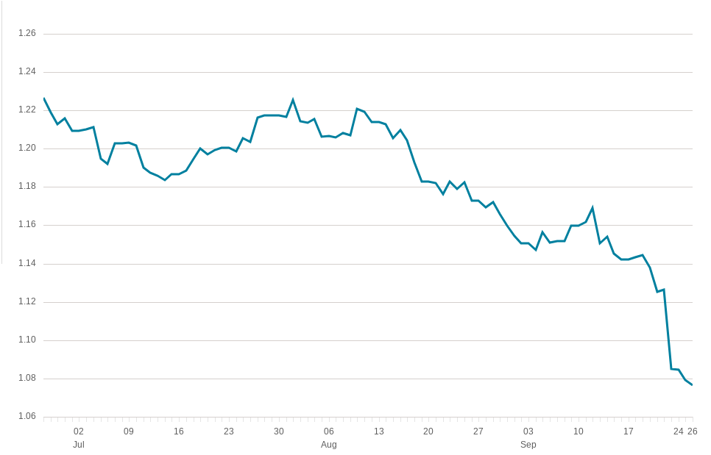
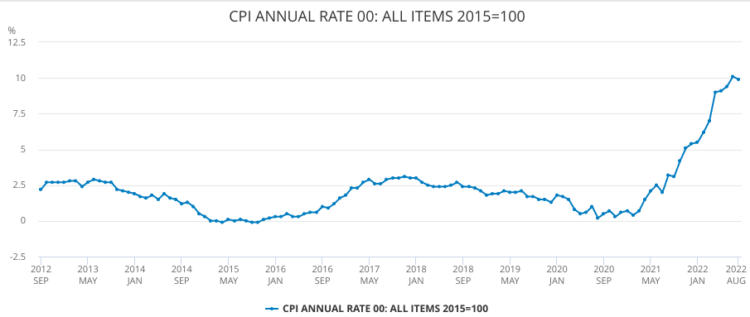
Context - Volatile Economy
Source: Financial Times, 27 September 2022
Source: The Guardian, 26 September 2022
GBP / USD
Source: ONS, August 2022 inflation

Slide 3
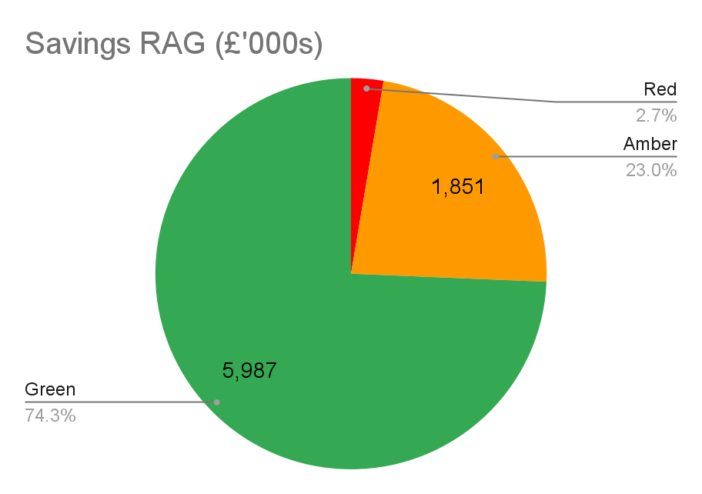
2. Latest In-year 2022/23 Budget Position
Month 4
£0.215m
RED (Undeliverable) savings
£2.947m
GF Variance (Overspend)
£1.112m overspend
HRA
£5.378m
DSG Overspend
£26.265m
Capital
Underspend in year
Overspend of £26m over the next 4 years

Slide 4
3. Key Financial Risks RBK
The Council continues to face significant financial challenges which has now been amplified by the latest national inflationary crisis seeing historic rises in inflation not seen in over 40 years. Economic uncertainty and high inflation is not limited to the current year and the ongoing impact on the MTFS will also be significant.
Supply chain issues and national skills shortages which have presented significant challenges in delivery and recruitment and retention.
Increasing Demand for services particularly within Adults Social Care, Children’s Services and Housing-It is clear that post-pandemic and current economic challenges have widened the gap between the demands that Kingston needs to address and the funding that is required versus what is available

Slide 5
4. Latest Medium Term Financial Strategy Position
 | 2023/24 | 2024/25 | 2025/26 | 2026/27
 | £'000s | £'000 | £'000 | £'000
Expenditure
Base Budget as per Agresso | 148,048 | 166,537 | 180,966 | 194,430
Adjustments to Base Budget | (432) | 0 | 0 | 0
Adjusted Base Budget | 147,615 | 166,537 | 180,966 | 194,430
Inflation | 14,444 | 7,456 | 4,880 | 5,539
Growth | 7,571 | 7,028 | 8,016 | 9,000
Savings | (3,094) | (54) | 567 | 0
Gross Budget requirement | 166,537 | 180,966 | 194,430 | 208,969
Resources
Parking / Bus Lane / Moving Traffic Enforcement Accounts | (5,650) | (5,650) | (5,650) | (5,650)
Specific grants | (8,265) | (8,265) | (2,413) | (2,413)
Revenue Support Grant | 0 | 0 | 0 | 0
Council Tax | (110,255) | (111,358) | (112,472) | (113,596)
Collection Fund Surplus / Deficit (Council Tax) | 691 | 0 | 0 | 0
Collection Fund Surplus / Deficit (Business Rates) | 880 | 0 | 0 | 0
Business Rates | (26,028) | (26,154) | (26,471) | (26,899)
Total Resources | (148,627) | (151,427) | (147,006) | (148,558)
Annual Increase in Budget Gap | 17,910 | 11,630 | 17,883 | 12,988
Cumulative Budget Gap | 17,910 | 29,540 | 47,423 | 60,411
£94.5m
Savings delivered
2012/22
£17.9m
Budget gap
2023/24
£60.4m
Cumulative budget gap
2023/27

