Slide 1


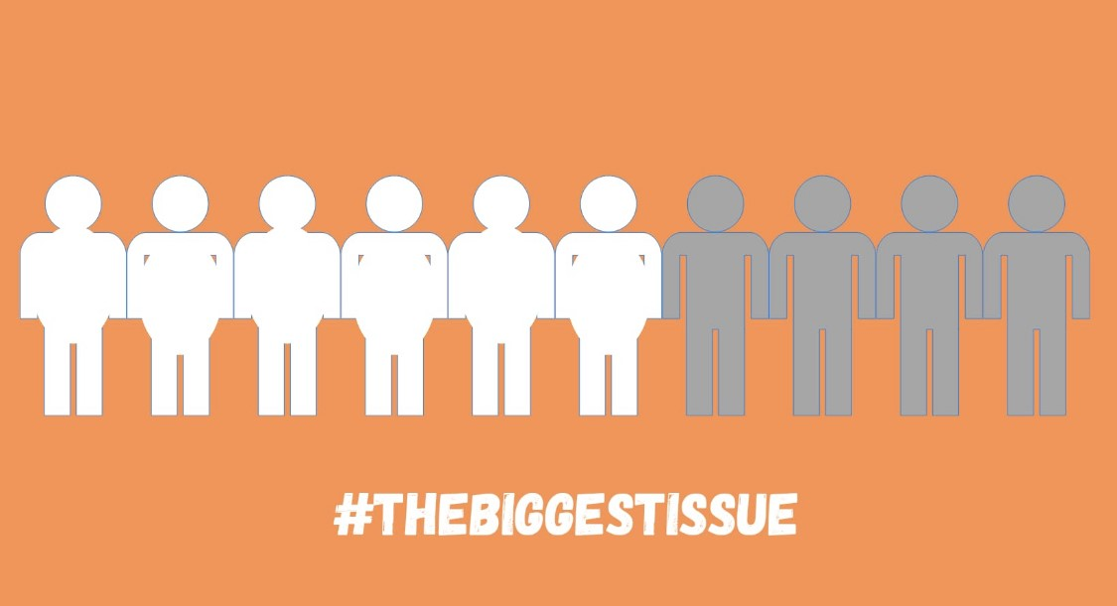
Obesity
The silent pandemic
Dr Annie Murphy
DR Mohan Sekeram
Iona Lidington

Slide 2
Arguably the biggest issue the UK is facing now is obesity – the silent pandemic. It is reported that over 60% of UK adults are overweight or obese
https://digital.nhs.uk/data-and-information/publications/statistical/statistics-on-obesity-physical-activity-and-diet/england-2020

Slide 3
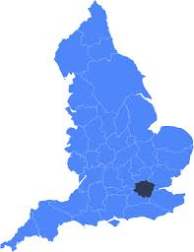
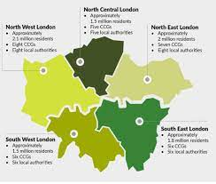
National picture on obesity
Obesity is directly linked to the risk of developing multiple long-term conditions
  https://www.cancerresearchuk.org/health-professional/cancer-statistics/risk/overweight-and-obesity
It has been forecasted that by 2050, the NHS will spend £9.7 billion per year treating obesity related conditions.
  https://digital.nhs.uk/data-and-information/publications/statistical/statistics-on-obesity-physical-activity-anddiet/statistics-on-obesity-physical-activity-and-diet-england-2018
In the UK, obesity rates are strongly correlated with social and economic circumstances
  https://www.parliament.uk/documents/fair-society-healthy-lives-full-report.pdf
Black, Asian and minority ethnic (BAME) populations have higher susceptible to obesity-related diseases (e.g. diabetes) at a lower weight compared to white populations
  Excess Weight and COVID-19 (publishing.service.gov.uk)

Slide 4
People in areas of high deprivation as 8 times less like to take up a lifestyle & weight management programme than the rest of the population in South West London
SWL National Diabetes Prevention Programme uptake data 2016-2018

Slide 5
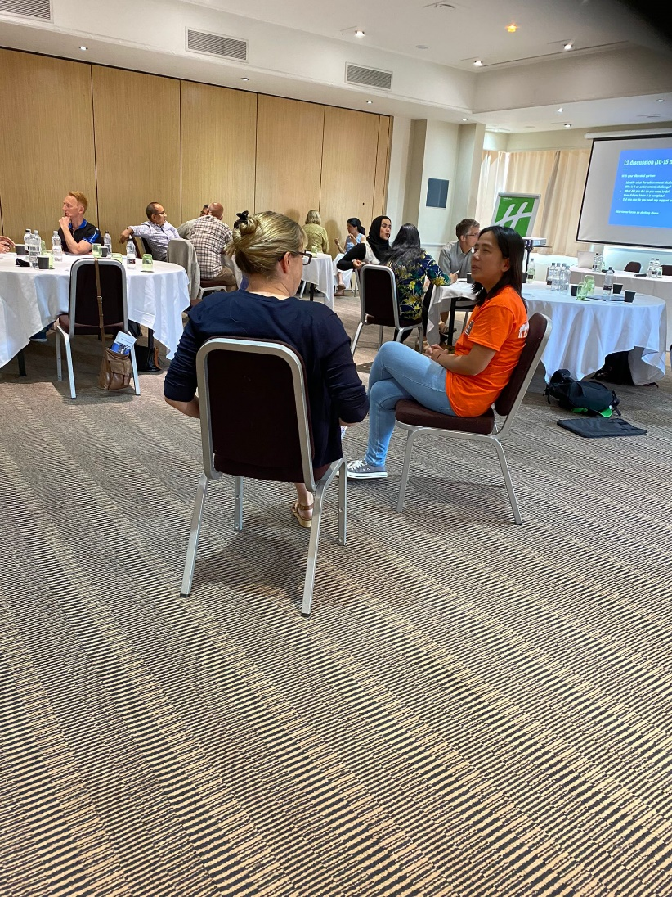
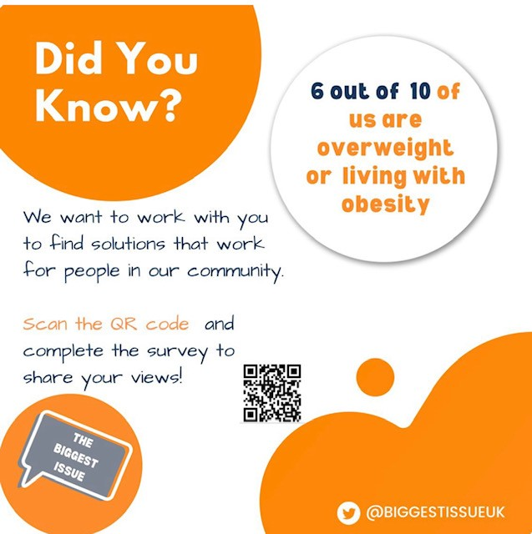
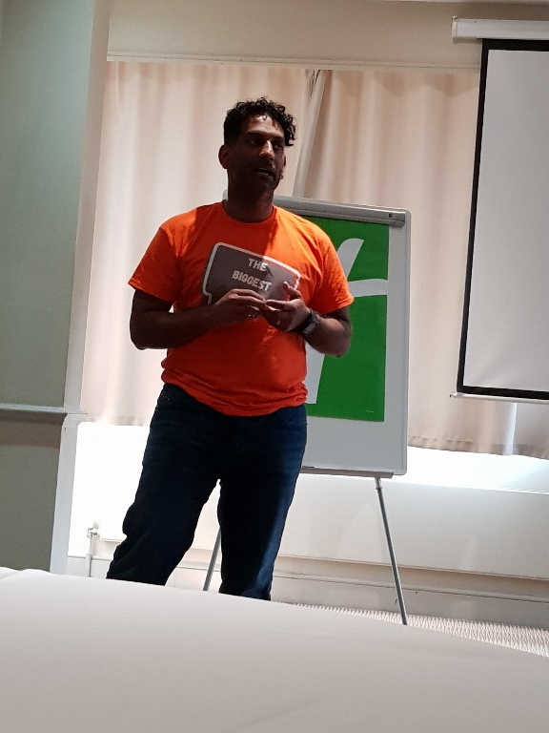
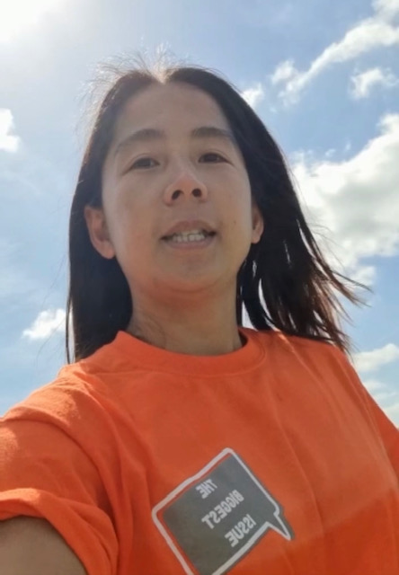
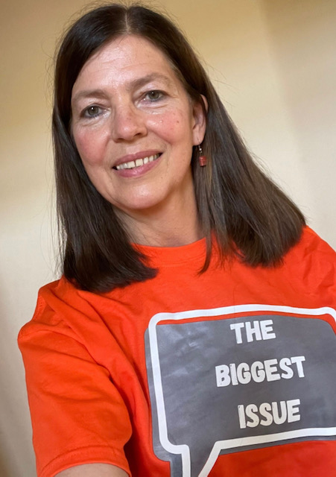
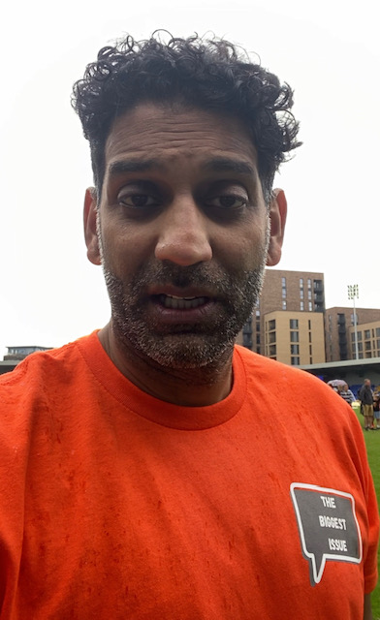
We want to hear from our communities – what people feel about their weight and why, and what they would find helpful to support them to be a healthy weight

Slide 6
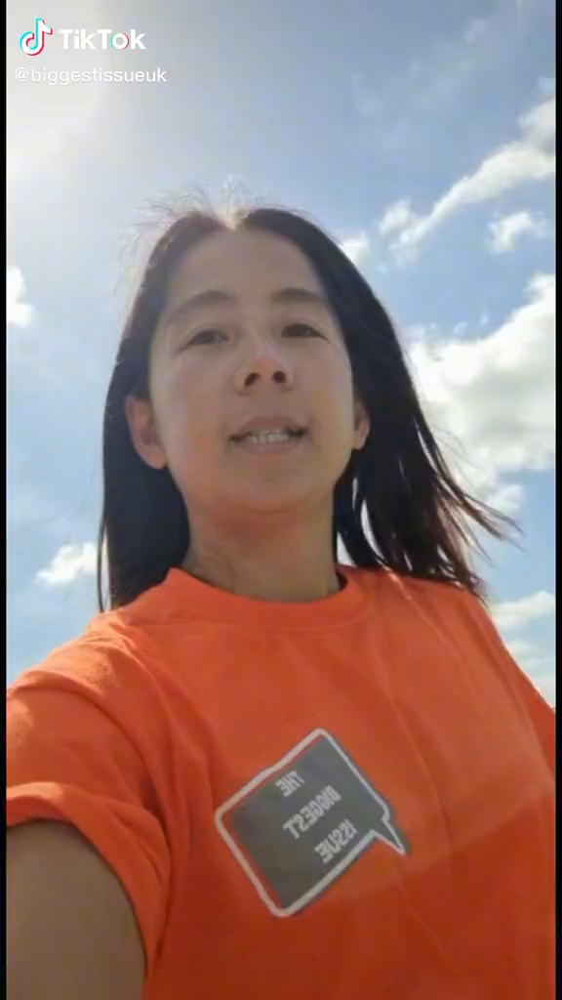
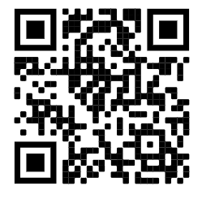
Please share this video with your networks and get people to fill in this survey now:
All who complete the survey can be entered into a draw with the chance to win £100.
The link to the survey is:
https://www.surveymonkey.co.uk/r/X5W52Z5
Or scan this QR code with your phone to take you directly to the survey:
Thank you ☺

