Slide 1
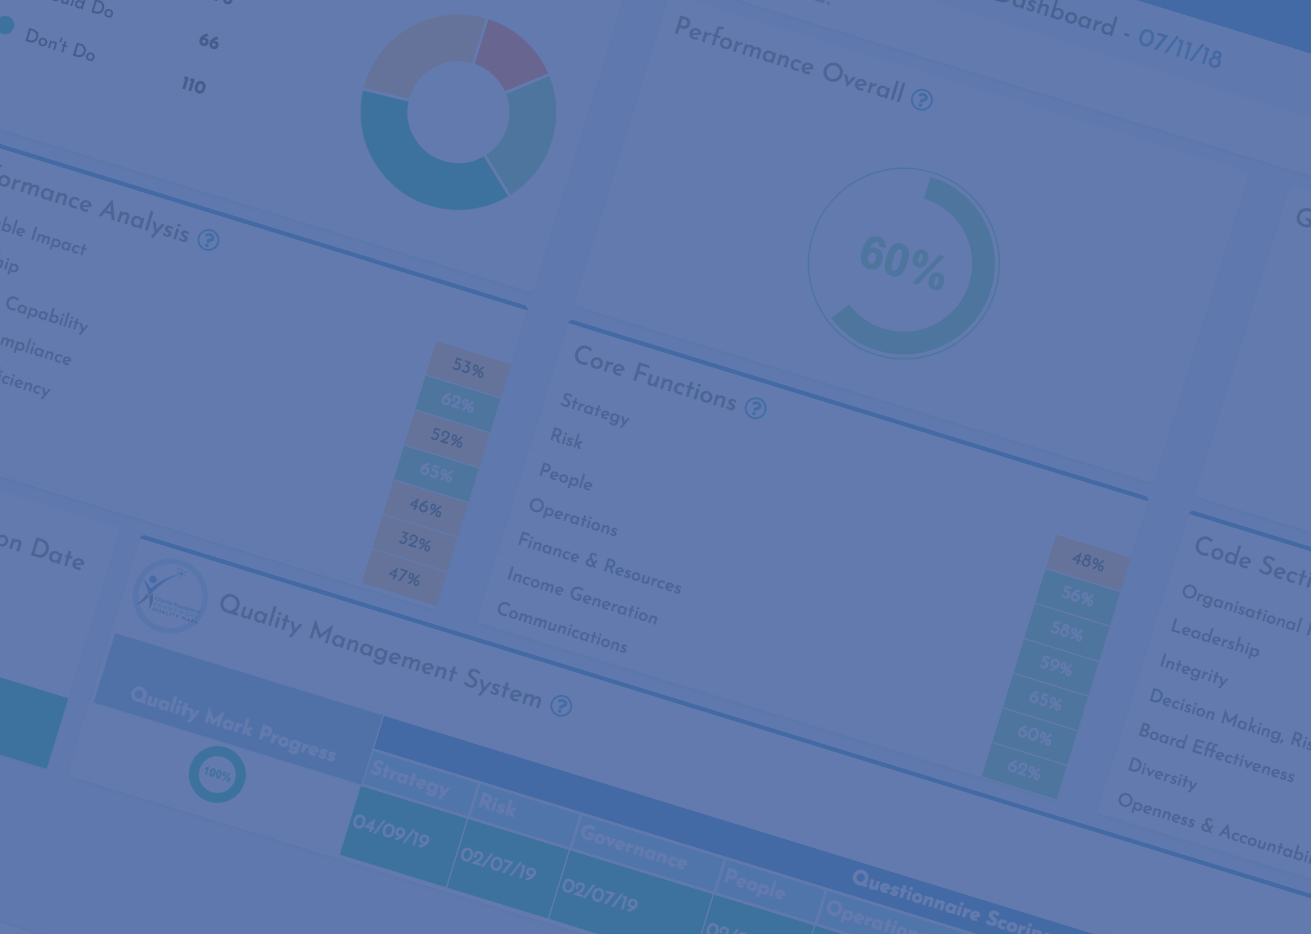

CHARITY
EXCELLENCE
Built for the sector, by the sector and owned by everyone
Notes:
I built a number of very successful decision support platforms, for very large organisation in a previous career, but have been a charity volunteer for over 40 years and worked at board/exec level for 25, including various chair and CEO roles. Build began in 2016 and launched in 2018. I do almost everything myself and fully fund it. What we are doing is of little interest to funders, so we are moving to sourcing commercial income streams. The CEF can neither create systemic change, nor be sustainable, unless ownership is transferred to the sector. We will use our social franchising framework to do so.

Slide 2
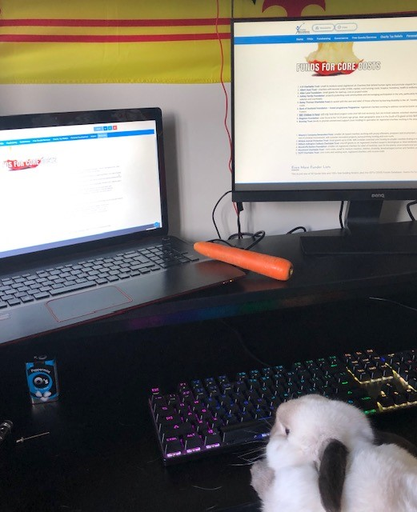
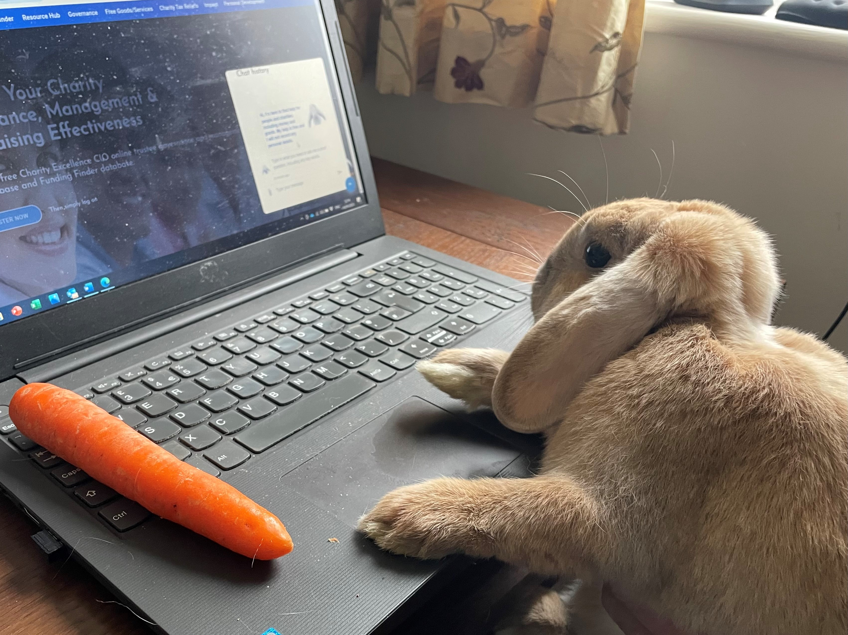

What’s With the Bunnies?

Slide 3
A Free One-stop-shop
Main health check system, QM and master resource hub
Policy downloads – 65+ AI ready policies
Three Finder directories
AI Services – funding bids, etc
Charity Sector Data Store – Big Data
Coming Soon ………..
Notes:
Find out more on the FAQs page - https://www.charityexcellence.co.uk/faqs/

Slide 4
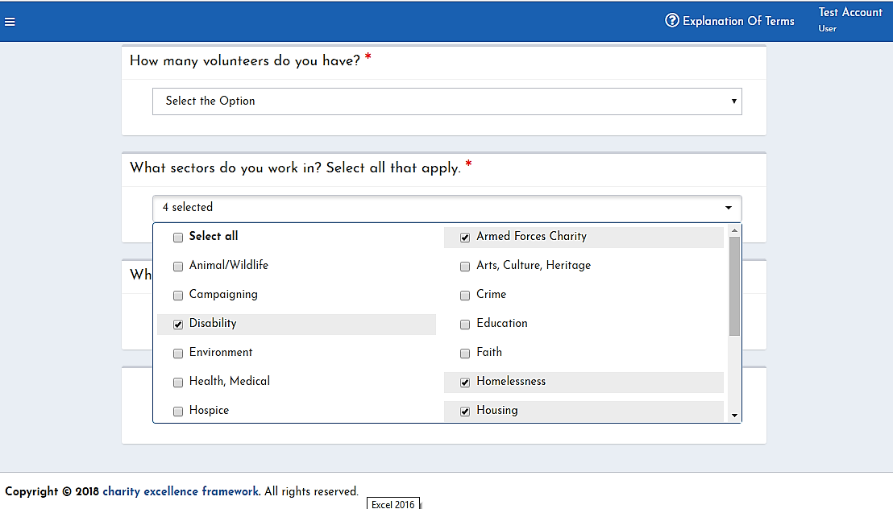
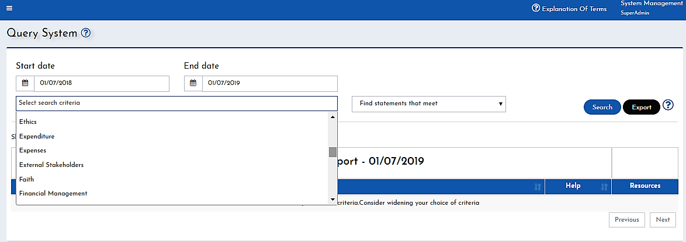

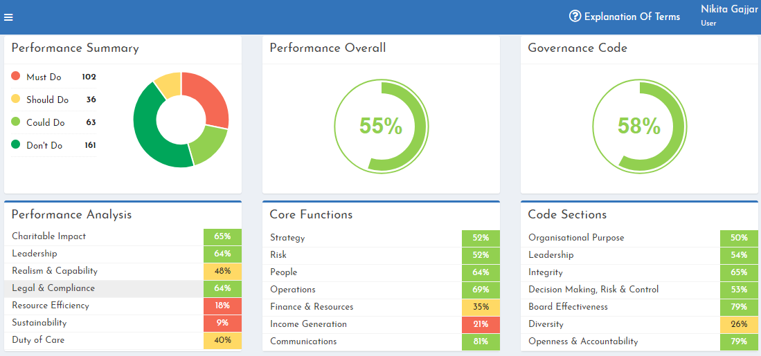
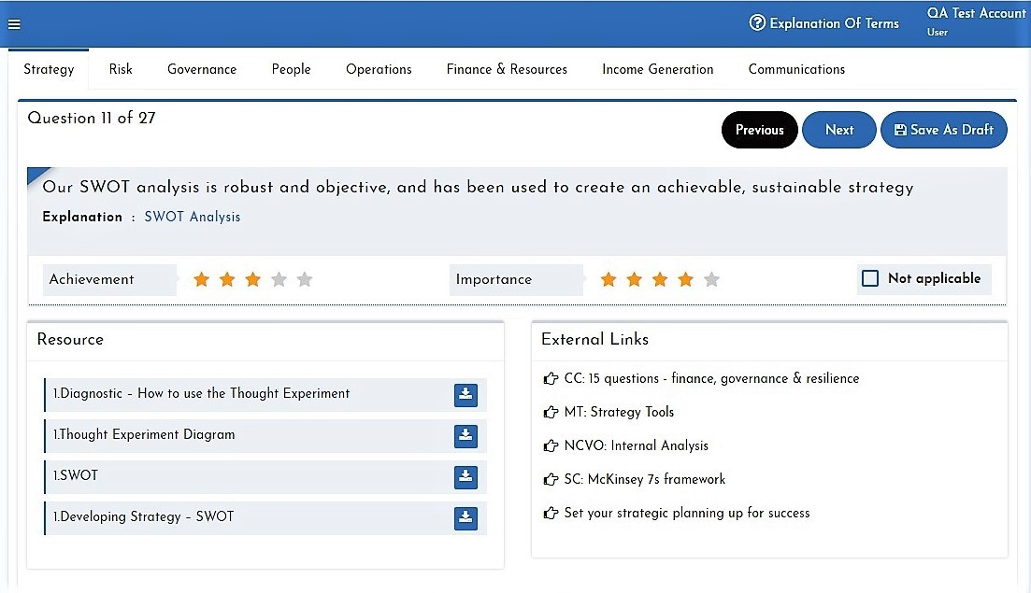
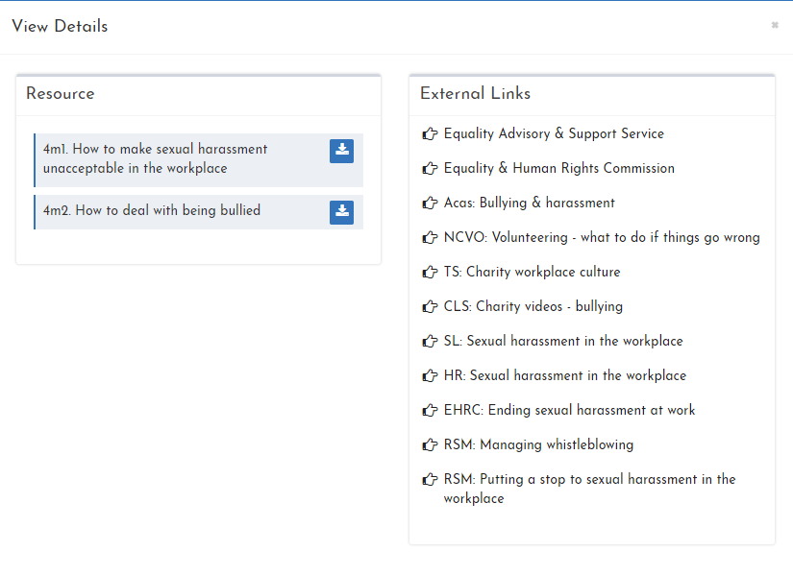
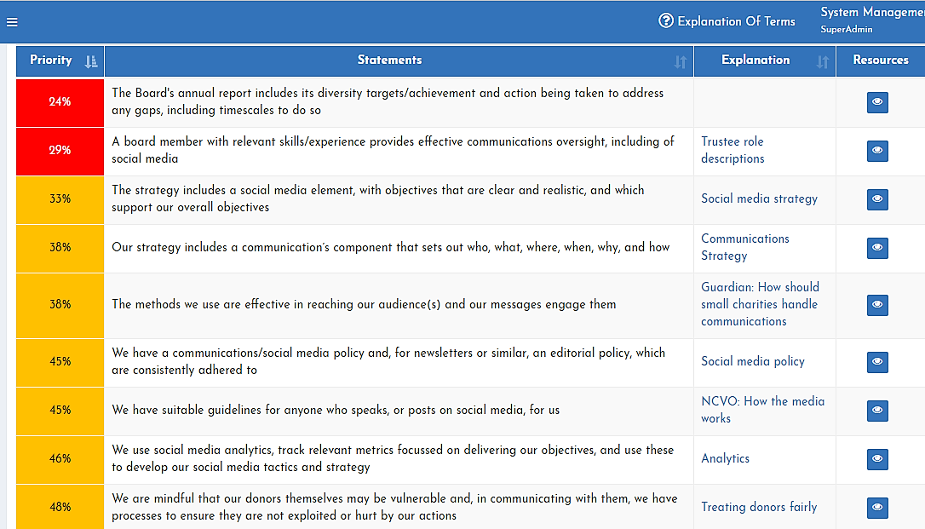
User Input
System Output
Main Health Check System
SET-UP
QUERY SYSTEM
DASHBOARD
SCORING
Resources
Data Store
From the interactive dashboard, it’s 2 clicks to everything
RESOURCES
REPORTING
Notes:
On 1st login, users spend 2 mins telling the system all about their charity and it uses this to build a health check framework unique to their non profit and specific to its needs. The system works for any charity, not matter how small and including UK based international charities, as well as CICs and schools. It is very quick to use and requires no charity or management expertise to use. They then score any or all of the 8 questionnaires (30 mins each). The charity’s results are displayed in the interactive dashboard. From here its’ 2 clicks to everything, including the underpinning reports, master information hub resources, query system and action plan exporting - 46% of users rate it 10/10.

Slide 5
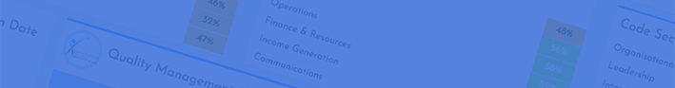

Three Finder - Directories
Funding Finder – simple, small charity optimised, 100k grant makers
Help Finder – company donations, raffle prizes – 28 search categories
Data Finder – data for non-profits, the areas they work in and fundraising
Notes:
The system 3 finder directories tap into the huge collective expertise of the sector and far beyond to enable anyone to find the funding, advice, help, resources and facts, figures and numbers they need. They do this by connecting to a huge range of other free grant directories, online funding lists, advice and support from the public, private and charity sector and open-source data portals. Each is optimised for the vulnerable and minority groups and most work globally, as well as in the UK. The AI Bunnies use machine learning to support people in navigating the system to find what they need, but also have an additional capability of finding advice, support and funding for individuals. They can also direct non-profits to external sources of support and answer questions about the charity sector. They love chatting about carrots.

Slide 6



AI Services
Both Bunnies – system help and non profit questions
Website Bunny – help for individuals
In-system AI Bunny – Funding Bids, Policies and AI Help Finder
AI Help Finder – our 1st next generation AI system
More accurate, accessible, effective and ethical
Notes:
https://www.charityexcellence.co.uk/ai-for-charities-and-non-profits/

Slide 7


Help Finder (Agentic) AI
Notes:
Simple AI Bid Writer (Funding Bid button) - https://www.charityexcellence.co.uk/free-charity-ai-bid-writing/
The In-System AI Bunny (Help Finder AI button) - https://www.charityexcellence.co.uk/charity-ai-help-finder/
AI Bid Writing Best Practice (applications) - https://www.charityexcellence.co.uk/ai-bid-writing-for-charities/
AI Bid Writing Best Practice Guide (Grant Makers) - https://www.charityexcellence.co.uk/charity-ai-bid-writing/

Slide 8
His Main Roles
Finding funding, free help and support
Drafting and reviewing funding bids and fundraising contents
Answering questions and writing guides/briefs
Analysing corporate and related data, except when he tells me to ‘Hop off!’

Slide 9

This winter will be even harder
Notes:
To book your sessions visit our Luma events web page and click follow to be kept up-to-date on new events - https://luma.com/Charity-Excellence

Slide 10
#SurviveAndThrive – Better Support
Official launch date is 1 Oct 26
Funding Finder – 33% more grants v Sep 25
Help Finder – 80% increase in support/companies
And our recent crowd funder is now enabling us to significantly improve quality too

Slide 11
#SurviveAndThrive – New Support
Launching 1 October - webinars, toolkits and AI/digital
  Oct - Charity Sector Outlook 2027
  Oct - Gift Aid - £500m pa unclaimed
  Nov - Communications – people give to people
  Jan - Funding – diversify and grow
  Feb - Resilience – protecting your charity
Notes:
To book your sessions visit our Luma events web page and click follow to be kept up-to-date on new events - https://luma.com/Charity-Excellence

Slide 12
#SurviveAndThrive – Active Support
Now not only finding income but actively supporting you to secure funds
  Small(s) Christmas Market – 1 Nov
  UK Community Lottery
  Bun Run 27
  CEF 2.0 – a new way to support small charities

Slide 13
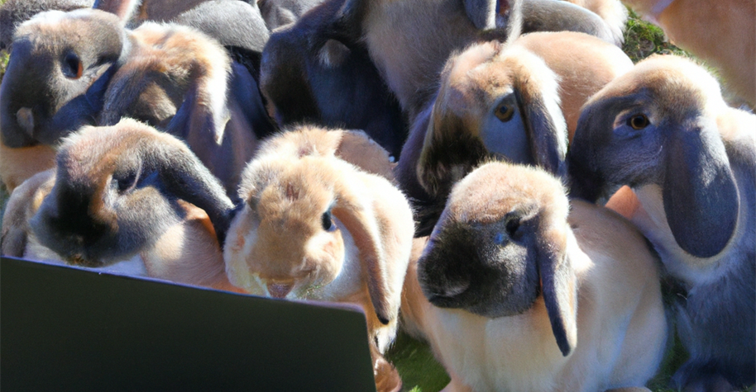

Charity Excellence 2.0
Notes:
Many struggle to exploit technology and we work to support small charities and the most marginalized, who may have very limited tech expertise, low educational attainment, or a disability or English may be a 2nd language. Consequently, we aim to create a single gateway to the sector. Driven by AI, that will enable almost anyone (individual or organisation) to find the help they need.

Slide 14
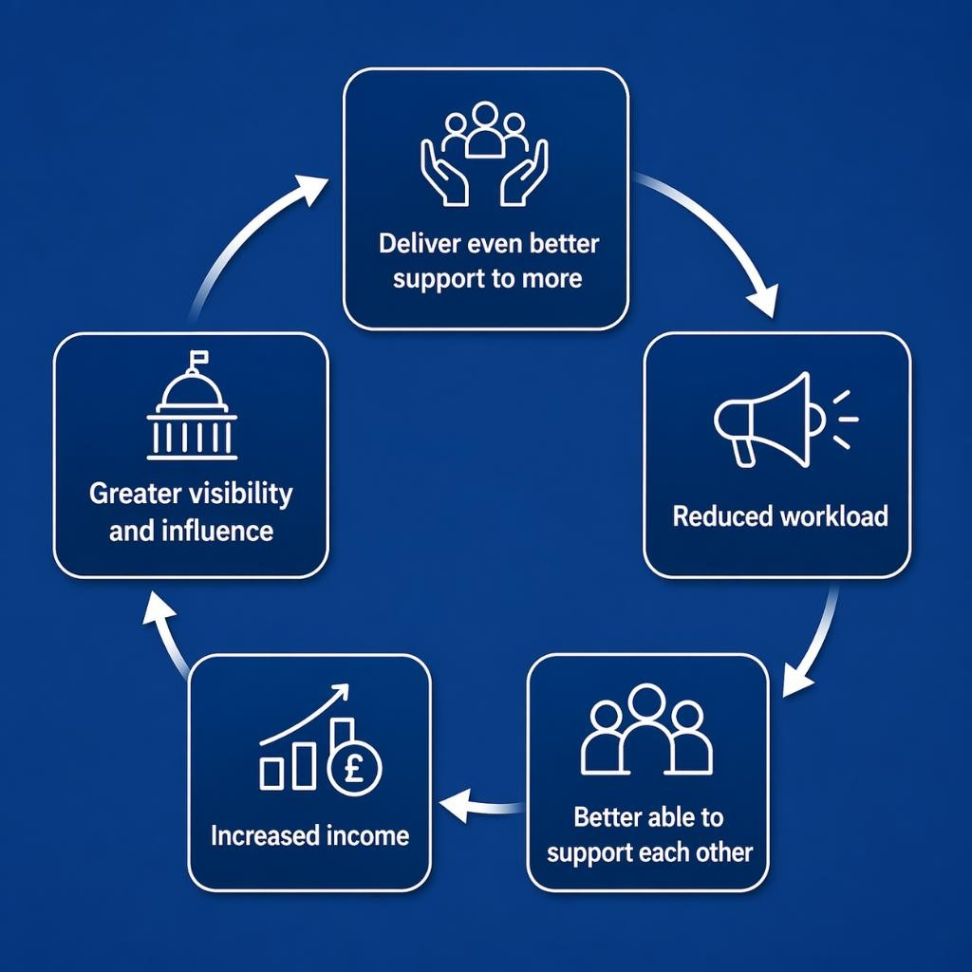
A New Way to Support Charities
A UK wide social franchise network
Making support easily findable by anyone
Providing support to the 700+ infrastructure bodies
Deploying existing and new CEF capabilities – far more accessible
Notes:
Enabling infrastructure bodies to deliver even better support and to more charities is the starting point in our righteous cycle to reverse the decline.
Reduced workload will free up hard pressed staff to focus on the things that matter most.
Support groups will grow and their members become better able to support each other.
Increased income from the deployed income generation capabilities, plus our promotion of paid membership and services.
The Media, Government and others will be able to find and tap into deep local and specialist expertise, giving them a real voice with greater visibility and influence.

Slide 15
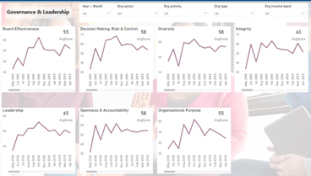

Charity Sector Data Store
5 Interactive dashboards
Analysable using 100 data tags and
50 categories
1 million data points
Including the Covid & CoL Crises
Notes:
The data store was used extensively by us during the recent crises in delivering our support programmes. During Covid, the initial emergency toolkits we created using insights from the near real-time data were accessed 38,000 times. In Aug 22, we used the Covid data to build our predictive model of the impact of the Cost-of-living crisis to end 2023 – it almost exactly predicted the path of the crisis. We used this to publish monthly forecast for sector bodies and also in creating our £1bn Funding Cuts report in Sep 23.

Slide 16

AI Predictive Analytics - The Future
Notes:
We very accurately predicted the path of the CoL crisis but using AI would enable us to not only automate the process but extend it to far wider options and make it available to everyone. Brining in external APIs would enable us to significantly expand the data, making it a single comprehensive source of data on the charity sector.

Slide 17

1 of 3 - Finding Things
Find me chocolate companies in England that support charities.
لقاني 10 شركات كتتبرع للجمعيات الخيرية في لندن.
I need to record a podcast - can you find me help and a studio?
Find me free image libraries for older and homeless people.
I run a youth sports charity - find nonprofit organisations and charity networks to help me
I need you to find laptops & furniture to help set up my charity.
Notes:
Find out more on the FAQs page - https://www.charityexcellence.co.uk/faqs/

Slide 18
2 of 3 - Creating Content
Review my funding bid and tell me what I can do to make it even better.
Here are details for my funding bid - draft it using the really good example bid I’ve uploaded
Review this corporate funding agreement and tell me what else should be included to comply with Fundraising Regulator Guidance.
Here are my project details – please create an Awards for All funding bid for me
Write me a volunteer agreement and some job descriptions
Draft me a really good thank you letter

Slide 19
3 of 3 – Helping You With Advice
Help. I know nothing about corporate fundraising - what I can offer companies and what are the risks
I don't know how to run a raffle. Can you give me notes for our PTA meeting and tell me how to find raffle prizes.
Write me a plain English guide to Gifts in Kind for my finance team, including accounting for these.
What are Charity of the Year partnerships and how could I get one?
How can I find a celebrity for my charity and how do I engage one?

