Slide 1

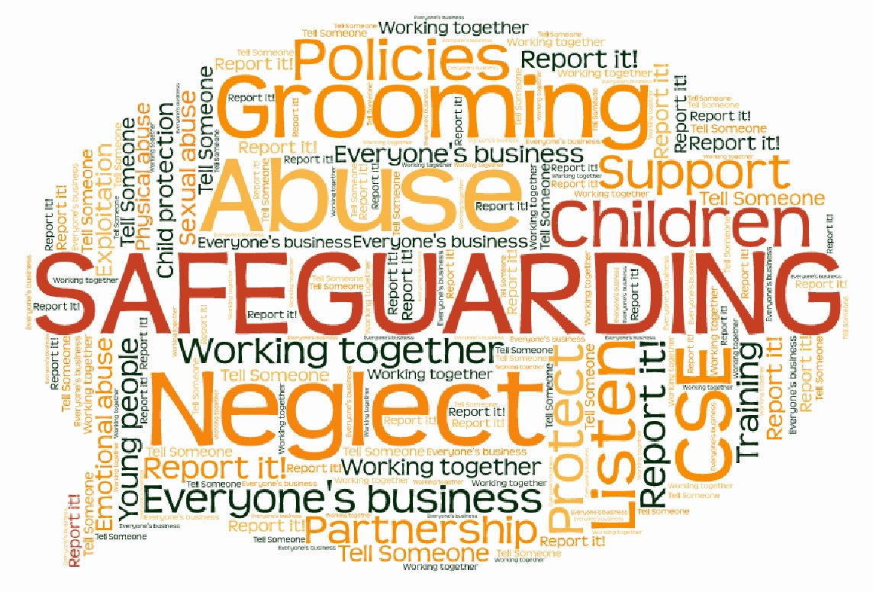
Kingston and Richmond Safeguarding Children Partnership
March 2025

Slide 2

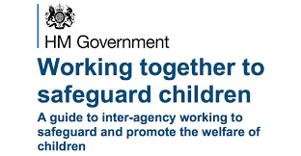
KRSCP role, what we do…………..
Kingston and Richmond Safeguarding Children Partnership (KRSCP) is a statutory body which is responsible for ensuring that all agencies working with children, young people and families work well together to promote children’s safety and welfare.
KRSCP’s role is to have an oversight of how effectively children are safeguarded and identify improvements where necessary.
Learning is promoted and embedded in a way that local services for children and families can become more effective/supportive and implement changes to practice
are safeguarded and their welfare promoted
is early identification and analysis of new safeguarding issues and emerging risks
Working together to safeguard children - GOV.UK Dec 23

Slide 3
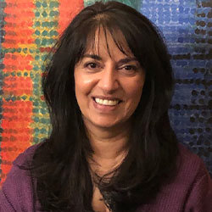
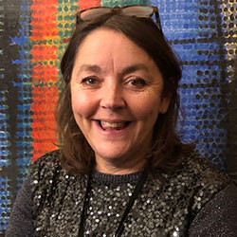
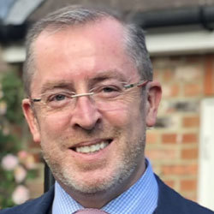
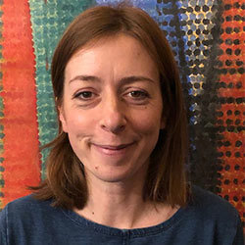
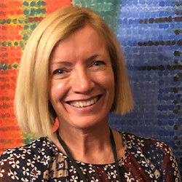
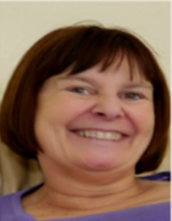
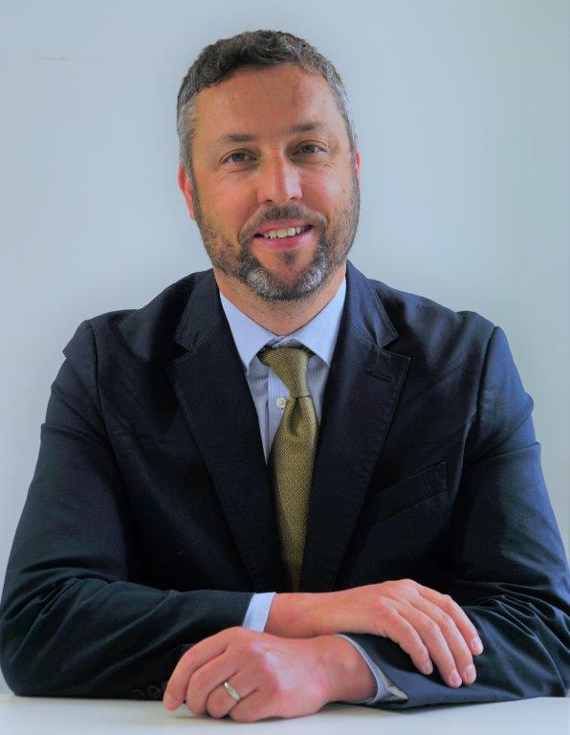
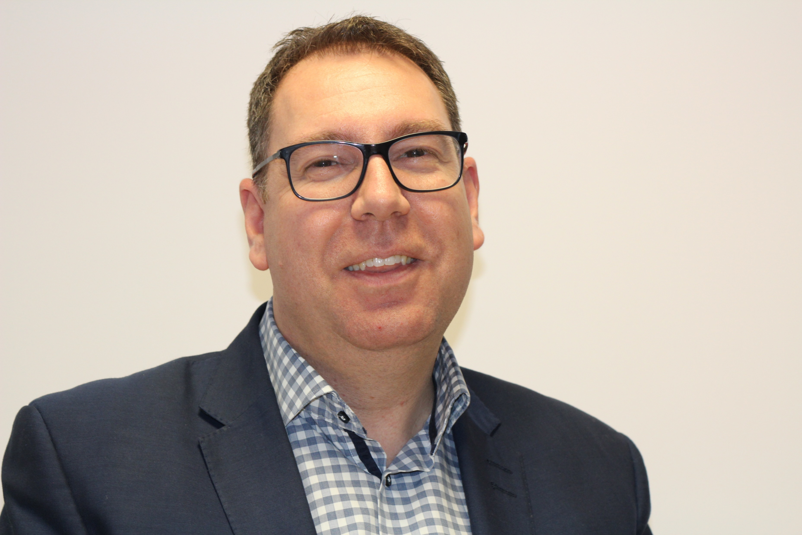
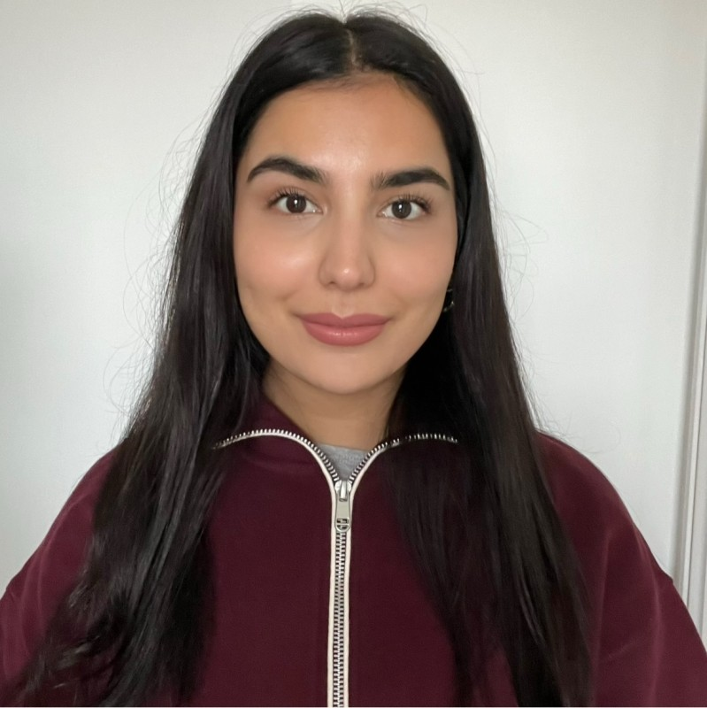

Meet the team…
Daksha Mistry
Partnership Manager for Kingston and Richmond Children Safeguarding
Tracey Welding
Deputy Partnership Manager for Kingston and Richmond Children Safeguarding
Fergus Keegan
Director of Quality NHS South West London CCG
Kingston and Richmond Safeguarding Partnership Chair
Sarah Bennett
Partnership Coordinator
Lucy MacArthur
Education Safeguarding Officer
Amanda Boodhoo
Independent Scrutineer
Steven Todd
Detective Superintendent South West BCU Public Protection
Metropolitan Police Service
Ian Dodds
Executive Director of Children’s Services of Royal Bourough of Kingston Upon Thames
Kingston and Richmond Safeguarding Partnership
Nisa Azeem
Working Together Implementation Coordinator
Keerthana Jeevathas
Support Officer Kingston and Richmond Safeguarding Partnership

Slide 4
Our Priorities
2024- 2026
After consultation with partners we have agreed that our priorities for 2024-26 will be:
Child Sexual Abuse & Exploitation
Neglect
Adolescent/Transitional Safeguarding & Serious Youth Violence
Implementation of Working Together and associated guidance

Slide 5
Learning from Child Safeguarding Practice Reviews
Neglect
Practitioners not seeing children in the home as a legacy of Covid 19
The cost-of-living crisis
Transitional safeguarding

Slide 6

Training
Safeguarding Training
Children are safeguarded and their welfare promoted
Partner organisations and agencies collaborate, share and co-own the vision for how to achieve improved outcomes for vulnerable children
Learning is promoted and embedded in a way that local services for children and families can become more reflective and implement changes to practice
Information is shared effectively to facilitate more accurate and timely decision making for children and families
There is early identification and analysis of new safeguarding issues and emerging risks
KRSCP Safeguarding Training expectations:
All staff/volunteers should complete at level 1 safeguarding training.
DSL and DDSL must complete KRSCP Safeguarding Children: A Shared Responsibility Level 2
AND KRSCP Safeguarding Children: Child Protection Process Level 3
DSL and DDSL must keep up to date with safeguarding training at least every 2 years.
After attending safeguarding training the DSL should cascade the information to any assistants if relevant.
Training courses are available through the AFC Learning Portal (opens a new window)

Slide 7

Concerned -Who to contact
There is early identification and analysis of new safeguarding issues and emerging risks
A child in immediate danger – Call 999
Single Point of Access (SPA)
Achieving for Children (AFC) are commissioned to provide the Children Social Care for Kingston.
0208 547 5008
Out of Hours Duty Social Worker
0208 770 5000
London Child Protection Procedures: You should contact Children’s Social Care in the Local Authority where the child lives or is ‘found’.

