Slide 1
Macmillan Welfare Benefit Advice Service for South West London

Slide 2
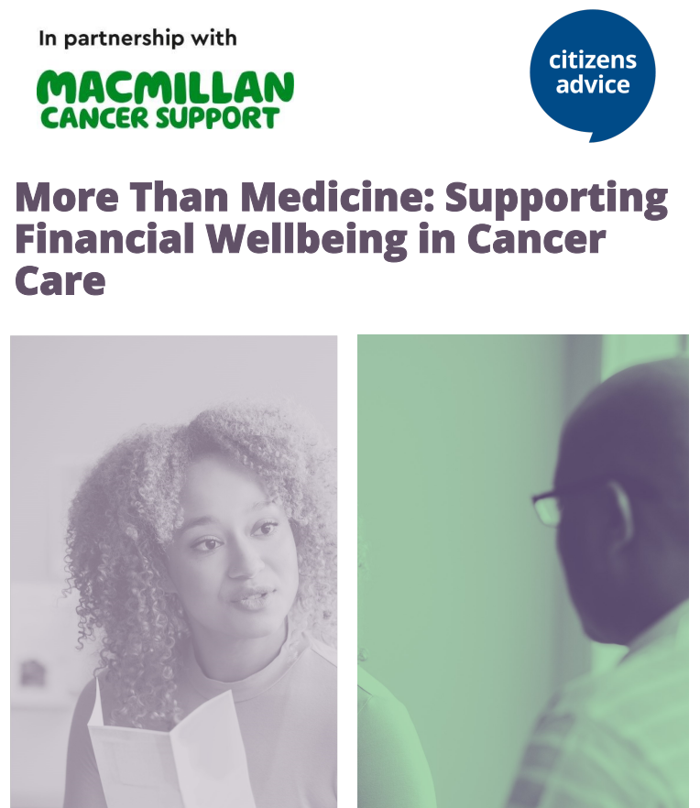

Slide 3
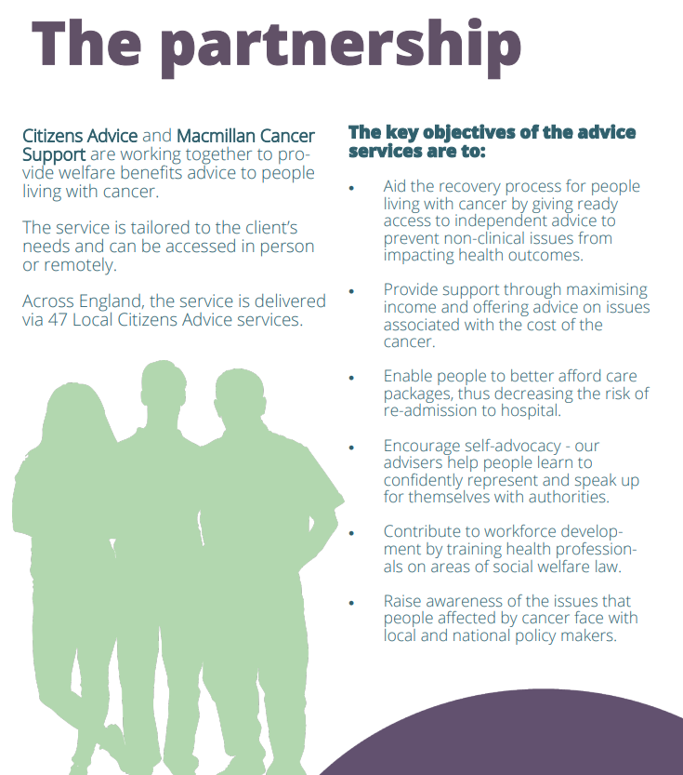

Slide 4
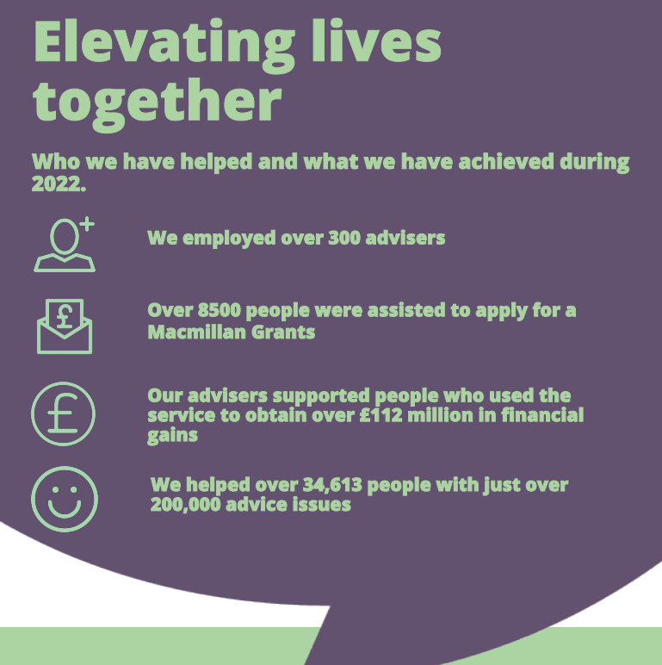
20202222
2022

Slide 5
Who we are ​ The South-West London Macmillan Benefits and Money service started in January 2007. ​ ​ We are a partnership between Citizens Advice Wandsworth, Citizens Advice Croydon and Macmillan Cancer Support to support people affected by cancer. ​ ​ Who we help​ Anyone living with cancer with a connection to Epsom & St Helier, Croydon University, St Georges or Kingston hospital. We would also support a Wandsworth and Croydon resident living with cancer who doesn`t have a connection to one of those hospitals. ​ ​ What we do ​ Free, specialist, confidential and impartial benefits, money and financial advice to people living with cancer. ​ ​ Advisors are available to help individuals to understand what support is available to them to help pay the bills or meet extra expenses. ​ ​ If more help is needed the advisers can help complete applications for benefits and grants and will continue to support a person until they are receiving everything they`re entitled to.

Slide 6
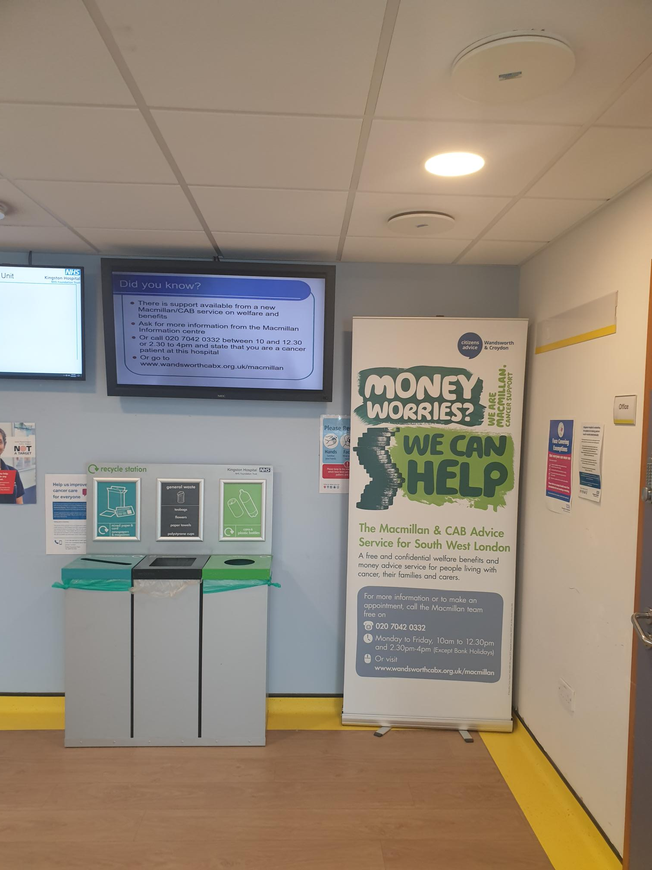
What we do
Outreach advice clinic at Kingston Hospital
We want to help more people in need of benefit and money advice who have a connection to Kingston Hospital; many of whom will be Kingston residents.

Slide 7
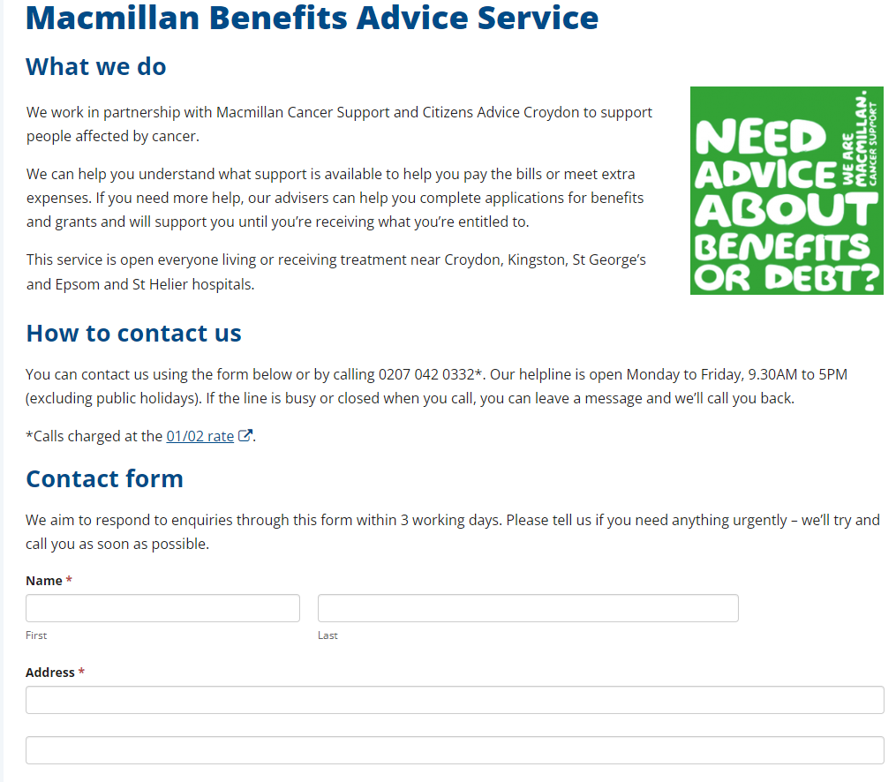
How to access the service ​ Individuals can telephone advice call 020 7042 0332 Monday to Friday, 9.30am - 5pm (excluding public holidays).​ ​ Individuals can complete the webform found on the CAW website ​ https://cawandsworth.org/our-projects/macmillan/​ ​ ​ ​ ​ ​ ​ ​ ​
Webform referrals can, of course, also be completed by medical, social care and health professionals, including GPs and social prescribers working in primary care. ​ ​We aim to respond to enquiries through the webform within 3 working days. Please tell us if there`s anything extremely urgent – we’ll try and call you as soon as possible.

Slide 8
​What we achieve ​
We`re very good at supporting our clients to improve their financial circumstances.
In 2023, we helped them secure £2,038,411.85 in benefits, grants, passes and more.
​ BBC London News ran a feature on our work, and Kingston Courier carried an article. Our message:
​ “many people need to access benefits for the first time in their lives following a cancer diagnosis, but don’t know where to turn for help.
It’s a complicated system to understand, particularly at a time when they should be focussed on their health, rather than their finances.
Cancer patients often tell us that the application process can feel like having to jump one hurdle after another, which can cause a good deal of unnecessary additional stress.
We’re here to help people navigate that process. We provide a high quality and comprehensive advice service for the most vulnerable cancer patients, who are struggling badly with money worries.​
​ We know, aside from the physical and emotional impact of being told you have the disease, it can also bring unexpected costs such as a loss of income if you’re too unwell to work, rising household bills and mounting transport costs to and from frequent hospital appointments.​

Slide 9
REPORT
Kingston Joint Strategic Needs Assessment 2023 2023 Report, "Reducing health inequities in London by improving access to social welfare advice" produced by Bromley by Bow Centre, funded by Mayor of London, focused on:
the effects on people’s health of the issues supported by social welfare advice, such as lack of income, overcrowded and substandard housing etc and the health benefits of people accessing timely, professional advice in their communities
the opportunity presented by the development of Integrated Care Partnerships and Integrated Neighbourhoods to better co-ordinate approaches to increase access to advice provision in the Capital https://www.bbbc.org.uk/insights/news-and-resources/news-and-resources-reducing-health-inequalities-in-london-by-improving-access-to-social-welfare-advice/

Slide 10
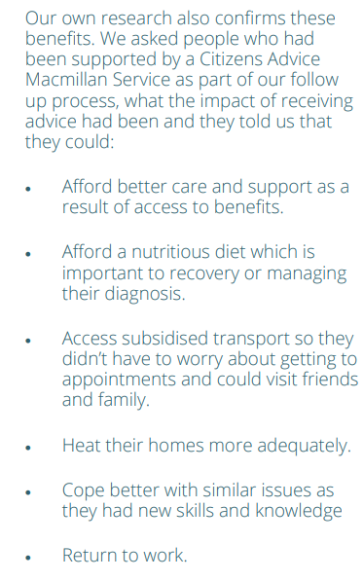
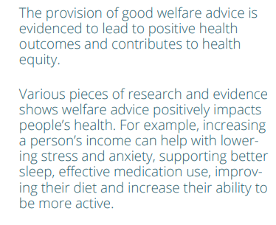

Slide 11
In 2023, we opened 825 new cases​. In 2024, we`re aiming to open 1000 new cases ​ ​
We want you to refer more Kingston residents to us. ​ ​​Citizens Advice Kingston encourage you to refer a person living with cancer in need of benefit and money advice to us. ​ ​
Looking ahead to achieve our objective of healthier lives through social welfare advice
We want to support more people from black and minority ethnic communities.​
We want to support more Kingston residents from areas of higher index of multiple deprivation. ​ ​ ​ Ideas and suggestions
how we can reach more people living with cancer in Norbiton, Chessington South, Hook & Chessington North, Tolworth, Old Malden, Surbiton Hill and Coombe Vale?

Slide 12
Breakdown of 2023 cases by ward Kingston In order of most clients supported by the project Areas with higher levels of deprivation [1-5 IMD] are underlined Hook and Chessington North Tolworth Hampton Alexandra Old Malden Berrylands Coombe Vale King Georges Motspur Park Surbiton Hill Norbiton Chessington South Tudor

Slide 13
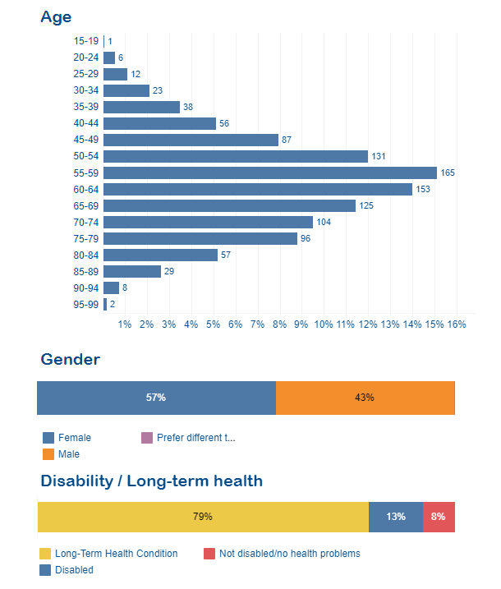
.

Slide 14
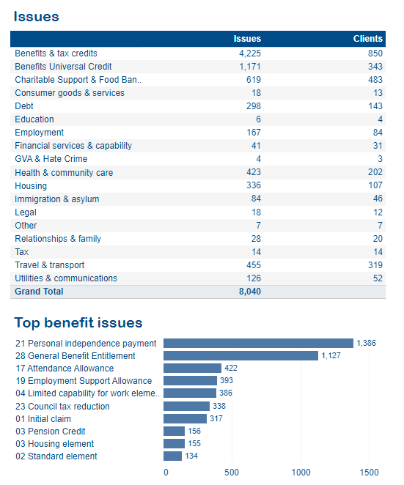
.

Slide 15
We hold an Advice Quality Standard in Benefits advice at casework level. Quality assurance scores awarded by national Citizens Advice tell us our advice is of a high standard.
Feedback from clients is consistently very positive.
.
THANK YOU
I appreciate the help and kindness
You were superb​
Thank you. The adviser who handled my case was very helpful and accommodating with a friendly approach
You seemed to care, for which I was very grateful since I was highly stressed during the time
Dear , Thank you enormously for everything. I am forever grateful for your listening ear, steer, support and guidance. I wouldn’t have got this far if it weren’t for your help. Please keep being fair, just and sincere it is a more precious than silver and gold.
Warmest, A

Slide 16
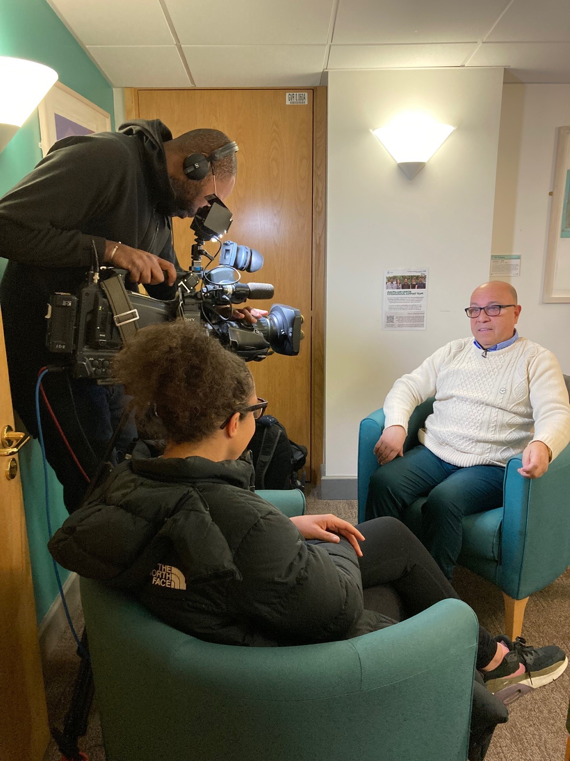
Rodrigo, being interviewed by BBC London News in the Macmillan Information and Support Centre in St Georges Hospital.
.

Slide 17
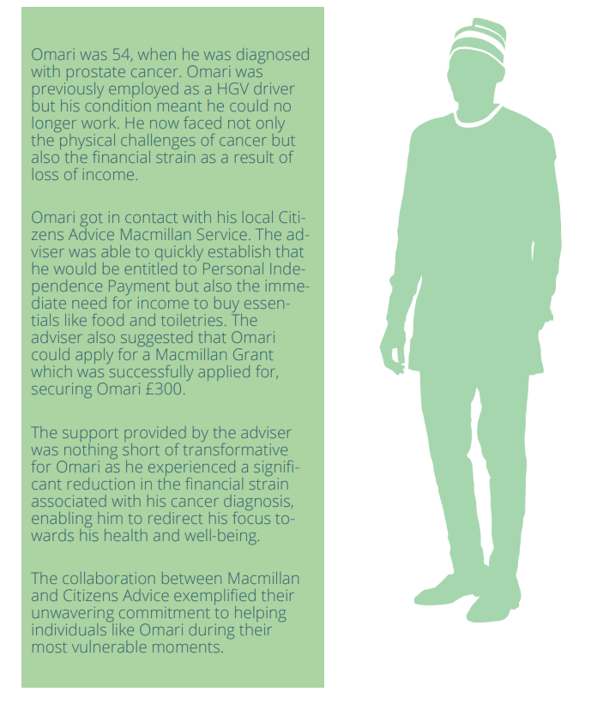

Slide 18
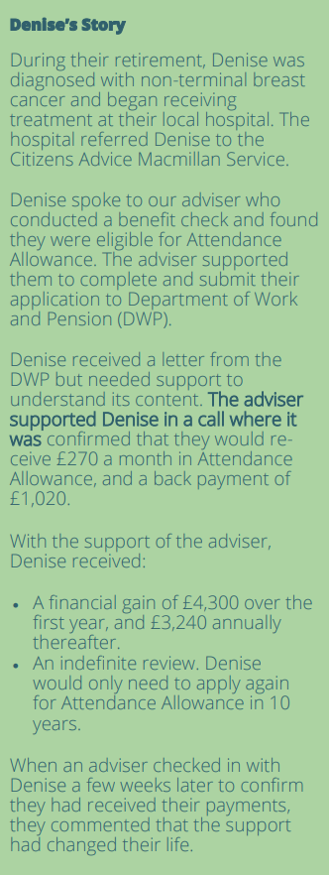

Slide 19
Case study Background This client (S) is a 66 year old man who lives with his wife in a council property, working as a self-employed taxi driver until he was diagnosed with prostrate cancer. The cancer had spread to his kidneys. He had not been working for 4-5 weeks and had a corresponding drop in income. His wife claimed no benefits, and earned £40-60 per week from working as a cleaner. S had a £6000 bank loan and had also fallen into council tax arrears. He was worried that he would soon fall into rent arrears. He had £500 savings. What we did: Helped client apply for a Macmillan grant. The grant application was successful – cl was awarded £350. Council Tax Support claim was successful, including request to backdate to when S was admitted to hospital. Referred the client to the Law Centre for debt advice. Discussed client’s benefits options, and explained that he may be eligible for Universal Credit, new style Employment Support Allowance and Personal Independence Payment. We explained the application process for each benefit. We helped him make a successful claim for UC. We also helped S to apply for NHS Low Income Scheme, Taxi Card and Blue Badge. How we helped Over a number of months, the adviser corresponded with S by email and phone. S knew that he could contact the adviser at any time. The medical treatment meant that S struggled to take action to make progress, so the adviser provided practical support. When S returned to work we provided further advice and support with UC and CTS re-assessments.

Slide 20
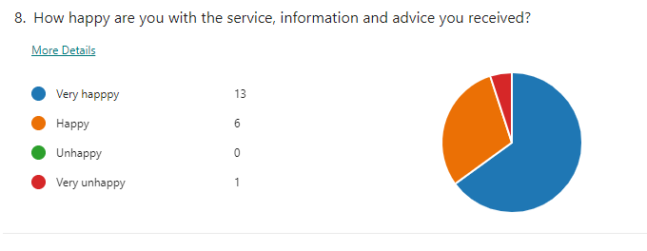
Client feedback survey 2023

Slide 21
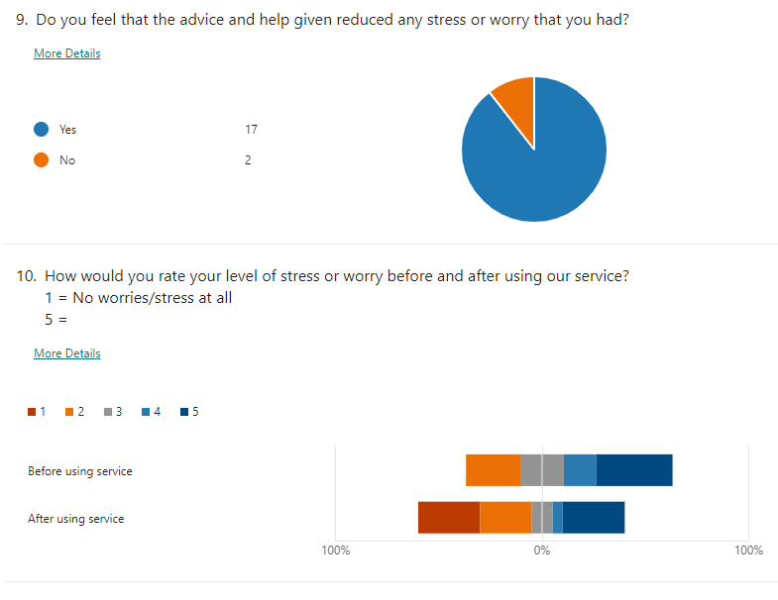
Client feedback survey 2023

