Slide 1
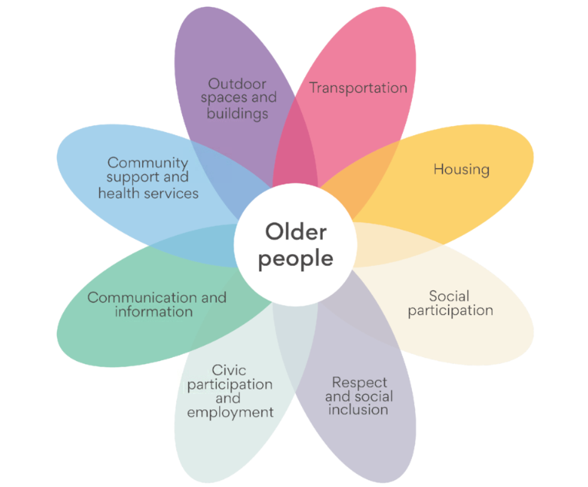
Kingston Age Friendly

Slide 2
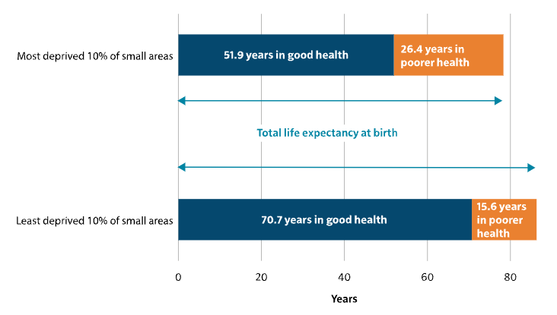
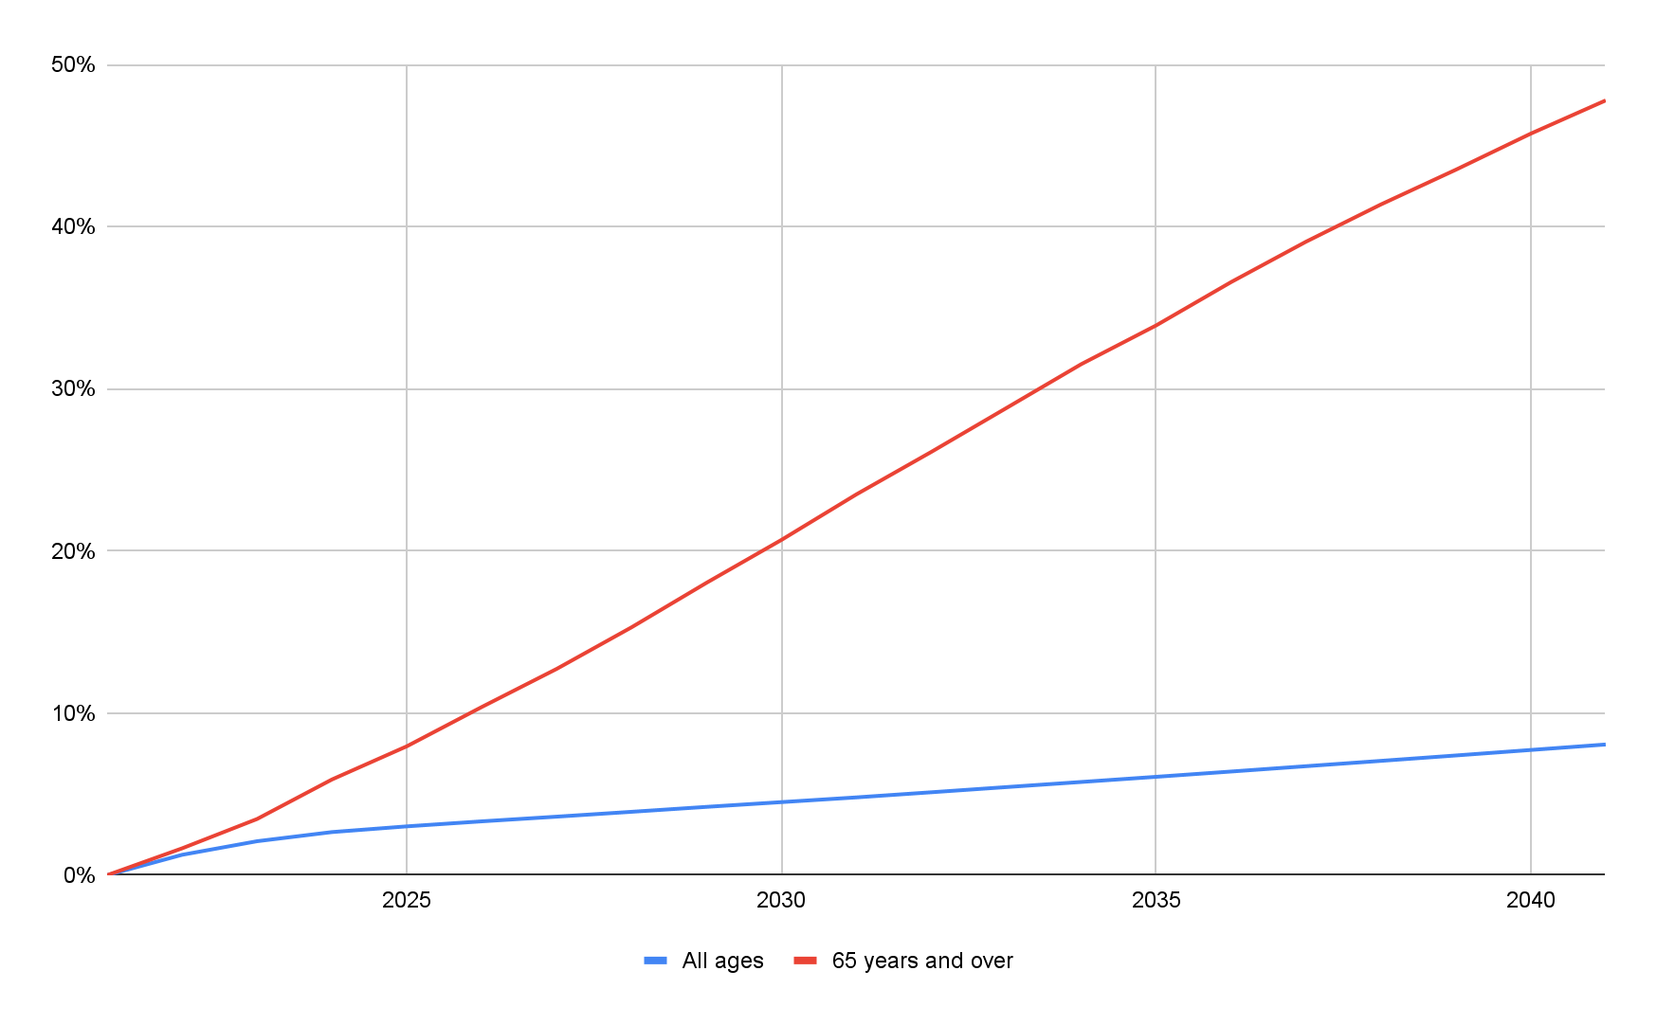
A growing older population in Kingston means that there is expected to be 12,000 extra older people in Kingston in 20 years
Inequality in life expectancy and healthy life expectancy at birth for females in the most and least deprived areas in England, 2018 to 2020
National data from the 2023 Chief Medical Officer Annual Report: https://www.gov.uk/government/publications/chief-medical-officers-annual-report-2023-health-in-an-ageing-society/executive-summary-and-recommendations
GLA projections estimate Kingston’s population will grow by 8% over the next 20 years. However, almost all of this growth will be in the 65 years and over population, set to rise by almost 50%, incorporating an extra 12,000 older residents

Slide 3
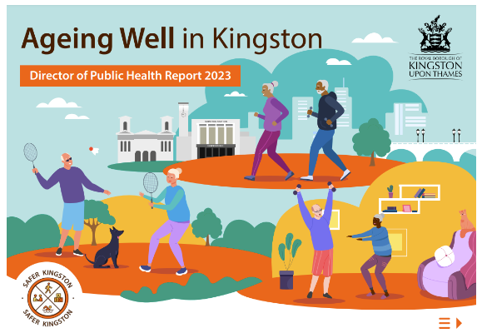

Slide 4
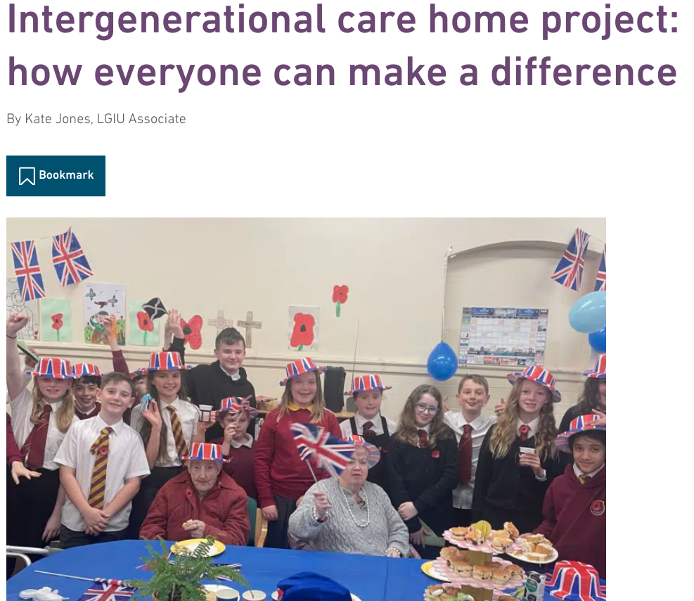
Everyone can contribute! Examples of Age Friendly initiatives

Slide 5
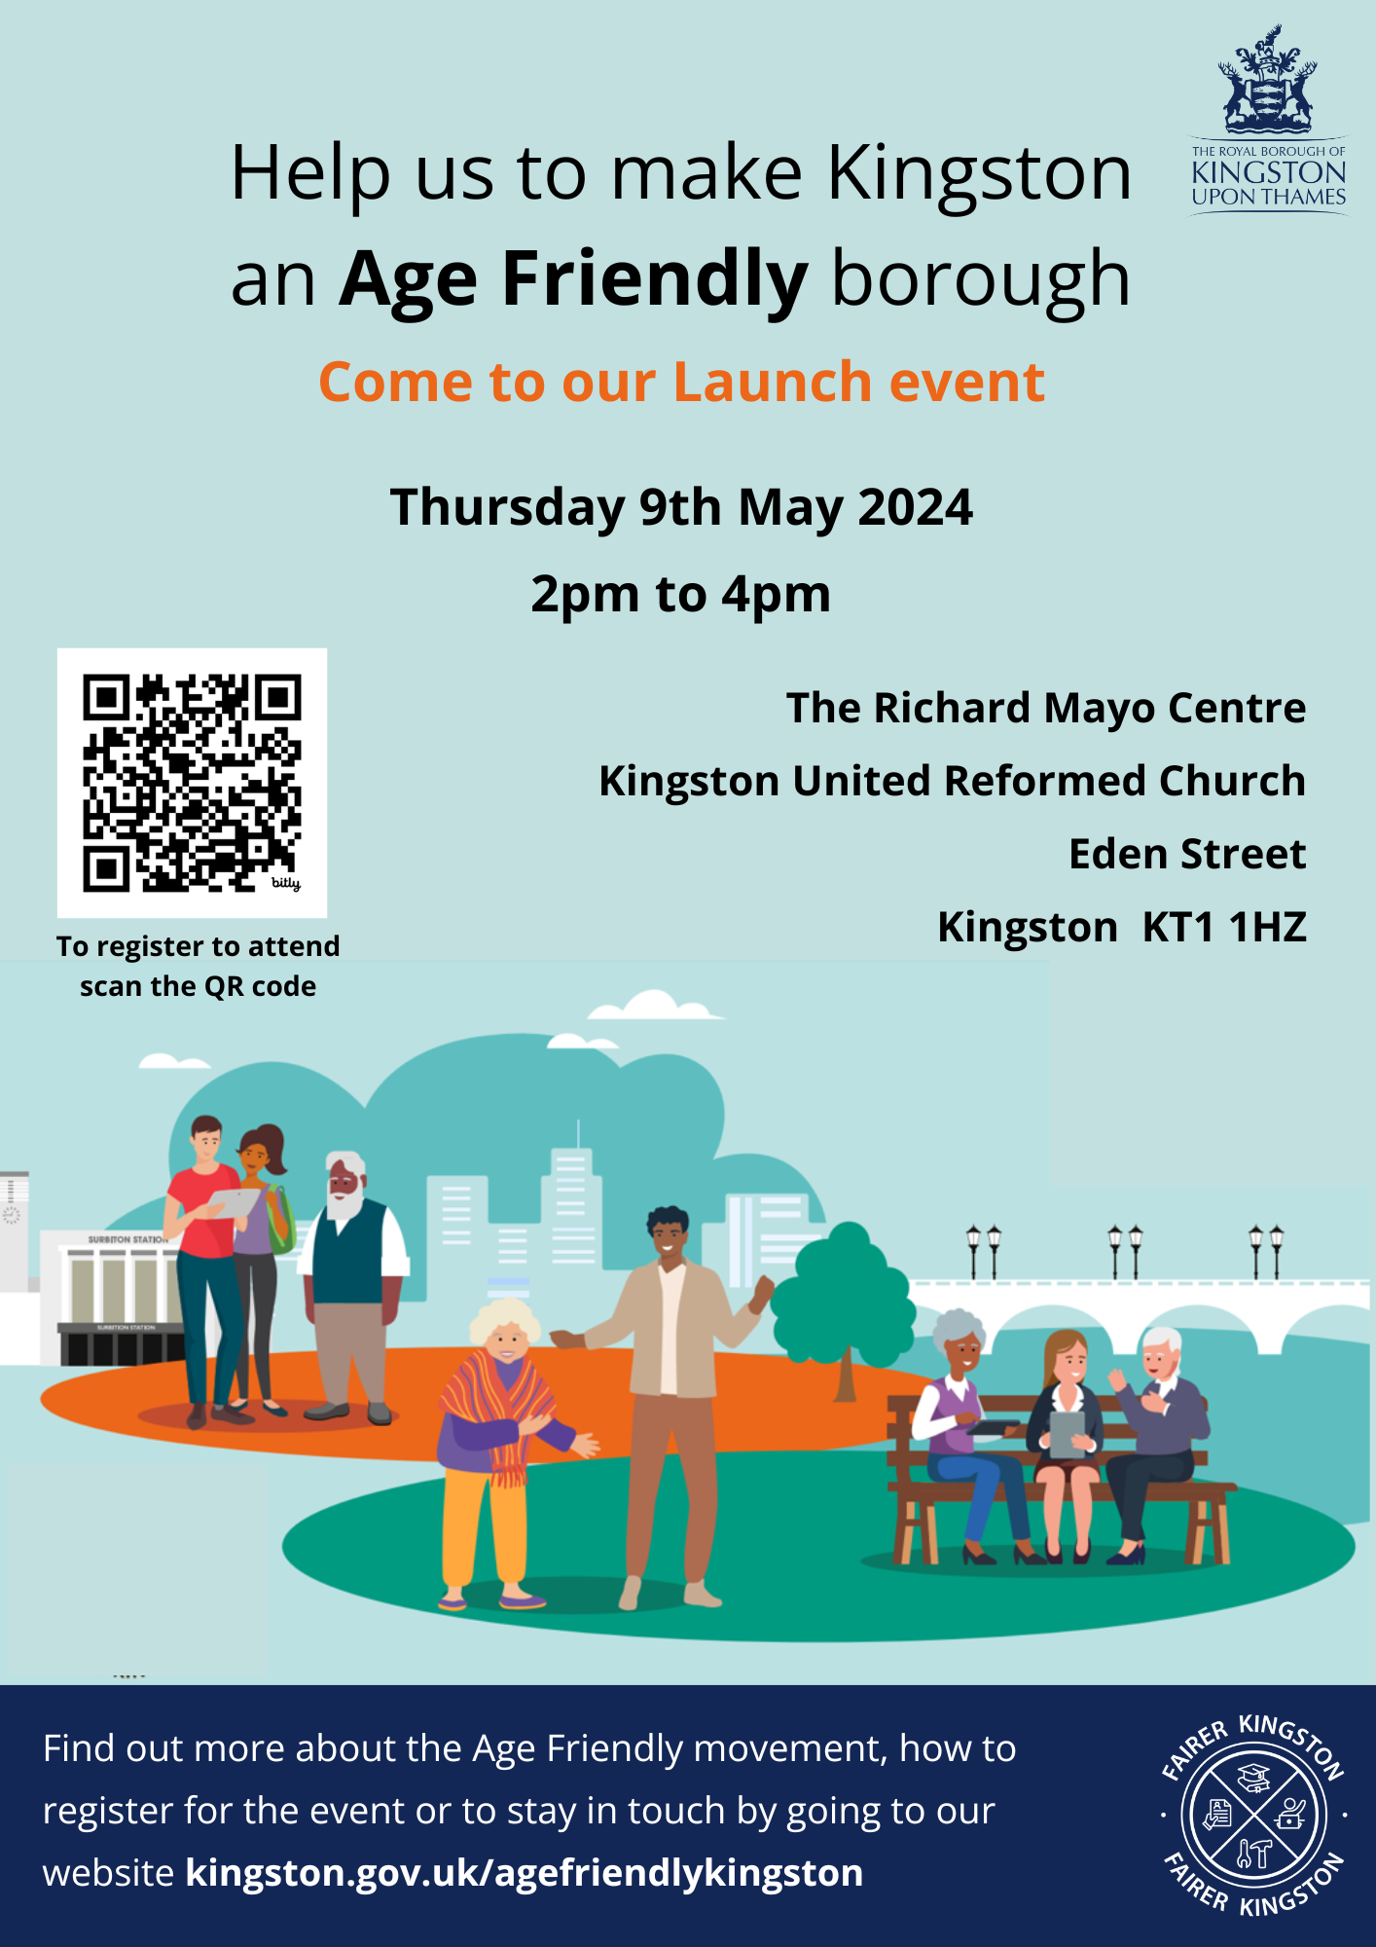
Contact agefriendly@kingston.gov.uk for more information about registering for the event or future information about Kingston Age Friendly.

