Slide 1
Family Hubs
Kingston
March 2025

Slide 2
Early Help Redesign
Family Hubs
Key Contacts & Key Documents
Opportunities

Slide 3
Early Help Redesign

Slide 4
Redesign drivers
Inflation
Efficiencies
Serious case reviews
Early Help
Social Care reforms

Slide 5
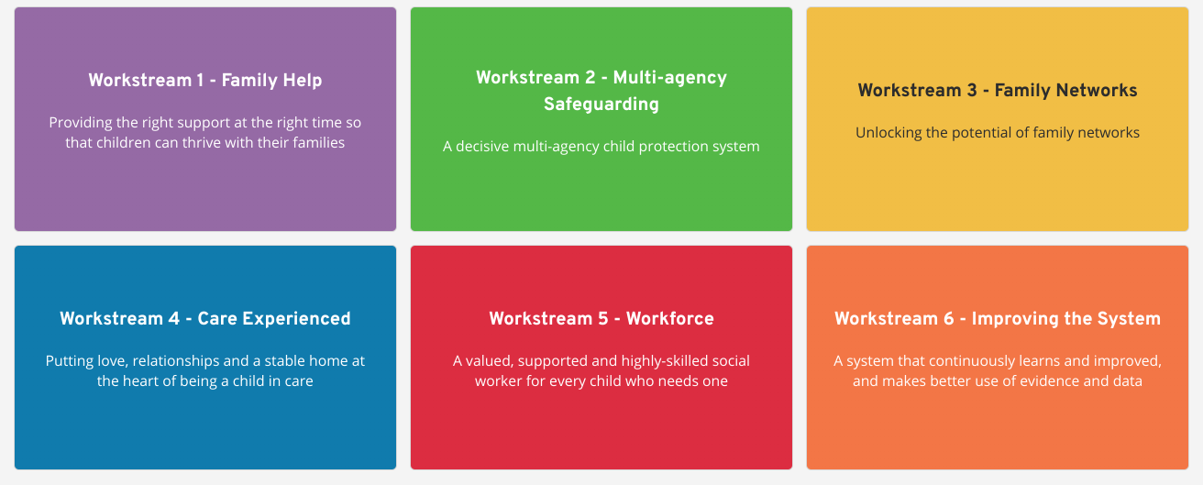
Social Care Reforms - AfC wider transformation

Slide 6
Workstream 1 and Early Help Redesign
New title from Early Help to Family and Adolescents
Family Hub model
Intensive Family Support offer
Integrated Adolescent specialist offer

Slide 7
Family Hubs
Co-location
Joined up governance
Joined up commissioning
Shared outcomes
Evidence-led practice and evaluation
Data sharing
Partnerships with VCS
Shared case management
Integrated services
Common assessment
Community co-production
Safeguarding
FAMILY HUB FRAMEWORK
CONNECTION
Published offer
Accessible
Equality
Outreach
Single access point
Clear brand
Whole family relational practice
Training and Development
National guidance

Slide 8
Early Help Redesign

Slide 9
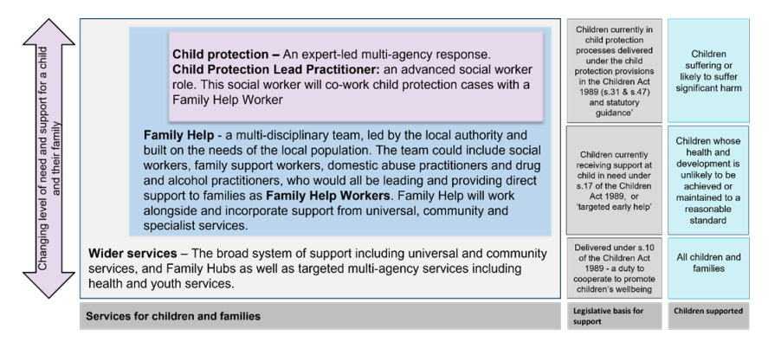
Family Help
Stable Homes Build on Love consultation

Slide 10
What is a Family Hub
A Family Hub is a system-wide model of providing high-quality, joined-up, whole-family support services. Hubs deliver these services from conception, through a child's early years until they reach the age of 19 (or 25 for young people with special educational needs and disabilities).
AFC’s Vision
To create a one stop shop approach for parents, carers, children and young people delivering early help, guidance, information, support and accessible programmes of activities focussing on early intervention and prevention

Slide 11
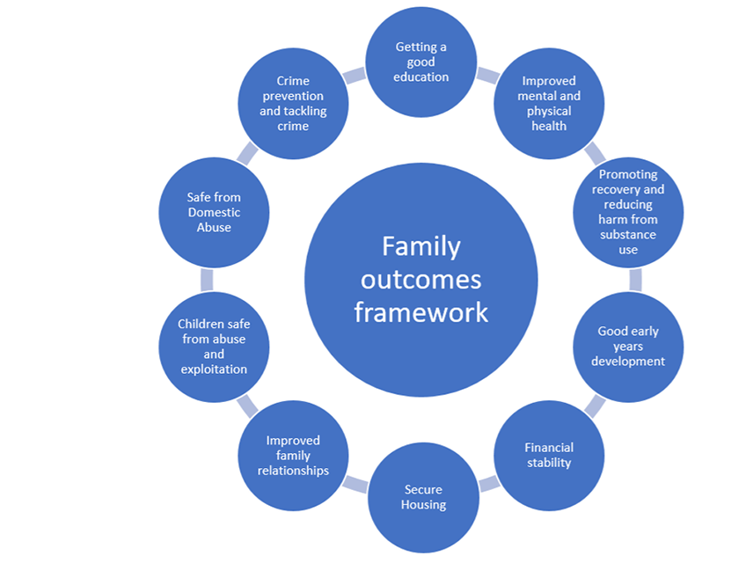
Notes:
https://docs.google.com/document/d/11bAhj3nB0_hTydfBwl_mOewunkjEZUpAyyjmoTG96Io/edit?usp=sharing

Slide 12
Hubs Vision and Approach - ‘To connect, support and empower communities’
Physical Space
Co-location in areas of need based on data
Maximising spaces for services, VCSE and communities
Variety of activities across a day
Signposting, IA&G, social prescribing, early intervention
Assisted Digital - reducing skills inequalities
Opportunities for communities to support each other
Digital Space
Online offer of groups and parenting workshops
A ‘digital by default’ council
Proactive Digital - online self serve
Developing existing sites
Signposting to online offer
Supporting residents to upskill
Signposting to support and courses
@ Home
Supporting independent living
Supporting connectivity through phone, digital
Supporting opportunities for participation and volunteering
How - taking an enabling approach through collaborative working; understanding our families and what is on offer; signposting well; listening, understanding and communicating with empathy.
Outcomes - together we build resilience, reduce social isolation and improve health and wellbeing of communities. Our residents live happier, healthier and more independent lives.

Slide 13
Update on Kingston’s Family Hubs March 2025
Service transformation - completed, JP’s reviewed, structures revised - including introduction of Early Help teams into the hubs and securing identified efficiencies
Comprehensive Workforce development training programme - delivered - mandatory and ongoing
Establish clear governance arrangements
System review - database recording systems and customer platforms developed - GO LIVE
Web pages - expansion of the digital offer
Old Malden Family building works renovations underway - delay due to roof issues - provision completion date yet to be confirmed

Slide 14
Family Hubs
Family Hubs
Where are the Hubs?
Programme timetable
Where are the Hubs?
Program timetable
What are the services?
Who we support

Slide 15
What are the Services - clickable links from each circle or go to one page with following links:
Health and Wellbeing
Education and Employment
Keeping safe
Practical support
Parenting
Youth offer
Send offer
Full Directory of Services

Slide 16
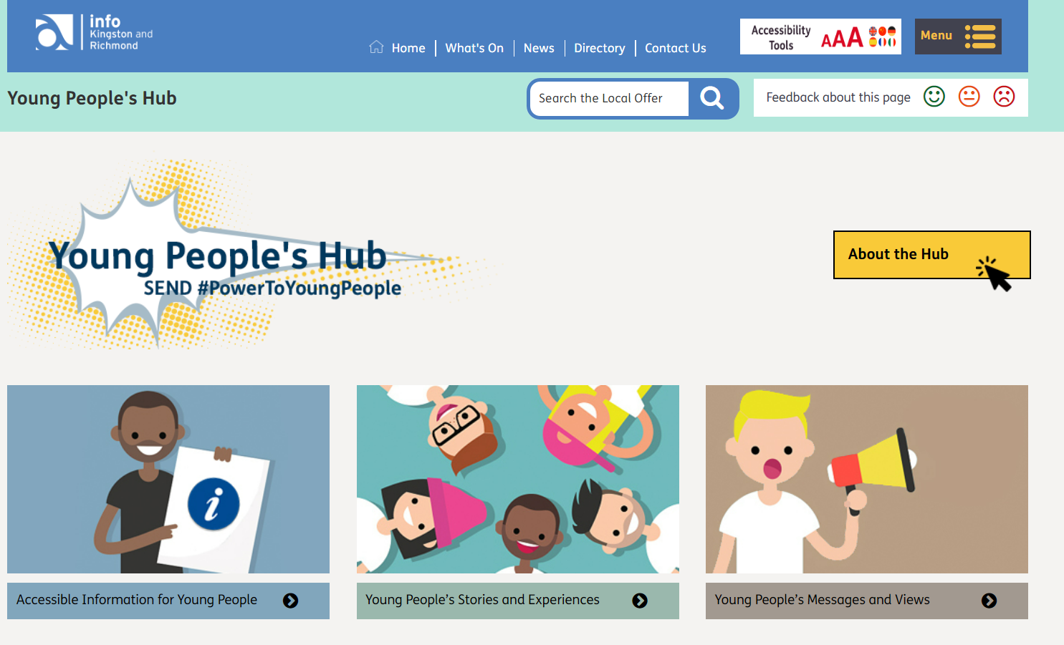
Landing page examples
Paid for:
https://kr.afcinfo.org.uk/sections/young_peoples_hub

Slide 17
Provisional Programme for Old Malden Family Hub
Playroom | Monday | Tuesday | Wednesday | Thursday | Friday
AM | Stay & Play under 18 months | Little Stars Speech & Language support | Stay & Play 0-5 years x 2 | ?Parenting creche | Parent Cafe
PM | Peer to Peer support group | After School sessions followed by Youth Activity | Poss Creche
Health Room | Monday | Tuesday | Wednesday | Thursday | Friday
AM | Well Baby Clinic | Themed - support - oral health, SEND various |  | Parenting Course | Parental wellbeing IAG
PM | Baby Massage |  | Adult Learning * | Team Meeting (HOLD)
Consult Room 1 | Monday | Tuesday | Wednesday | Thursday | Friday
AM | Infant Feeding Support |  | Parenting advisor - bookable support |  | Housing surgery
PM | 1:1 support space |  | Counselling YP | Counselling YP
Consult Room 2 | Monday | Tuesday | Wednesday | Thursday | Friday
AM |  | 1:1 YP support | 1:1 YP support |  | DWP/Employment
PM | FSW bookable support* | FSW bookable support*

Slide 18
Benefits to children, young people and their families
One stop shop approach for information advice and guidance
Coordinated programme of activities and events
Fully funded activities and sessions for children and young people
Holiday programmes for all ages including HAF/FUEL at some sites
Access to wider community support and organisations
Brief intervention support available for families swiftly
Access to parenting support, early help
Access to trained, skilled workforce

Slide 19
Early Help Key Contacts

Slide 20
Key Contacts - Kingston
Brenda Wood - Family Hub Manager - Kingston
Matthew Angell - Youth Service Manager - Kingston
Rebecca Eggleton - Wills - Family Hub Early Help Team Leader
Karen Williams - Parenting Lead - Kingston
Michael Connor - Participation Lead - Youth
Email example Sarah.Reid@achieivingforchildren.org.uk

Slide 21
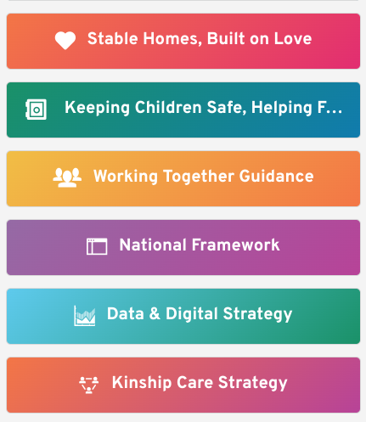
Key documents

Slide 22
Opportunities

Slide 23
Opportunities
Engagement - Parents Voice - any synergies? Opportunities?
Peer to peer support spaces
Access to Parenting Lead/FSW/EH for your families
Advisory Board present your organisation to group? Join?
Collaboration on programme of activities, local regional events
Delivery of activities from sites

Slide 24
Thank You and Questions

