Slide 1
KINGSTON VOLUNTARY ACTION
In a recent team meeting, we asked staff
“What has made you feel proud lately?”
These are some of our answers…

Slide 2
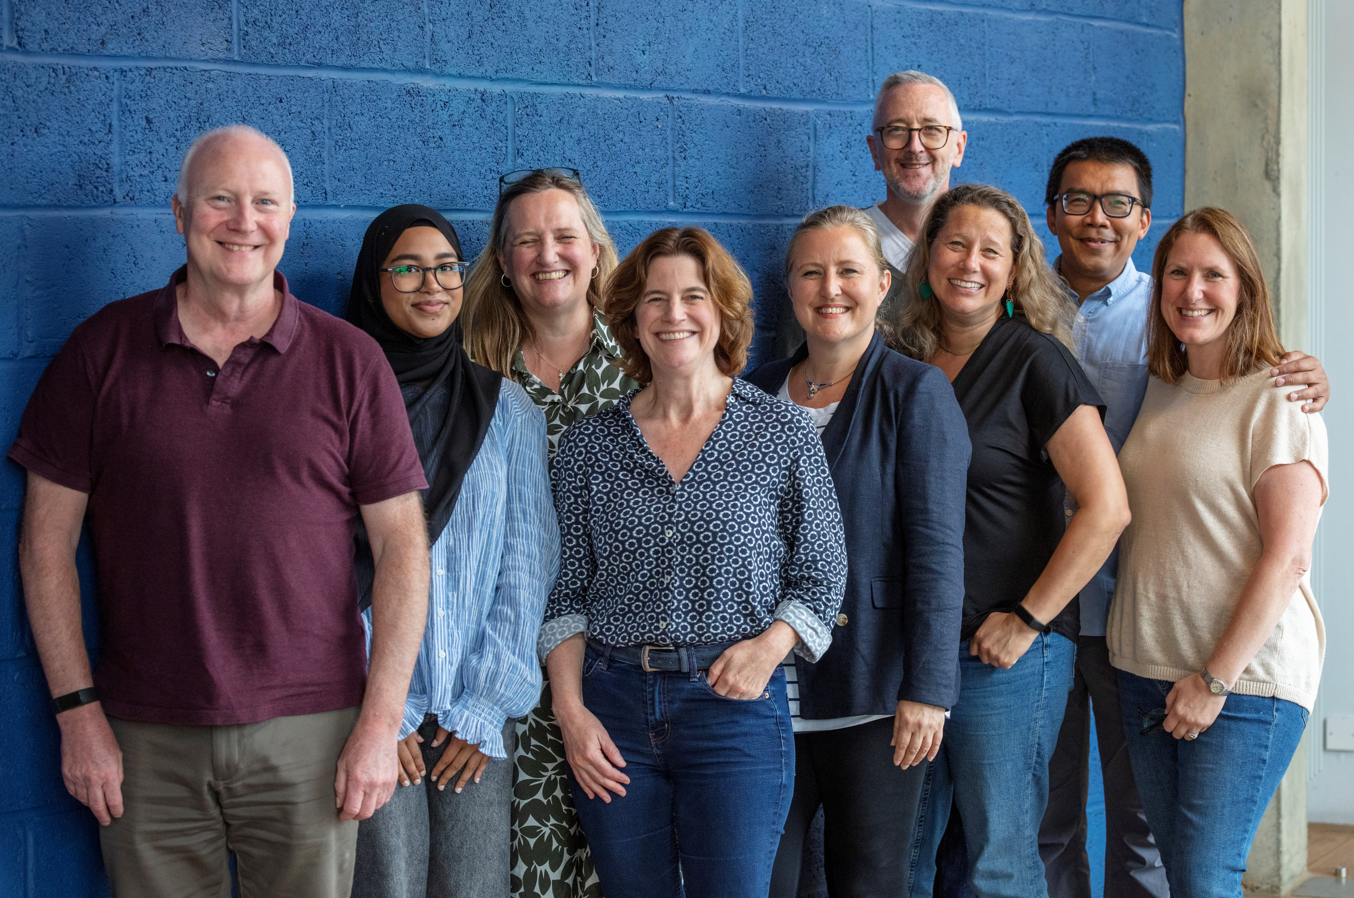
‘Supporting small groups to better use their data - with Superhighways’ Data Project’

Slide 3
‘We ran a session at the London Funders Festival of Learning sharing learning from our Digital Foundations programme’

Slide 4
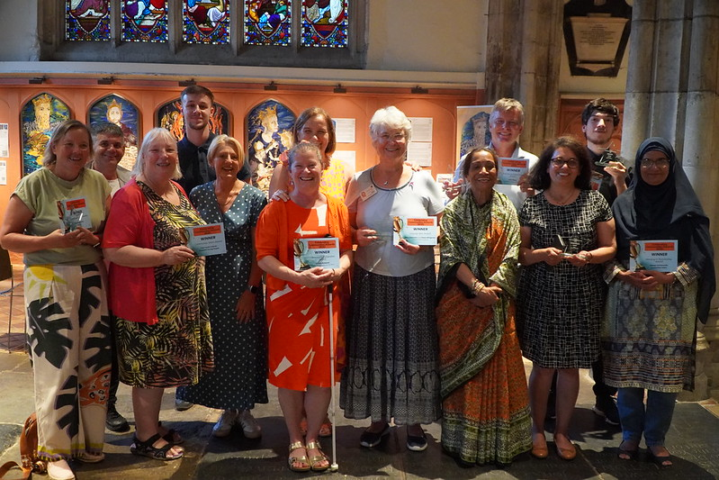
‘I’m proud of the Celebrating Communities Awards video. A real labour of love.’

Slide 5
‘Delivering our Funding Support session to 19 people on one of the hottest days of the year in a room without AC.’

Slide 6
‘Our re-designed monthly e-bulletin achieving a 53.7% open rate’

Slide 7
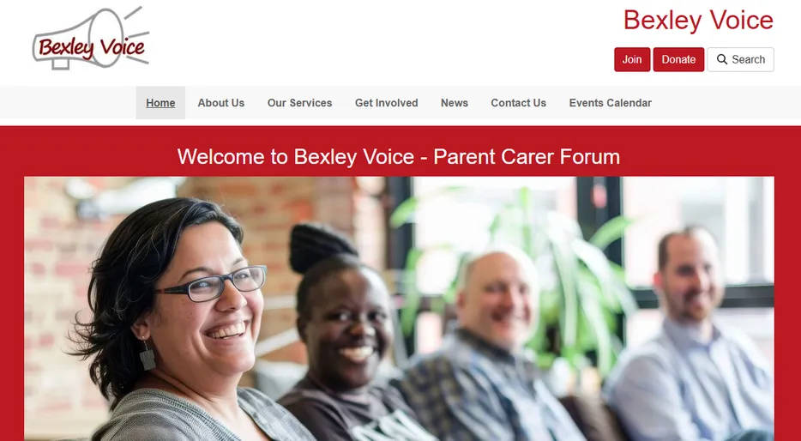
‘Our Supported Digital Foundation programme, supporting 42 people from 39 organisations’

Slide 8
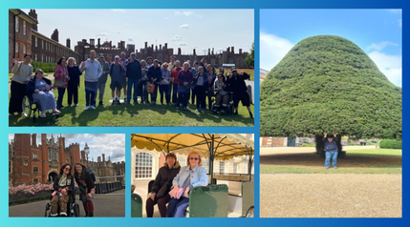
‘Our Buddy Scheme Day out to Hampton Court Palace.
24 people attended!’

Slide 9
‘I supported a client at Get Active yesterday’

Slide 10
‘Kingston Community Football members telling us how the sessions have helped their mental health and the community it has built for everyone, in the video we made’

Slide 11
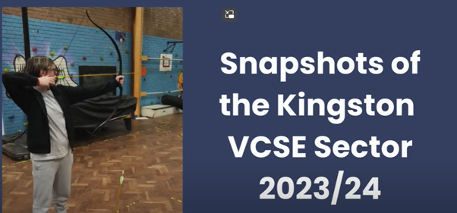
‘Showcasing the VCSE Sector at the Kingston Partnership Board’

Slide 12
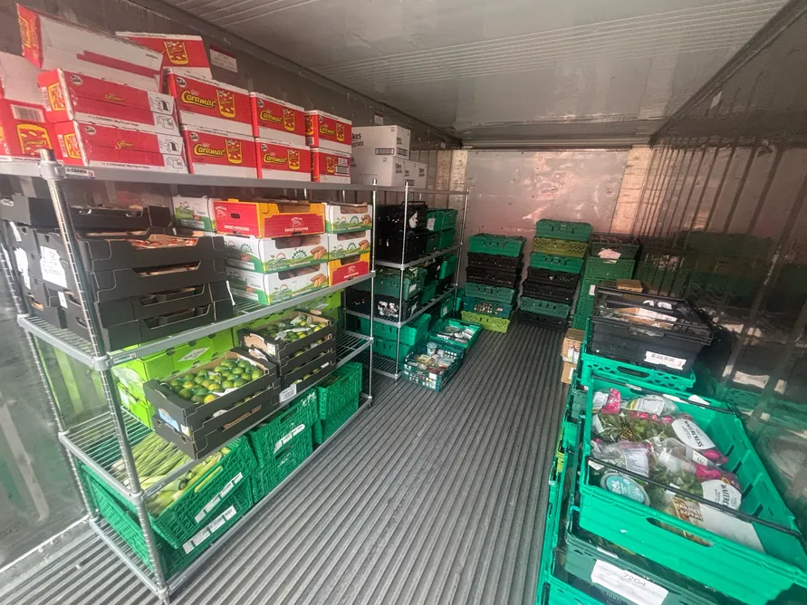
‘Our 20ft fridge!
On 14 April we redistributed 900kg of surplus food to 4 organisations in the borough’

Slide 13
‘Our interviews at the Celebrating Communities Awards – a real team effort’

Slide 14
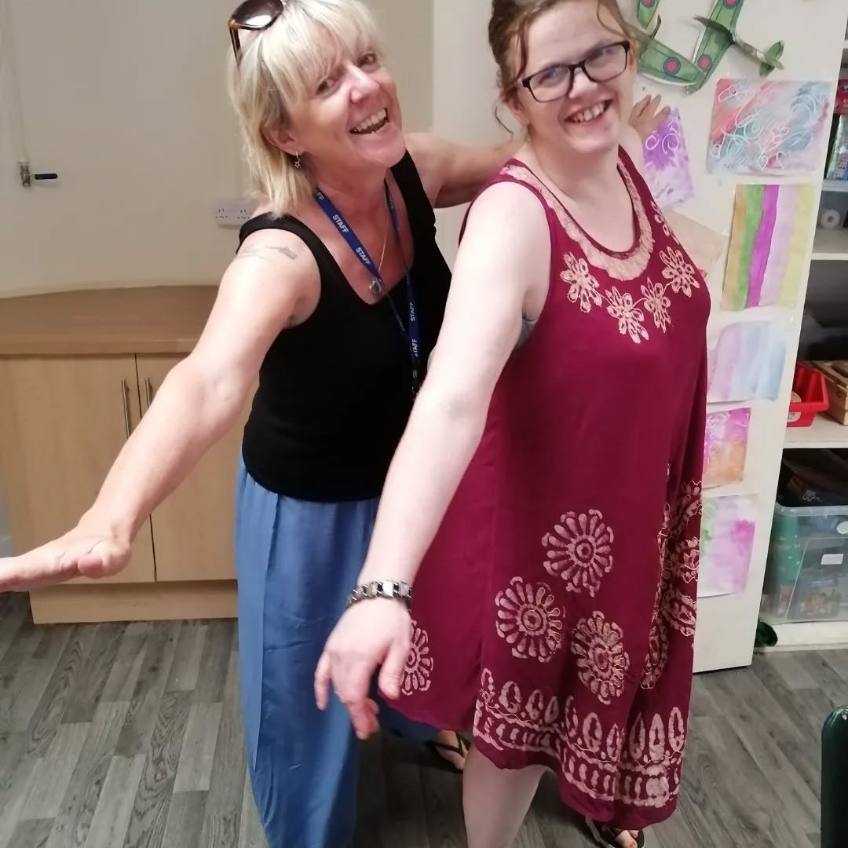
‘Preventing social isolation. Making our members laugh and smile’

Slide 15
‘Supporting a new client to the local shops’

Slide 16
‘Community Accountancy - HMRC waivered a fine to a small organisation due to late submissions.’

Slide 17
‘Improving my skills on Sage software’

Slide 18
‘A new way to track outcomes for our community.
Spent time getting feedback from the amazing frontline team to put together new KPI's for our funder.’

Slide 19
‘Lovely feedback from a Buddy Scheme client’

Slide 20
‘Our Surbiton Farmers’ Market Stall and a donation of £500.00’

Slide 21
‘I’m really proud of
our Leadership Programme’

Slide 22
‘Running 10 Hours of M365 Training in 4 sessions for Charity Digital Academy’

Slide 23
‘Lovely feedback from an organisation after I had interviewed their service users and volunteers’

Slide 24
‘Securing an organisation who had been hacked’

Slide 25
What are you proud of?

