Slide 1
Health & Wellbeing Network July 2025 Emma Hill Deputy CEO / Health Programmes Manager

Slide 2
Agenda
10am - Welcome, housekeeping and introductions
10:05-10:10 – KVA health & Wellbeing update
10:10-10:20 – Hugh Williams – Save the World Club
10:20- 10.40 – Mansour Miralami – Movemingle CIC
10:40-11.00 – Dr Danielle Solomon – RBK Public Health
11:00 – 11:15 - Break and networking
11:15-12:45 - Talk Listen Connect – Princess Alice Hospice
12:45 – Close

Slide 3
KVA Health Programmes
KVA Health
Community Health
Good Food Group
Buddy Scheme
Eco-op
Kingston Community Football
Surplus food hub
Connected Kingston

Slide 4
KVA Surplus to Supper hub
The KVA Surplus to Supper Hub is committed to addressing food insecurity and reducing food waste in our borough. By collecting surplus food and redistributing it to those in need, we ensure that everyone has access to healthy, nutritious food. Our efforts not only support the community but also promote environmental sustainability.
Nourishing Lives
Our aim is to ensure that our community experiencing food insecurity has access to healthy, nutritious food. By redistributing surplus food to those in need, we help improve diets and overall well-being, particularly for vulnerable individuals and families.
Reducing Waste
We are committed to minimising food waste by collecting surplus food from local sources and redistributing it efficiently. This not only helps the environment but also promotes sustainable practices within our community.
Supporting Communities
Our goal is to foster a strong, connected community by providing food to various organisations, hosting community events, and encouraging volunteerism. Through these efforts, we build a supportive network that enhances the quality of life for all residents.
Kingston Surplus Food Hub - Kingston Voluntary Action

Slide 5
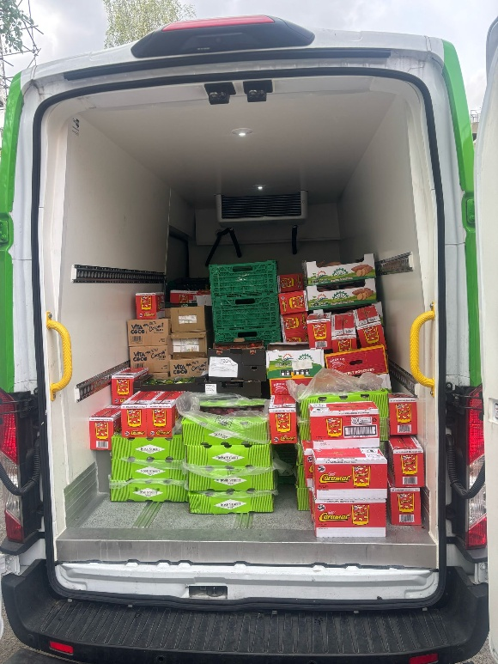
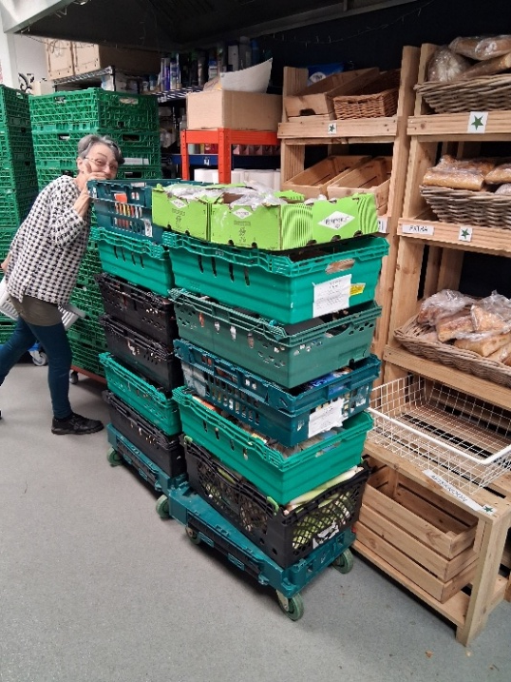
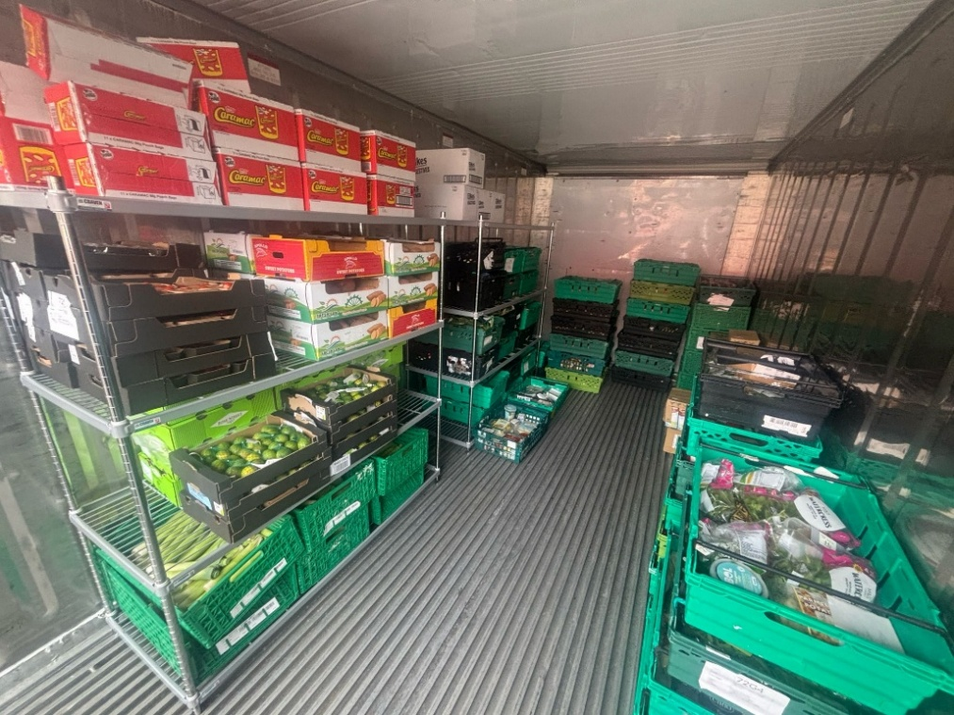
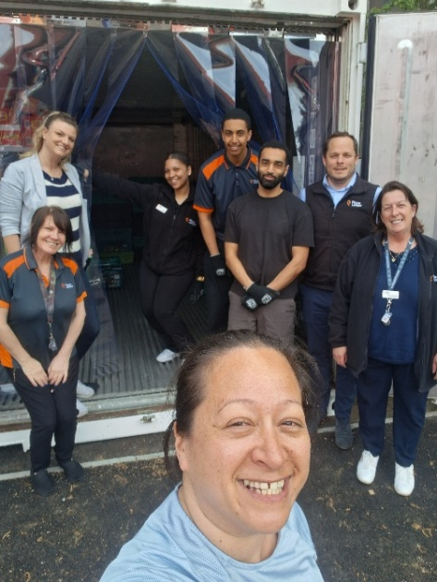
Felix delivery
Kingston Food Bank
900kg surplus food
Volunteers
Notes:
Improving the nutritional content of food support across the borough

Slide 6
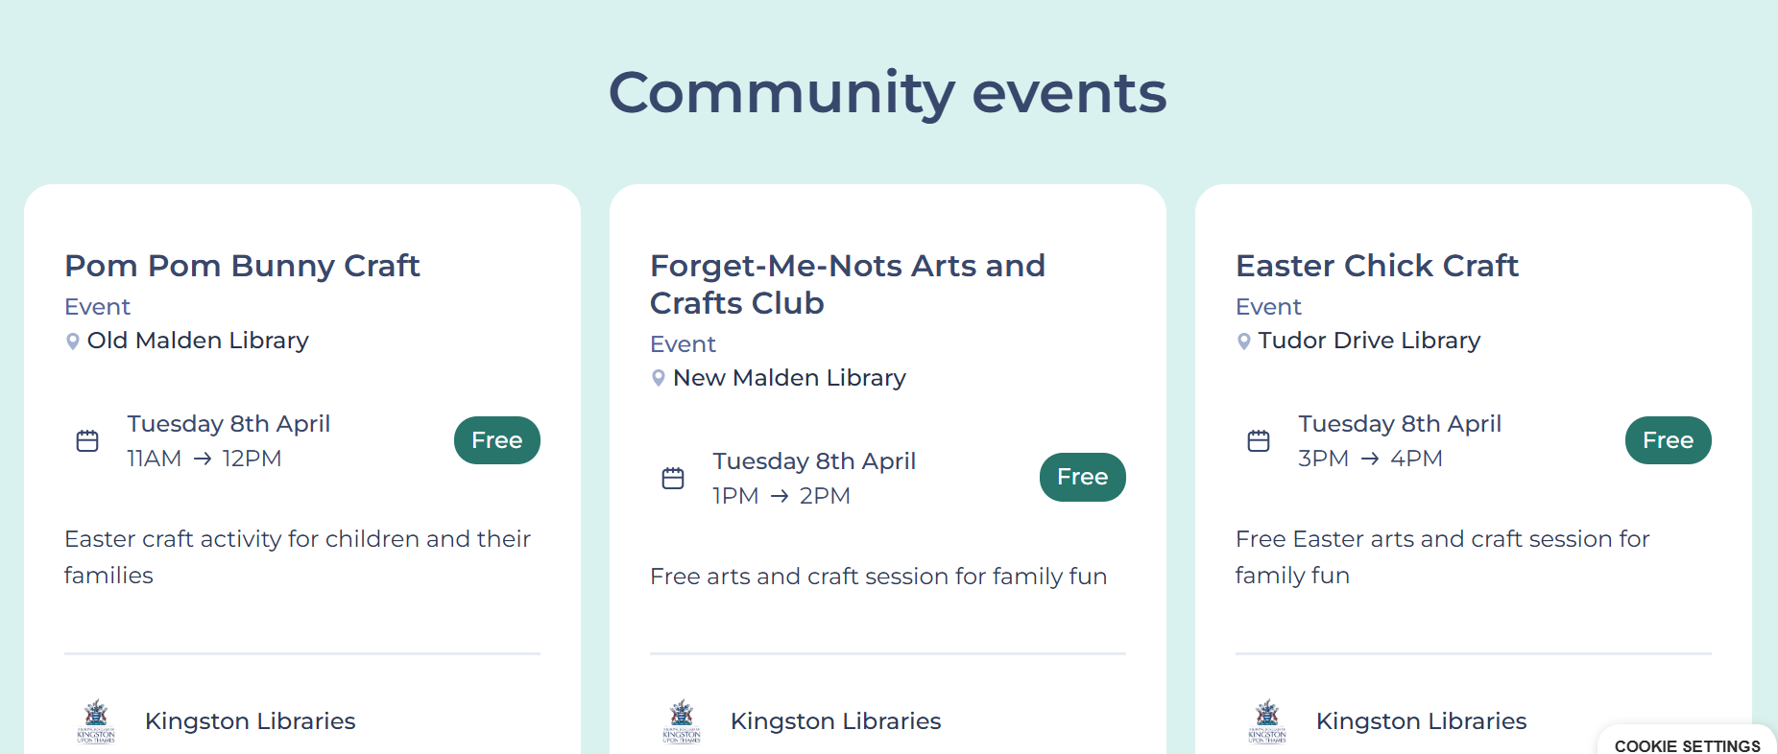
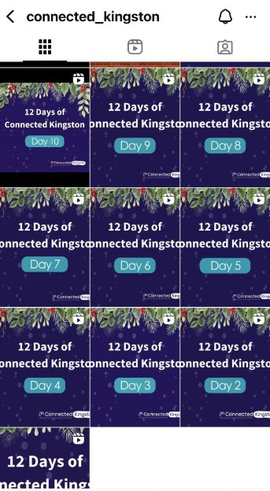
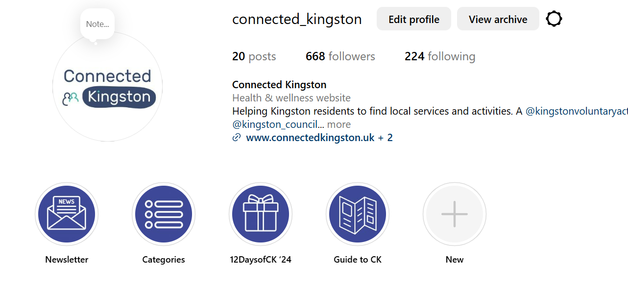
New events page and Instagram

Slide 7
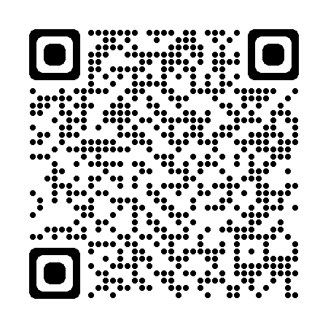
www.connectedkingston.uk

Slide 9
Contact Details Emma.hill@kva.org.uk 020 8255 3335
Thank you and good bye

