Slide 1
Building Resilience
Amanda Tincknell
Chief Executive, Cranfield Trust

Slide 2
What do we mean by ‘resilience’?
“Improved ability to anticipate, prepare for, respond and adapt to incremental change and sudden disruptions in order to survive and prosper”
(Cranfield University, 2017)

Slide 3
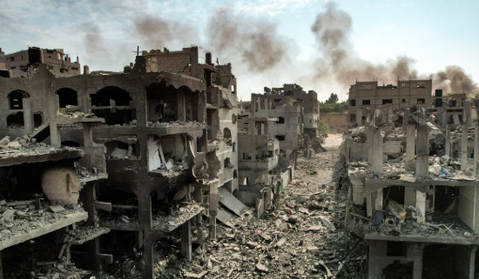
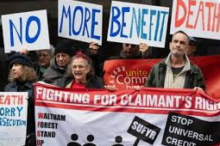
Change is all around …

Slide 4
Resilience building blocks
Clear mission and strong strategic planning
Financial sustainability
People and culture that meet the needs of the organisation
Effective leadership
Operations fit for purpose

Slide 5
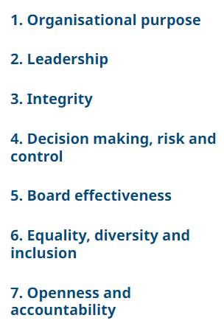
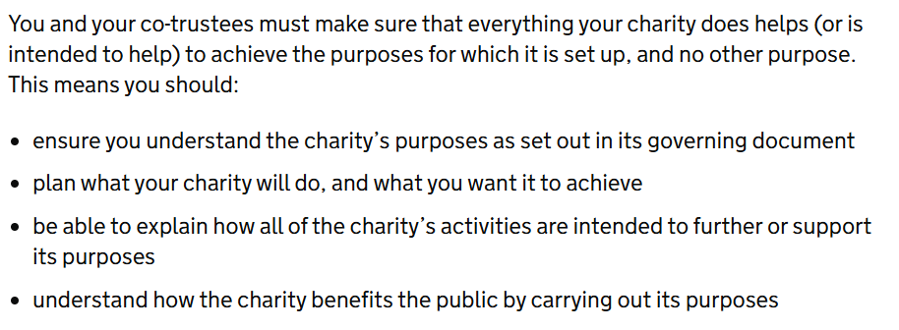
Mission: setting priorities
Charitable objects: what must you do?

Slide 6
Strategic planning

Slide 7
Strategic Plan
Do you have a plan in place?
How far ahead are you planning?
Process is as important as the plan
Changing environment, changing organisation
Scenario planning
What’s the next ‘what if’?

Slide 9
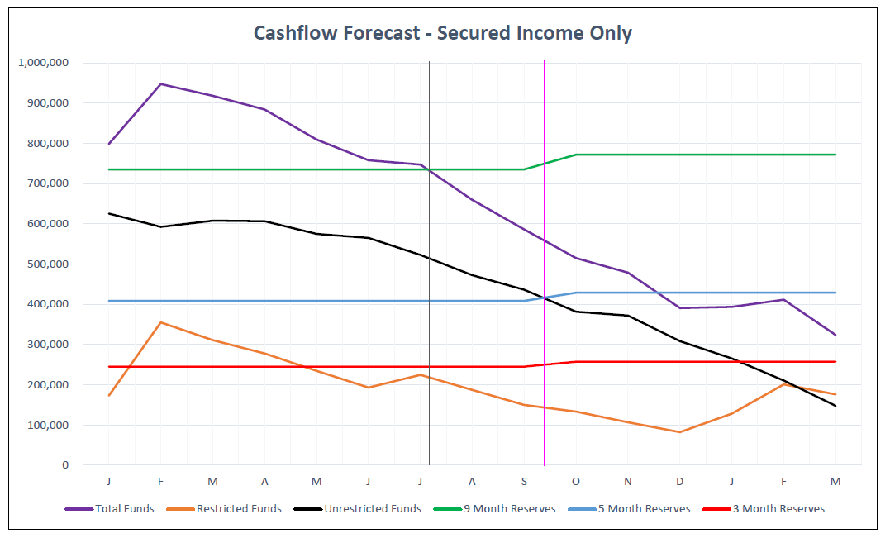
Forecasting is vital
Secured income forecast is base for different income scenarios
What’s your Plan B?

Slide 10
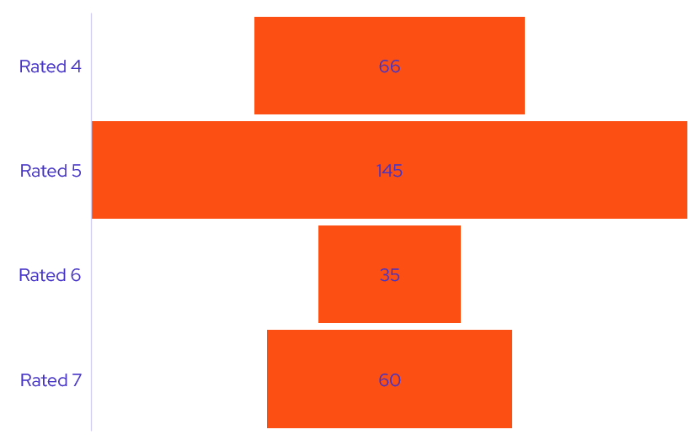
Fundraising Pipeline
1-10 Probability basis (1 = unverified prospect, 10 = funds banked)
8-10 = secured income
Cashflow forecast based on secured funds only
Example: halfway through financial year, 76% of budget already secured
£238k to raise to meet budget target
Current unsecured pipeline value (quantified prospects rated 4-7) is £306k.
Average conversion ratio in the current financial year is 65% (higher for renewals, lower for new funders)
Pipeline value = £198k: pipeline too small
Unsecured pipeline
Prospects rated 4-7
Decisions expected before Sept
Figures in £’000
Total pipeline value: £306k

Slide 11
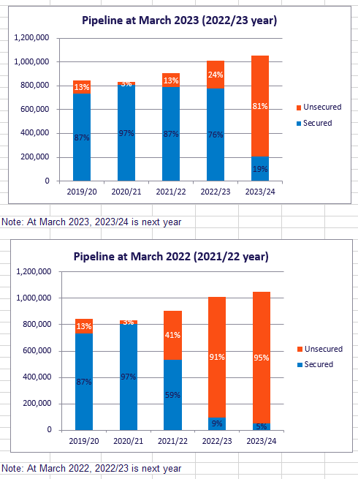
Fundraising Performance
Targets and pipeline: by year end, we aim to have achieved our income budget, and to have secured 40% of the following year’s budget requirement.
Year on year comparisons: at the time of charts, we had raised 19% of next year’s draft budget requirement, compared to 9% at end of March 2022.
Percentage of current year funding secured | Secured | Budget | %
At March 2023 | 774,601 | 1,012,551 | 76%
At March 2022 | 534,611 | 903,530 | 59%
Percentage of next year funding secured
At March 2023 | 205,000 | 1,052,013 | 19%
At March 2022 | 95,000 | 1,012,551 | 9%

Slide 12
Understanding costs
Are all services/contracts covering their costs?
Full cost recovery?
Cost allocation – especially management costs
Confident unit costs

Slide 13
People, organisation, culture: change
Organisation resilience = people resilience
Effective leadership: future focus, time, priorities, people
Operations fit for purpose: processes, skills, resourcing
‘Culture eats strategy for breakfast’

Slide 14
Working together, meeting needs
Services, not organisations
Potential partners: service user focus
Align processes? Partnership? Collaboration? Merger?

Slide 15
Sources of support
Capacity Building/Digital/Tech: Kingston Voluntary Action, Superhighways
Management support: Cranfield Trust, Reach Volunteering
Legal advice: LawWorks, TrustLaw
HR/people advice: ACAS, RootsHR, NCVO
Trustee training (online): ICAEW
Trustee recruitment: Reach, Trustees Unlimited, ICAEW, Hon Treasurers’ Forum, Women on Boards, Board Racial Diversity UK
Data/impact: DatakindUK, Pro Bono Economics
… there are many more free/low cost services

Slide 16
Get started …
Resilience
https://www.gotostage.com/channel/546a606c53a1459f81013a1f9c14d198/recording/f5d4f54029c24eef858c048655d0f3b8/watch?source=CHANNEL
Financial/cashflow forecasting
https://www.gotostage.com/channel/546a606c53a1459f81013a1f9c14d198/recording/b040b689ed104ef2a30330013226e444/watch?source=CHANNEL
https://www.cranfieldtrust.org/articles/67-controlling-cashflow-at-a-time-of-economic-uncertainty-ideas-for-charities
Business planning
https://www.cranfieldtrust.org/resources/charity-strategy-and-business-planning
https://www.gotostage.com/channel/546a606c53a1459f81013a1f9c14d198/recording/cc5f17f3aa244604bbef21da8e52afad/watch?source=CHANNEL

Slide 17
“The difficulty lies not so much in developing new ideas as in escaping old ones”
John Maynard Keynes

