Slide 1
John Mikucki – Fundraising Officer
Email: john.Mikucki@kva.org.uk
Working days: Mondays, Wednesdays and Fridays

Slide 2
Support Available:
Identifying funding opportunities.
Reviewing funding applications

Slide 3
Two key thoughts to take away from today
Read the guidelines.
Keep it simple - simple applications are far more likely to succeed

Slide 4
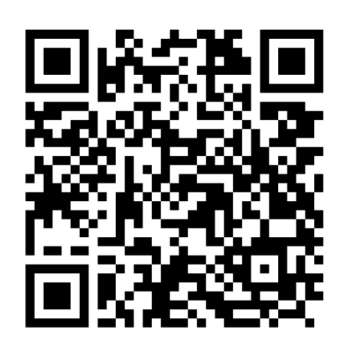
Kingston Eco-op
Text here
Coming soon
Our Pilot Funding Applications Review Surgery
Not just on applications you want to make but also to review ones where you failed.
Every other Wednesday, starting from 30 April 2025, from 11:00 to 15.45.
Book a 45 minute slot online and send your application at least a week in advance.
Superhighways
Text here
Funding
More text

