Slide 1
Anne Bren
Deputy Chief Executive
anne.bren@staywellservices.org.uk
Notes:
Shane / Anne

Slide 2
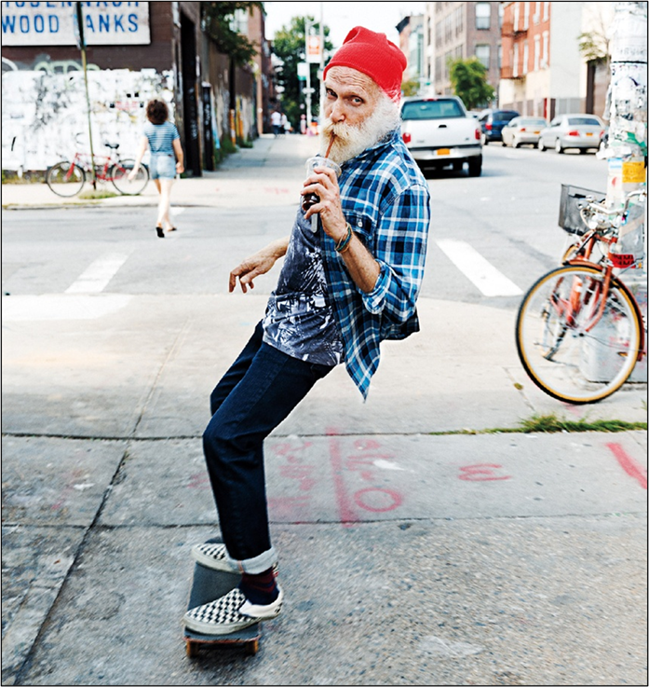
Who we are:
A local charity
Not for profit, but for purpose
A voluntary organisation
A social business
Our purpose: to support and help people in need to live independent, healthy, safe and fulfilling lives through the provision of a range of services which meet their needs and wishes.
Our vision: making life a greater life
1946 – 2025 supporting people at home for 79 years

Slide 3
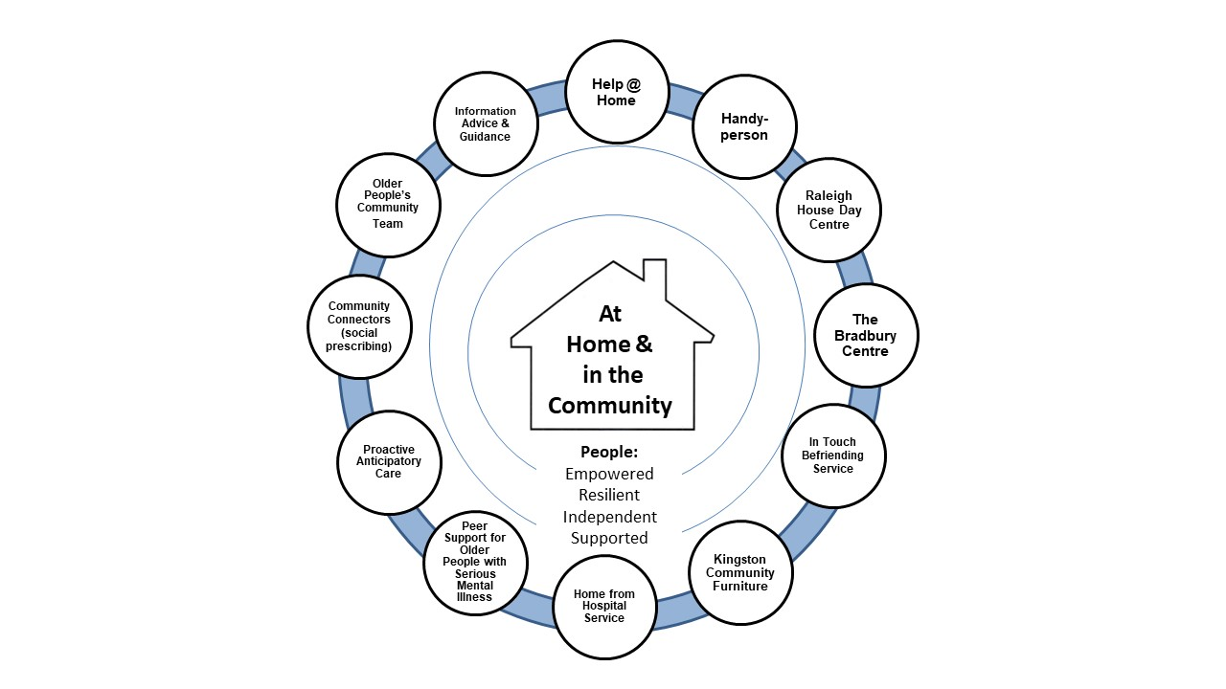
Our ‘Circle of Services’

Slide 4
Information, Advice & Guidance
Provides accurate, up-to-date and independent information and advice on issues of concern, from health concerns to care options, hospital discharge to housing options.
Advises on benefit entitlements for people of state pension age and assist with claims and form filling.
Gives information about other local services and social activities.
Eligibility: Kingston residents of retirement age or over (or family members/carers).
Notes:
Staywell provides a specialist Information & Advice Service to anyone of pension age living in the Borough of Kingston upon Thames and/or their family/carers. The service is free, independent and confidential.
What we can help you to do:
Make informed choices.
Think through the options.
Put decisions into actions.
Stay in charge of your life.

Slide 5
Older People’s Community Team
Looking at opportunities and activities in the community, including our social centres, local groups and classes.
Exploring services that can help clients feel comfortable at home.
Short-term practical help e.g. accompanying clients for a walk to build up their confidence.
Eligibility: people aged 65+, Kingston resident or registered with a Kingston GP.

Slide 6
Help@Home
Cleaning and housework
Helping with shopping
Meal preparation
Companionship
Accompanying people to appointments
Sitting service
Chargeable service - aimed at older people and people with disabilities living in Kingston borough.
Notes:
Staff trained, DBS checked

Slide 7
Handyperson
Supply and fit a key safe - C500 police & insurance approved
Garden tidy, grass cutting, clearing & cleaning pathways
Fit or replace curtain rails
Supply and fit new light bulbs
TV tuning and home computer support
Chargeable service - aimed at older people and people with disabilities living in Kingston borough.

Slide 8
Home from Hospital
Up to 6 hours free support with:
moving furniture to make room for equipment
shopping, prescriptions, light meal preparation and housework
help with medical appointments
help arranging transport
Follow-up support after discharge and linking with other Staywell services.
Eligibility: people aged 65+, Kingston resident or registered with a Kingston GP.
Referrals & enquiries: hospital.team@staywellservices.org.uk
Please complete referral form:
Home from Hospital | Staywell

Slide 9
Staywell Day Services
Raleigh House, New Malden
The Bradbury, Kingston

Slide 10
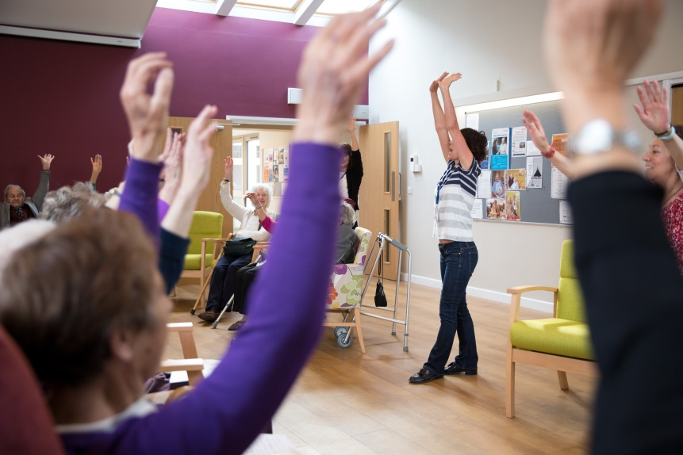
Eligibility: older people resident in their own homes in Kingston borough.
Including people with mild to moderate dementia.
Lot 1 – people who meet Care Act criteria. Charges (usually) paid directly by RBK ASC.
Lot 3 – not Care Act eligible, self-funders, clients charged directly.
Notes:
People receive the same service – only the method of funding is different
Typical users are 85+, frail, living with dementia / cognitive impairment
Lonely or isolated, respite for carers

Slide 11
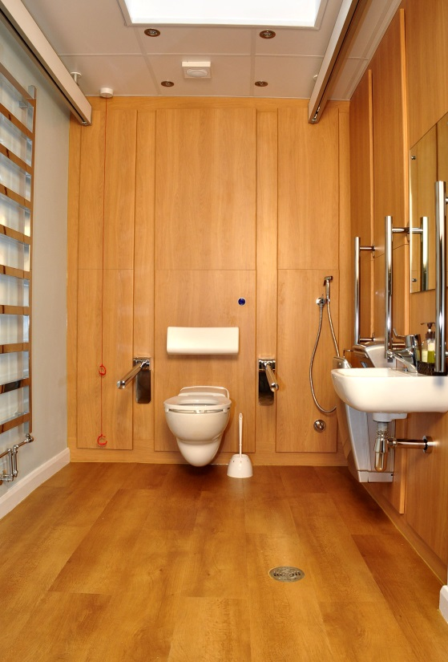
Raleigh House
Up to 40 people per day, Mon-Fri
Personal care (including showers), plus hairdressing, podiatry
Transport provided or arranged
Lunch freshly cooked on premises

Slide 12
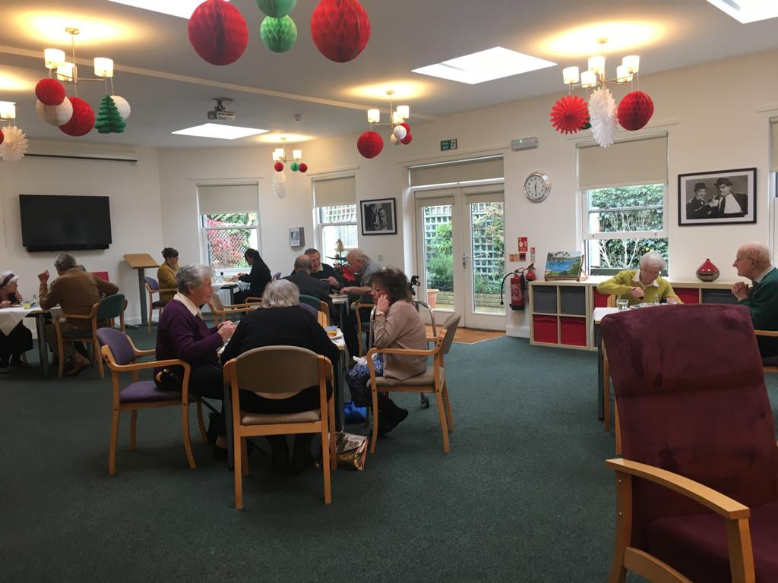
The Bradbury
Places per day: 20
No transport or personal care provided
Mondays, Wednesdays & Thursdays

Slide 13
Contact Details & Referrals
All enquiries: 020 8942 8256
(8.30am to 4.30pm, Monday to Friday)
information.office@staywellservices.org.uk
www.staywellservices.org.uk
Referral forms: Make a referral | Staywell

Slide 14
www.staywellservices.org.uk
79 years of supporting people at home…
Follow us:
Bluesky: https://bsky.app/profile/staywellcharity.bsky.social
Twitter / X @staywellcharity
facebook.com/staywellservices
Notes:
Host
Thank everyone for attending.
Invite any questions or comments.
COMPLETE ANY PAPERWORK? Give out now – can take away with them to complete at home
(or complete there and then if host has time to stay around).
Host stays until last person has left.

